Slide 1
1 Nephi 5
Lesson 9

Slide 2

Devotional
Hymn:
Prayer:
Thought:
Notes:
ID 272818

Slide 3
Sariah
Read 1 Nephi 5:1–3, looking for reasons why Sariah began to complain.

Slide 4
Sariah
Read 1 Nephi 5:1–3, looking for reasons why Sariah began to complain.
Read 1 Nephi 5:4–6. How did Lehi respond to Sariah’s complaints?

Slide 5
Sariah
Read 1 Nephi 5:1–3, looking for reasons why Sariah began to complain.
Read 1 Nephi 5:4–6. How did Lehi respond to Sariah’s complaints?
What can we learn from Lehi’s response to Sariah?

Slide 6
Sariah’s Testimony
Read 1 Nephi 5:7–9. How was Sariah’s testimony of the Lord and His dealings with her family affected by the successful return of her sons?

Slide 7
Sariah’s Testimony
Read 1 Nephi 5:7–9. How was Sariah’s testimony of the Lord and His dealings with her family affected by the successful return of her sons?
Before searching the contents of the brass plates, what did Lehi and Sariah take time to do?

Slide 8
Sariah’s Testimony
Read 1 Nephi 5:7–9. How was Sariah’s testimony of the Lord and His dealings with her family affected by the successful return of her sons?
Before searching the contents of the brass plates, what did Lehi and Sariah take time to do?
What truth can we learn from their example?

Slide 9
Pause to Give Thanks
When we receive blessings from God, we can choose to pause and give Him thanks.

Slide 10
Pause to Give Thanks
When we receive blessings from God, we can choose to pause and give Him thanks.
Why do you think it is important to pause and thank God for blessings we receive from Him?

Slide 11

The Scriptures
What did Lehi’s family give to obtain the scriptures?

Slide 12
The Brass Plates
Read 1 Nephi 5:11–16. What did the plates of brass contain?

Slide 13
The Brass Plates
Read 1 Nephi 5:11–16. What did the plates of brass contain?
Read 1 Nephi 5:17–19. How was Lehi blessed as he searched the scriptures?

Slide 14
The Brass Plates
Read 1 Nephi 5:11–16. What did the plates of brass contain?
Read 1 Nephi 5:17–19. How was Lehi blessed as he searched the scriptures?
What is a principle we can learn from verses 17–19 about what can happen as we search the scriptures?

Slide 15
Search the Scriptures
As we search the scriptures, we can be filled with the Spirit and receive revelation.

Slide 16
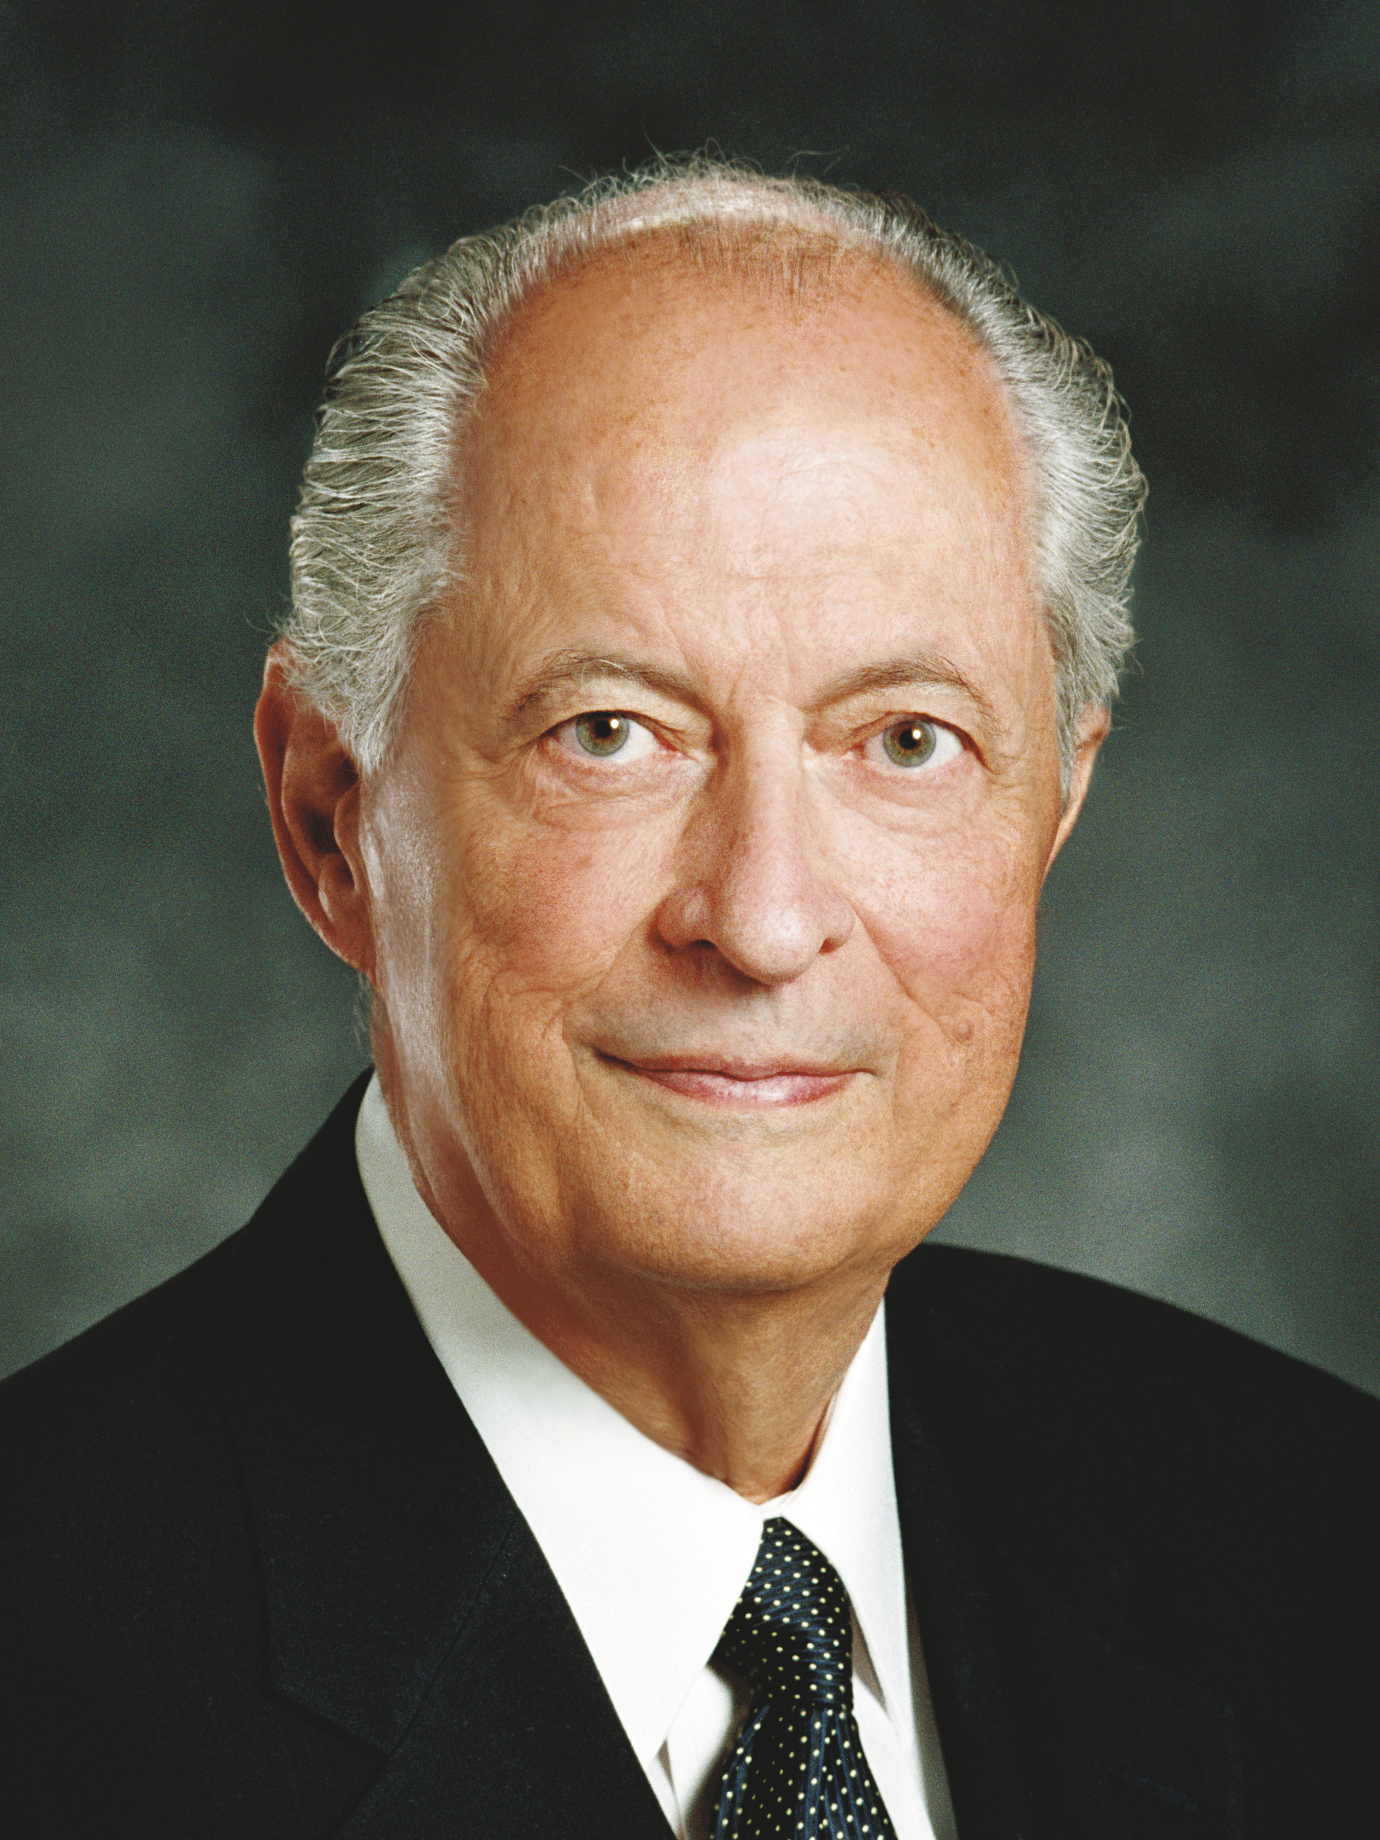
Elder Robert D. Hales
“When we want to speak to God, we pray. And when we want Him to speak to us, we search the scriptures; for His words are spoken through His prophets. He will then teach us as we listen to the promptings of the Holy Spirit” (Robert D. Hales, “Holy Scriptures: The Power of God unto Our Salvation,” Ensign or Liahona, Nov. 2006, 26–27).

Slide 17
A Scenario
Each night a young man reads the Book of Mormon. He tries to get through as many verses as he can before falling asleep. He has heard others speak of blessings they have received from reading the scriptures daily, but he doesn’t feel like doing so has brought him many blessings.

Slide 18
A Scenario
Each night a young man reads the Book of Mormon. He tries to get through as many verses as he can before falling asleep. He has heard others speak of blessings they have received from reading the scriptures daily, but he doesn’t feel like doing so has brought him many blessings.
Why do you think this young man hasn’t fully experienced the blessings of searching the scriptures?

Slide 19

Elder D. Todd Christofferson
“When I say ‘study,’ I mean something more than reading. It is a good thing sometimes to read a book of scripture within a set period of time to get an overall sense of its message, but for conversion, you should care more about the amount of time you spend in the scriptures than about the amount you read in that time. …
Continued on next page.

Slide 20
Elder D. Todd Christofferson, cont.
“I see you sometimes reading a few verses, stopping to ponder them, carefully reading the verses again, and as you think about what they mean, praying for understanding, asking questions in your mind, waiting for spiritual impressions, and writing down the impressions and insights that come so you can remember and learn more. Studying in this way, you may not read a lot of chapters or verses in a half hour, but you will be giving place in your heart for the word of God, and He will be speaking to you” (D. Todd Christofferson, “When Thou Art Converted,” Ensign or Liahona, May 2004, 11).

Slide 21
Studying the Scriptures
In your own words, how would you explain to the young man what it means to search the scriptures?

Slide 22
Studying the Scriptures
In your own words, how would you explain to the young man what it means to search the scriptures?
When have you felt the companionship of the Holy Ghost or received revelation as a result of searching and studying the scriptures? How was this a blessing to you?

Slide 23
Searching the Scriptures
Read 1 Nephi 5:20–21. Like Lehi and Nephi, as we search the scriptures, what can we discover about them?

Slide 24
Searching the Scriptures
Read 1 Nephi 5:20–21. Like Lehi and Nephi, as we search the scriptures, what can we discover about them?
As we search the scriptures, we can discover their great worth for us.

Slide 25
Searching the Scriptures
Read 1 Nephi 5:20–21. Like Lehi and Nephi, as we search the scriptures, what can we discover about them?
As we search the scriptures, we can discover their great worth for us.
As you have searched the scriptures, how have they been of worth to you?

Slide 26
Elder Robert D. Hales
“If you have not heard His voice speaking to you lately, return with new eyes and new ears to the scriptures. They are our spiritual lifeline” (Robert D. Hales, “Holy Scriptures: The Power of God unto Our Salvation,” Ensign or Liahona, Nov. 2006, 27).

