Slide 1
1 Nephi 2
Lesson 7

Slide 2

Devotional
Hymn:
Prayer:
Thought:
Notes:
ID 272818

Slide 3
A Scenario
A young man has invested a lot of time and money in acquiring a large music collection. A large portion of his music contains inappropriate messages. One Sunday, his priesthood quorum discusses the Lord’s standards for entertainment and media. He feels a prompting to dispose of his music that does not align with the Lord’s standards, but he struggles with following this prompting.

Slide 4
Choosing to Obey
What are possible reasons why this young man may be struggling with choosing to obey the Lord’s standards regarding music?

Slide 5
Lehi and His Family
Read 1 Nephi 2:1–4, looking for what the Lord commanded Lehi to do with his family.

Slide 6
Lehi and His Family
Read 1 Nephi 2:1–4, looking for what the Lord commanded Lehi to do with his family.
According to verse 4, what did Lehi’s family have to give up in order to obey this commandment? Why might this have been difficult?

Slide 7
Lehi and His Family
Read 1 Nephi 2:1–4, looking for what the Lord commanded Lehi to do with his family.
According to verse 4, what did Lehi’s family have to give up in order to obey this commandment? Why might this have been difficult?
What truth about obedience is illustrated in this experience?

Slide 8
Obedience and Sacrifice
Obedience to the Lord’s commandments can require sacrifice.

Slide 9
Obedience and Sacrifice
Obedience to the Lord’s commandments can require sacrifice.
Why do you think Lehi was willing to leave behind his home, his land, and his possessions in order to obey this commandment?

Slide 10
A Scenario, cont.
Think of the scenario at the beginning of the lesson. What would the young man in this situation need to sacrifice in order to keep the Lord’s standards regarding music?

Slide 11
A Scenario, cont.
Think of the scenario at the beginning of the lesson. What would the young man in this situation need to sacrifice in order to keep the Lord’s standards regarding music?
What are some additional commandments or gospel standards? What might a person need to give up or go without in order to keep these commandments?

Slide 12
Keeping the Commandments
Think about a commandment you might be struggling with because of the sacrifice required to obey it.

Slide 13
Keeping the Commandments
Think about a commandment you might be struggling with because of the sacrifice required to obey it.
Why is it ultimately worth any sacrifice we make in order to keep the Lord’s commandments?

Slide 14
Keeping the Commandments
Think about a commandment you might be struggling with because of the sacrifice required to obey it.
Why is it ultimately worth any sacrifice we make in order to keep the Lord’s commandments?
How can we develop the willingness to sacrifice in order to obey the Lord’s commandments?

Slide 15
1 Nephi 2:5–7
Lehi’s family traveled from Jerusalem to a river valley near the Red Sea, a possible distance of 260 miles (420 kilometers). Their trek likely went through a hot and barren country, known for thieves who waited to rob unprepared travelers, and may have taken 12 to 14 days. After arriving in the river valley, Lehi built an altar, made a sacrificial offering, and gave thanks to the Lord.

Slide 16
Complaining
Have you ever complained, either vocally or inwardly, about a commandment or counsel from the Lord given through His prophets?

Slide 17
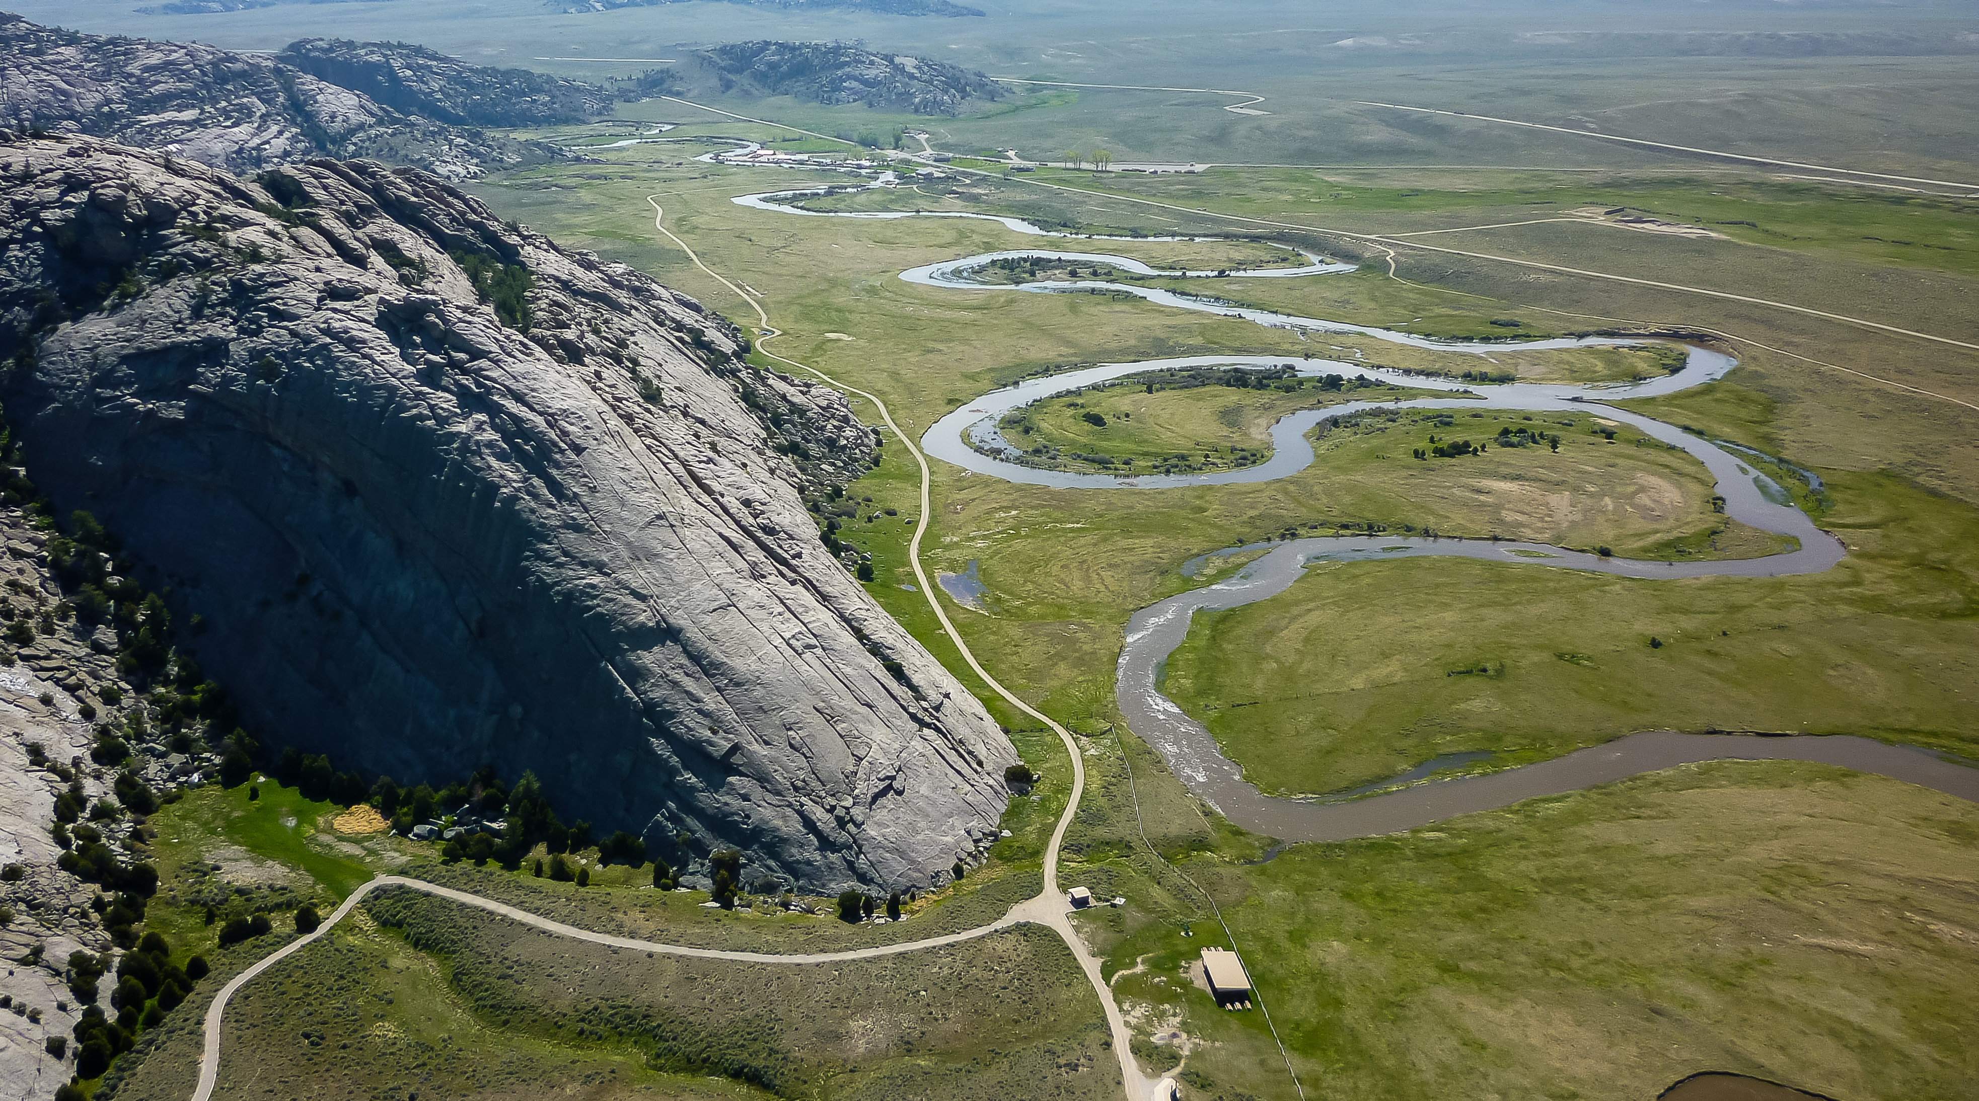
Like a River and a Valley
Read 1 Nephi 2:8–10, looking for what Lehi desired for Laman and Lemuel.

Slide 18
Laman and Lemuel
Read 1 Nephi 2:11–14. Why did Lehi encourage Laman and Lemuel to be faithful and obedient?

Slide 19
Laman and Lemuel
Read 1 Nephi 2:11–14. Why did Lehi encourage Laman and Lemuel to be faithful and obedient?
What do you think it means to be stiff-necked (see verse 11)?

Slide 20
Laman and Lemuel
Read 1 Nephi 2:11–14. Why did Lehi encourage Laman and Lemuel to be faithful and obedient?
What do you think it means to be stiff-necked (see verse 11)?
What does it mean to “murmur” (verses 11, 12)?

Slide 21
Laman and Lemuel
Read 1 Nephi 2:11–14. Why did Lehi encourage Laman and Lemuel to be faithful and obedient?
What do you think it means to be stiff-necked (see verse 11)?
What does it mean to “murmur” (verses 11, 12)?
According to verses 12–13, what are some reasons why Laman and Lemuel murmured against their father?

Slide 22
Murmuring
What principle can we learn from 1 Nephi 2:12–13 about what can lead to murmuring against God’s prophets?

Slide 23
Murmuring
What principle can we learn from 1 Nephi 2:12–13 about what can lead to murmuring against God’s prophets?
If we do not understand God’s dealings with His children and if we disbelieve His prophets, then we can be led to murmur against them.

Slide 24
Leaving Jerusalem
The commandment to leave Jerusalem demonstrated God’s mercy and love for Laman and Lemuel by keeping them safe from Jerusalem’s pending destruction. However, they did not appreciate what God had done for them because they did not believe that God had revealed this commandment to their father or that Jerusalem could be destroyed.

Slide 25
God’s Dealings
Why do you think murmuring sometimes results when people do not understand God’s dealings with His children and disbelieve His prophets?

Slide 26
Nephi’s Response
Read 1 Nephi 2:16. How did Nephi respond to the commandment to leave Jerusalem?

Slide 27
Nephi’s Response
Read 1 Nephi 2:16. How did Nephi respond to the commandment to leave Jerusalem?
What phrases in verse 16 indicate that this commandment may not have been easy for Nephi to obey?

Slide 28
Desire and Pray
How would you complete this statement based on Nephi’s experience recorded in verse 16: When we earnestly desire and pray, …

Slide 29
Desire and Pray
How would you complete this statement based on Nephi’s experience recorded in verse 16: When we earnestly desire and pray, …
When we earnestly desire and pray, the Lord can soften our hearts to help us believe and obey His words.

Slide 30
Desire and Pray
What are some situations in our day in which people might need to have their hearts softened to help them believe and obey the Lord’s words?

Slide 31
Desire and Pray
What are some situations in our day in which people might need to have their hearts softened to help them believe and obey the Lord’s words?
How would you explain what it means to earnestly desire and pray?

Slide 32
Desire and Pray
What are some situations in our day in which people might need to have their hearts softened to help them believe and obey the Lord’s words?
How would you explain what it means to earnestly desire and pray?
Why do you think earnest desire and prayer can allow the Lord to soften our hearts?

Slide 33
Our Hearts
Read 1 Nephi 2:17–19, looking for the way Nephi’s brothers responded to his words and the qualities the Lord commended Nephi for.

Slide 34
Our Hearts
Read 1 Nephi 2:17–19, looking for the way Nephi’s brothers responded to his words and the qualities the Lord commended Nephi for.
In what ways were Nephi and Sam’s hearts softened?

Slide 35
Our Hearts
Read 1 Nephi 2:17–19, looking for the way Nephi’s brothers responded to his words and the qualities the Lord commended Nephi for.
In what ways were Nephi and Sam’s hearts softened?
In what ways were Laman and Lemuel’s hearts hardened?

Slide 36
Our Hearts
How does the spiritual condition of our hearts influence our ability to believe and obey the Lord’s words?

Slide 37
Our Hearts
How does the spiritual condition of our hearts influence our ability to believe and obey the Lord’s words?
When have you or someone you know earnestly sought and received the Lord’s help to believe and obey His words?

Slide 38
Obedience and Disobedience
Read 1 Nephi 2:20–21. What principles about obedience and disobedience can we learn from these verses?

Slide 39
Obedience and Disobedience
Read 1 Nephi 2:20–21. What principles about obedience and disobedience can we learn from these verses?
If we keep the Lord’s commandments, He will prosper us and bless us. If we rebel against the Lord and His servants, we will be separated from His influence.

