Slide 1
1 Nephi 1
Lesson 6

Slide 2
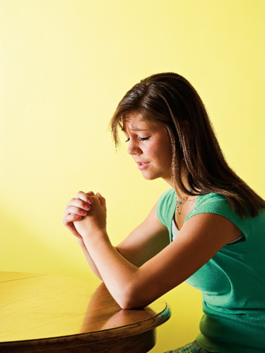
Devotional
Hymn:
Prayer:
Thought:
Notes:
ID 272818

Slide 3
The Attributes of God
God is _____________________ .

Slide 4
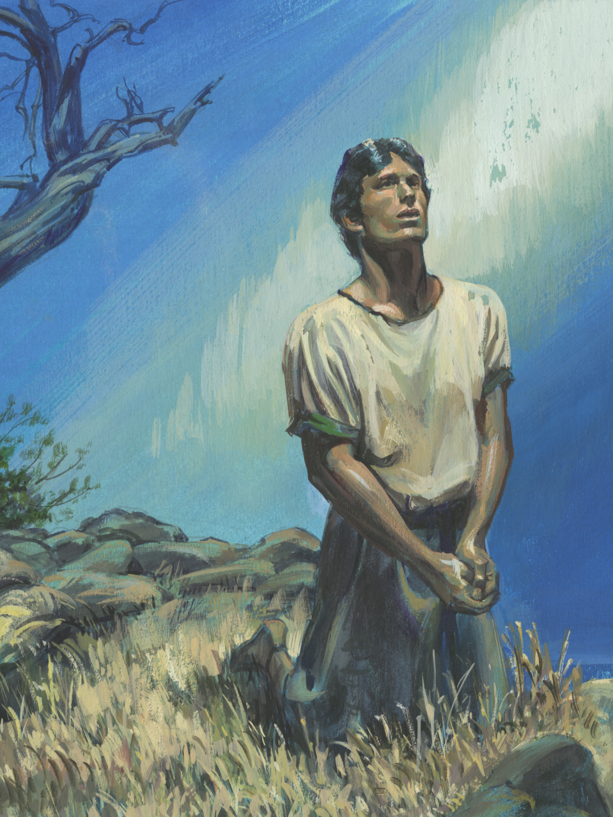
Nephi
Read 1 Nephi 1:1, looking for what Nephi described about his life.

Slide 5
Nephi
Read 1 Nephi 1:1, looking for what Nephi described about his life.
What did Nephi’s “knowledge of the goodness and the mysteries of God” lead him to do?

Slide 6
Nephi
Read 1 Nephi 1:1, looking for what Nephi described about his life.
What did Nephi’s “knowledge of the goodness and the mysteries of God” lead him to do?
Read 1 Nephi 1:3 and mark Nephi’s testimony about the truthfulness of his record.

Slide 7
The Lord’s Warning
Read 1 Nephi 1:4, looking for how the Lord warned the people in Jerusalem.

Slide 8
The Lord’s Warning
Read 1 Nephi 1:4, looking for how the Lord warned the people in Jerusalem.
Read 1 Nephi 1:5–13, looking for what Lehi saw in vision.

Slide 9
The Lord’s Warning
Read 1 Nephi 1:4, looking for how the Lord warned the people in Jerusalem.
Read 1 Nephi 1:5–13, looking for what Lehi saw in vision.
According to verse 13, what did Lehi learn about Jerusalem?

Slide 10
The Lord’s Warning
Read 1 Nephi 1:4, looking for how the Lord warned the people in Jerusalem.
Read 1 Nephi 1:5–13, looking for what Lehi saw in vision.
According to verse 13, what did Lehi learn about Jerusalem?
How might you have reacted if you had seen and learned what Lehi did?

Slide 11
Lehi’s Testimony
Read 1 Nephi 1:14–15. Why do you think Lehi rejoiced?

Slide 12
Lehi’s Testimony
Read 1 Nephi 1:14–15. Why do you think Lehi rejoiced?
What truth about God can we learn from Lehi’s testimony at the end of verse 14?

Slide 13
Lehi’s Testimony
Read 1 Nephi 1:14–15. Why do you think Lehi rejoiced?
What truth about God can we learn from Lehi’s testimony at the end of verse 14?
Because God is merciful, He will not allow those who come unto Him to perish.

Slide 14
Come unto God
What do you think it means to come unto God?

Slide 15
Come unto God
What do you think it means to come unto God?
What do you think it means that God will not allow those who come unto Him to perish?

Slide 16
Come unto God
What do you think it means to come unto God?
What do you think it means that God will not allow those who come unto Him to perish?
Why is it important to understand this truth about God’s nature?

Slide 17
Lehi’s Calling
Read 1 Nephi 1:18–20. What did Lehi do after receiving these revelations?

Slide 18
Lehi’s Calling
Read 1 Nephi 1:18–20. What did Lehi do after receiving these revelations?
How did people in Jerusalem respond to Lehi’s prophecies and testimony?

Slide 19
Lehi’s Calling
Read 1 Nephi 1:18–20. What did Lehi do after receiving these revelations?
How did people in Jerusalem respond to Lehi’s prophecies and testimony?
What truth can we learn from these verses about what God calls prophets to do?

Slide 20
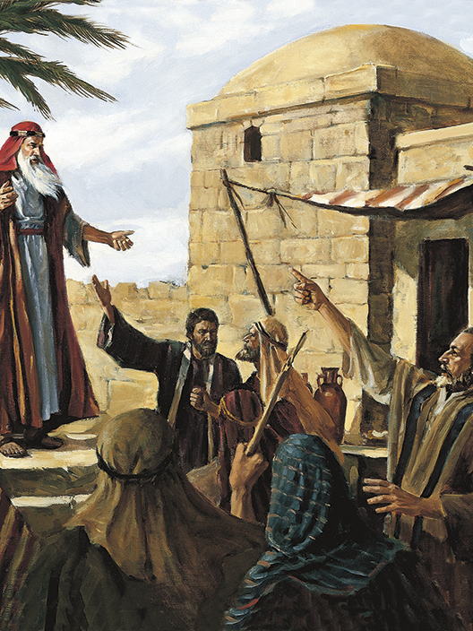
God Calls Prophets
God calls prophets to denounce sin, warn of its consequences, and testify of Jesus Christ.

Slide 21

A Scenario
During general conference, the President of the Church teaches a doctrine that opposes a popular social practice. After the prophet’s talk, a friend sends you a message through social media containing a statement from the talk, along with the following question: “Why do Church leaders say things like this when they know that people are going to get upset or take offense?”

Slide 22
A Scenario
During general conference, the President of the Church teaches a doctrine that opposes a popular social practice. After the prophet’s talk, a friend sends you a message through social media containing a statement from the talk, along with the following question: “Why do Church leaders say things like this when they know that people are going to get upset or take offense?”
How can the truth we just identified help answer the friend’s question?

Slide 23
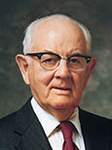
President Spencer W. Kimball
“Those prophets I have known are the most loving of men. It is because of their love and integrity that they cannot modify the Lord’s message merely to make people feel comfortable. They are too kind to be so cruel” (Spencer W. Kimball, “Listen to the Prophets,” Ensign, May 1978, 77).

Slide 24
Responsibility of a Prophet
Imagine having the responsibility of a prophet. What do you think it would be like to speak against people’s sins and warn of the consequences of sin?

Slide 25
Elder Jeffrey R. Holland
“In addition to teaching, encouraging, and cheering people on (that is the pleasant part of discipleship), from time to time . . . messengers [of the Lord] are called upon to worry, to warn, and sometimes just to weep (that is the painful part of discipleship). They know full well that the road leading to the promised land ‘flowing with milk and honey’ [Exodus 3:8] of necessity runs by way of Mount Sinai, flowing with ‘thou shalts’ and ‘thou shalt nots’ [see Exodus 20:3–17].
Continued on next page.

Slide 26
Elder Jeffrey R. Holland, cont.
“Unfortunately, messengers of divinely mandated commandments are often no more popular today than they were anciently” (Jeffrey R. Holland, “The Cost—and Blessings—of Discipleship,” Ensign or Liahona, May 2014, 7).

Slide 27
Our Prophets
In what ways do some people in our day show anger toward prophets or mock or ignore their words? Why do you think some people respond this way?

Slide 28
Our Prophets
In what ways do some people in our day show anger toward prophets or mock or ignore their words? Why do you think some people respond this way?
How have you or someone you know been blessed by the efforts of modern prophets to denounce sin, warn of its consequences, and testify of Jesus Christ?

Slide 29
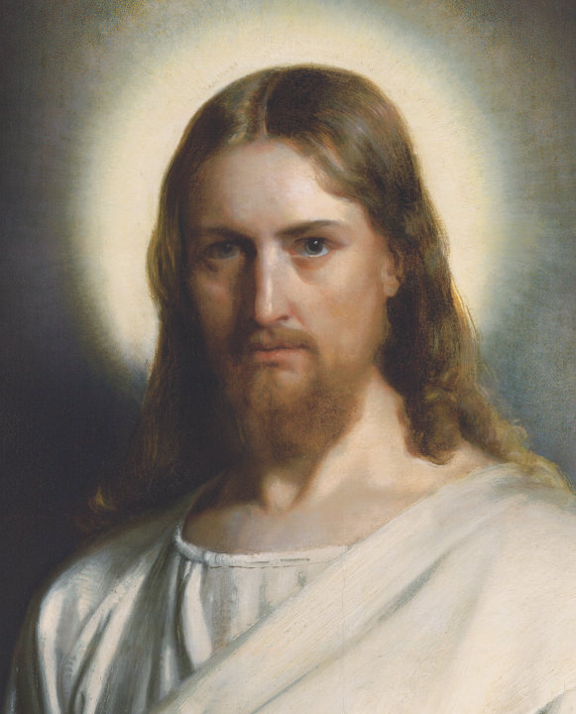
Tender Mercies of the Lord
Read 1 Nephi 1:20. What did Nephi intend to show us with the experiences he recorded?

Slide 30
Tender Mercies of the Lord
Read 1 Nephi 1:20. What did Nephi intend to show us with the experiences he recorded?
The Lord, through His tender mercies, will deliver those whom He has chosen, because of their faith.

