Slide 1
Jarom and Omni
Lesson 50

Slide 2
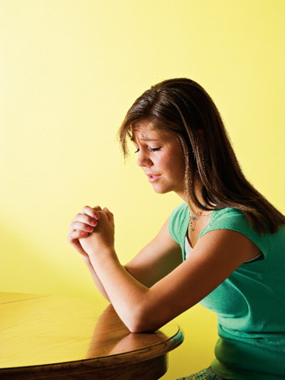
Devotional
Hymn:
Prayer:
Thought:
Notes:
ID 272818

Slide 3
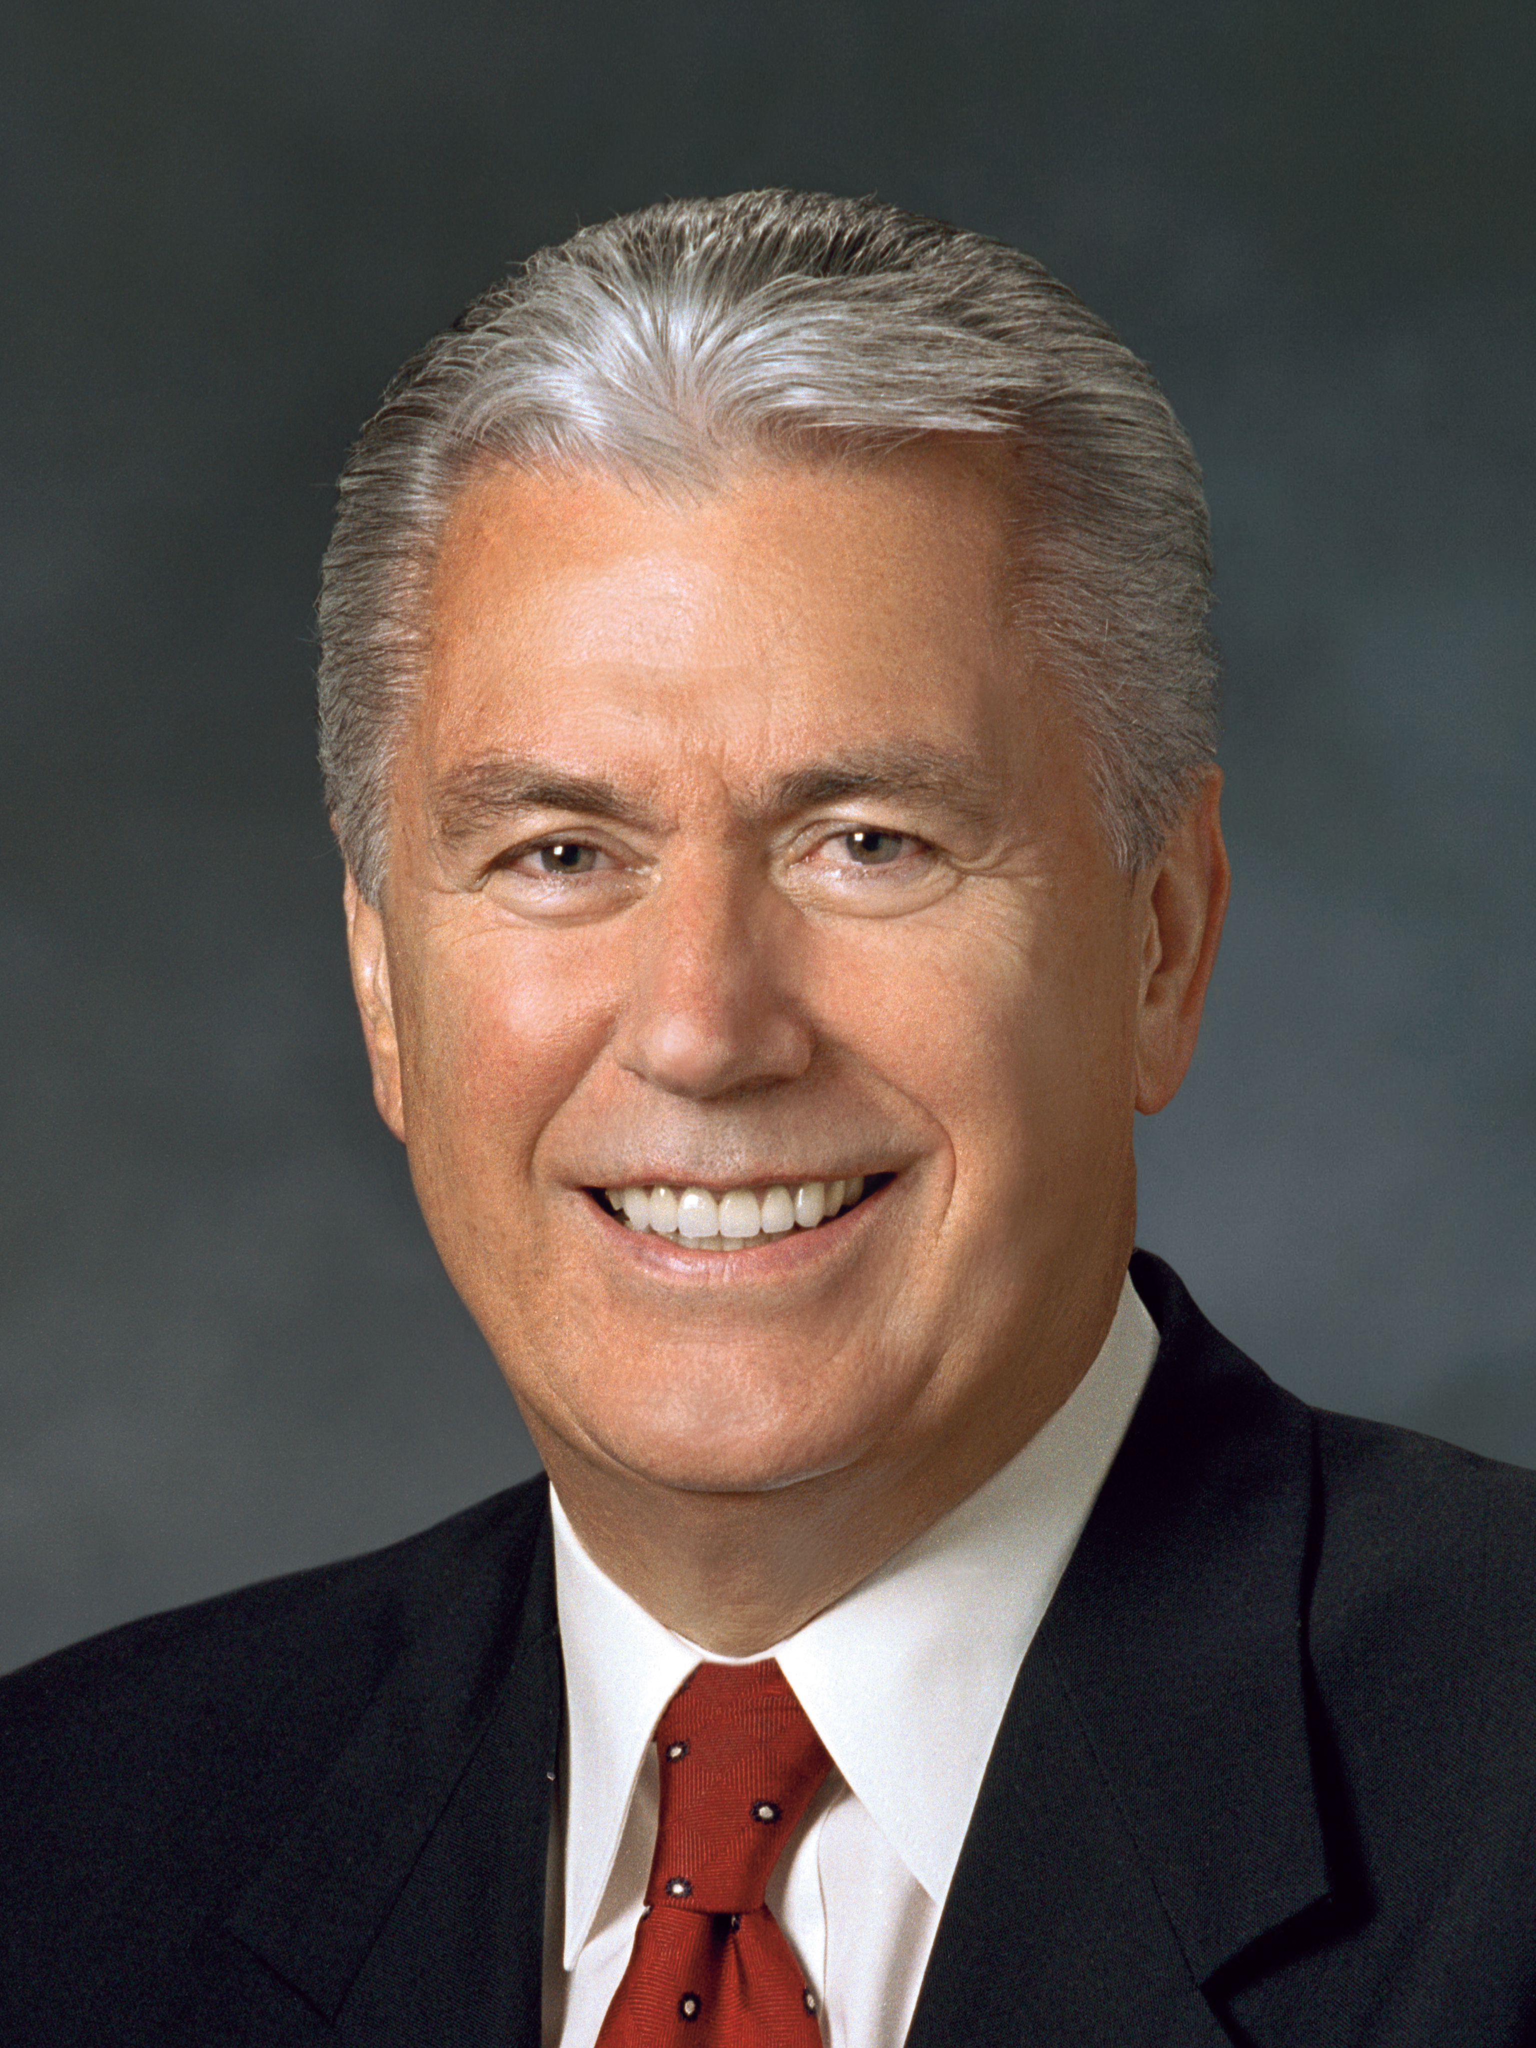
President Dieter F. Uchtdorf
“I remember when I was preparing to be trained as a fighter pilot. We spent a great deal of our preliminary military training in physical exercise. I’m still not exactly sure why endless running was considered such an essential preparatory part of becoming a pilot. Nevertheless, we ran and we ran and we ran some more.
Continued on the next page.

Slide 4
President Dieter F. Uchtdorf, cont.
“As I was running I began to notice something that, frankly, troubled me. Time and again I was being passed by men who smoked, drank, and did all manner of things that were contrary to the gospel and, in particular, to the Word of Wisdom.
Continued on the next page.

Slide 5
President Dieter F. Uchtdorf, cont.
“I remember thinking, ‘Wait a minute! Aren’t I supposed to be able to run and not be weary?’ But I was weary, and I was overtaken by people who were definitely not following the Word of Wisdom. I confess, it troubled me at the time. I asked myself, was the promise true or was it not?” (Dieter F. Uchtdorf, “Continue in Patience,” Ensign or Liahona, May 2010, 58).

Slide 6
The Lord’s Promise
Have you ever felt troubled, wondering if or how the Lord would fulfill His promise to bless you for keeping His commandments?

Slide 7
The Lord’s Promise
Have you ever felt troubled, wondering if or how the Lord would fulfill His promise to bless you for keeping His commandments?
As you study the book of Jarom today, look for truths that can help you when you may wonder if or how the Lord will fulfill His promises.

Slide 8
Jarom
In Jarom 1:1–3, Jarom received the plates from his father, Enos. Jarom wrote only a small amount, and he hoped his words would help preserve the genealogy of his family and benefit the Lamanites.

Slide 9
Jarom
In Jarom 1:1–3, Jarom received the plates from his father, Enos. Jarom wrote only a small amount, and he hoped his words would help preserve the genealogy of his family and benefit the Lamanites.
Read Jarom 1:9, looking for the promise of the Lord that was verified. Jarom used the word verified as he wrote about a promise given to his ancestors. The word verify means to confirm or prove that something is true.

Slide 10
A Principle
How would you state the promise in Jarom 1:9 as a principle that we can apply today?

Slide 11
A Principle
How would you state the promise in Jarom 1:9 as a principle that we can apply today?
As we keep the commandments of God, we will prosper.

Slide 12
The Nephites
Read Jarom 1:4–5, 8. What are some examples of how the Nephites were obedient and how they were blessed?

Slide 13
Leaders and Prophets
Read Jarom 1:7, 10–12. How did leaders and prophets help the Nephites to obey and prosper?

Slide 14
God’s Promise
Read Omni 1:5–7. How was God’s promise later verified in a different way?

Slide 15
The Blessings of God
Based on what you have learned from the experience of the Nephites, what are some ways God will bless those who obey His commandments?

Slide 16
President Dieter F. Uchtdorf
“The answer didn’t come immediately. But eventually I learned that God’s promises are not always fulfilled as quickly as or in the way we might hope; they come according to His timing and in His ways. Years later I could see clear evidence of the temporal blessings that come to those who obey the Word of Wisdom—in addition to the spiritual blessings that come immediately from obedience to any of God’s laws. Looking back, I know for sure that the promises of the Lord, if perhaps not always swift, are always certain” (Dieter F. Uchtdorf, “Continue in Patience,” 58).

Slide 17
The Lord’s Blessings
When has the Lord blessed, or prospered, you for keeping His commandments?

Slide 18
The Lord’s Blessings
When has the Lord blessed, or prospered, you for keeping His commandments?
From your experience, what testimony can you share about the Lord and His promises?

Slide 19
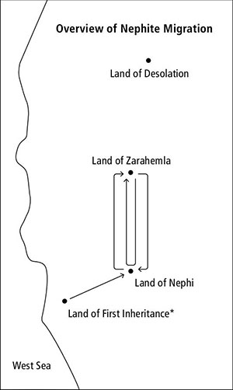
The Book of Omni
The book of Omni by was written by descendants of Jarom and covers approximately 230 years. This book describes several important events in the history of the people in the Book of Mormon.

Slide 20
The Book of Omni
The book of Omni by was written by descendants of Jarom and covers approximately 230 years. This book describes several important events in the history of the people in the Book of Mormon.
In Nephi’s time, the Nephites separated from the Lamanites and settled in a place they called the land of Nephi. On the map, notice an arrow from the land of first inheritance to the land of Nephi.

Slide 21
The Land of Zarahemla
After many years, a man named Mosiah was warned by the Lord to flee out of the land of Nephi with as many people as would follow him (see Omni 1:12). Follow the arrow from the land of Nephi to the land of Zarahemla.

Slide 22
The Land of Zarahemla
After many years, a man named Mosiah was warned by the Lord to flee out of the land of Nephi with as many people as would follow him (see Omni 1:12). Follow the arrow from the land of Nephi to the land of Zarahemla.
Read Omni 1:13, looking for who among the Nephites followed Mosiah and how they were blessed. What principle can we learn from this?

Slide 23
The Land of Zarahemla
After many years, a man named Mosiah was warned by the Lord to flee out of the land of Nephi with as many people as would follow him (see Omni 1:12). Follow the arrow from the land of Nephi to the land of Zarahemla.
Read Omni 1:13, looking for who among the Nephites followed Mosiah and how they were blessed. What principle can we learn from this?
If we hearken to the Lord’s words, He will guide and protect us.

Slide 24
Mulekites
In Omni 1:14–16, when the Nephites came to the land of Zarahemla, they discovered that it was already inhabited. The people they found there were the descendants of a group that had been led out of Jerusalem by a man named Mulek around the same time that Lehi’s family had departed from Jerusalem (see Mosiah 25:2). The people of Zarahemla were led by a man named Zarahemla at the time they were discovered by Mosiah and his people.

Slide 25
People in Zarahemla
Read Omni 1:14, looking for why Zarahemla rejoiced when the Nephites arrived.

Slide 26
People in Zarahemla
Read Omni 1:14, looking for why Zarahemla rejoiced when the Nephites arrived.
Read Omni 1:17, looking for similarities and differences between the Nephites and the people they discovered in the land of Zarahemla.

Slide 27
People in Zarahemla
Read Omni 1:14, looking for why Zarahemla rejoiced when the Nephites arrived.
Read Omni 1:17, looking for similarities and differences between the Nephites and the people they discovered in the land of Zarahemla.
Which of the difficulties in verse 17 do you think the people of Zarahemla might have been able to avoid if they had had the words of the Lord and followed them? Why?

Slide 28
Coriantumr
In Omni 1:18–22, the people of Zarahemla learned the language of the Nephites, united with them, and made Mosiah their king. These verses also tell of how the people of Zarahemla had previously encountered Coriantumr, who was one of the last survivors of the Jaredite nation.

Slide 29
The Land of Desolation
On this map, notice the land of Desolation. This is the place in the land northward where the Jaredite people’s “bones lay scattered” after they were destroyed (Omni 1:22). You will learn about the Jaredites when you study the book of Ether. Write Jaredites in your scriptures next to Omni 1:20–22.

Slide 30
Two Arrows
Notice the arrow that extends from the land of Zarahemla to the land of Nephi and then turns back to Zarahemla. Notice another arrow from the land of Zarahemla that extends in one direction to the land of Nephi.

Slide 31
Two Arrows
Notice the arrow that extends from the land of Zarahemla to the land of Nephi and then turns back to Zarahemla. Notice another arrow from the land of Zarahemla that extends in one direction to the land of Nephi.
What do these two arrows represent?

Slide 32
Two Groups
In Omni 1:27–30, two groups from Zarahemla attempted to return to the land of Nephi. The first group failed and went back to Zarahemla. As Amaleki concluded the book of Omni, he mentioned that he did not know the fate of the second group. You will learn about this group, the people of Zeniff, as you study the book of Mosiah chapters 9–22. You may want to consider writing people of Zeniff in your scriptures next to Omni 1:29–30.

Slide 33
Amaleki
As Amaleki concluded his record, he wrote an important invitation to those who would read his words. Read Omni 1:25–26, looking for what Amaleki invited his readers to do.

Slide 34
Amaleki
As Amaleki concluded his record, he wrote an important invitation to those who would read his words. Read Omni 1:25–26, looking for what Amaleki invited his readers to do.
What principles can we identify in these verses?

Slide 35
Offer Your Whole Soul
If we come unto Christ and offer our whole souls unto Him, we will be saved.

Slide 36
Offer Your Whole Soul
If we come unto Christ and offer our whole souls unto Him, we will be saved.
What do you think it means to offer your whole soul to Jesus Christ?

Slide 37
Offer Your Whole Soul
If we come unto Christ and offer our whole souls unto Him, we will be saved.
What do you think it means to offer your whole soul to Jesus Christ?
What do you think might be the difference between offering the Lord your whole soul and offering Him only part of your soul?

Slide 38
A Good Example
Can you think of someone you know who is a good example of giving his or her whole soul to the Lord?

Slide 39
A Good Example
Can you think of someone you know who is a good example of giving his or her whole soul to the Lord?
What have you seen that makes you think this person is offering his or her whole soul to the Lord?

Slide 40
A Good Example
Can you think of someone you know who is a good example of giving his or her whole soul to the Lord?
What have you seen that makes you think this person is offering his or her whole soul to the Lord?
How do you think this person has been blessed by offering his or her whole soul to the Lord?

Slide 41
Worth the Blessings
Anything we might sacrifice in order to come unto Jesus Christ and offer our whole souls to Him will be well worth the blessings we will receive from Him. Reflect on how you can more fully give your whole soul to Jesus Christ.

