Slide 1
Enos
Lesson 49

Slide 2

Devotional
Hymn:
Prayer:
Thought:
Notes:
ID 272818

Slide 3
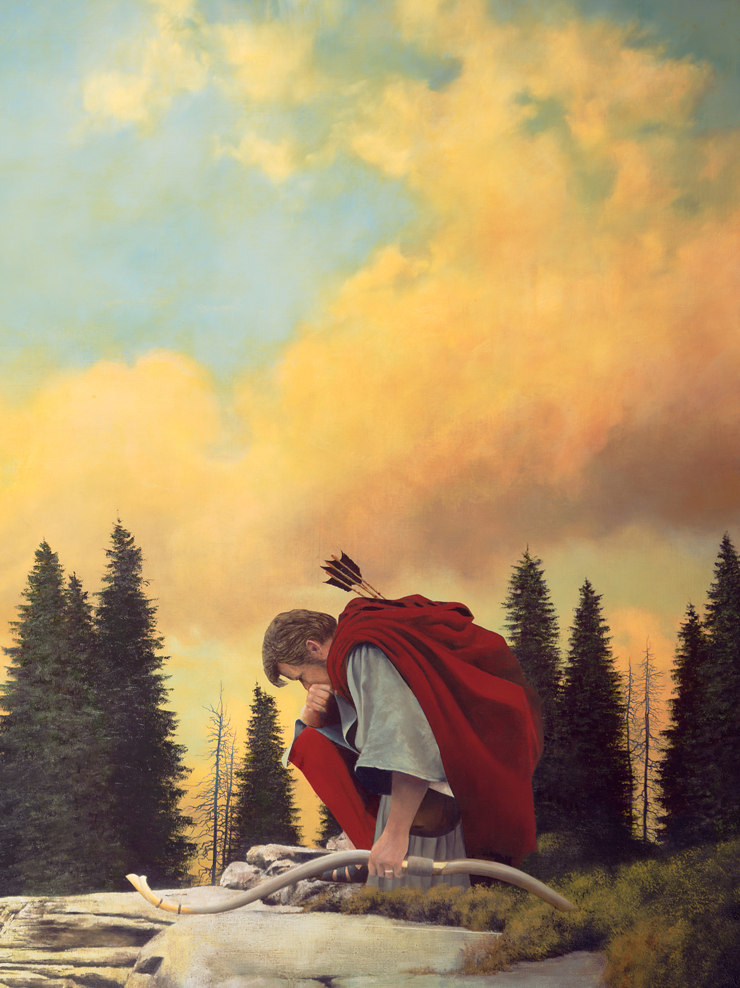
Who Is This Person?
What do you know about the person in this picture?

Slide 4
Who Is This Person?
What do you know about the person in this picture?
This is Enos, who was a grandson of Lehi and Sariah and a son of Jacob. He was entrusted with the small plates shortly before his father’s death (see Jacob 7:27).

Slide 5
Who Is This Person?
What do you know about the person in this picture?
This is Enos, who was a grandson of Lehi and Sariah and a son of Jacob. He was entrusted with the small plates shortly before his father’s death (see Jacob 7:27).
Read the first phrase of Enos 1:4. What do you think Enos might have meant by the phrase “my soul hungered”?

Slide 6
My Soul Hungered
The phrase “my soul hungered” might include the following meanings: feelings of spiritual emptiness, pain, or weakness, or a desire to be filled spiritually and obtain a greater understanding and testimony of the gospel. Think of a time when your soul has hungered.

Slide 7
Desires, Actions, and Results
Read Enos 1:1–8, looking for phrases indicating Enos’s desires, his actions and the results of what Enos did. Mark these phrases.

Slide 8
Desire, Action, or Result?
“a remission of my sins”
“eternal life”
“the joy of the saints”
“wrestle ... before God”
“cried unto him in mighty prayer”
“[exercised] faith in Christ”
“thy sins are forgiven thee”
“my guilt was swept away”
“thy faith hath made thee whole”
Desire
Action
Result

Slide 9
Eternal Life and Joy
Enos had “often heard [his] father speak concerning eternal life, and the joy of the saints” (Enos 1:3). How might reflecting on teachings concerning eternal life and the joy of the Saints cause a person’s soul to hunger?

Slide 10
Remission of Sins
Enos desired a remission of his sins. His sins may have contributed to his feelings of spiritual hunger or emptiness (see Enos 1:4). Why does sin cause us to feel spiritually empty?

Slide 11
Remission of Sins
Enos desired a remission of his sins. His sins may have contributed to his feelings of spiritual hunger or emptiness (see Enos 1:4). Why does sin cause us to feel spiritually empty?
Do you have some of the same feelings of spiritual hunger that Enos described?

Slide 12
Seeking a Remission of Sins
What do these phrases teach us about seeking a remission of our sins?
“wrestle … before God”
“cried unto him in mighty prayer”
“[exercised] faith in Christ”

Slide 13
Sincerely Seeking Forgiveness
Why is wrestle a good word to describe our efforts to repent?

Slide 14
Sincerely Seeking Forgiveness
Why is wrestle a good word to describe our efforts to repent?
In Enos 1:1–4, what evidence do you see that Enos was sincere as he sought a remission of his sins?

Slide 15
Receiving Forgiveness
Read Enos 1:7–8. What made it possible for Enos to be forgiven and made whole?

Slide 16
Receiving Forgiveness
Read Enos 1:7–8. What made it possible for Enos to be forgiven and made whole?
What principle can we learn from Enos about the process of receiving forgiveness for our sins?

Slide 17
Receiving Forgiveness
Read Enos 1:7–8. What made it possible for Enos to be forgiven and made whole?
What principle can we learn from Enos about the process of receiving forgiveness for our sins?
As we exercise faith in Jesus Christ, our sins can be forgiven and we can be made whole.

Slide 18
Faith in Jesus Christ
Why is exercising faith in Jesus Christ necessary for us to be forgiven and made whole?

Slide 19
Faith in Jesus Christ
Why is exercising faith in Jesus Christ necessary for us to be forgiven and made whole?
What are some things we can do to exercise faith in Jesus Christ as we seek forgiveness for our sins?

Slide 20
Faith in Jesus Christ
Why is exercising faith in Jesus Christ necessary for us to be forgiven and made whole?
What are some things we can do to exercise faith in Jesus Christ as we seek forgiveness for our sins?
According to Enos 1:5–6, how did Enos know he had been forgiven?

Slide 21
Faith in Jesus Christ
Why is exercising faith in Jesus Christ necessary for us to be forgiven and made whole?
What are some things we can do to exercise faith in Jesus Christ as we seek forgiveness for our sins?
According to Enos 1:5–6, how did Enos know he had been forgiven?
How can you know that you have been forgiven of your sins?

Slide 22
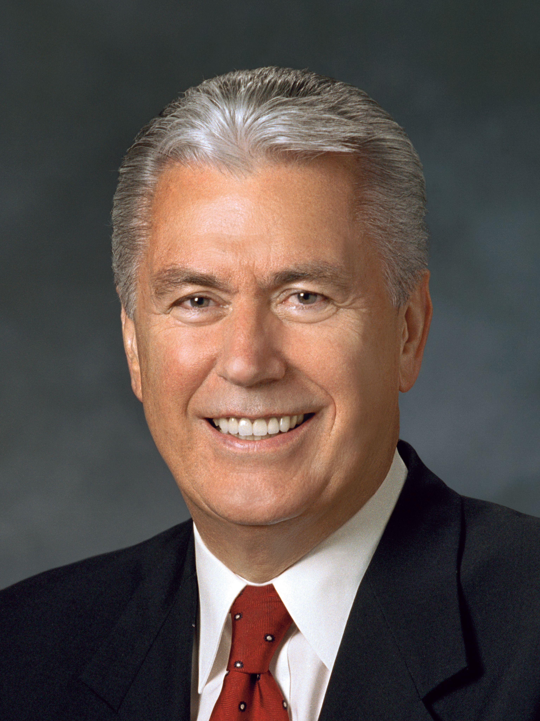
President Dieter F. Uchtdorf
“Once we have truly repented, Christ will take away the burden of guilt for our sins. We can know for ourselves that we have been forgiven and made clean. The Holy Ghost will verify this to us; He is the Sanctifier. No other testimony of forgiveness can be greater” (Dieter F. Uchtdorf, “Point of Safe Return,” Ensign or Liahona, May 2007, 101).

Slide 23
Reflect on These Questions
When have you felt that the Lord has forgiven you of your sins?
How did you know you were forgiven?
Have you felt the Lord’s forgiveness recently?

Slide 24
Enos’s Prayer
Read Enos 1:9–14, looking for the two groups of people for whom Enos prayed and what he prayed for in each case.

Slide 25
Enos’s Prayer
Read Enos 1:9–14, looking for the two groups of people for whom Enos prayed and what he prayed for in each case.
According to Enos 1:14, what were the Lamanites’ intentions toward the Nephites?

Slide 26
Enos’s Prayer
Read Enos 1:9–14, looking for the two groups of people for whom Enos prayed and what he prayed for in each case.
According to Enos 1:14, what were the Lamanites’ intentions toward the Nephites?
Based on Enos’s experience, what happens as we experience the blessings of Jesus Christ’s Atonement?

Slide 27
The Atonement of Jesus Christ
As we experience the blessings of Jesus Christ’s Atonement, we will seek to help others receive salvation.

Slide 28
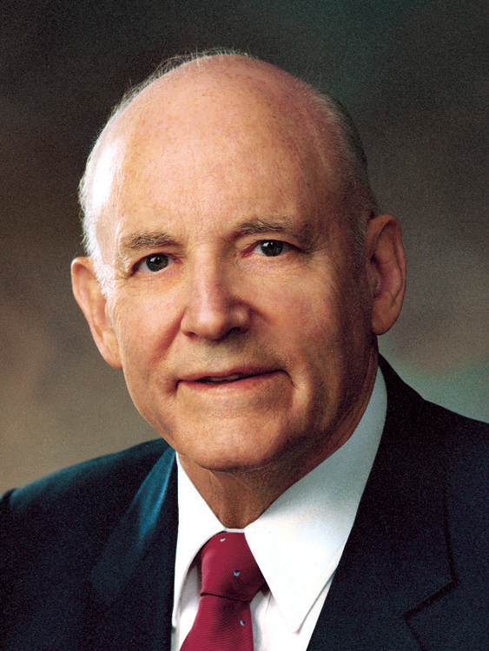
President Howard W. Hunter
“Any time we experience the blessings of the Atonement in our lives, we cannot help but have a concern for the welfare of [others]. …
“A great indicator of one’s personal conversion is the desire to share the gospel with others” (Teachings of Presidents of the Church: Howard W. Hunter [2015], 127, 128).

Slide 29
President Howard W. Hunter
“Any time we experience the blessings of the Atonement in our lives, we cannot help but have a concern for the welfare of [others]. …
“A great indicator of one’s personal conversion is the desire to share the gospel with others” (Teachings of Presidents of the Church: Howard W. Hunter [2015], 127, 128).
Why do you think we desire to share the gospel with others after we have experienced the blessings of the Atonement of Jesus Christ?

Slide 30
Prayer
Read Enos 1:12, 15–20, looking for what we can learn about prayer from Enos’s example.

Slide 31
Prayer
Read Enos 1:12, 15–20, looking for what we can learn about prayer from Enos’s example.
The Lord answers our prayers according to our faith and diligence.

Slide 32
Prayer
Read Enos 1:12, 15–20, looking for what we can learn about prayer from Enos’s example.
The Lord answers our prayers according to our faith and diligence.
What do you think it means to pray in faith?

Slide 33
Prayer
Read Enos 1:12, 15–20, looking for what we can learn about prayer from Enos’s example.
The Lord answers our prayers according to our faith and diligence.
What do you think it means to pray in faith?
According to Enos 1:12, 19–20, how did Enos show diligence during and after his prayer?

Slide 34
Prayer
Read Enos 1:12, 15–20, looking for what we can learn about prayer from Enos’s example.
The Lord answers our prayers according to our faith and diligence.
What do you think it means to pray in faith?
According to Enos 1:12, 19–20, how did Enos show diligence during and after his prayer?
According to verse 16, what is one of the ways the Lord answered Enos’s prayer?

Slide 35
Following the Example of Enos
Like Enos, I desire to receive a remission of my sins. I will show the Lord that I am sincere in this desire by …

Slide 36
Following the Example of Enos
Like Enos, I desire to receive a remission of my sins. I will show the Lord that I am sincere in this desire by …
Like Enos, I desire to help my family members and friends come unto Christ. One person I will seek to help is … I will seek to help this person by …

Slide 37
Following the Example of Enos
Enos prayed for the Lamanites, who were considered his enemies. Like Enos, I want to show the Lord’s love toward those who are unkind to me. One way I will do this is …

Slide 38
The Evidence of Joy
Read Enos 1:26–27 and look for evidence of the joy Enos experienced as he preached the gospel.

Slide 39
The Evidence of Joy
Read Enos 1:26–27 and look for evidence of the joy Enos experienced as he preached the gospel.
As we exercise faith in Jesus Christ, we can experience forgiveness and joy, and our desires to help others come unto Christ will increase.

Slide 40
The Evidence of Joy
Read Enos 1:26–27 and look for evidence of the joy Enos experienced as he preached the gospel.
As we exercise faith in Jesus Christ, we can experience forgiveness and joy, and our desires to help others come unto Christ will increase.
Think about the statement you chose to complete. How will you accomplish it?

Slide 41
Doctrinal Mastery: The Godhead
Here is a list of all of the doctrinal mastery passages you have studied so far in the Book of Mormon: 2 Nephi 26:33; 2 Nephi 28:30; 2 Nephi 32:3; 2 Nephi 32:8–9; Mosiah 4:9; 3 Nephi 11:10–11; 3 Nephi 12:48; 3 Nephi 18:15, 20–21; Ether 12:6; Moroni 10:4–5.

Slide 42
Doctrinal Mastery: The Godhead
Here is a list of all of the doctrinal mastery passages you have studied so far in the Book of Mormon: 2 Nephi 26:33; 2 Nephi 28:30; 2 Nephi 32:3; 2 Nephi 32:8–9; Mosiah 4:9; 3 Nephi 11:10–11; 3 Nephi 12:48; 3 Nephi 18:15, 20–21; Ether 12:6; Moroni 10:4–5.
Select one of these doctrinal mastery passages and prepare a scriptural thought you could share in your weekly class or in a family home evening lesson.

Slide 43
Doctrinal Mastery: The Godhead
Include the reference of the scripture mastery passage you selected.
Explain how the scripture passage teaches or supports a statement of doctrine in the Doctrinal Mastery Core Document.
Explain what that doctrine means to you.
Share why you think that doctrine is important for youth to understand.
Conclude with your testimony of the doctrine.

