Slide 1
Jacob 7
Lesson 48

Slide 2
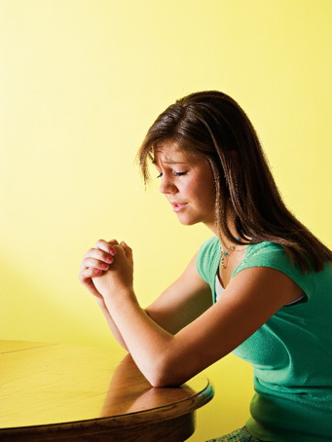
Devotional
Hymn:
Prayer:
Thought:
Notes:
ID 272818

Slide 3
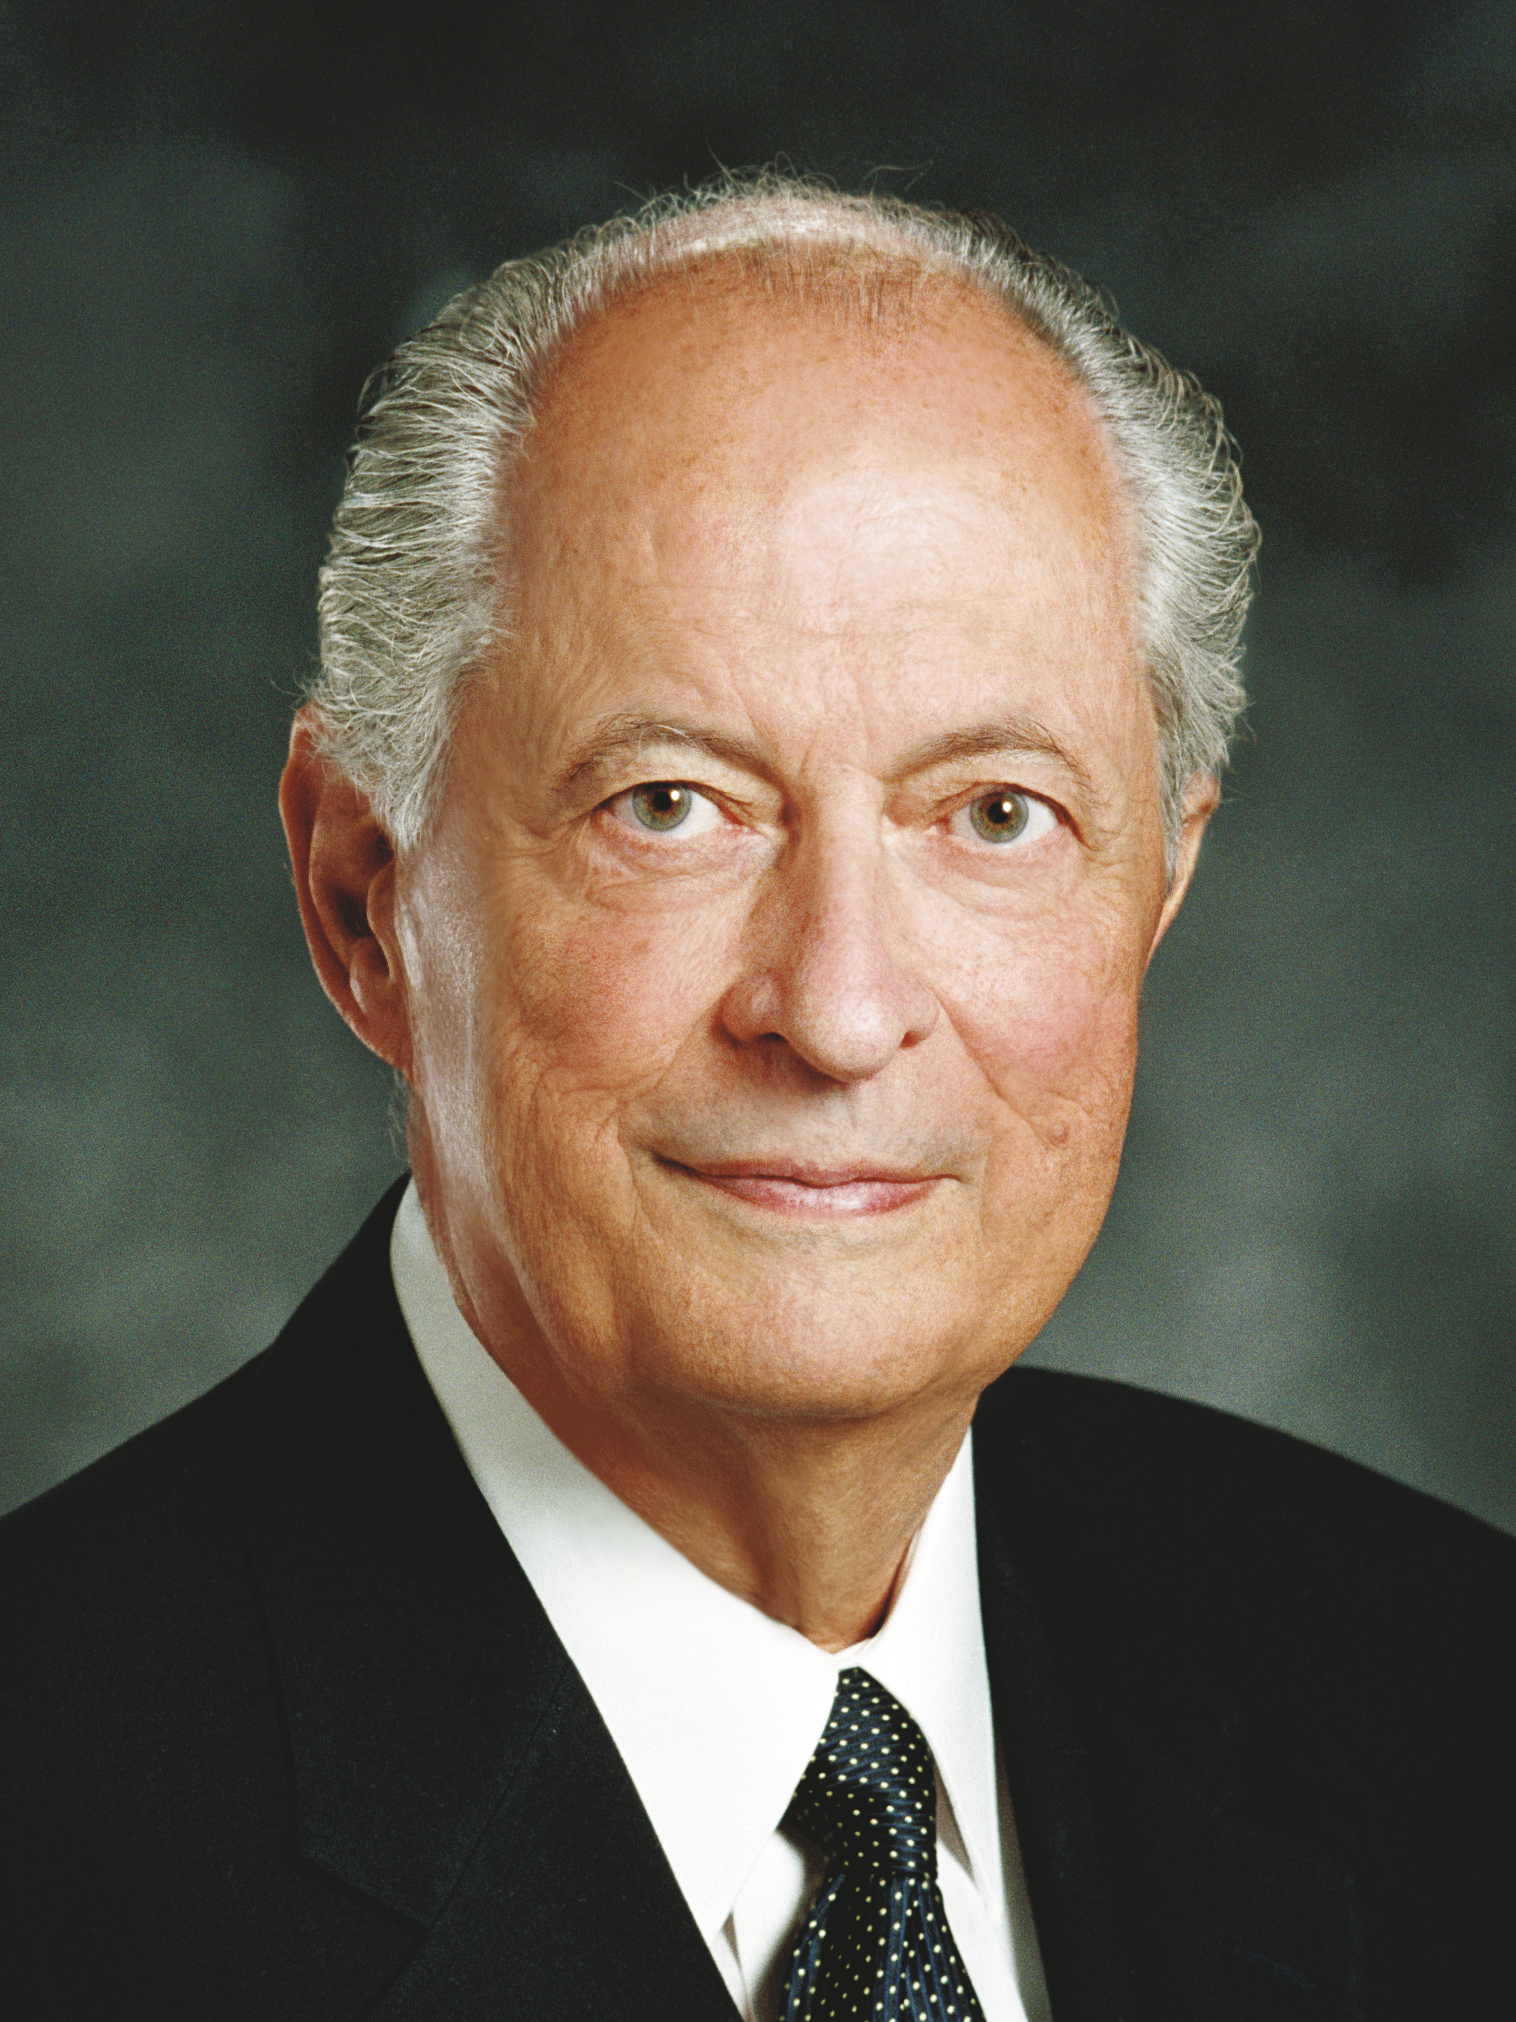
Elder Robert D. Hales
“One of mortality’s great tests comes when our beliefs are questioned or criticized” (Robert D. Hales, “Christian Courage: The Price of Discipleship,” Ensign or Liahona, Nov. 2008, 72).

Slide 4
Challenging Our Beliefs
Individuals may question or challenge our beliefs in person or through the internet or other media. Think of a time when someone questioned or criticized your beliefs. How did you feel when that happened?

Slide 5
Challenging Our Beliefs
Individuals may question or challenge our beliefs in person or through the internet or other media. Think of a time when someone questioned or criticized your beliefs. How did you feel when that happened?
As you study Jacob 7 today, look for principles that can help you know how to overcome challenges to your faith. This chapter recounts Jacob’s experience with a man named Sherem.

Slide 6
Sherem
Read Jacob 7:1–4, looking for what Sherem sought to do.

Slide 7
Sherem
Read Jacob 7:1–4, looking for what Sherem sought to do.
What effect did Sherem have on the people?

Slide 8
Sherem
Read Jacob 7:1–4, looking for what Sherem sought to do.
What effect did Sherem have on the people?
According to verse 4, why was Sherem able to lead away the hearts of many Nephites?

Slide 9
Sherem
Read Jacob 7:1–4, looking for what Sherem sought to do.
What effect did Sherem have on the people?
According to verse 4, why was Sherem able to lead away the hearts of many Nephites?
Why is it sometimes difficult to defend our faith against people like Sherem?

Slide 10
Not All People
Not all people who question or criticize our faith have the same motives as Sherem. While some people like Sherem deliberately seek to destroy faith, others may question our faith because they are curious or because they have been misinformed concerning our beliefs.

Slide 11
Sherem’s Intent
Read Jacob 7:5–7, looking for what Sherem hoped to do to Jacob.

Slide 12
Sherem’s Intent
Read Jacob 7:5–7, looking for what Sherem hoped to do to Jacob.
According to verse 5, why could Jacob’s faith not be shaken?

Slide 13
Jacob’s Faith
According to Jacob 7:5, Jacob’s faith could not be shaken by Sherem. Jacob had received many revelations, seen angels, and heard the voice of the Lord speaking to him. When Jacob’s faith was challenged, Jacob chose to remember past experiences that had strengthened his faith.

Slide 14
Challenges to Our Faith
Based on what we learn from Jacob’s example, how would you complete this statement of principle? We can overcome challenges to our faith by …

Slide 15
Challenges to Our Faith
Based on what we learn from Jacob’s example, how would you complete this statement of principle? We can overcome challenges to our faith by …
We can overcome challenges to our faith by remembering past experiences that have strengthened our faith.

Slide 16
Strengthening Our Faith
What are some experiences that have strengthened your faith?

Slide 17
Strengthening Our Faith
What are some experiences that have strengthened your faith?
How can remembering these experiences help you when someone questions or criticizes your faith?

Slide 18
Jacob’s Help
Read Jacob 7:8, looking for what else helped Jacob as Sherem sought to challenge his faith.

Slide 19
Jacob’s Help
Read Jacob 7:8, looking for what else helped Jacob as Sherem sought to challenge his faith.
What principle can we learn from verse 8 about overcoming challenges to our faith?

Slide 20
Jacob’s Help
Read Jacob 7:8, looking for what else helped Jacob as Sherem sought to challenge his faith.
What principle can we learn from verse 8 about overcoming challenges to our faith?
We can overcome challenges to our faith by relying on guidance from the Holy Ghost.

Slide 21
Elder Robert D. Hales
“Fortunately, the Lord knows the hearts of our accusers and how we can most effectively respond to them. As true disciples seek guidance from the Spirit, they receive inspiration tailored to each encounter. And in every encounter, true disciples respond in ways that invite the Spirit of the Lord” (Robert D. Hales, “Christian Courage: The Price of Discipleship,” Ensign or Liahona, Nov. 2008, 73).

Slide 22
The Holy Ghost
What are some ways the Holy Ghost can help us know how to respond to questions or criticisms about our faith?

Slide 23
The Holy Ghost
What are some ways the Holy Ghost can help us know how to respond to questions or criticisms about our faith?
When has the Holy Ghost helped you respond to questions or criticisms about your faith?

Slide 24
When Faith Is Challenged
Read Jacob 7:9–12, looking for what else Jacob did as Sherem sought to challenge his faith.

Slide 25
When Faith Is Challenged
Read Jacob 7:9–12, looking for what else Jacob did as Sherem sought to challenge his faith.
What principle can we learn from verses 9–12 about overcoming challenges to our faith?

Slide 26
When Faith Is Challenged
Read Jacob 7:9–12, looking for what else Jacob did as Sherem sought to challenge his faith.
What principle can we learn from verses 9–12 about overcoming challenges to our faith?
We can overcome challenges to our faith by relying on the words of prophets and sharing our testimonies of the gospel.

Slide 27
Scriptures and Prophets
How can a daily habit of studying the scriptures and the words of latter-day prophets help us when others question or criticize our faith?

Slide 28
Scriptures and Prophets
How can a daily habit of studying the scriptures and the words of latter-day prophets help us when others question or criticize our faith?
How can choosing to share our testimonies help us overcome challenges to our faith?

Slide 29
Jacob’s Testimony
Read Jacob 7:13–14, looking for what happened after Jacob shared his testimony with Sherem.

Slide 30
Jacob’s Testimony
Read Jacob 7:13–14, looking for what happened after Jacob shared his testimony with Sherem.
What did Jacob do in response to Sherem’s challenge?

Slide 31
Jacob’s Testimony
Read Jacob 7:13–14, looking for what happened after Jacob shared his testimony with Sherem.
What did Jacob do in response to Sherem’s challenge?
What principle can we learn from verses 13–14 about overcoming challenges to our faith?

Slide 32
Overcoming Challenges
We can overcome challenges to our faith by trusting in the Lord and leaving the outcome in His hands.

Slide 33
Overcoming Challenges
We can overcome challenges to our faith by trusting in the Lord and leaving the outcome in His hands.
How might it help you to know that it is not necessary for you to prove the truthfulness of your testimony to those who challenge your faith?

Slide 34
Elder Robert D. Hales
“Through the years we learn that challenges to our faith are not new, and they aren’t likely to disappear soon. But true disciples of Christ see opportunity in the midst of opposition” (Robert D. Hales, “Christian Courage,” 72).

Slide 35
Elder Robert D. Hales
“Through the years we learn that challenges to our faith are not new, and they aren’t likely to disappear soon. But true disciples of Christ see opportunity in the midst of opposition” (Robert D. Hales, “Christian Courage,” 72).
What do you think it means to “see opportunity in the midst of opposition”?

Slide 36
The Good Result
Read Jacob 7:15–23, looking for anything good that resulted from Jacob’s encounter with Sherem.

Slide 37
The Good Result
Read Jacob 7:15–23, looking for anything good that resulted from Jacob’s encounter with Sherem.
According to Jacob 7:22, what had Jacob done to help the multitude?

Slide 38
The Good Result
Read Jacob 7:15–23, looking for anything good that resulted from Jacob’s encounter with Sherem.
According to Jacob 7:22, what had Jacob done to help the multitude?
According to Jacob 7:23, how did Jacob’s encounter with Sherem ultimately affect the multitude?

Slide 39
The Good Result
Read Jacob 7:15–23, looking for anything good that resulted from Jacob’s encounter with Sherem.
According to Jacob 7:22, what had Jacob done to help the multitude?
According to Jacob 7:23, how did Jacob’s encounter with Sherem ultimately affect the multitude?
What truths can we learn from the results of Jacob’s encounter with Sherem?

Slide 40
Helping Others
As we appropriately respond to questions or criticisms of our faith, we can help others turn to the Lord.

Slide 41
Helping Others
As we appropriately respond to questions or criticisms of our faith, we can help others turn to the Lord.
What is one thing you will begin doing (or continue doing) to help you prepare for a time when someone challenges your faith?

Slide 42
The Prophet Jacob
Read Jacob 7:24–25, looking for how Jacob described the relationship between the Nephites and the Lamanites.

Slide 43
The Prophet Jacob
Read Jacob 7:24–25, looking for how Jacob described the relationship between the Nephites and the Lamanites.
Read Jacob 7:26–27, looking for words or phrases that reflect how Jacob felt as he neared the end of his life.

Slide 44
The Prophet Jacob
Read Jacob 7:24–25, looking for how Jacob described the relationship between the Nephites and the Lamanites.
Read Jacob 7:26–27, looking for words or phrases that reflect how Jacob felt as he neared the end of his life.
Why do you think the wars between the Nephites and the Lamanites brought sorrow to Jacob?

Slide 45
The Prophet Jacob
Read Jacob 7:24–25, looking for how Jacob described the relationship between the Nephites and the Lamanites.
Read Jacob 7:26–27, looking for words or phrases that reflect how Jacob felt as he neared the end of his life.
Why do you think the wars between the Nephites and the Lamanites brought sorrow to Jacob?
What did Jacob give to his son Enos?

Slide 46
Additional Resources
Robert D. Hales, “Christian Courage: The Price of Discipleship” (Ensign or Liahona, Nov. 2008, 72–75). In this general conference address, Elder Hales taught about how we can respond to criticism or persecution with courage, tolerance, and charity.

Slide 47
Additional Resources
True to the Faith: A Gospel Reference. This book contains an alphabetical list of gospel topics and commentary. The First Presidency wrote that one purpose of this book is to help members of the Church “answer questions about the Church” (True to the Faith [2004], 1).

Slide 48
Additional Resources
Topics.lds.org. The Church’s official website contains an alphabetical list of gospel topics and commentary, with links to related study materials and talks, articles, and statements by Church leaders.

