Slide 1
Jacob 5:52–77; 6:1–13
Lesson 47

Slide 2
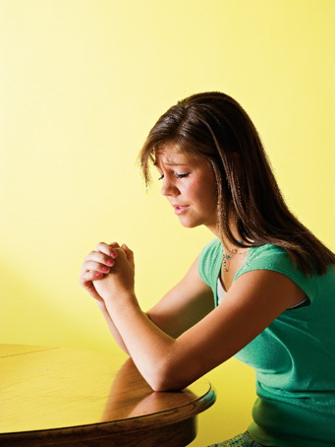
Devotional
Hymn:
Prayer:
Thought:
Notes:
ID 272818

Slide 3
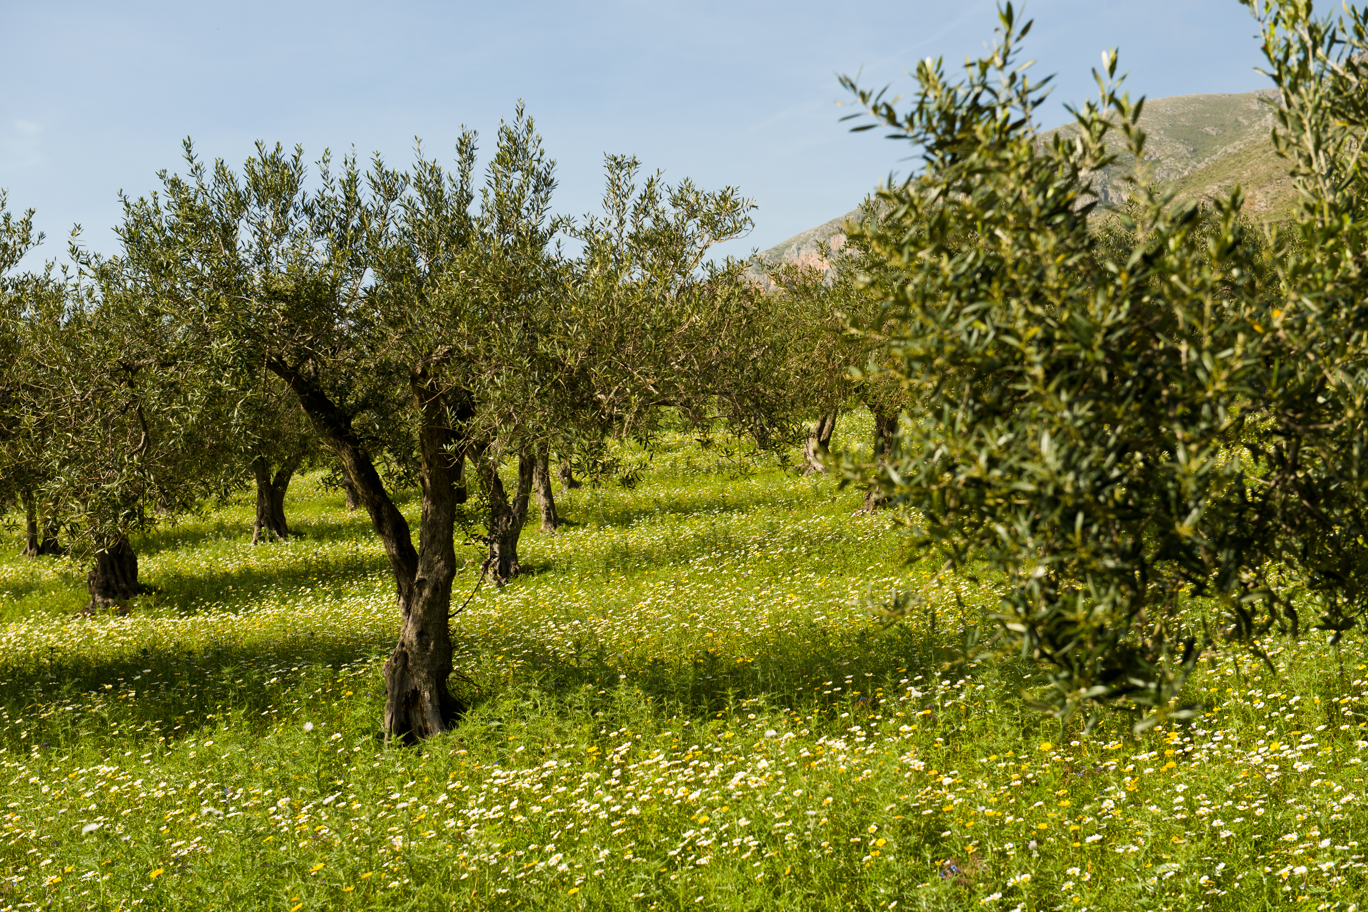
Review of Previous Lesson
The master of the vineyard represents …

Slide 4
Review of Previous Lesson
The master of the vineyard represents …
The efforts of the master of the vineyard to save his trees represent …

Slide 5
Review of Previous Lesson
The master of the vineyard represents …
The efforts of the master of the vineyard to save his trees represent …
One thing I learned about Jesus Christ from the words or actions of the master of the vineyard is …

Slide 6
Jacob 5:29–42
As recorded in Jacob 5:29–42, all the trees in the vineyard were bringing forth wild fruit (evil works), which likely represents the time of the Great Apostasy. The master of the vineyard then decided to spare the vineyard “a little longer” (Jacob 5:51).

Slide 7
Jacob 5:52–60
In Jacob 5:52–60, the master of the vineyard grafted branches from the scattered natural trees back into their original tree. The original tree represents the house of Israel. Then he grafted branches from the original tree into the other natural trees. He knew that as the roots would take strength, the branches throughout the vineyard would change, “that the good [might] overcome the evil” (Jacob 5:59). He also cast the most bitter branches into the fire.

Slide 8
The Lord’s Prophets
The servant mentioned throughout the first part of the allegory of the tame and wild olive trees represents the Lord’s prophets.

Slide 9
The Lord’s Prophets
The servant mentioned throughout the first part of the allegory of the tame and wild olive trees represents the Lord’s prophets.
Read Jacob 5:61–62, looking for what the master of the vineyard instructed his servant to do and why he asked him to do it.

Slide 10
The Lord’s Prophets
The servant mentioned throughout the first part of the allegory of the tame and wild olive trees represents the Lord’s prophets.
Read Jacob 5:61–62, looking for what the master of the vineyard instructed his servant to do and why he asked him to do it.
Who might be represented by the multiple servants in Jacob 5:61?

Slide 11
Participants in the Lord’s Work
In Jacob 5:61, these servants can represent all members of the Church: prophets and apostles, general and local Church leaders, missionaries, home teachers, visiting teachers, and anyone who participates in the Lord’s work.

Slide 12
Participants in the Lord’s Work
In Jacob 5:61, these servants can represent all members of the Church: prophets and apostles, general and local Church leaders, missionaries, home teachers, visiting teachers, and anyone who participates in the Lord’s work.
What truth can we learn from the master of the vineyard’s use of the words we, our, and us in Jacob 5:61–62?

Slide 13
Laboring with the Lord
The Lord labors with us as we do His work.

Slide 14
Laboring with the Lord
The Lord labors with us as we do His work.
What are some ways in which the Lord labors with us as we do His work?

Slide 15
Laboring with the Lord
The Lord labors with us as we do His work.
What are some ways in which the Lord labors with us as we do His work?
According to Jacob 5:62, what is unique about the time in which these servants were called to labor?

Slide 16
The Last Laborers
In Jacob 5:62, we learn that what is unique about the time in which these servants were called to labor is that it was the “last time” the master would prune the vineyard. Prophets have referred to this “last time” as “the dispensation of the fulness of times.” For example, see Ephesians 1:10 and Doctrine and Covenants 128:20.

Slide 17
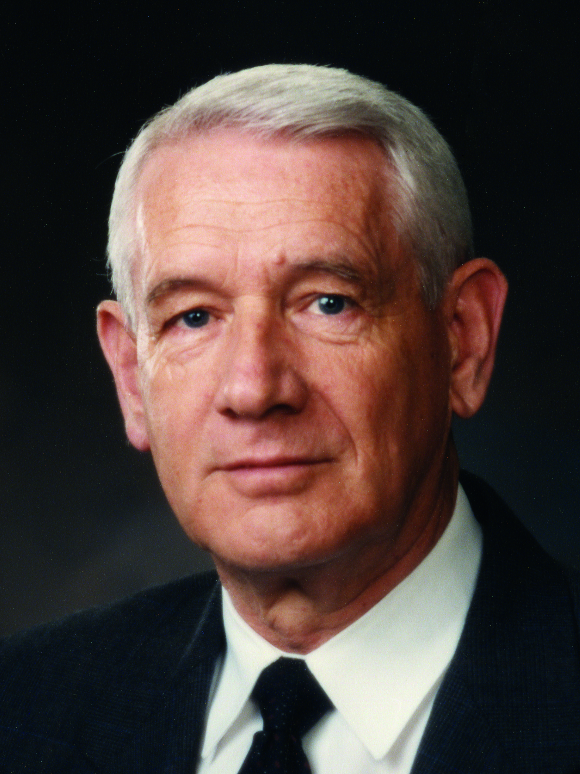
Elder Dean L. Larsen
“[Now] is the period during which the Lord and his servants will make the final great effort to take the message of truth to all the peoples of the earth and to reclaim the descendants of ancient Israel who have lost their true identity. ...
Continued on the next page.

Slide 18
Elder Dean L. Larsen, cont.
“You have come to the earth when the foundation has been laid for this great work. The gospel has been restored for the last time. The Church has been established in almost every part of the world. The stage is set for the final dramatic scenes to be enacted. You will be the principal players. You are among the last laborers in the vineyard. ... This is the service for which you are chosen” (Dean L. Larsen, “A Royal Generation,” Ensign, May 1983, 33).

Slide 19
The Last Laborers
What are your thoughts about being among the last laborers in the Lord’s vineyard before His Second Coming?

Slide 20
The Last Laborers
What are your thoughts about being among the last laborers in the Lord’s vineyard before His Second Coming?
Read Jacob 5:70–71, looking for what the Lord of the vineyard promised to the servants who labored with him.

Slide 21
The Last Laborers
What are your thoughts about being among the last laborers in the Lord’s vineyard before His Second Coming?
Read Jacob 5:70–71, looking for what the Lord of the vineyard promised to the servants who labored with him.
Using your own words, how would you state the Lord’s promise in Jacob 5:71 as a principle?

Slide 22
Blessed with Joy
If we labor mightily with the Lord, then we will be blessed with joy.

Slide 23
Blessed with Joy
If we labor mightily with the Lord, then we will be blessed with joy.
What are some opportunities you have to serve with the Lord in His work?

Slide 24
Blessed with Joy
If we labor mightily with the Lord, then we will be blessed with joy.
What are some opportunities you have to serve with the Lord in His work?
What are some ways we can labor mightily with the Lord in these various opportunities?

Slide 25
The Trees and the Fruits
Read Jacob 5:72, 74–75, looking for what happened to the trees and the fruit as the servants labored mightily with the Lord.

Slide 26
The Trees and the Fruits
Read Jacob 5:72, 74–75, looking for what happened to the trees and the fruit as the servants labored mightily with the Lord.
In verse 74, the trees becoming “like unto one body” and the “fruits [being] equal” represent the righteousness and unity that exist among the Lord’s people as they obey His commandments and do His work. (See also Moses 7:18.)

Slide 27
The Lord of the Vineyard
In Jacob 5:75, look for what the Lord of the vineyard told his servants after their work was complete.

Slide 28
The Lord of the Vineyard
In Jacob 5:75, look for what the Lord of the vineyard told his servants after their work was complete.
What feelings would you have if you heard the Lord say to you, “Blessed art thou”? Why?

Slide 29
The Lord of the Vineyard
In Jacob 5:75, look for what the Lord of the vineyard told his servants after their work was complete.
What feelings would you have if you heard the Lord say to you, “Blessed art thou”? Why?
When have you felt joy because you labored mightily with the Lord in His work?

Slide 30
Laboring Mightily
What is one way you will labor more mightily with the Lord in His work?

Slide 31
Laboring Mightily
What is one way you will labor more mightily with the Lord in His work?
In Jacob 5:76–77, we learn that after the Second Coming of Jesus Christ, righteousness will prevail for a “long time” (during the Millennium). When evil again enters the world, God will separate the righteous from the wicked and cleanse the earth by fire.

Slide 32
Truths from Zenos’s Allegory
Read Jacob 6:4–10. What truths or principles did Jacob want his people to understand from these verses?

Slide 33
Truths from Zenos’s Allegory
God remembers us even when we are sinful and offers us the opportunity to repent. (See Jacob 6:4.)

Slide 34
Truths from Zenos’s Allegory
God remembers us even when we are sinful and offers us the opportunity to repent. (See Jacob 6:4.)
We will receive God’s mercy if we repent and come unto Him with full purpose of heart. (See Jacob 6:4–5.)

Slide 35
Truths from Zenos’s Allegory
God remembers us even when we are sinful and offers us the opportunity to repent. (See Jacob 6:4.)
We will receive God’s mercy if we repent and come unto Him with full purpose of heart. (See Jacob 6:4–5.)
Those who persist in evil and do not repent will someday stand with shame before God. (See Jacob 6:7–9.)

Slide 36
Understanding Truths
How does the allegory in Jacob 5 help us understand these truths?

Slide 37
Understanding Truths
How does the allegory in Jacob 5 help us understand these truths?
Why do you think it is important for us to understand these truths today?

Slide 38
Understanding Truths
How does the allegory in Jacob 5 help us understand these truths?
Why do you think it is important for us to understand these truths today?
In what ways does God show mercy to us as we repent and come unto Him?

Slide 39
Additional Counsel
Read Jacob 6:11–12, looking for additional counsel Jacob gave.

Slide 40
Additional Counsel
Read Jacob 6:11–12, looking for additional counsel Jacob gave.
Based on the truths you learned in Jacob 6, why would it be wise to follow Jacob’s counsel to repent?

Slide 41
Act in Faith
We act in faith when we choose to trust God and turn to Him first through sincere prayer, a study of His teachings, and obedience to His commandments.

Slide 42
Act in Faith
As we seek to develop our understanding and to resolve concerns, it is important that we rely on the testimony that we already have of Jesus Christ, the Restoration of His gospel, and the teachings of His ordained prophets.

Slide 43
Act in Faith
Elder Jeffrey R. Holland taught: “When those moments come and issues surface, the resolution of which is not immediately forthcoming, hold fast to what you already know and stand strong until additional knowledge comes” (“Lord, I Believe,” Ensign or Liahona, May 2013, 94). The Lord Himself has invited us to “look unto [Him] in every thought; doubt not, fear not” (D&C 6:36).

Slide 44
Act in Faith
During times when we may not immediately find answers to our questions, it is helpful to remember that although Heavenly Father has revealed all that is necessary for our salvation, He has not yet revealed all truth.

Slide 45
Act in Faith
As we continue to seek for answers, we must live by faith—trusting that we will eventually receive the answers we seek (see Proverbs 3:5–6; Ether 12:6). As we are faithful to the truth and light we have already received, we will receive more. Answers to our questions and prayers often come “line upon line, precept upon precept” (2 Nephi 28:30).

Slide 46
Examine Concepts and Questions with an Eternal Perspective
To examine doctrinal concepts, questions, and social issues with an eternal perspective, we consider them in the context of the plan of salvation and the teachings of the Savior.

Slide 47
Examine Concepts and Questions with an Eternal Perspective
We seek the help of the Holy Ghost in order to see things as the Lord sees them. This allows us to reframe the question (to see the question differently) and view ideas based on the Lord’s standard of truth rather than accepting the world’s premise or assumptions (see 1 Corinthians 2:5, 9–11).

Slide 48
Examine Concepts and Questions with an Eternal Perspective
We can do this by asking questions such as “What do I already know about Heavenly Father, His plan, and how He deals with His children?” and “What gospel teachings relate to or clarify this concept or issue?”

Slide 49
Examine Concepts and Questions with an Eternal Perspective
Even questions that relate to historical events may need to be examined with an eternal perspective. As we stay anchored to our trust in our Heavenly Father and His plan of salvation, we are able to see issues more clearly. It may also help to examine historical questions in the proper historical context by considering the culture and norms of the time period rather than imposing current perspectives and attitudes.

Slide 50
Examine Concepts and Questions with an Eternal Perspective
It is important to remember that historical details do not carry the saving power of ordinances, covenants, and doctrine. To be distracted by less significant details at the expense of missing the unfolding miracle of the Restoration is like spending time analyzing a gift box and ignoring the wonder of the gift itself.

Slide 51
Seek Further Understanding through Divinely Appointed Sources
As part of the Lord’s appointed process for obtaining spiritual knowledge, He has established sources through which He reveals truth and guidance to His children. These sources include the Light of Christ, the Holy Ghost, the scriptures, parents, and Church leaders.

Slide 52
Seek Further Understanding through Divinely Appointed Sources
The First Presidency and the Quorum of the Twelve Apostles—the Lord’s prophets upon the earth today—are a vital source of truth. The Lord has chosen and ordained these individuals to speak for Him.

Slide 53
Seek Further Understanding through Divinely Appointed Sources
We can also learn truth through other trustworthy sources. However, sincere seekers of truth should be wary of unreliable sources of information. We live in a time when many “call evil good, and good evil” (Isaiah 5:20). Satan is the father of lies and seeks to distort truth and persuade us to turn away from the Lord and His appointed servants.

Slide 54
Seek Further Understanding through Divinely Appointed Sources
As we turn to the Lord’s divinely appointed sources for answers and direction, we can be blessed to discern between truth and error. Learning to recognize and avoid unreliable sources can protect us from misinformation and from those who seek to destroy faith.

Slide 55
Doctrinal Mastery: A Conversation
On the next few pages, you will read a text-message conversation between two sisters. As you read this conversation, consider how you would answer these questions:
How did the girl’s sister help her to act in faith?
How did the girl’s sister help her examine the situation with an eternal perspective?
How did the girl’s sister help her seek understanding through divinely appointed sources?

Slide 56
A Conversation, cont.
Here is the conversation:
You looked sad earlier. Are you OK?
Not really.
Why?
I was eating lunch with my friends and some girls walked by. One of my friends pointed at them and was really mean because they look and dress different. My other friends joined in. Maybe it’s not that bad. They were just joking.

Slide 57
A Conversation, cont.
Well, did it bug you?
Yes!! It made me feel awful.
Do you know these girls at all?
Not really ... they just seem different I guess.
We talked about something like this in seminary today. Sometimes it’s easy to think we’re better than others just because they look or act differently.
That’s what happened at lunch!!

Slide 58
A Conversation, cont.
We read the scripture 2 Nephi 26:33. It says that all are alike unto God. He loves everyone and we are all important to Him. So I think we should try to see people how He sees them.
True. I think remembering that can change how I sometimes look at others and treat them.

Slide 59
A Conversation, cont.
My teacher also shared this quote that I loved by President Uchtdorf: “God does not look on the outward appearance. ... Though we are incomplete, God loves us completely. Though we are imperfect, He loves us perfectly.”
That is such a good quote! The thing is that not all of my friends believe what we do and I’m not sure what to do whenever this happens.

Slide 60
A Conversation, cont.
Yeah. Whenever this happens to me I just think about the Savior and what He would do in these situations.
He probably would’ve said something to my friends and maybe taught them about the good Samaritan or something like that. I probably should have said something, but it’s so hard! I’m scared to see how my friends would respond.

Slide 61
A Conversation, cont.
It’s not easy to speak up. What do you think could help you?
I think if I just remember the Savior’s example because He had so much courage and was so kind even to people that others rejected. Maybe I can also pray. Prayer always helps.
Great ideas!
Thanks for your help!
That’s what sisters are for!

Slide 62
Using the Principles
Answer one of the questions below. Describe how the sister used one of the principles of acquiring spiritual knowledge to help her sister.
How did the girl’s sister help her to act in faith?
How did the girl’s sister help her examine the situation with an eternal perspective?
How did the girl’s sister help her seek understanding through divinely appointed sources?

