Slide 1
2 Nephi 31
Lesson 40

Slide 2

Devotional
Hymn:
Prayer:
Thought:

Slide 3
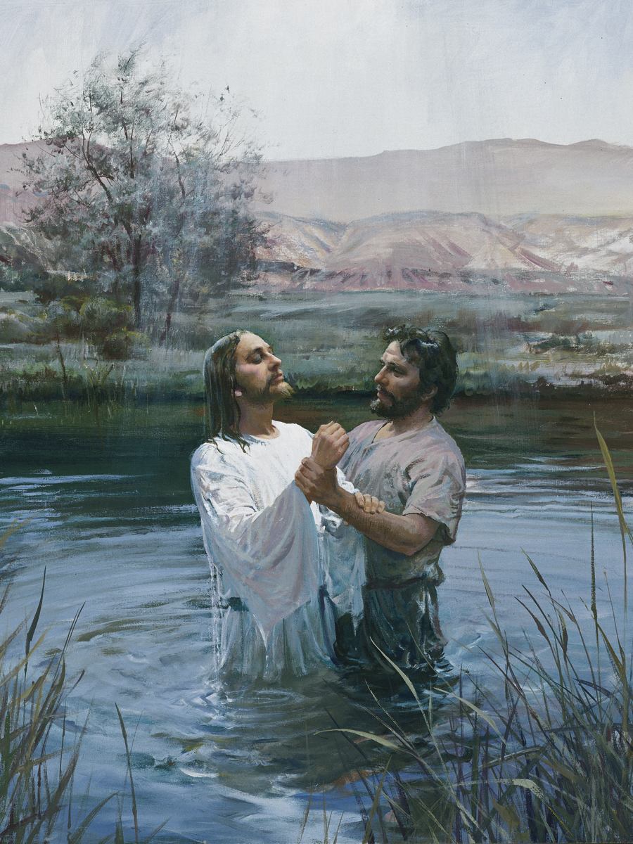
Baptism
What do you remember about your baptism? How did you feel when you were baptized?

Slide 4
Baptism
What do you remember about your baptism? How did you feel when you were baptized?
As Nephi drew closer to the conclusion of his writings on the small plates, he desired to speak about “the doctrine of Christ.” Mark this phrase in 2 Nephi 31:2 and 2 Nephi 31:21.

Slide 5
The Importance of Baptism
Baptism is an essential component of the Savior’s doctrine. However, some people feel that they do not need to be baptized. They believe that they can show faith in the Savior and follow Him without being baptized.

Slide 6
The Importance of Baptism
Baptism is an essential component of the Savior’s doctrine. However, some people feel that they do not need to be baptized. They believe that they can show faith in the Savior and follow Him without being baptized.
Read 2 Nephi 31:4–13, looking for truths Nephi taught that can help us understand the importance of baptism.

Slide 7
Understanding Important Phrases
To “fulfil all righteousness” (2 Nephi 31:5–6; see also Matthew 3:15) means to fulfill God’s requirements for eternal life (see John 3:5). The phrases “with full purpose of heart,” “acting no hypocrisy and no deception before God,” and “with real intent” (2 Nephi 31:13) refer to being completely sincere in one’s efforts and commitment to follow the Son of God. “To speak with the tongue of angels” (2 Nephi 31:13) is to speak the words of Jesus Christ by the power of the Holy Ghost (see 2 Nephi 32:3).

Slide 8
Fill in the Blanks
Jesus Christ, though sinless, was baptized to _________________________ (see 2 Nephi 31:5–7).

Slide 9
Fill in the Blanks
Jesus Christ, though sinless, was baptized to _________________________ (see 2 Nephi 31:5–7).
Jesus Christ set the perfect ___________________ of _____________________________ for us to follow (see 2 Nephi 31:7, 9–10, 12).

Slide 10
Fill in the Blanks
Jesus Christ, though sinless, was baptized to _________________________ (see 2 Nephi 31:5–7).
Jesus Christ set the perfect ___________________ of _____________________________ for us to follow (see 2 Nephi 31:7, 9–10, 12).
If we sincerely _____________ and follow the Savior by being _________________, then we will receive ______________________ (see 2 Nephi 31:11–13).

Slide 11
The Savior’s Example
How does the Savior’s example illustrate the importance of baptism?

Slide 12
The Savior’s Example
How does the Savior’s example illustrate the importance of baptism?
Like the Savior, what do we show Heavenly Father by choosing to be baptized?

Slide 13
Important Truths
Jesus Christ, though sinless, was baptized to fulfill all righteousness (see 2 Nephi 31:5–7). Jesus Christ set the perfect example of obedience for us to follow (see 2 Nephi 31:7, 9–10, 12). If we sincerely repent and follow the Savior by being baptized, then we will receive the gift of the Holy Ghost (see 2 Nephi 31:11–13).

Slide 14

The Gate and Path
Read 2 Nephi 31:17–18, looking for what Nephi taught about the gate and about the path the gate opens onto.

Slide 15
Repentance and Baptism
Based on 2 Nephi 31:17–18, the gate represents repentance and baptism. The path leads to eternal life, which is exaltation in the celestial kingdom. Nephi taught that after baptism, we receive the gift of the Holy Ghost (see 2 Nephi 31:13–14).

Slide 16
The Holy Ghost
According to 2 Nephi 31:17–18, what does the Holy Ghost do for us?

Slide 17
The Holy Ghost
According to 2 Nephi 31:17–18, what does the Holy Ghost do for us?
The Holy Ghost witnesses of the Father and the Son and brings a remission of sins.

Slide 18
The Holy Ghost Testifies
The Holy Ghost helps us know that the Father and the Son live. In addition, the Holy Ghost helps us come to know Them—Their will and character—and helps us to become like Them.

Slide 19
The Holy Ghost Testifies
The Holy Ghost helps us know that the Father and the Son live. In addition, the Holy Ghost helps us come to know Them—Their will and character—and helps us to become like Them.
What does it mean that the Holy Ghost brings a remission of sins?

Slide 20
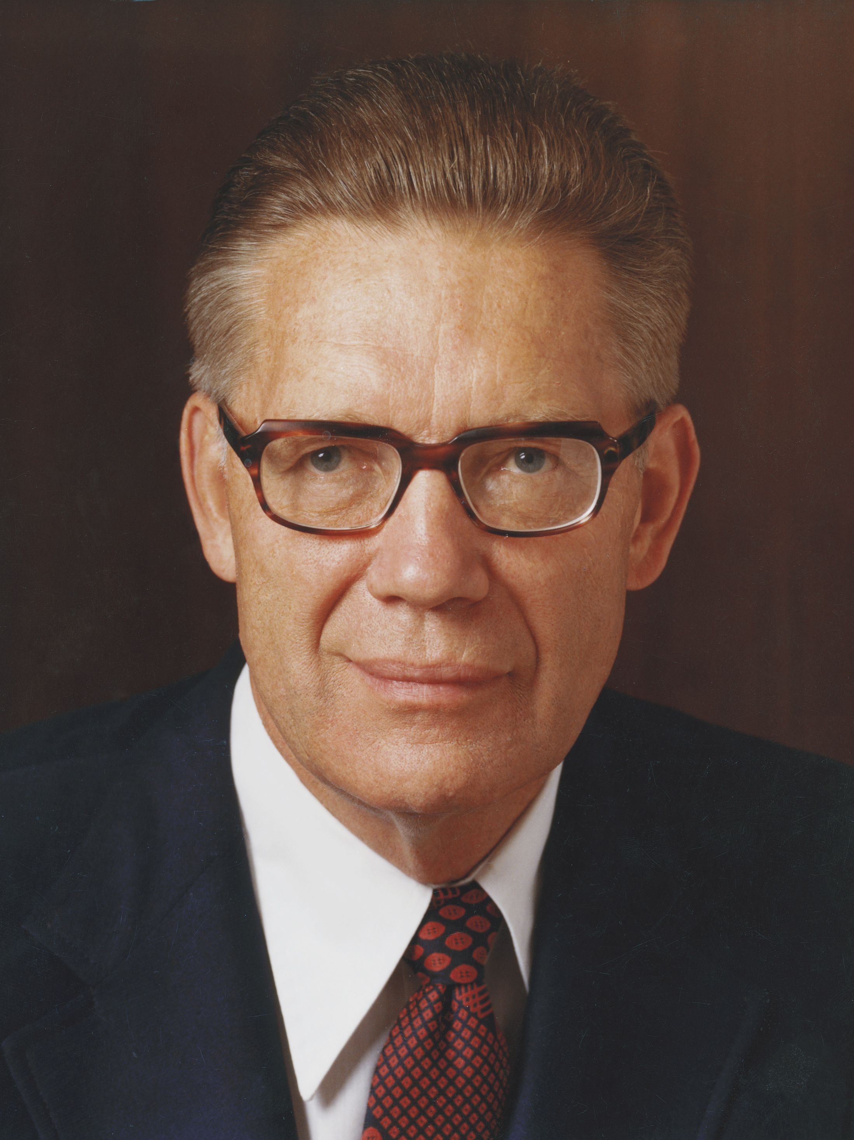
Elder Bruce R. McConkie
“Sins are remitted not in the waters of baptism, as we say in speaking figuratively, but when we receive the Holy Ghost. … We become clean when we actually receive the fellowship and companionship of the Holy Ghost. It is then that sin and dross and evil are burned out of our souls as though by fire. The baptism of the Holy Ghost is the baptism of fire” (Bruce R. McConkie, A New Witness for the Articles of Faith [1985], 290).

Slide 21
The Remission of Sins
Based on this statement from Elder McConkie, how would you explain the meaning of the phrase “then cometh a remission of your sins by fire and by the Holy Ghost” in 2 Nephi 31:17?

Slide 22
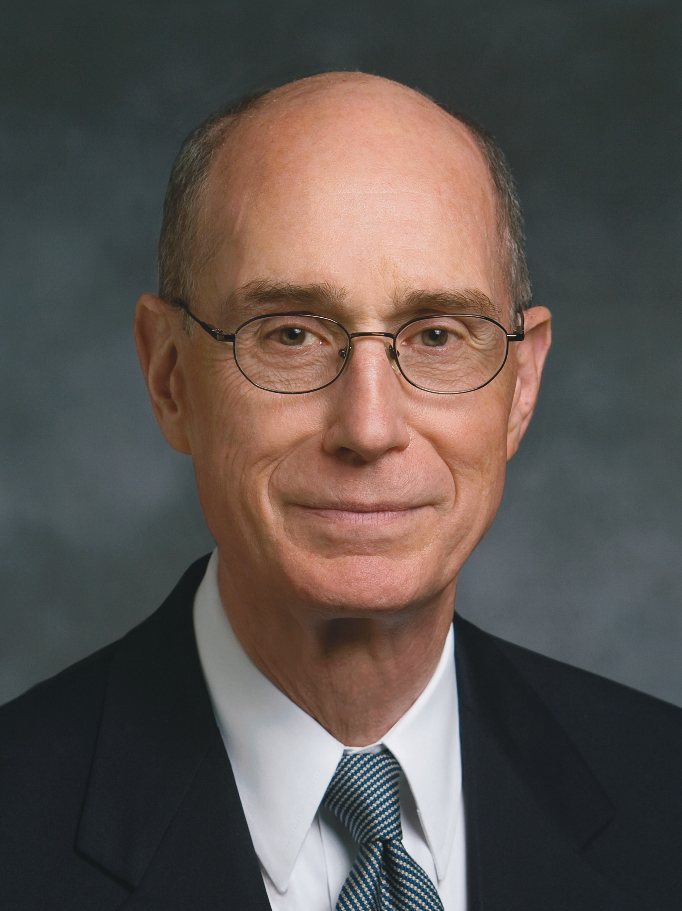
President Henry B. Eyring
“When [the Holy Ghost] is your companion, you can have confidence that the Atonement is working in your life. …
“Not only is your feeling the influence of the Holy Ghost a sign that the Atonement, the cure for sin, is working in your life, but you will also know that a preventative against sin is working” (Henry B. Eyring, “Come unto Christ” [Brigham Young University devotional, Oct. 29, 1989], speeches.byu.edu).

Slide 23
The Holy Ghost’s Influence
What are some ways we can recognize whether the Holy Ghost is our companion?

Slide 24
The Holy Ghost’s Influence
What are some ways we can recognize whether the Holy Ghost is our companion?
According to the statement by President Eyring, what can you know is happening when you feel the influence of the Holy Ghost in your life? Why is that helpful for you to know?

Slide 25
The Power of Purification
As you examine your life, consider how often you experience the influence of the Holy Ghost and what might be keeping you from enjoying it as often as you would like. Consider any changes you need to make so that you can enjoy the Spirit’s purifying influence.

Slide 26
The Strait and Narrow
In 2 Nephi 31:18, the word strait means narrow, strict, exacting, and allowing for no deviation. Nephi used this word to describe the path we must take after baptism in order to receive eternal life.

Slide 27
The Strait and Narrow
In 2 Nephi 31:18, the word strait means narrow, strict, exacting, and allowing for no deviation. Nephi used this word to describe the path we must take after baptism in order to receive eternal life.
Read 2 Nephi 31:15–16, 19–21, looking for words and phrases that explain what we must do to receive eternal life.

Slide 28
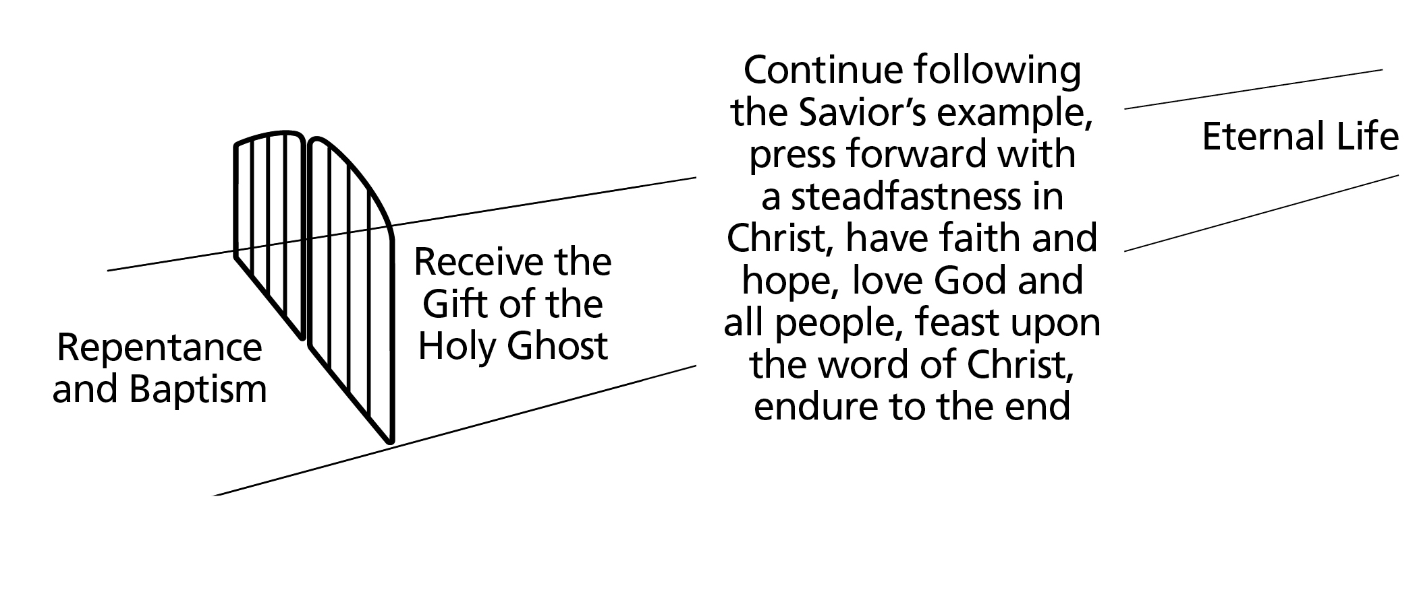
The Doctrine of Christ
If we live according to the doctrine of Christ, we will receive eternal life.

Slide 29
Enduring to the End
Why do you think enduring to the end is an important element of the doctrine of Christ?

Slide 30
Enduring to the End
Why do you think enduring to the end is an important element of the doctrine of Christ?
How is Jesus Christ an example of enduring to the end? Who else is an example for you of enduring to the end?

Slide 31
Enduring to the End
Why do you think enduring to the end is an important element of the doctrine of Christ?
How is Jesus Christ an example of enduring to the end? Who else is an example for you of enduring to the end?
What has helped you to press forward with a steadfastness in Christ and faithfully endure?

Slide 32
What Will I Do?
What do you feel impressed to do to more fully live according to the doctrine of Christ and to thereby progress toward eternal life?

Slide 33
Doctrinal Mastery: The Godhead
Jesus Christ’s life is the perfect example of how we are to live.

Slide 34
Doctrinal Mastery: The Godhead
Jesus Christ’s life is the perfect example of how we are to live.
In 3 Nephi 12:48, Jesus Christ continued teaching the Nephites after appearing to them. He explained how to come unto Him and what was required to enter the kingdom of heaven.

Slide 35
Doctrinal Mastery: The Godhead
Jesus Christ’s life is the perfect example of how we are to live.
In 3 Nephi 12:48, Jesus Christ continued teaching the Nephites after appearing to them. He explained how to come unto Him and what was required to enter the kingdom of heaven.
Read 3 Nephi 12:48, looking for the Savior’s commandment to the people.

Slide 36
Doctrinal Mastery: The Godhead
To be perfect in the way that the Savior commanded in 3 Nephi 12:48 means to become like Heavenly Father and Jesus Christ. As we strive to follow the Savior, we can become perfected through Him and His atoning sacrifice. It is important to remember that perfection is a process that continues into the next life.

Slide 37
Doctrinal Mastery: The Godhead
To be perfect in the way that the Savior commanded in 3 Nephi 12:48 means to become like Heavenly Father and Jesus Christ. As we strive to follow the Savior, we can become perfected through Him and His atoning sacrifice. It is important to remember that perfection is a process that continues into the next life.
What are some ways that you can be obedient to this commandment now?

