Slide 1
2 Nephi 28
Lesson 38

Slide 2

Devotional
Hymn:
Prayer:
Thought:

Slide 3
Learning about Opponents
What are some situations in which you would want to learn the goals and strategies of an opponent?

Slide 4
Learning about Opponents
What are some situations in which you would want to learn the goals and strategies of an opponent?
In these situations, where might you find this information?

Slide 5
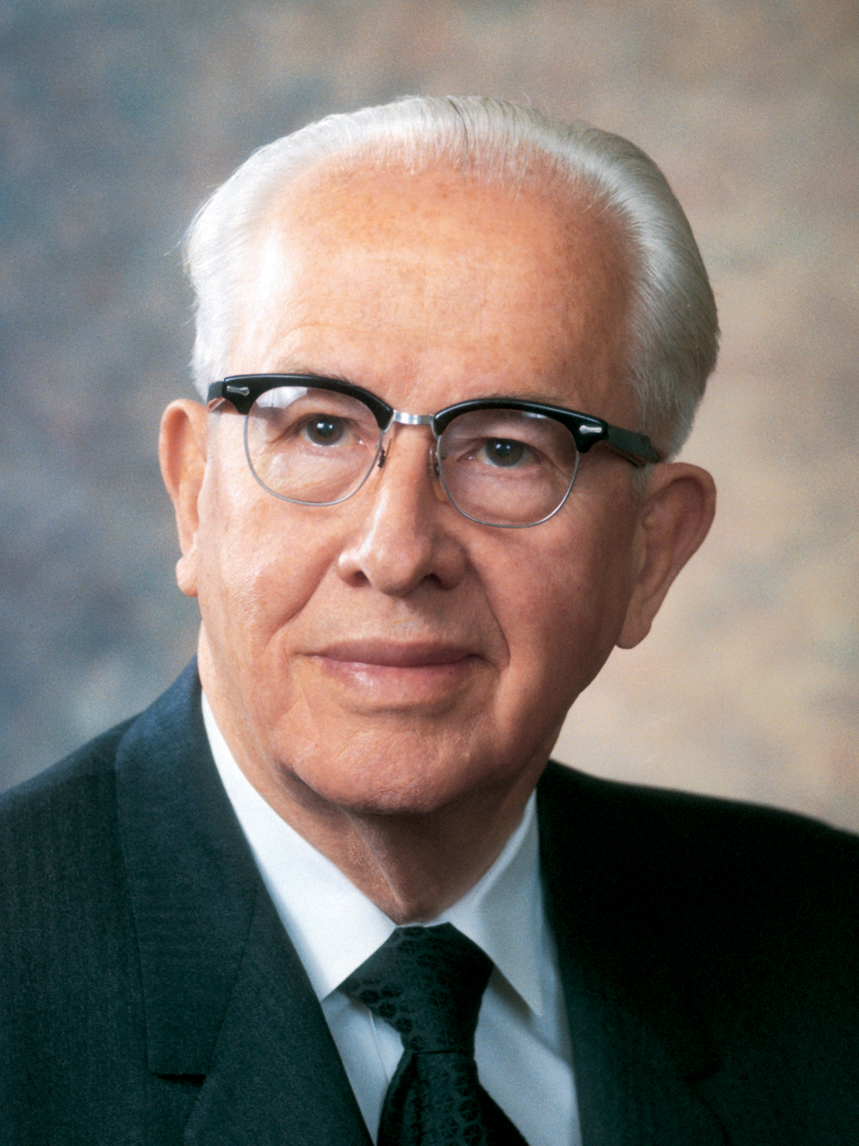
President Ezra Taft Benson
“The Book of Mormon exposes the enemies of Christ. It confounds false doctrines. … It fortifies the humble followers of Christ against the evil designs, strategies, and doctrines of the devil in our day” (Ezra Taft Benson, “The Book of Mormon Is the Word of God,” Ensign, Jan. 1988, 3).

Slide 6
President Ezra Taft Benson
“The Book of Mormon exposes the enemies of Christ. It confounds false doctrines. … It fortifies the humble followers of Christ against the evil designs, strategies, and doctrines of the devil in our day” (Ezra Taft Benson, “The Book of Mormon Is the Word of God,” Ensign, Jan. 1988, 3).
According to President Benson, how can the Book of Mormon help us in our war against Satan?

Slide 7
False Doctrines
Read 2 Nephi 28:3–9. What are some false doctrines you identified in these verses?

Slide 8
False Doctrines
Read 2 Nephi 28:3–9. What are some false doctrines you identified in these verses?
Why might these false doctrines be appealing to some people?

Slide 9
False Doctrines
Read 2 Nephi 28:3–9. What are some false doctrines you identified in these verses?
Why might these false doctrines be appealing to some people?
How do these false doctrines hinder people from following the plan of our Heavenly Father?

Slide 10
Justifying Sin
What are some situations in our day in which people might be tempted to justify sin in the ways described in 2 Nephi 28:8?

Slide 11
Justifying Sin
What are some situations in our day in which people might be tempted to justify sin in the ways described in 2 Nephi 28:8?
What is the danger in thinking that it is acceptable to commit “a little sin” (verse 8)?

Slide 12
Justifying Sin
What are some situations in our day in which people might be tempted to justify sin in the ways described in 2 Nephi 28:8?
What is the danger in thinking that it is acceptable to commit “a little sin” (verse 8)?
Read Doctrine and Covenants 1:31, looking for how the Lord corrects this misunderstanding. Write this reference next to 2 Nephi 28:8.

Slide 13
Churches in the Last Days
In 2 Nephi 28:12–19, Nephi said churches in the last days would become corrupted because of pride, false teachers, and false doctrine. In addition, Nephi warned that those who “pervert the right way of the Lord” (verse 15) will be thrust down to hell, but those who repent will not be destroyed (see verse 17).

Slide 14
Spiritual Crocodiles
While on an assignment in Africa, President Boyd K. Packer (1924–2015) of the Quorum of the Twelve Apostles went to see animals at a game reserve. Watch this video and listen for what surprised him on this visit.
https://www.lds.org/media-library/video/2010-06-13-spiritual-crocodiles?lang=eng

Slide 15
Spiritual Dangers
How can this account from President Packer help us better understand the spiritual dangers that surround us?

Slide 16
Spiritual Dangers
How can this account from President Packer help us better understand the spiritual dangers that surround us?
Read 2 Nephi 28:19–23, looking for what tactics Satan would use against us in the latter days.

Slide 17
Spiritual Dangers
How can this account from President Packer help us better understand the spiritual dangers that surround us?
Read 2 Nephi 28:19–23, looking for what tactics Satan would use against us in the latter days.
How would you complete this sentence? Satan seeks to grasp us by his power by _______________.

Slide 18
Being Carnal
Satan seeks to grasp us by his power by stirring us up to anger, pacifying us, lulling us away into carnal security, and flattering us.

Slide 19
Being Carnal
Satan seeks to grasp us by his power by stirring us up to anger, pacifying us, lulling us away into carnal security, and flattering us.
The word carnal refers to “something that is not spiritual” or that is “worldly” (Guide to the Scriptures, “Carnal,” scriptures.lds.org). To be lulled into carnal security means to trust in worldly things rather than trusting in the Lord.

Slide 20
Tactics of Satan
In what ways are the tactics of Satan similar to those of the crocodiles in President Packer’s story?

Slide 21
Guarding against Satan’s Efforts
What are some examples of Satan trying to “stir [people] up to anger against that which is good” (2 Nephi 28:20)? How does anger confuse people about what is good and what is evil?

Slide 22
Guarding against Satan’s Efforts
What are some examples of Satan trying to “stir [people] up to anger against that which is good” (2 Nephi 28:20)? How does anger confuse people about what is good and what is evil?
What are some things we can do to guard against anger?

Slide 23
Guarding against Satan’s Efforts
Why do you think it is dangerous for people to think that “all is well in Zion” (2 Nephi 28:21) and that no improvement is needed? Why do you think Satan is able to lead such people “carefully down to hell” (2 Nephi 28:21)?

Slide 24
Guarding against Satan’s Efforts
Why do you think it is dangerous for people to think that “all is well in Zion” (2 Nephi 28:21) and that no improvement is needed? Why do you think Satan is able to lead such people “carefully down to hell” (2 Nephi 28:21)?
How can we guard against the feeling that we do not need to improve?

Slide 25
Guarding against Satan’s Efforts
What are other ways Satan attempts to lull individuals into carnal security, or a false sense of safety and well-being?

Slide 26
Guarding against Satan’s Efforts
What are other ways Satan attempts to lull individuals into carnal security, or a false sense of safety and well-being?
What does it mean to flatter someone? Why do you think flattery can lead some people away from the Lord?

Slide 27
Guarding against Satan’s Efforts
What are other ways Satan attempts to lull individuals into carnal security, or a false sense of safety and well-being?
What does it mean to flatter someone? Why do you think flattery can lead some people away from the Lord?
Why would Satan try to convince people that he does not exist?

Slide 28
Guarding against Satan’s Efforts
What are other ways Satan attempts to lull individuals into carnal security, or a false sense of safety and well-being?
What does it mean to flatter someone? Why do you think flattery can lead some people away from the Lord?
Why would Satan try to convince people that he does not exist?
How can we guard against flattery?

Slide 29
How God Reveals Truth
In 2 Nephi 28:24–29, Nephi warned that those who give in to these devilish tactics will experience sorrow and suffering. He also prophesied that some people will say they “need no more of the word of God, for [they] have enough” (2 Nephi 28:29).

Slide 30
How God Reveals Truth
In 2 Nephi 28:24–29, Nephi warned that those who give in to these devilish tactics will experience sorrow and suffering. He also prophesied that some people will say they “need no more of the word of God, for [they] have enough” (2 Nephi 28:29).
Read 2 Nephi 28:30, looking for principles regarding how God reveals truth and the importance of our openness and responsiveness to His words. This verse is a doctrinal mastery passage.

Slide 31
Principles
God reveals truth line upon line, precept upon precept.
If we hearken to God’s precepts and counsel, we will learn wisdom.
If we receive God’s words, He will give us more.
If we believe that we do not need more of God’s words, we will lose those we already have.

Slide 32
Receiving God’s Words
What do you think it means that God teaches us “line upon line, precept upon precept”? In what ways have your understanding and testimony of the gospel grown little by little?

Slide 33
Receiving God’s Words
What do you think it means that God teaches us “line upon line, precept upon precept”? In what ways have your understanding and testimony of the gospel grown little by little?
What can we do to receive God’s words?

Slide 34
Come unto Him
In 2 Nephi 28:31–32, the Lord warned against trusting in the world and said He will be merciful to those who repent and come unto Him.

Slide 35
Come unto Him
In 2 Nephi 28:31–32, the Lord warned against trusting in the world and said He will be merciful to those who repent and come unto Him.
Set a goal to improve in your efforts to hearken to God’s words. Doing this can help you avoid falling victim to Satan’s tactics.

Slide 36
Doctrinal Mastery: The Godhead
In the last few lessons we have been studying these truths: God loves each of His children perfectly, and all are alike unto Him. Jesus Christ does the will of the Father in all things. He lived a sinless life and atoned for the sins of all mankind.

Slide 37
Doctrinal Mastery: The Godhead
In the last few lessons we have been studying these truths: God loves each of His children perfectly, and all are alike unto Him. Jesus Christ does the will of the Father in all things. He lived a sinless life and atoned for the sins of all mankind.
How does Jesus Christ’s atoning sacrifice illustrate God’s perfect love for each of His children and illustrate that all are alike unto Him?

