Slide 1
2 Nephi 27
Lesson 37

Slide 2

Devotional
Hymn:
Prayer:
Thought:

Slide 3
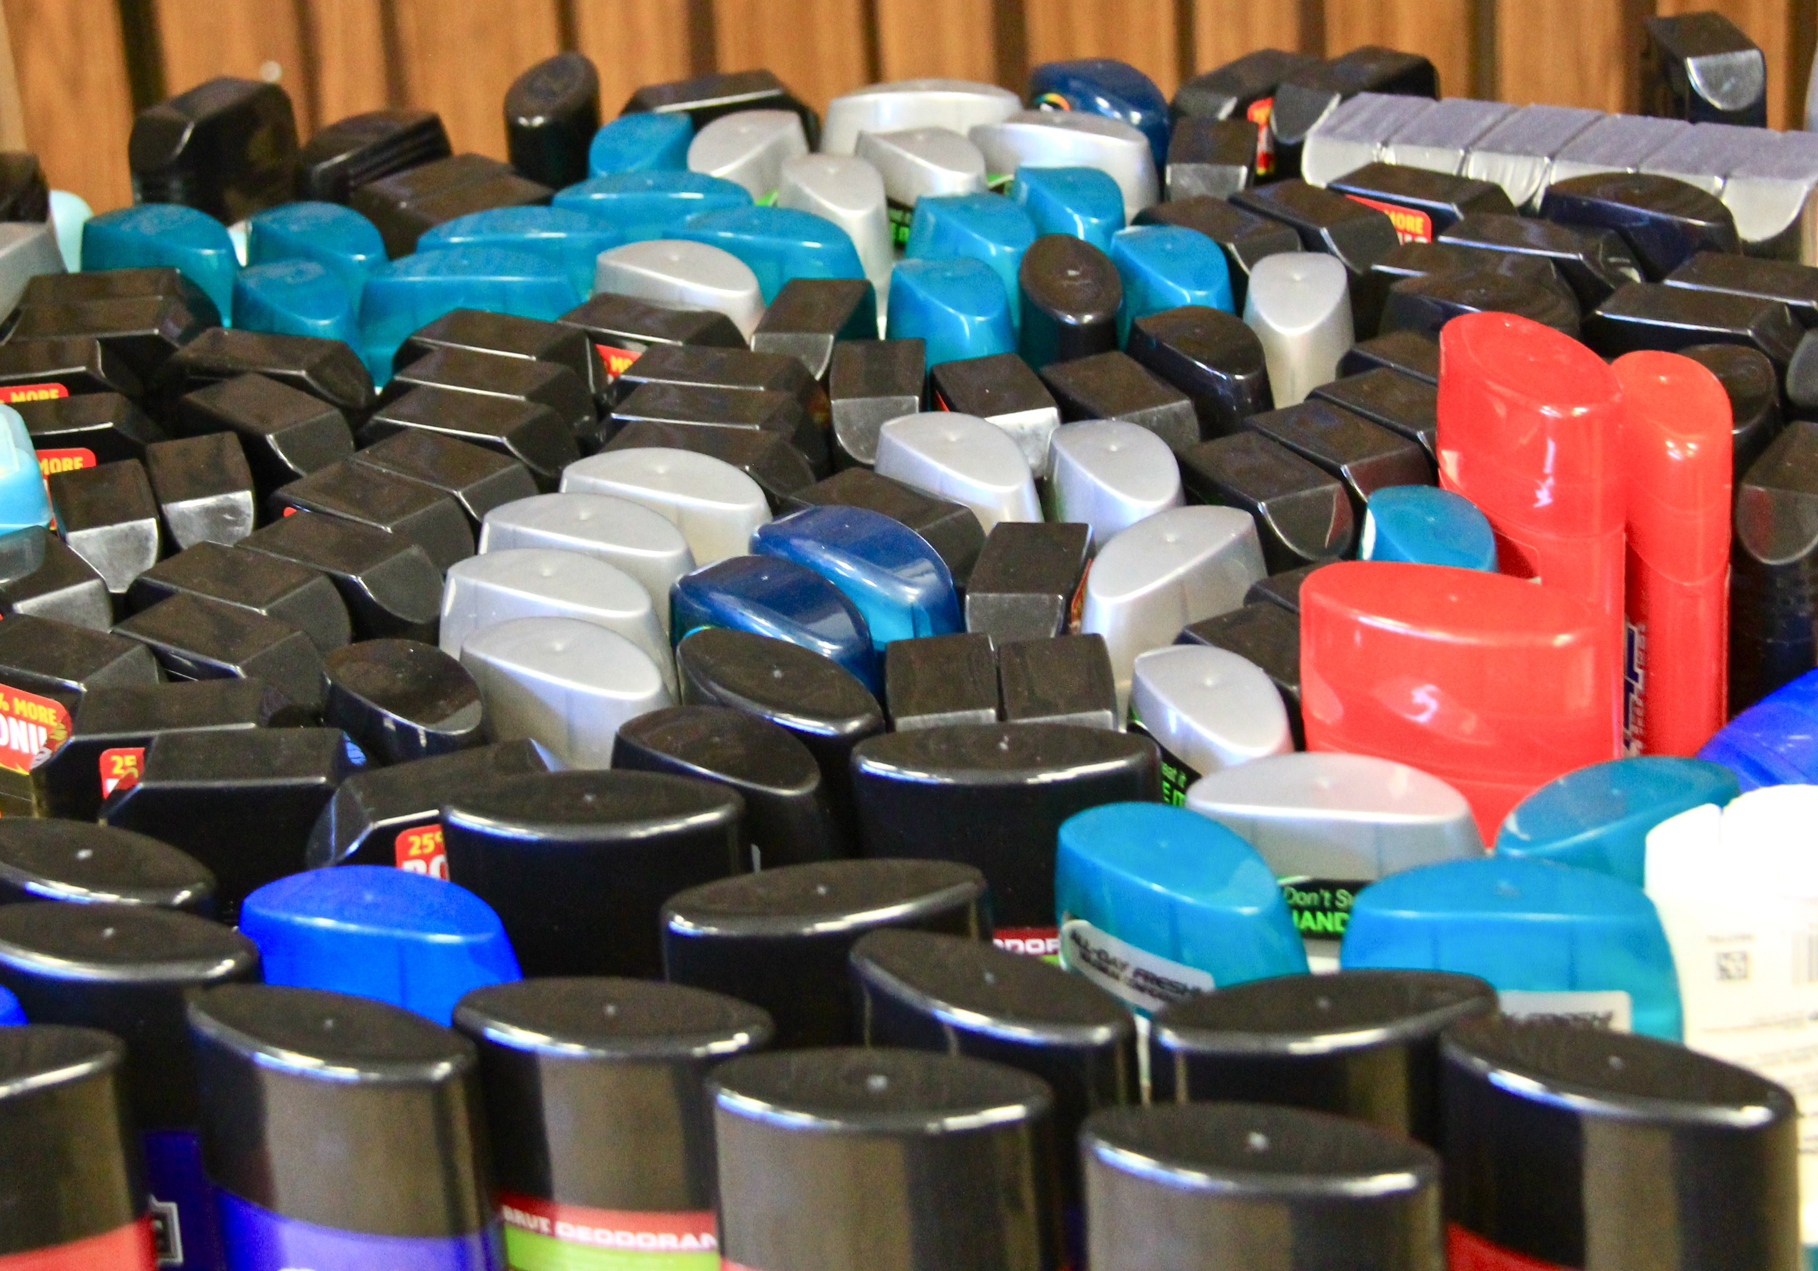

Solutions to Problems
Each item in this picture is intended to be a solution to a problem. What problem does each item intend to solve?

Slide 4
Solutions to Problems
Each item in this picture is intended to be a solution to a problem. What problem does each item intend to solve?
Nephi’s prophecy in 2 Nephi 27 records problems that would exist in our day and what God would do to solve these problems. A similar prophecy is found in Isaiah 29.

Slide 5
Problems of the Last Days
Read 2 Nephi 27:1–5 and look for words and phrases that describe some problems of the last days.

Slide 6
Problems of the Last Days
Read 2 Nephi 27:1–5 and look for words and phrases that describe some problems of the last days.
What do you think it means to be “drunken with iniquity” (verse 1)?

Slide 7
Problems of the Last Days
Read 2 Nephi 27:1–5 and look for words and phrases that describe some problems of the last days.
What do you think it means to be “drunken with iniquity” (verse 1)?
In 2 Nephi 27:3, we read that some people in the last days are likened to a hungry man who dreams of eating or a thirsty man who dreams of drinking but then awakens and feels his soul is empty. What can we learn from this?

Slide 8
No Lasting Satisfaction
Eating or drinking in a dream gives no lasting satisfaction and accomplishes nothing, since hunger or thirst remains after the dream. Likewise, those who “fight against Mount Zion,” or the Lord’s Church, will have no lasting satisfaction, nor will they accomplish anything meaningful.

Slide 9
No Lasting Satisfaction
Eating or drinking in a dream gives no lasting satisfaction and accomplishes nothing, since hunger or thirst remains after the dream. Likewise, those who “fight against Mount Zion,” or the Lord’s Church, will have no lasting satisfaction, nor will they accomplish anything meaningful.
What do you think the phrase “ye have closed your eyes” (2 Nephi 27:5) means?

Slide 10
A Gospel Truth
How would you summarize what you have learned in 2 Nephi 27:1–5?

Slide 11
A Gospel Truth
How would you summarize what you have learned in 2 Nephi 27:1–5?
In the last days, many people will be full of iniquity and will reject the prophets.

Slide 12
A Gospel Truth
How would you summarize what you have learned in 2 Nephi 27:1–5?
In the last days, many people will be full of iniquity and will reject the prophets.
In what ways do you see this prophecy being fulfilled in our day?

Slide 13
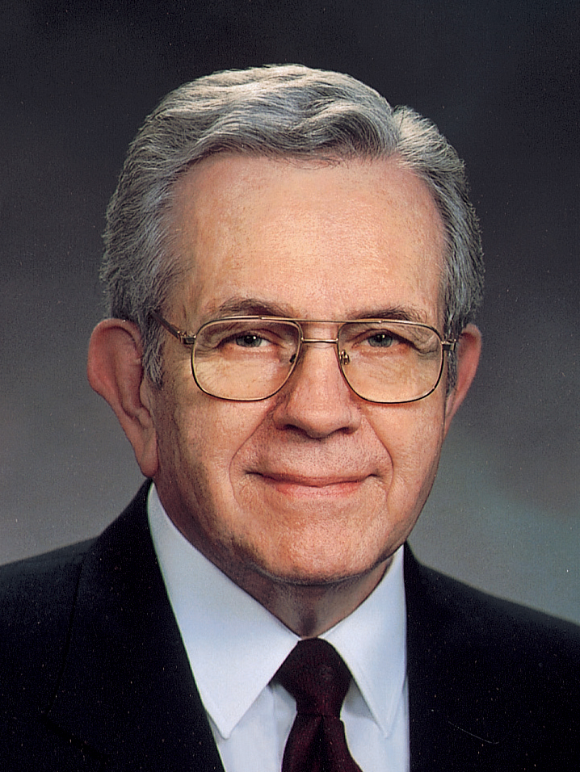
President Boyd K. Packer
“I know of nothing in the history of the Church or in the history of the world to compare with our present circumstances. Nothing happened in Sodom and Gomorrah which exceeds in wickedness and depravity that which surrounds us now.
Continued on the next page.

Slide 14
President Boyd K. Packer, cont.
“Words of profanity, vulgarity, and blasphemy are heard everywhere. Unspeakable wickedness and perversion were once hidden in dark places; now they are in the open, even accorded legal protection.
“At Sodom and Gomorrah these things were localized. Now they are spread across the world, and they are among us” (Boyd K. Packer, “The One Pure Defense” [evening with a General Authority, Feb. 6, 2004], 4).

Slide 15
Solving Spiritual Problems
Read 2 Nephi 27:6 and look for something the Lord would provide to help solve people’s spiritual problems in the last days.

Slide 16
Solving Spiritual Problems
Read 2 Nephi 27:6 and look for something the Lord would provide to help solve people’s spiritual problems in the last days.
What book do you think this verse is describing?

Slide 17
The Book of Mormon
The phrase “them which have slumbered” (2 Nephi 27:6) refers to the deceased prophets who kept the records that became the Book of Mormon. The Lord brought forth the Book of Mormon to help correct problems in the last days and to bring light to a darkened world.

Slide 18
The Book of Mormon
The phrase “them which have slumbered” (2 Nephi 27:6) refers to the deceased prophets who kept the records that became the Book of Mormon. The Lord brought forth the Book of Mormon to help correct problems in the last days and to bring light to a darkened world.
The Lord revealed to ancient prophets details concerning the coming forth of the Book of Mormon. Nephi recorded these details in 2 Nephi 27.

Slide 19
The Sealed Portion
In 2 Nephi 27:7–11 Nephi prophesied of the withholding and eventual coming forth of the sealed portion of the golden plates, which contains a revelation of “all things from the foundation of the world unto the end thereof” (verse 10).

Slide 20
Witnesses of the Book of Mormon
Read 2 Nephi 27:12–14 and look for who Nephi said would be permitted to see the book.

Slide 21
Witnesses of the Book of Mormon
Read 2 Nephi 27:12–14 and look for who Nephi said would be permitted to see the book.
Who were the three witnesses who were allowed to see the plates from which the Book of Mormon was translated?

Slide 22
Witnesses of the Book of Mormon
Read 2 Nephi 27:12–14 and look for who Nephi said would be permitted to see the book.
Who were the three witnesses who were allowed to see the plates from which the Book of Mormon was translated?
The other witnesses mentioned in verses 13–14 were the eight additional witnesses of the Book of Mormon.

Slide 23
Nephi’s Prophecy
A prophecy regarding the coming forth of the Book of Mormon is recorded in 2 Nephi 27:15–19, and its fulfillment is found in Joseph Smith—History 1:63–65.

Slide 24
Nephi’s Prophecy
A prophecy regarding the coming forth of the Book of Mormon is recorded in 2 Nephi 27:15–19, and its fulfillment is found in Joseph Smith—History 1:63–65.
Read 2 Nephi 27:15–19 and look for Nephi’s prophecy of what these men would do: the first man (“not learned”); the second man (“another”); the third man (“learned”).

Slide 25
Fulfillment of Prophecy
Read Joseph Smith—History 1:63–65 and identify the names of the men who fulfilled Nephi’s prophecy regarding the coming forth of the Book of Mormon. The word characters found in these verses refers to the writing engraved on the golden plates from which the Book of Mormon was translated.

Slide 26
Fulfillment of Prophecy
Read Joseph Smith—History 1:63–65 and identify the names of the men who fulfilled Nephi’s prophecy regarding the coming forth of the Book of Mormon. The word characters found in these verses refers to the writing engraved on the golden plates from which the Book of Mormon was translated.
If God had His choice of learned men to translate the Book of Mormon, why do you think He chose Joseph Smith, who was “not learned” (2 Nephi 27:19)?

Slide 27
Joseph Smith
Read 2 Nephi 27:20–21, looking for a reason why God chose someone who was not learned to translate the Book of Mormon.

Slide 28
Joseph Smith
Read 2 Nephi 27:20–21, looking for a reason why God chose someone who was not learned to translate the Book of Mormon.
What does the phrase “I am able to do mine own work” (verse 20) mean to you?

Slide 29
Joseph Smith
Read 2 Nephi 27:20–21, looking for a reason why God chose someone who was not learned to translate the Book of Mormon.
What does the phrase “I am able to do mine own work” (verse 20) mean to you?
What does this phrase indicate about how God would bring forth the Book of Mormon through Joseph Smith?

Slide 30
Joseph Smith
By the gift and power of God, Joseph Smith translated the Book of Mormon.

Slide 31
The Book of Mormon Translation
The Lord provided instruments—the Urim and Thummim, which had been buried with the plates—to assist Joseph Smith in translating the Book of Mormon. Joseph’s wife Emma and others reported that Joseph at times also used a small oval stone, referred to as a seer stone, to assist in translating portions of the Book of Mormon.

Slide 32
By the Gift and Power of God
When Joseph Smith was asked for specifics about the process of translation, he testified that it had been done “by the gift and power of God” (see “Book of Mormon Translation,” Gospel Topics, topics.lds.org).

Slide 33
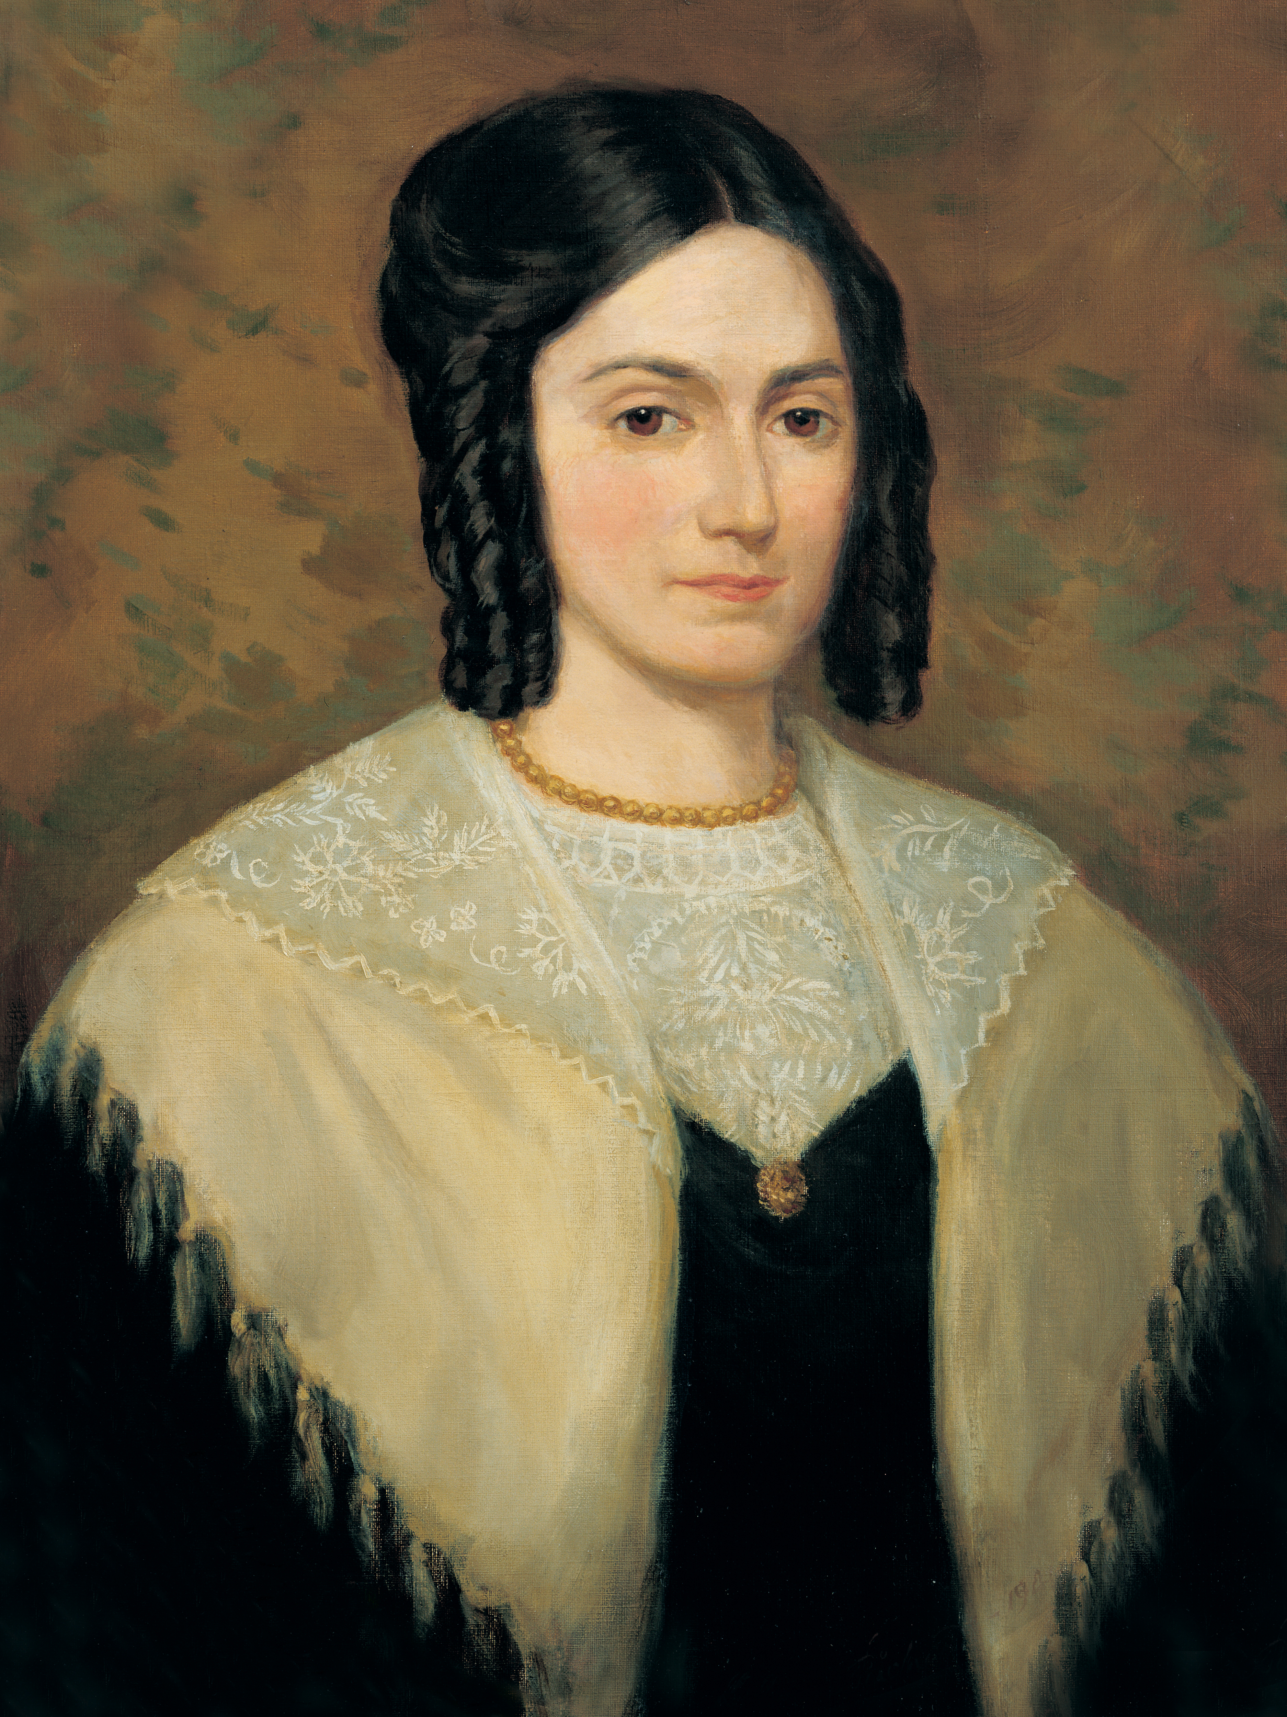
Emma Smith
“Joseph Smith could neither write nor dictate a coherent and well-worded letter; let alone [dictate] a book like the Book of Mormon. …
“My belief is that the Book of Mormon is of divine authenticity—I have not the slightest doubt of it.
Continued on the next page.

Slide 34
Emma Smith, cont.
“I am satisfied that no man could have dictated the writing of the manuscripts unless he was inspired; for, when acting as his scribe, [he] would dictate to me hour after hour; and when returning after meals, or after interruptions, he would at once begin where he had left off, without either seeing the manuscript or having any portion of it read to him.
Continued on the next page.

Slide 35
Emma Smith, cont.
“This was a usual thing for him to do. It would have been improbable that a learned man could do this; and, for one so ignorant and unlearned as he was, it was simply impossible” (“Last Testimony of Sister Emma,” The Saints’ Herald, vol. 26, no. 19 [Oct. 1, 1879], 290).

Slide 36
A Testimony of the Translation
Why is it important to know that Joseph Smith translated the Book of Mormon by the gift and power of God?

Slide 37
Spiritual Problems in the Last Days
Read 2 Nephi 27:25–26, looking for additional spiritual problems that Isaiah and Nephi prophesied would exist in the latter days.

Slide 38
Spiritual Problems in the Last Days
Read 2 Nephi 27:25–26, looking for additional spiritual problems that Isaiah and Nephi prophesied would exist in the latter days.
According to verse 26, what did the Lord say He would do to help overcome these problems?

Slide 39
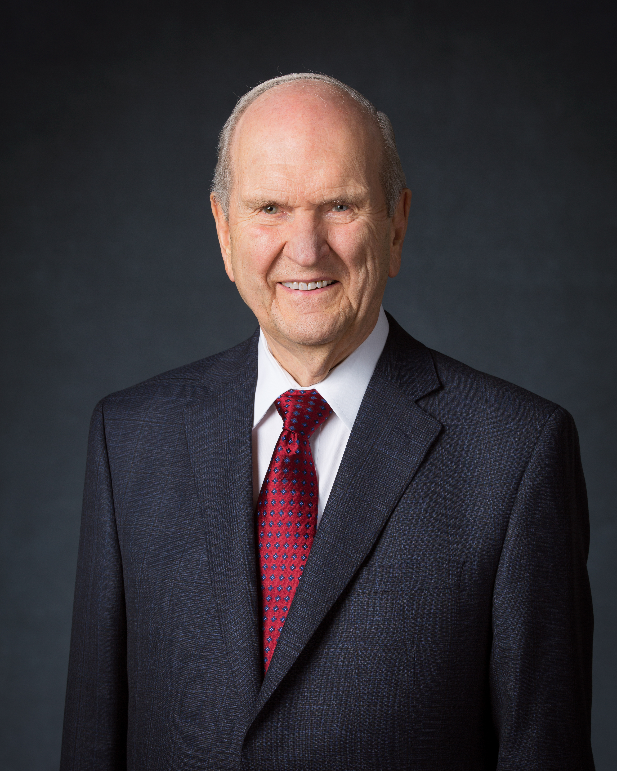
President Russell M. Nelson
“ [This] marvelous work would include the coming forth of the Book of Mormon and the Restoration of the gospel” (“Scriptural Witnesses,” Ensign or Liahona, Nov. 2007, 46).

Slide 40
A Marvelous Work
The Restoration of the gospel, including the coming forth of the Book of Mormon, is a marvelous work and a wonder.

Slide 41
A Marvelous Work
The Restoration of the gospel, including the coming forth of the Book of Mormon, is a marvelous work and a wonder.
What about the Restoration of the gospel and the coming forth of the Book of Mormon can be considered “marvelous” and “a wonder” (2 Nephi 27:26)?

Slide 42
A Marvelous Work
The Restoration of the gospel, including the coming forth of the Book of Mormon, is a marvelous work and a wonder.
What about the Restoration of the gospel and the coming forth of the Book of Mormon can be considered “marvelous” and “a wonder” (2 Nephi 27:26)?
How does studying the Book of Mormon help you overcome the spiritual challenges and wickedness that you encounter?

Slide 43
Studying the Book of Mormon
In 2 Nephi 27:29–35, Nephi testified that the Book of Mormon would help people gain spiritual sight and learn true doctrine.

Slide 44
Studying the Book of Mormon
In 2 Nephi 27:29–35, Nephi testified that the Book of Mormon would help people gain spiritual sight and learn true doctrine.
How does studying the Book of Mormon help you and others overcome spiritual challenges and wickedness?

Slide 45
Doctrinal Mastery: The Godhead
Match the Truth
Doctrinal Mastery Passage
God loves each of His children perfectly, and all are alike unto Him.
Jesus Christ does the will of the Father in all things.
Jesus Christ lived a sinless life and atoned for the sins of all mankind.
3 Nephi 12:48
2 Nephi 26:33
3 Nephi 11:10–11

