Slide 1
2 Nephi 25
Lesson 35

Slide 2
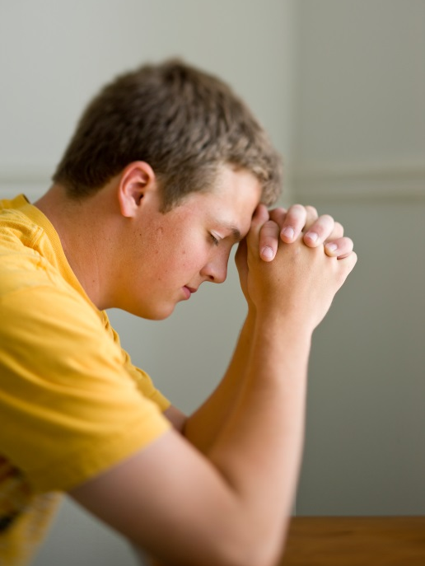
Devotional
Hymn:
Prayer:
Thought:
Notes:
738194

Slide 3
Persuading Others
When have you or someone you know tried to persuade someone to do something they weren’t already doing on their own but that would have benefitted them?

Slide 4
Persuading Others
When have you or someone you know tried to persuade someone to do something they weren’t already doing on their own but that would have benefitted them?
In the example you thought of, what might be a reason why the individual did not do the task on his or her own?

Slide 5
Persuading Others
When have you or someone you know tried to persuade someone to do something they weren’t already doing on their own but that would have benefitted them?
In the example you thought of, what might be a reason why the individual did not do the task on his or her own?
What can keep people from choosing to believe in Jesus Christ?

Slide 6
The Words of Isaiah
Remember that 2 Nephi 12–24 includes some of the words of Isaiah, as recorded by Nephi. In 2 Nephi 25:1–10, Nephi taught that the spirit of prophecy enables people to understand the words of Isaiah. Nephi also testified that the judgments of God come upon all nations according to God’s word and that the Jews had never been destroyed unless God’s prophets had first warned them against iniquity and called them to repentance.

Slide 7
After Captivity
Read 2 Nephi 25:12–15, looking for what the Jews would experience after being restored to their lands following their captivity in Babylon.

Slide 8
After Captivity
Read 2 Nephi 25:12–15, looking for what the Jews would experience after being restored to their lands following their captivity in Babylon.
According to verse 12, who would manifest Himself to the Jews after they returned to the land of Jerusalem?

Slide 9
After Captivity
Read 2 Nephi 25:12–15, looking for what the Jews would experience after being restored to their lands following their captivity in Babylon.
According to verse 12, who would manifest Himself to the Jews after they returned to the land of Jerusalem?
How would the Jews respond to the Savior?

Slide 10
After Captivity
Read 2 Nephi 25:12–15, looking for what the Jews would experience after being restored to their lands following their captivity in Babylon.
According to verse 12, who would manifest Himself to the Jews after they returned to the land of Jerusalem?
How would the Jews respond to the Savior?
What judgments would come upon the Jews as a result of rejecting the Savior and fighting against His disciples?

Slide 11
The Messiah
Read 2 Nephi 25:16, looking for when the Jews would cease to be scattered and scourged. The title Messiah means “the anointed Prophet, Priest, King, and Deliverer” (Guide to the Scriptures, “Messiah,” scriptures.lds.org).

Slide 12
The Messiah
Read 2 Nephi 25:16, looking for when the Jews would cease to be scattered and scourged. The title Messiah means “the anointed Prophet, Priest, King, and Deliverer” (Guide to the Scriptures, “Messiah,” scriptures.lds.org).
When Jesus Christ lived among the Jews during His mortal ministry, why did many Jews not believe He was the promised Messiah?

Slide 13
Jesus, the Messiah
Many of the Jews during the mortal ministry of Christ did not believe Jesus was the Messiah because they “were looking only for a deliverer from the Roman power and for a greater national prosperity; thus, when the Messiah came, the leaders and many others rejected him” (Guide to the Scriptures, “Messiah,” scriptures.lds.org).

Slide 14
Jesus, the Messiah
Many of the Jews during the mortal ministry of Christ did not believe Jesus was the Messiah because they “were looking only for a deliverer from the Roman power and for a greater national prosperity; thus, when the Messiah came, the leaders and many others rejected him” (Guide to the Scriptures, “Messiah,” scriptures.lds.org).
Read 2 Nephi 25:18, looking for what Nephi said the Lord would do to convince the Jews of the true Messiah.

Slide 15
The Book of Mormon
The words Nephi refers to in 2 Nephi 25:18 include the words of the Book of Mormon. These words were written “to the convincing of the Jew and Gentile that Jesus is the Christ” (title page of the Book of Mormon). In 2 Nephi 25:19 Nephi declared that the name of the true Messiah “shall be Jesus Christ, the Son of God.”

Slide 16
The Importance of Jesus Christ
Read 2 Nephi 25:20, looking for what Nephi taught about the importance of Jesus Christ.

Slide 17
The Importance of Jesus Christ
Read 2 Nephi 25:20, looking for what Nephi taught about the importance of Jesus Christ.
As declared by Nephi in verse 20, what truth do we learn about Jesus Christ?

Slide 18
The Importance of Jesus Christ
Read 2 Nephi 25:20, looking for what Nephi taught about the importance of Jesus Christ.
As declared by Nephi in verse 20, what truth do we learn about Jesus Christ?
Jesus Christ is the only name whereby we can be saved.

Slide 19
The Only Name
In the scriptures, the word name can be used to represent a person or to represent his or her power or authority. Thus, another way of saying that “Jesus Christ is the only name whereby we can be saved” is “Jesus Christ is the only person with the power to save us,” or “Jesus Christ is the only person who can save us.”

Slide 20
Choosing to Believe
Think again of the person you know who may need help choosing to believe in Jesus Christ. How would you explain to this person why Jesus Christ is the only name by which we can be saved?

Slide 21
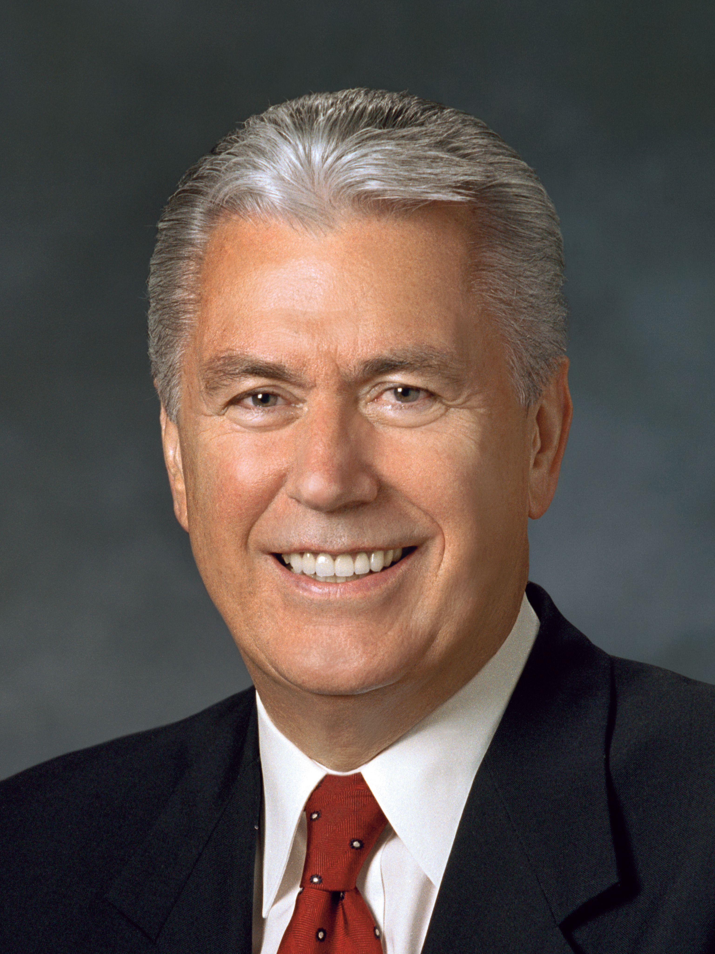
President Dieter F. Uchtdorf
“Many people feel discouraged because they constantly fall short. They know firsthand that ‘the spirit indeed is willing, but the flesh is weak’ [Matthew 26:41; see also Romans 7:19]. They raise their voices with Nephi in proclaiming, ‘My soul grieveth because of mine iniquities’ [2 Nephi 4:17]” (Dieter F. Uchtdorf, “The Gift of Grace,” Ensign or Liahona, May 2015, 110).

Slide 22
Feeling Discouraged?
Think of times when you may have felt discouraged because of your weaknesses or sins. Why is it easy to feel discouraged at times because of our weaknesses or sins?

Slide 23
The Writings of Nephi
In 2 Nephi 25:21–22, Nephi prophesied that his writings would be passed down to subsequent generations who would be judged by what those writings contained.

Slide 24
The Writings of Nephi
In 2 Nephi 25:21–22, Nephi prophesied that his writings would be passed down to subsequent generations who would be judged by what those writings contained.
Read 2 Nephi 25:23, looking for why Nephi and others “[labored] diligently to write.”

Slide 25
The Writings of Nephi
In 2 Nephi 25:21–22, Nephi prophesied that his writings would be passed down to subsequent generations who would be judged by what those writings contained.
Read 2 Nephi 25:23, looking for why Nephi and others “[labored] diligently to write.”
What do you think it means to be “reconciled to God”?

Slide 26
Grace
Grace is a gift from Heavenly Father given through His Son, Jesus Christ. The word grace, as used in the scriptures, refers primarily to enabling power and spiritual healing offered through the mercy and love of Jesus Christ (see Bible Dictionary, “Grace”).

Slide 27
Grace
Grace is a gift from Heavenly Father given through His Son, Jesus Christ. The word grace, as used in the scriptures, refers primarily to enabling power and spiritual healing offered through the mercy and love of Jesus Christ (see Bible Dictionary, “Grace”).
In what ways might we experience the grace of Jesus Christ?

Slide 28
The Grace of Jesus Christ
What truth can we learn from 2 Nephi 25:23 about the grace of Jesus Christ?

Slide 29
The Grace of Jesus Christ
What truth can we learn from 2 Nephi 25:23 about the grace of Jesus Christ?
We are saved by the grace of Jesus Christ, after all we can do.

Slide 30
The Grace of Jesus Christ
What truth can we learn from 2 Nephi 25:23 about the grace of Jesus Christ?
We are saved by the grace of Jesus Christ, after all we can do.
What do you think the phrase “after all we can do” means?

Slide 31
President Dieter F. Uchtdorf
“I wonder if sometimes we misinterpret the phrase ‘after all we can do.’ We must understand that ‘after’ does not equal ‘because.’
“We are not saved ‘because’ of all that we can do. Have any of us done all that we can do? Does God wait until we’ve expended every effort before He will intervene in our lives with His saving grace?” (Dieter F. Uchtdorf, “The Gift of Grace,” 110).

Slide 32
President Dieter F. Uchtdorf
“I wonder if sometimes we misinterpret the phrase ‘after all we can do.’ We must understand that ‘after’ does not equal ‘because.’
“We are not saved ‘because’ of all that we can do. Have any of us done all that we can do? Does God wait until we’ve expended every effort before He will intervene in our lives with His saving grace?” (Dieter F. Uchtdorf, “The Gift of Grace,” 110).
How might this teaching from President Uchtdorf help those who feel they must be perfect before they can receive God’s grace?

Slide 33
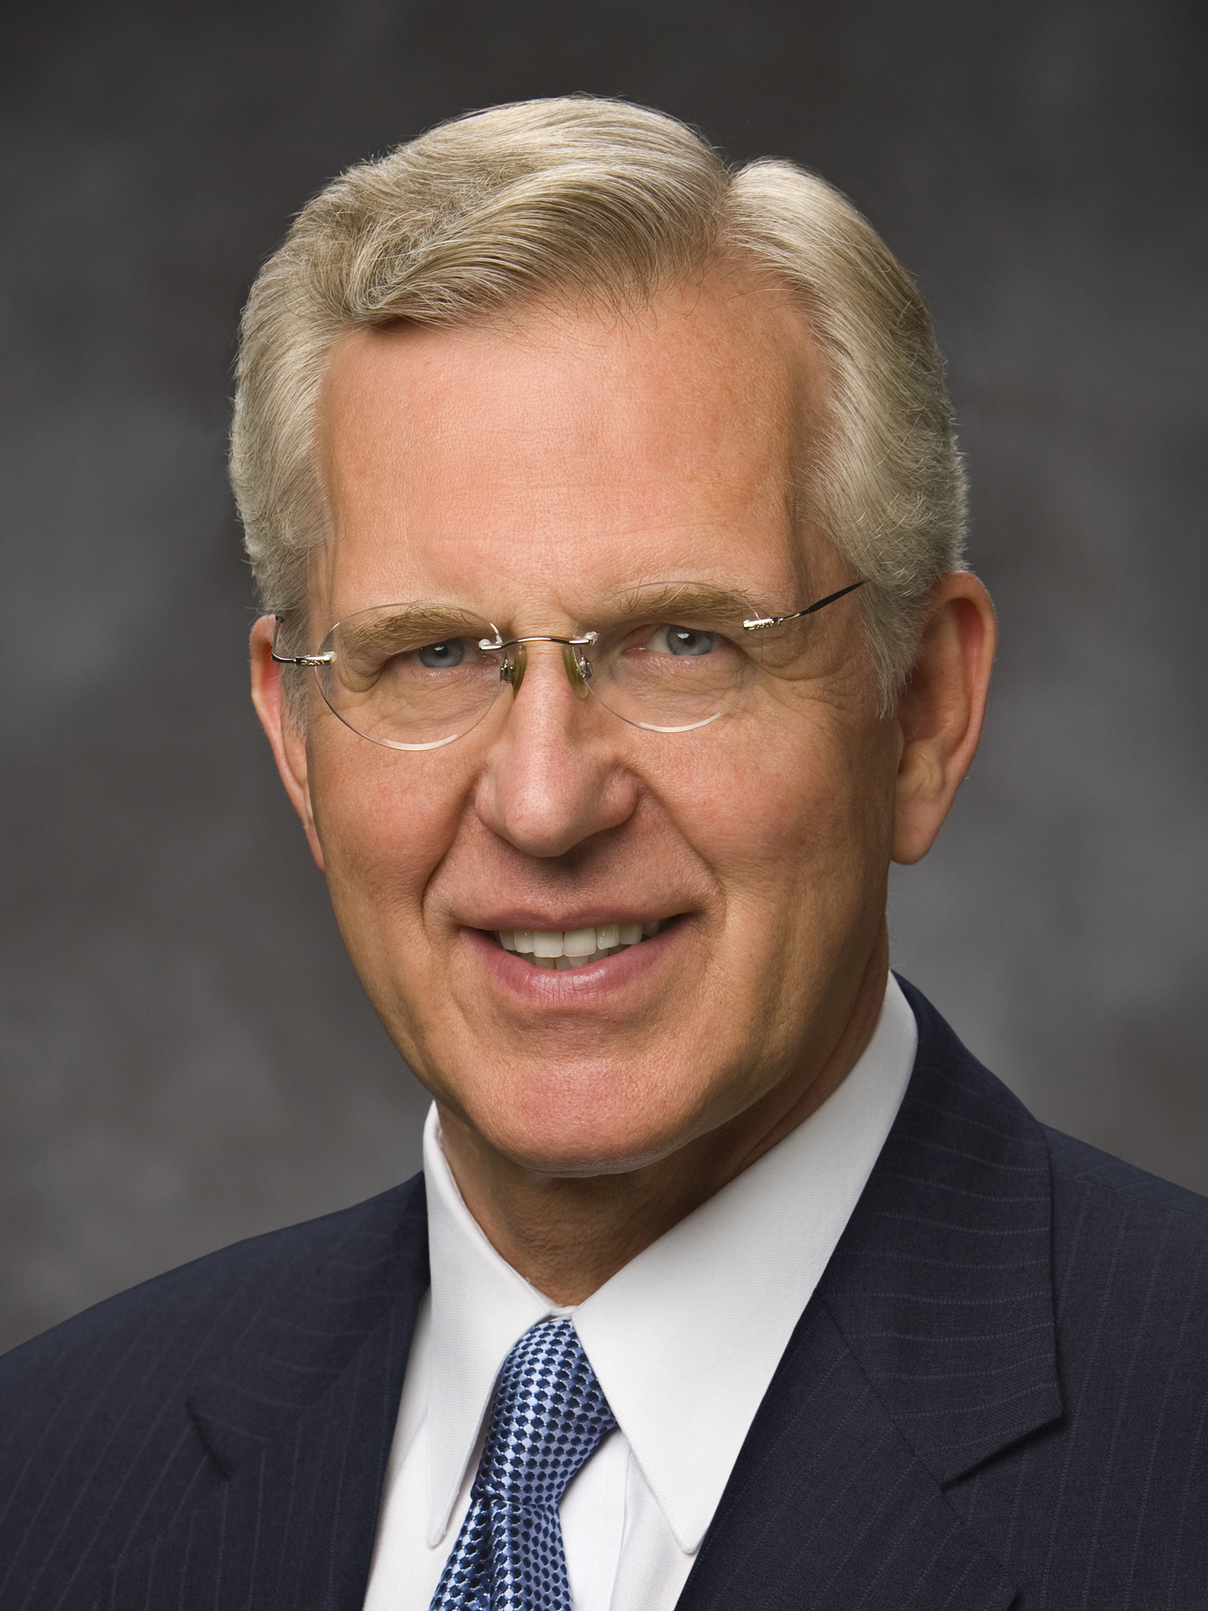
Elder D. Todd Christofferson
“We do not need to achieve some minimum level of capacity or goodness before God will help—divine aid can be ours every hour of every day, no matter where we are in the path of obedience. But I know that beyond desiring His help, we must exert ourselves, repent, and choose God for Him to be able to act in our lives consistent with justice and moral agency” (D. Todd Christofferson, “Free Forever, to Act for Themselves,” Ensign or Liahona, Nov. 2014, 19).

Slide 34
Elder D. Todd Christofferson
According to Elder Christofferson, what can we do to more consistently receive God’s help in our lives?

Slide 35
Katie’s Story
Watch and listen to Katie’s story. What did she do in order to experience the grace of Jesus Christ?
https://www.lds.org/media-library/video/2015-01-002-his-grace-unplanned-pregnancy-adoption-and-the-best-gift-ever?lang=eng

Slide 36
The Savior’s Grace
What will you do to seek and rely on the Savior’s grace?

Slide 37
2 Nephi 25:24–25
In 2 Nephi 25:24–25 Nephi and others knew that the law of Moses would be fulfilled through the Atonement of Jesus Christ. The Savior’s disciples would eventually no longer be required to keep it. However, the faithful Nephites continued to obey the law at this time. They knew the law pointed them to Jesus Christ, who would bring them salvation.

Slide 38
During the Time of Moses
Imagine that you were living among the Israelites at the time of Moses when the people were bitten by poisonous serpents. What would you have done to convince the snakebitten Israelites to look at the serpent that Moses placed before them?

Slide 39
During the Time of Moses
Imagine that you were living among the Israelites at the time of Moses when the people were bitten by poisonous serpents. What would you have done to convince the snakebitten Israelites to look at the serpent that Moses placed before them?
In what ways could the poisonous snakebites be compared to our sins?

Slide 40
Look to the Savior
Read 2 Nephi 25:26, looking for what Nephi said he and others did to help their posterity look to the Savior for a remission of their sins.

Slide 41
Look to the Savior
Read 2 Nephi 25:26, looking for what Nephi said he and others did to help their posterity look to the Savior for a remission of their sins.
By talking of, testifying of, and rejoicing in Jesus Christ, we can help others look to Him for a remission of their sins.

Slide 42
Look to the Savior
Read 2 Nephi 25:26, looking for what Nephi said he and others did to help their posterity look to the Savior for a remission of their sins.
By talking of, testifying of, and rejoicing in Jesus Christ, we can help others look to Him for a remission of their sins.
What do you think it means to “rejoice in Christ”?

Slide 43
Look to the Savior
Read 2 Nephi 25:26, looking for what Nephi said he and others did to help their posterity look to the Savior for a remission of their sins.
By talking of, testifying of, and rejoicing in Jesus Christ, we can help others look to Him for a remission of their sins.
What do you think it means to “rejoice in Christ”?
What are some examples of how our efforts to talk of, testify of, and rejoice in Jesus Christ can help others look to Him as their Savior?

Slide 44
Nephi’s Counsel
Read 2 Nephi 25:28–29, looking for what Nephi counseled his people to do.

Slide 45
Nephi’s Counsel
Read 2 Nephi 25:28–29, looking for what Nephi counseled his people to do.
What did Nephi describe as “the right way”?

Slide 46
Nephi’s Counsel
Read 2 Nephi 25:28–29, looking for what Nephi counseled his people to do.
What did Nephi describe as “the right way”?
Based on the truths you have learned from 2 Nephi 25, why is believing in Jesus Christ “the right way”?

Slide 47
Nephi’s Counsel
Read 2 Nephi 25:28–29, looking for what Nephi counseled his people to do.
What did Nephi describe as “the right way”?
Based on the truths you have learned from 2 Nephi 25, why is believing in Jesus Christ “the right way”?
What are some ways you are seeking to follow Nephi’s counsel in verse 29 to “believe in Christ” and “worship him with … your whole soul”?

Slide 48
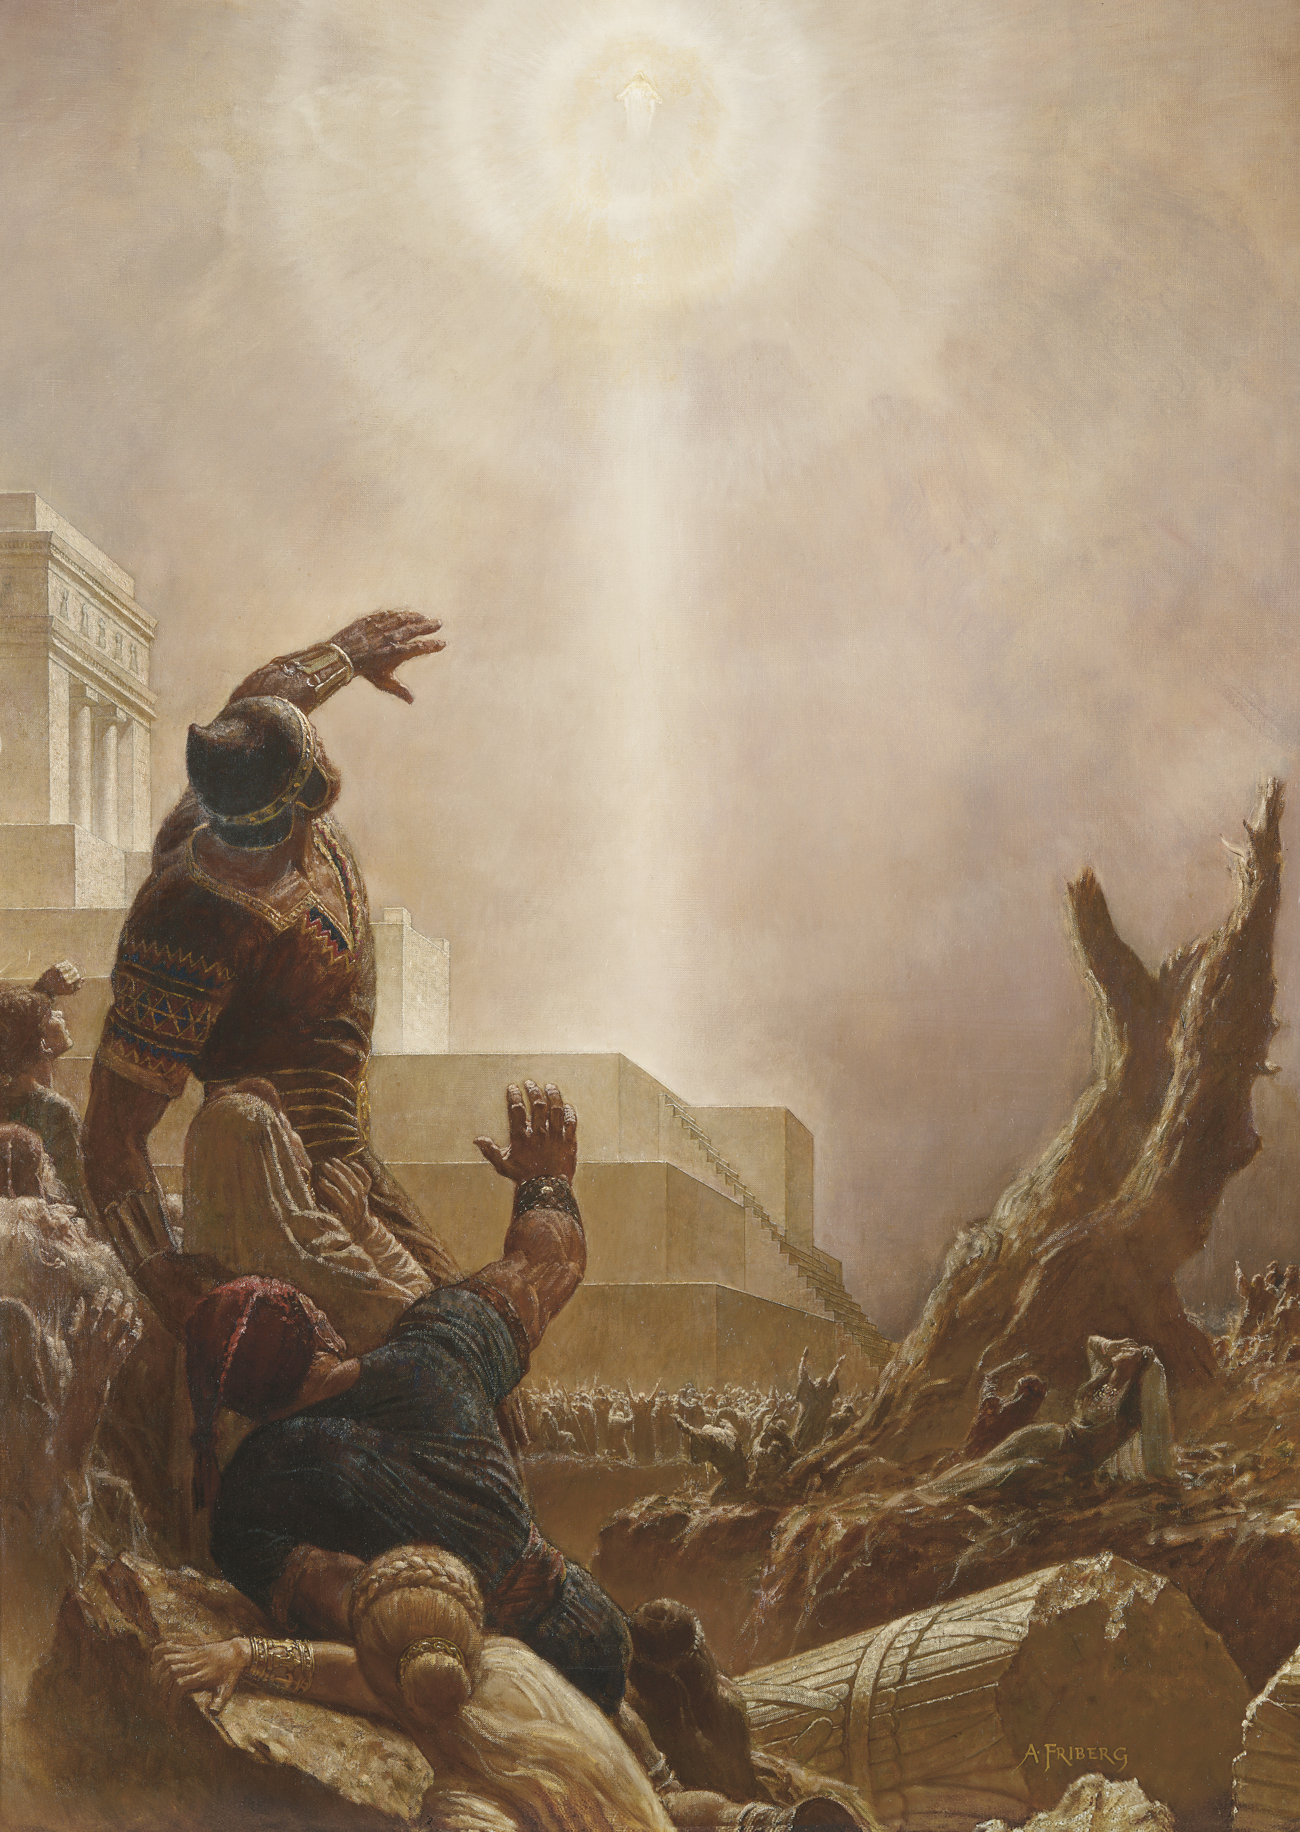
Doctrinal Mastery: The Godhead
What scriptural account is depicted in this image?

Slide 49
Doctrinal Mastery: The Godhead
What scriptural account is depicted in this image?
Read 3 Nephi 11:10–11. These verses contain the first words Jesus spoke to the Nephites when He appeared to them. This is a doctrinal mastery passage.

Slide 50
Doctrinal Mastery: The Godhead
What scriptural account is depicted in this image?
Read 3 Nephi 11:10–11. These verses contain the first words Jesus spoke to the Nephites when He appeared to them. This is a doctrinal mastery passage.
What truths did the Savior teach the Nephites about Himself?

Slide 51
Doctrinal Mastery: The Godhead
The Lord’s declaration “I have drunk out of that bitter cup” (3 Nephi 11:11) refers to the bitterness of the suffering He endured during His atoning sacrifice.

Slide 52
Doctrinal Mastery: The Godhead
The Lord’s declaration “I have drunk out of that bitter cup” (3 Nephi 11:11) refers to the bitterness of the suffering He endured during His atoning sacrifice.
Jesus Christ does the will of the Father in all things, and Jesus Christ lived a sinless life and atoned for the sins of all mankind.

