Slide 1
2 Nephi 17–20
Lesson 33

Slide 2
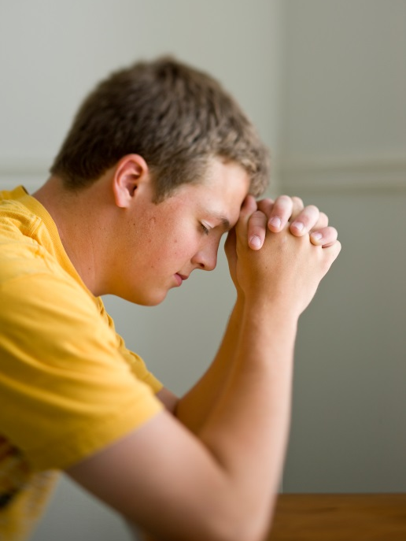
Devotional
Hymn:
Prayer:
Thought:
Notes:
738194

Slide 3
A Scenario
Imagine a professional sports team playing a game against a local team (such as your school’s team) of the same sport. What words describe the feelings that members of the local team might have if they competed against the professional team?

Slide 4
A Scenario
Imagine a professional sports team playing a game against a local team (such as your school’s team) of the same sport. What words describe the feelings that members of the local team might have if they competed against the professional team?
Think about experiences you have had when you felt overwhelmed, intimidated, or fearful. As you study 2 Nephi 17–20 today, look for truths that can help you when you are in situations where you might have these feelings.

Slide 5
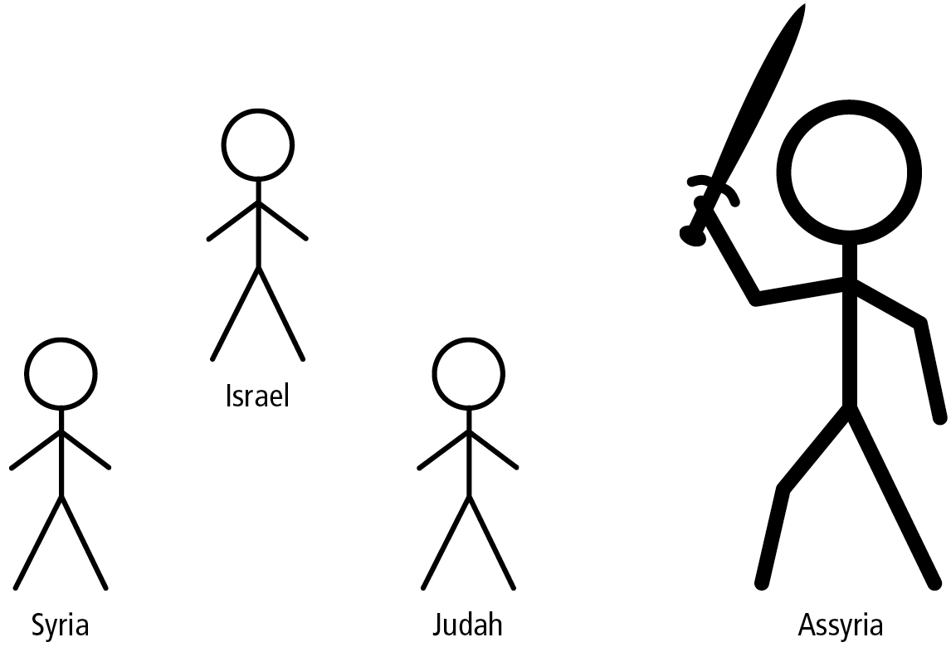
The Mighty Assyrians
In order to understand the context of Isaiah’s words that Nephi recorded in 2 Nephi 17–18, it is helpful to understand that the nations of Israel, Syria, and Judah were being threatened by the much stronger Assyrian Empire.

Slide 6
Nations of Judah, Syria, and Israel
Country | Judah | Syria | Israel
Capital city | Jerusalem | Damascus | Samaria
Territory or principal tribe | Judah | Aram | Ephraim
Leader | Ahaz (king), of the house of David | Rezin (king) | Pekah (king), son of Remaliah
Here is a chart containing some additional information about these nations (adapted from Victor L. Ludlow, Isaiah: Prophet, Seer, and Poet [1982], 140).

Slide 7
Threats against Judah
During Isaiah’s ministry in the kingdom of Judah, the kings of Israel (home of the northern ten tribes) and Syria wanted King Ahaz of Judah to join them in an alliance against the powerful empire of Assyria. The Assyrian kings and soldiers were famous for their brutality, which included torturing and cruelly murdering the people they conquered. Assyria had already threatened Israel and Syria and was forcing them to pay tribute or face destruction.

Slide 8
King Ahaz
When King Ahaz refused to join the alliance against Assyria, Israel and Syria attacked Judah in order to place another ruler on Judah’s throne who would support the alliance against Assyria (see 2 Nephi 17:1, 6).

Slide 9
King Ahaz
When King Ahaz refused to join the alliance against Assyria, Israel and Syria attacked Judah in order to place another ruler on Judah’s throne who would support the alliance against Assyria (see 2 Nephi 17:1, 6).
Read 2 Nephi 17:2, looking for words that indicate how Ahaz and the people of Judah felt as they considered the threats posed by Israel, Syria, and Assyria.

Slide 10
His Heart Was Moved
What do you think it means that Ahaz’s “heart was moved, and the heart of his people, as the trees of the wood are moved with the wind”?

Slide 11
His Heart Was Moved
What do you think it means that Ahaz’s “heart was moved, and the heart of his people, as the trees of the wood are moved with the wind”?
Ahaz and his people were fearful and unsure about what to do after Israel and Syria had attacked them.

Slide 12
His Heart Was Moved
What do you think it means that Ahaz’s “heart was moved, and the heart of his people, as the trees of the wood are moved with the wind”?
Ahaz and his people were fearful and unsure about what to do after Israel and Syria had attacked them.
If you had been the ruler of Judah, what do you think you would have done in this situation?

Slide 13
His Heart Was Moved
What do you think it means that Ahaz’s “heart was moved, and the heart of his people, as the trees of the wood are moved with the wind”?
Ahaz and his people were fearful and unsure about what to do after Israel and Syria had attacked them.
If you had been the ruler of Judah, what do you think you would have done in this situation?
Because Ahaz feared Israel and Syria, he considered forming an alliance with Assyria to protect his kingdom (see 2 Kings 16:7).

Slide 14
The Lord’s Counsel
Read 2 Nephi 17:3–8, looking for the Lord’s counsel to King Ahaz. The phrase “smoking firebrands” (verse 4) refers to a burned-out torch, indicating that Israel and Syria had spent their strength. They would soon be crushed by Assyria and would no longer be a threat to Judah.

Slide 15
The Lord’s Counsel
Read 2 Nephi 17:3–8, looking for the Lord’s counsel to King Ahaz. The phrase “smoking firebrands” (verse 4) refers to a burned-out torch, indicating that Israel and Syria had spent their strength. They would soon be crushed by Assyria and would no longer be a threat to Judah.
If you had been in King Ahaz’s position, would you have obeyed Isaiah’s counsel? Why or why not?

Slide 16
Disregarding Counsel
Read 2 Nephi 17:9, looking for what would happen if Ahaz disregarded Isaiah’s counsel. In this context established means protected and allowed to prosper.

Slide 17
Disregarding Counsel
Read 2 Nephi 17:9, looking for what would happen if Ahaz disregarded Isaiah’s counsel. In this context established means protected and allowed to prosper.
Read 2 Nephi 17:10–12, looking for what the Lord invited Ahaz to do.

Slide 18
Disregarding Counsel
Read 2 Nephi 17:9, looking for what would happen if Ahaz disregarded Isaiah’s counsel. In this context established means protected and allowed to prosper.
Read 2 Nephi 17:10–12, looking for what the Lord invited Ahaz to do.
Read 2 Nephi 17:13–16, looking for the sign that the Lord would send to Ahaz.

Slide 19
Immanuel
Isaiah’s prophecy indicated that the kingdoms of Israel and Syria would be broken up. This is also a prophecy of the Savior’s birth. The name Immanuel means “God with us” (Bible Dictionary, “Immanuel”).

Slide 20
Immanuel
Isaiah’s prophecy indicated that the kingdoms of Israel and Syria would be broken up. This is also a prophecy of the Savior’s birth. The name Immanuel means “God with us” (Bible Dictionary, “Immanuel”).
Why would it have been important for King Ahaz to humble himself and turn to the Lord during his nation’s crisis?

Slide 21
King Ahaz’s Choice
We learn in 2 Nephi 17:17–25 that King Ahaz (and many of the people of Judah) chose not to believe Isaiah and did not trust in the Lord for protection. Isaiah prophesied that the Assyrians would attack, capture, and enslave many people from the kingdom of Judah.

Slide 22
Fulfillment of Isaiah’s Prophecy
Rather than trusting in the Lord’s protection, Ahaz plundered the temple treasury in Jerusalem and offered those resources to the Assyrians in an attempt to buy their protection and favor. However, the Assyrians attacked Judah anyway, thus fulfilling Isaiah’s prophecy. (See 2 Kings 16:8; 2 Chronicles 28:21.)

Slide 23
Fulfillment of Isaiah’s Prophecy
In the days of King Hezekiah—the son of Ahaz—Isaiah compared the Assyrian army to a river that would symbolically flood the land of Judah and “reach even to the neck”—meaning the walls of Jerusalem (2 Nephi 18:8). This prophecy was fulfilled when 185,000 Assyrian soldiers came to attack Jerusalem, stopping at the walls of the city.

Slide 24
The Lord’s Instruction
Read 2 Nephi 18:11–14, looking for what the Lord instructed Isaiah and the people of Judah to do during this crisis. The word confederacy (verse 12) implies joining with other nations.

Slide 25
The Lord’s Instruction
Read 2 Nephi 18:11–14, looking for what the Lord instructed Isaiah and the people of Judah to do during this crisis. The word confederacy (verse 12) implies joining with other nations.
In verse 13, to “sanctify the Lord ... and let him be your fear, and let him be your dread” means that the people of Judah were to trust in the Lord and fear His power rather than fearing the power of their enemies.

Slide 26
The Lord’s Promise
According to 2 Nephi 18:14, what did the Lord promise to become as the people of Judah placed their trust in Him?

Slide 27
King Hezekiah
King Hezekiah, unlike his father, Ahaz, chose to trust in the Lord and follow Isaiah’s counsel. As a result, the Lord defended the people in Jerusalem by sending an angel to destroy the attacking army. (See Isaiah 36–37; 2 Kings 19:32–35.)

Slide 28
King Hezekiah
King Hezekiah, unlike his father, Ahaz, chose to trust in the Lord and follow Isaiah’s counsel. As a result, the Lord defended the people in Jerusalem by sending an angel to destroy the attacking army. (See Isaiah 36–37; 2 Kings 19:32–35.)
What truths can we learn from the accounts we have studied in 2 Nephi 17–18 about the blessings that come from putting our trust in the Lord during times of difficulty?

Slide 29
Trust in the Lord
If we put our trust in the Lord during times of difficulty, He will help, protect, and be with us.

Slide 30
Trust in the Lord
If we put our trust in the Lord during times of difficulty, He will help, protect, and be with us.
What are the dangers of putting our trust in worldly powers and influences rather than in the Lord?

Slide 31
Trust in the Lord
If we put our trust in the Lord during times of difficulty, He will help, protect, and be with us.
What are the dangers of putting our trust in worldly powers and influences rather than in the Lord?
When have you turned to God for strength when you were initially tempted to turn to other sources? How did God help you?

Slide 32
Look to the Lord
In 2 Nephi 18:15–22, Isaiah admonished the house of Israel to look to the Lord rather than to false teachers for guidance.

Slide 33
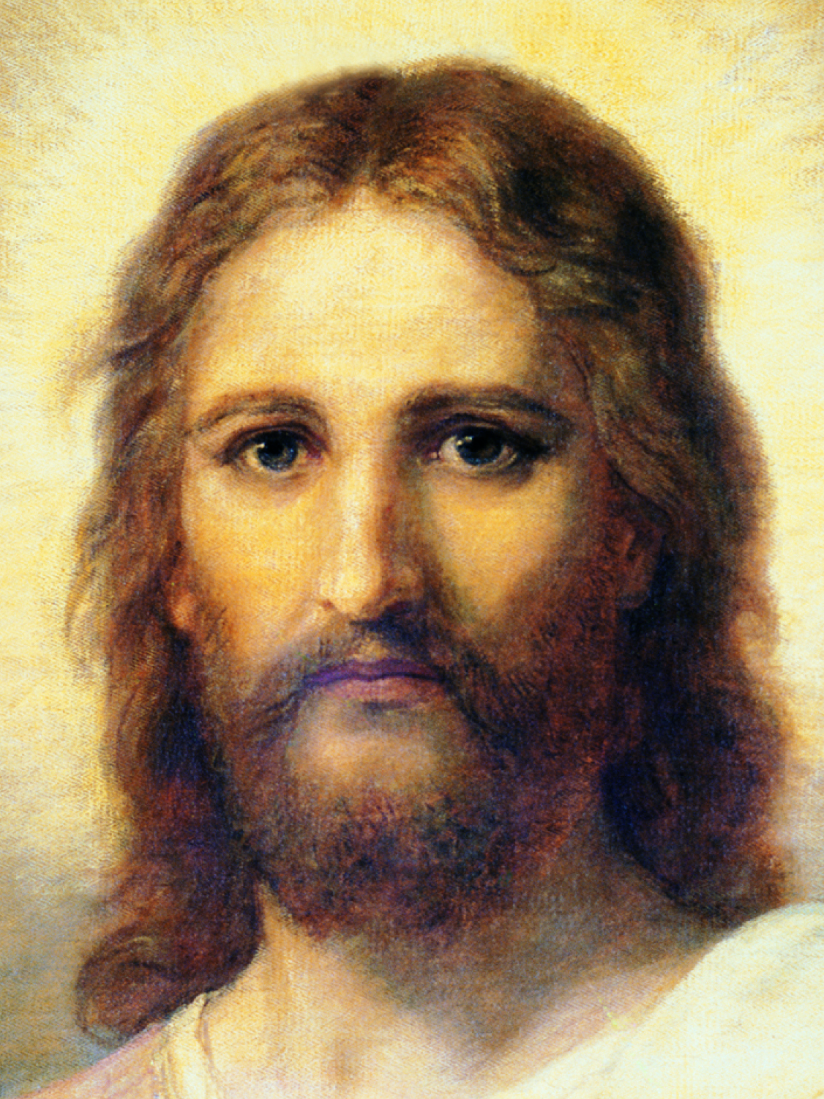
Jesus Christ
Read 2 Nephi 19:2, 6, looking for additional prophecies Isaiah gave about Jesus Christ.

Slide 34
Jesus Christ
Read 2 Nephi 19:2, 6, looking for additional prophecies Isaiah gave about Jesus Christ.
What truth can we learn from these verses about who Jesus Christ is?

Slide 35
Jesus Christ
Read 2 Nephi 19:2, 6, looking for additional prophecies Isaiah gave about Jesus Christ.
What truth can we learn from these verses about who Jesus Christ is?
Jesus Christ is the Mighty God, the Everlasting Father, and the Prince of Peace.

Slide 36
2 Nephi 19–20
In the rest of 2 Nephi 19–20, Isaiah prophesied of the punishments that would come upon Israel and Judah by Assyria’s hand. Isaiah warned Israel that destruction and captivity would soon come upon them, and he foretold a later attack on Judah because they refused to trust in the Lord.

Slide 37
Doctrinal Mastery: The Godhead
Why do some people judge others to be inferior to themselves?

Slide 38
Doctrinal Mastery: The Godhead
God the Father is the Supreme Being whom we worship. He is the Father of our spirits (see Hebrews 12:9). He is perfect, has all power, and knows all things. He is also just, merciful, and kind. God loves each of His children perfectly, and all are alike unto Him (see 2 Nephi 26:33). His work and glory is to bring about the immortality and eternal life of man.

Slide 39
Doctrinal Mastery: The Godhead
God the Father is the Supreme Being whom we worship. He is the Father of our spirits (see Hebrews 12:9). He is perfect, has all power, and knows all things. He is also just, merciful, and kind. God loves each of His children perfectly, and all are alike unto Him (see 2 Nephi 26:33). His work and glory is to bring about the immortality and eternal life of man.
What truth describes how God feels about all of His children?

Slide 40
Doctrinal Mastery: The Godhead
God loves each of His children perfectly, and all are alike unto Him.

Slide 41
Doctrinal Mastery: The Godhead
God loves each of His children perfectly, and all are alike unto Him.
2 Nephi 26:33 is the doctrinal mastery passage that supports this doctrine. Read 2 Nephi 26:33, looking for words and phrases that help teach the statement of doctrine above.

