Slide 1
2 Nephi 12–15
Lesson 32

Slide 2
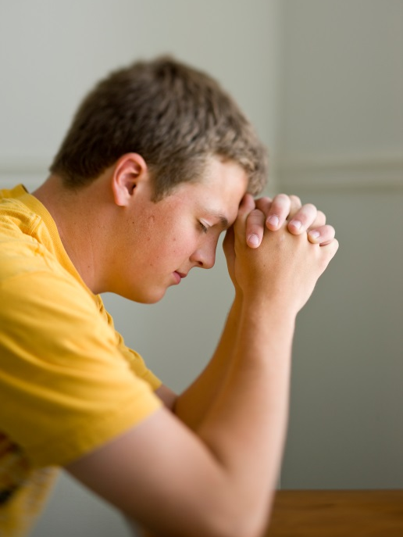
Devotional
Hymn:
Prayer:
Thought:
Notes:
738194

Slide 3
A Desire to Be Better
Where would you go for help if you had one of these desires? I want to be a better student. I want to be a better musician. I want to be a better athlete.

Slide 4
A Desire to Be Better
Where would you go for help if you had one of these desires? I want to be a better student. I want to be a better musician. I want to be a better athlete.
Where could someone go for help if they wanted to become a better disciple of the Lord?

Slide 5
A Better Disciple
Read 2 Nephi 12:1–4, looking for where we can go to learn how to become better disciples of the Lord.

Slide 6
A Better Disciple
Read 2 Nephi 12:1–4, looking for where we can go to learn how to become better disciples of the Lord.
What do you think the phrase “mountain of the Lord” (verse 3) refers to?

Slide 7
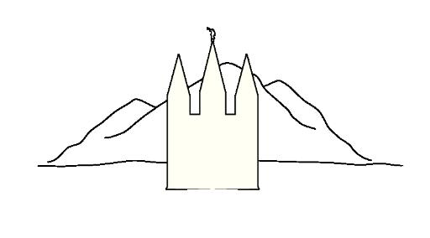
Similarities
Think about some of the similarities between a mountain and a temple.

Slide 8
Similarities
Think about some of the similarities between a mountain and a temple.
What principle can we learn from 2 Nephi 12:3 about the blessings that come as we worship in the temple?

Slide 9
Worshipping in the Temple
As we worship in the temple, the Lord will teach us of His ways and help us walk in His paths.

Slide 10
Worshipping in the Temple
As we worship in the temple, the Lord will teach us of His ways and help us walk in His paths.
How do temples teach us the Lord’s ways and help us to walk in His paths?

Slide 11
Worshipping in the Temple
As we worship in the temple, the Lord will teach us of His ways and help us walk in His paths.
How do temples teach us the Lord’s ways and help us to walk in His paths?
When has worshipping in the temple helped you learn of the Lord’s ways and walk in His paths?

Slide 12
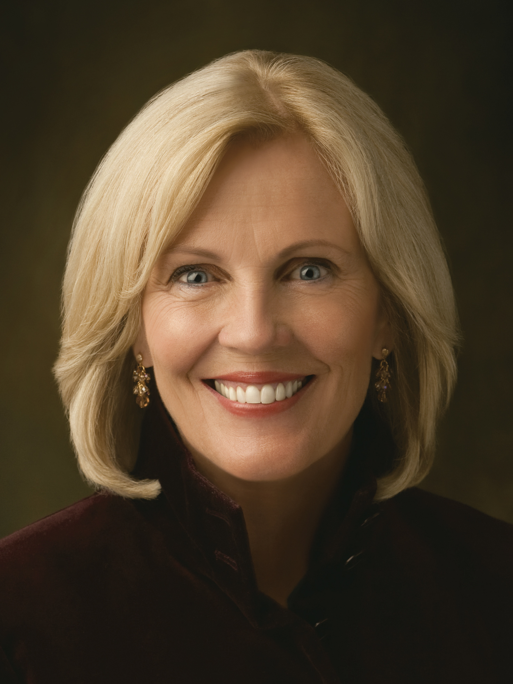
Sister Elaine S. Dalton
“Prepare now for the temple, the mountain of the Lord. Never allow the goal of the temple to be out of your sight. Walk into His presence in purity and virtue, and receive His blessings—even ‘all that he hath’ (Luke 12:44). Within His holy house you will be cleansed, taught, and endowed with power, and His ‘angels [will] have charge over [you]’ (D&C 109:22)” (Elaine S. Dalton, “Come Let Us Go Up to the Mountain of the Lord,” Ensign or Liahona, May 2009, 122–23).
Photo © Busath.com

Slide 13
Preparing for the Temple
What will you do now to prepare for the temple and to attend as often as your circumstances will permit?

Slide 14
Attitudes and Practices
Read 2 Nephi 12:5–12, 17–19; 13:5, 8. What attitudes and practices reflect the sins of these people?

Slide 15
Attitudes and Practices
Read 2 Nephi 12:5–12, 17–19; 13:5, 8. What attitudes and practices reflect the sins of these people?
What will happen to these people as a consequence of their sins?

Slide 16
Attitudes and Practices
Read 2 Nephi 12:5–12, 17–19; 13:5, 8. What attitudes and practices reflect the sins of these people?
What will happen to these people as a consequence of their sins?
Read 2 Nephi 13:16–26. What attitudes and practices reflect the sins of these people?

Slide 17
Attitudes and Practices
Read 2 Nephi 12:5–12, 17–19; 13:5, 8. What attitudes and practices reflect the sins of these people?
What will happen to these people as a consequence of their sins?
Read 2 Nephi 13:16–26. What attitudes and practices reflect the sins of these people?
What will happen to these people as a consequence of their sins?

Slide 18
The Sins of the People
Read 2 Nephi 13:9, looking for one way the sins of the people were evident.

Slide 19
The Sins of the People
Read 2 Nephi 13:9, looking for one way the sins of the people were evident.
The word countenance refers to a person’s appearance, particularly the face. How can a person’s countenance witness against them?

Slide 20
The Sins of the People
Read 2 Nephi 13:9, looking for one way the sins of the people were evident.
The word countenance refers to a person’s appearance, particularly the face. How can a person’s countenance witness against them?
What truth can we learn from verse 9 about trying to hide our sins from the Lord?

Slide 21
The Sins of the People
Read 2 Nephi 13:9, looking for one way the sins of the people were evident.
The word countenance refers to a person’s appearance, particularly the face. How can a person’s countenance witness against them?
What truth can we learn from verse 9 about trying to hide our sins from the Lord?
We cannot hide our sins from the Lord.

Slide 22
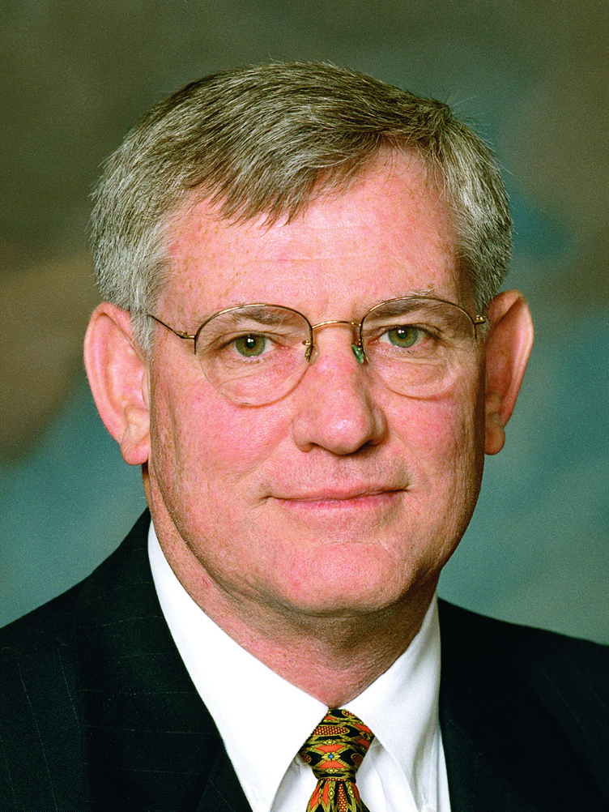
Elder Spencer V. Jones
“At times, consequences of sin may appear to be very subtle to the sinner. We may even convince ourselves … that no one will be able to detect our sins and that they are well concealed. But always to our Heavenly Father and often to spiritually sensitive leaders, parents, and friends, our sins are glaringly apparent.
Continued on the next page

Slide 23
Elder Spencer V. Jones, cont.
“While attending a youth fireside with Elder Richard G. Scott, I noticed five youths scattered among the congregation whose countenances or body language almost screamed that something was spiritually amiss in their lives. After the meeting, when I mentioned the five youths to Elder Scott, he simply replied, ‘There were eight’” (Spencer V. Jones, “Overcoming the Stench of Sin,” Ensign or Liahona, May 2003, 88).

Slide 24
Hiding Our Sins
How can understanding that we cannot hide our sins from the Lord help us make better choices?

Slide 25
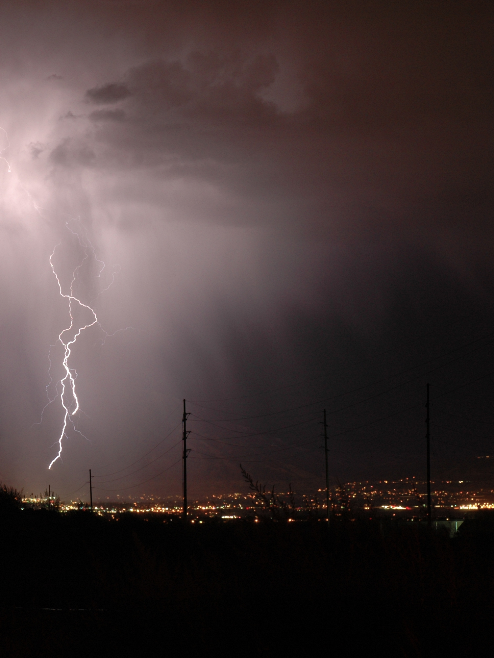
Storms
When have you been caught in a bad or violent storm?

Slide 26
Storms
When have you been caught in a bad or violent storm?
How did you seek shelter? How effective was the shelter at protecting you from the storm?

Slide 27
Storms
When have you been caught in a bad or violent storm?
How did you seek shelter? How effective was the shelter at protecting you from the storm?
Storms can be used to represent times of intense concern, problems, or temptation in our lives. Have there been times when you have experienced these types of storms?

Slide 28
Cleansing and Redemption
In 2 Nephi 14, Isaiah foresaw the Lord’s cleansing and redemption of His people in the millennial day and that the Lord would offer protection from the storms of life.

Slide 29
Cleansing and Redemption
In 2 Nephi 14, Isaiah foresaw the Lord’s cleansing and redemption of His people in the millennial day and that the Lord would offer protection from the storms of life.
Read 2 Nephi 14:5–6, looking for places Isaiah mentioned that would provide spiritual protection.

Slide 30
Cleansing and Redemption
In 2 Nephi 14, Isaiah foresaw the Lord’s cleansing and redemption of His people in the millennial day and that the Lord would offer protection from the storms of life.
Read 2 Nephi 14:5–6, looking for places Isaiah mentioned that would provide spiritual protection.
Notice the words dwelling-place (house or home), assemblies (places of congregation, such as branches, wards, or stakes), and tabernacle (temple).

Slide 31
His Protection and Guidance
Both of the expressions “cloud and smoke by day” and “the shining of a flaming fire by night” (2 Nephi 12:5) are associated with the presence of the Lord and refer to the protection and guidance that Moses and his people received from the Lord in the wilderness (see Exodus 13:21–22).

Slide 32
His Protection and Guidance
Both of the expressions “cloud and smoke by day” and “the shining of a flaming fire by night” (2 Nephi 12:5) are associated with the presence of the Lord and refer to the protection and guidance that Moses and his people received from the Lord in the wilderness (see Exodus 13:21–22).
It is important to note that Isaiah likened the temple to a protective shelter from the heat and a “covert,” or shelter, from storms and rain.

Slide 33
Spiritual Protection
Based on 2 Nephi 14:5–6, how would you summarize as a statement of truth what the Lord has established to provide spiritual protection?

Slide 34
Spiritual Protection
Based on 2 Nephi 14:5–6, how would you summarize as a statement of truth what the Lord has established to provide spiritual protection?
The Lord has established the home, Church congregations, and temples as places of spiritual protection and refuge.

Slide 35
Spiritual Protection
Based on 2 Nephi 14:5–6, how would you summarize as a statement of truth what the Lord has established to provide spiritual protection?
The Lord has established the home, Church congregations, and temples as places of spiritual protection and refuge.
What can we do to make our homes and branches or wards places of spiritual safety and protection?

Slide 36
Share an Experience
When have you felt the Lord’s protection or guidance in your home or at church?

Slide 37
Share an Experience
When have you felt the Lord’s protection or guidance in your home or at church?
When have you found spiritual relief or protection in the temple?

Slide 38
A Vineyard
Read 2 Nephi 15:1–2, looking for what the well-beloved master (representing the Lord) did for the vineyard and what the vineyard produced.

Slide 39
A Vineyard
Read 2 Nephi 15:1–2, looking for what the well-beloved master (representing the Lord) did for the vineyard and what the vineyard produced.
How might this represent the house of Israel at the time of Isaiah?

Slide 40
A Vineyard
Read 2 Nephi 15:1–2, looking for what the well-beloved master (representing the Lord) did for the vineyard and what the vineyard produced.
How might this represent the house of Israel at the time of Isaiah?
The wild grapes symbolize apostasy, signifying that Israel had turned away from the Lord.

Slide 41
What Did He Do?
Read 2 Nephi 15:5–6, looking for what the Lord would do to His vineyard.

Slide 42
What Did He Do?
Read 2 Nephi 15:5–6, looking for what the Lord would do to His vineyard.
What would be the effects of taking away the hedge, breaking down the wall, and the vineyard not being worked or watered?

Slide 43
What Did He Do?
Read 2 Nephi 15:5–6, looking for what the Lord would do to His vineyard.
What would be the effects of taking away the hedge, breaking down the wall, and the vineyard not being worked or watered?
How might these results represent the consequences that come to those who disobey the Lord’s commandments?

Slide 44
Losing His Protection
What truth can we learn from 2 Nephi 15:5–6 about what can cause us to lose the Lord’s protection?

Slide 45
Losing His Protection
What truth can we learn from 2 Nephi 15:5–6 about what can cause us to lose the Lord’s protection?
If we are prideful and turn away from the Lord, we will lose His protection.

Slide 46
Rebellious Israel
In 2 Nephi 15:8–30, Isaiah described some of the prideful attitudes and behaviors rebellious Israel would exhibit. For example, they would “call evil good, and good evil” (verse 20). In addition, Isaiah prophesied that the Lord would “lift up an ensign to the nations” (verse 26).

Slide 47
An Ensign
An ensign is a flag or banner that is used as a rallying point or as a signal to assemble, especially in battle. This prophecy refers to how nations would gather against the Israelites in Isaiah’s day, and it also foreshadows the latter-day Restoration of the gospel and gathering of Israel.

Slide 48
Doctrinal Mastery: The Godhead
The last time you studied doctrinal mastery, you considered this misunderstanding that someone might have: God doesn’t really know me or care about what I’m going through.

Slide 49
Doctrinal Mastery: The Godhead
The last time you studied doctrinal mastery, you considered this misunderstanding that someone might have: God doesn’t really know me or care about what I’m going through.
What truth from the doctrinal topic “The Godhead” in the Doctrinal Mastery Core Document can help correct or clarify the italicized statement above?

