Slide 1
2 Nephi 9:27–54; 10
Lesson 30

Slide 2

Devotional
Hymn:
Prayer:
Thought:
Notes:
ID 272818

Slide 3

Finding an Object
Imagine that you were blindfolded and asked to find a hidden object in the room. To find the object, you will be prompted with the words warm and warmer as you get closer to it and the words cold and colder as you get farther away from it.

Slide 4
Finding an Object
Imagine that you were blindfolded and asked to find a hidden object in the room. To find the object, you will be prompted with the words warm and warmer as you get closer to it and the words cold and colder as you get farther away from it.
Why would you choose to follow the prompts that will get you closer to the hidden object?

Slide 5
Finding an Object
Imagine that you were blindfolded and asked to find a hidden object in the room. To find the object, you will be prompted with the words warm and warmer as you get closer to it and the words cold and colder as you get farther away from it.
Why would you choose to follow the prompts that will get you closer to the hidden object?
Why might a person in this situation choose not to follow the prompts that are intended to help him or her find the object?

Slide 6
Attitudes and Actions
As recorded in 2 Nephi 9–10, Jacob described attitudes and actions that lead people closer to Jesus Christ and the blessings of His Atonement, as well as attitudes and actions that lead people farther away from Him. As you study the rest of 2 Nephi 9 and 2 Nephi 10 today, look for these attitudes and actions.

Slide 7
Attitudes and Actions
Read 2 Nephi 9:27–39, looking for attitudes and actions that can distance us from the Savior.

Slide 8
Attitudes and Actions
Read 2 Nephi 9:27–39, looking for attitudes and actions that can distance us from the Savior.
Using what you learned from these verses, how would you complete this principle? If we _____________________________, we will distance ourselves from Jesus Christ.

Slide 9
Distancing Ourselves from God
If we trust in our learning and riches more than we trust in the Lord, we will distance ourselves from Jesus Christ. If we choose to lie, we will distance ourselves from Jesus Christ.

Slide 10
Trusting in Their Own Learning
According to 2 Nephi 9:28, how can trusting in their own learning lead individuals to distance themselves from Jesus Christ?

Slide 11
Trusting in Their Own Learning
According to 2 Nephi 9:28, how can trusting in their own learning lead individuals to distance themselves from Jesus Christ?
According to 2 Nephi 9:30, how can trusting in riches lead individuals to distance themselves from Jesus Christ?

Slide 12
Trusting in Their Own Learning
According to 2 Nephi 9:28, how can trusting in their own learning lead individuals to distance themselves from Jesus Christ?
According to 2 Nephi 9:30, how can trusting in riches lead individuals to distance themselves from Jesus Christ?
What can we do to ensure that learning and wealth do not lead us away from Jesus Christ?

Slide 13
Dishonesty
In what ways might we be tempted to justify lying or other forms of dishonesty?

Slide 14
Dishonesty
In what ways might we be tempted to justify lying or other forms of dishonesty?
When we face these temptations, how can it help us to remember that if we are dishonest we will distance ourselves from Jesus Christ?

Slide 15
Come unto the Savior
Read 2 Nephi 9:39, 42, 45–46, 49–52, looking for attitudes and actions that help us come unto the Savior and receive the blessings of His Atonement.

Slide 16
Come unto the Savior
Read 2 Nephi 9:39, 42, 45–46, 49–52, looking for attitudes and actions that help us come unto the Savior and receive the blessings of His Atonement.
What do you think it means to be “spiritually-minded” (2 Nephi 9:39)?

Slide 17
Come unto the Savior
Read 2 Nephi 9:39, 42, 45–46, 49–52, looking for attitudes and actions that help us come unto the Savior and receive the blessings of His Atonement.
What do you think it means to be “spiritually-minded” (2 Nephi 9:39)?
What are some activities that can help us be spiritually minded?

Slide 18
Come unto the Savior
Read 2 Nephi 9:39, 42, 45–46, 49–52, looking for attitudes and actions that help us come unto the Savior and receive the blessings of His Atonement.
What do you think it means to be “spiritually-minded” (2 Nephi 9:39)?
What are some activities that can help us be spiritually minded?
What does it mean to “turn away from your sins” (2 Nephi 9:45)?

Slide 19
The Abundant Blessings
In 2 Nephi 9:50–51, when he said to drink, eat, and “delight in fatness,” Jacob was referring to partaking of the abundant blessings of the gospel made available by Jesus Christ and His Atonement.

Slide 20
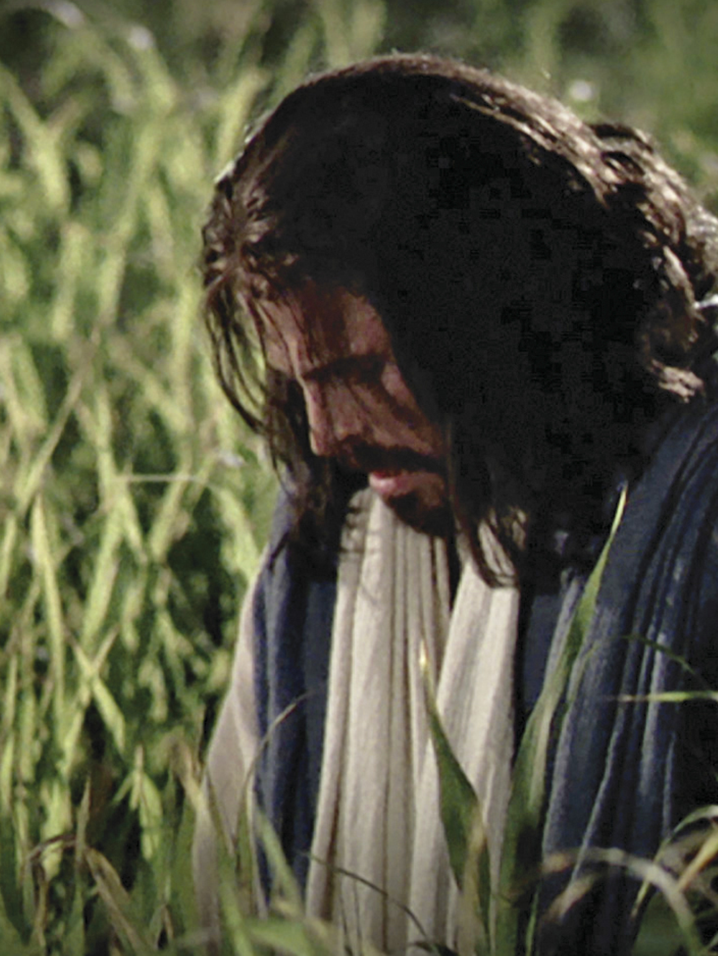
The Atonement of Jesus Christ
Identify a principle from 2 Nephi 9:45, 50–51 that describes what we can do to receive the full blessings of the Atonement of Jesus Christ.

Slide 21
The Atonement of Jesus Christ
Identify a principle from 2 Nephi 9:45, 50–51 that describes what we can do to receive the full blessings of the Atonement of Jesus Christ.
As we come to the Lord and live according to His will, we will receive the full blessings of the Atonement of Jesus Christ.

Slide 22
The Atonement of Jesus Christ
Identify a principle from 2 Nephi 9:45, 50–51 that describes what we can do to receive the full blessings of the Atonement of Jesus Christ.
As we come to the Lord and live according to His will, we will receive the full blessings of the Atonement of Jesus Christ.
Think about how you have seen this principle in your life.

Slide 23
Your Attitudes and Actions
What attitudes and actions have helped you come closer to the Savior?

Slide 24
Your Attitudes and Actions
What attitudes and actions have helped you come closer to the Savior?
Think of one way you will seek to come to Jesus Christ and live according to His will so you can receive the full blessings of His Atonement.

Slide 25
Summary
In 2 Nephi 9:53–54, Jacob rejoiced in the Lord’s “greatness, … grace and mercy” and the Lord’s promise that the posterity of Jacob and his people would not be completely destroyed. Jacob told his people that he would finish delivering his teachings the following day.

Slide 26
Your Choices
What are some recent choices you have made that resulted in positive consequences?

Slide 27
Your Choices
What are some recent choices you have made that resulted in positive consequences?
Think of poor choices you have made that resulted in negative consequences.

Slide 28
Jacob’s Prophecy
In 2 Nephi 10:1–9, Jacob prophesied of the Jews—particularly those who would inhabit Jerusalem at the time of the Savior’s mortal ministry.

Slide 29
Jacob’s Prophecy
In 2 Nephi 10:1–9, Jacob prophesied of the Jews—particularly those who would inhabit Jerusalem at the time of the Savior’s mortal ministry.
Read 2 Nephi 10:3–6, looking for some of the Jews’ choices and the consequences that would follow those choices.

Slide 30
Poor Choices
What are some of the poor choices Jacob prophesied the ancient Jews would make?

Slide 31
Poor Choices
What are some of the poor choices Jacob prophesied the ancient Jews would make?
What were some of the consequences of those choices?

Slide 32
Consequences
Read 2 Nephi 10:7–8, looking for other choices Jacob prophesied the Jews would make and the resulting consequences.

Slide 33
Consequences
Read 2 Nephi 10:7–8, looking for other choices Jacob prophesied the Jews would make and the resulting consequences.
What will happen when the Jews choose to believe in Jesus Christ?

Slide 34
The Latter Days
In 2 Nephi 10:9–22, Jacob prophesied that in the latter days, the Gentiles will assist in gathering the house of Israel to their lands of inheritance and in building Zion. Jacob also rejoiced in the Lord’s mercy and kindness for preserving and remembering the Nephites and other people whom He had led away to other lands.

Slide 35
Choices and Consequences
Read 2 Nephi 10:23, looking for a truth Jacob taught about choices and consequences.

Slide 36
Choices and Consequences
Read 2 Nephi 10:23, looking for a truth Jacob taught about choices and consequences.
We are free to act for ourselves, and we will receive the consequences of our choices.

Slide 37
Choices and Consequences
Read 2 Nephi 10:23, looking for a truth Jacob taught about choices and consequences.
We are free to act for ourselves, and we will receive the consequences of our choices.
If people know that negative consequences follow poor choices, why do you think they still make poor choices?

Slide 38
Consequences of Choices
Why might Satan want us to believe that we can avoid the consequences of our choices?

Slide 39
Consequences of Choices
What are some examples of poor choices people might make while believing they can avoid the consequences?

Slide 40
Consequences of Choices
What are some examples of poor choices people might make while believing they can avoid the consequences?
What consequences eventually result from those choices?

Slide 41
Choose Eternal Life
Read 2 Nephi 10:24–25, looking for how we can “choose … the way of eternal life” (2 Nephi 10:23). The word reconcile in verse 24 means to bring people or things into harmony or agreement with each other.

Slide 42
Choose Eternal Life
Read 2 Nephi 10:24–25, looking for how we can “choose … the way of eternal life” (2 Nephi 10:23). The word reconcile in verse 24 means to bring people or things into harmony or agreement with each other.
As we make righteous choices, we become reconciled to God and will be saved by His grace from physical and spiritual death.

Slide 43
The Atonement of Jesus Christ
https://www.lds.org/media-library/video/2015-10-280-power-of-the-atonement-veme?lang=eng

Slide 44
Doctrinal Mastery: Review
Match Doctrinal Mastery
Scripture Passage
God knows all things and is the source of all truth.
As we continue to seek for answers, we must live by faith—trusting that we will eventually receive the answers we seek.
The Holy Ghost can help us recognize truth or error in whatever source we may find it.
Ether 12:6
Moroni 10:4–5
Mosiah 4:9

