Slide 1
2 Nephi 9:1–26
Lesson 29

Slide 2

Devotional
Hymn:
Prayer:
Thought:
Notes:
ID 272818

Slide 3
To Be Rescued
Think about any dangerous or harmful situations from which you or someone you know have needed to be rescued.

Slide 4
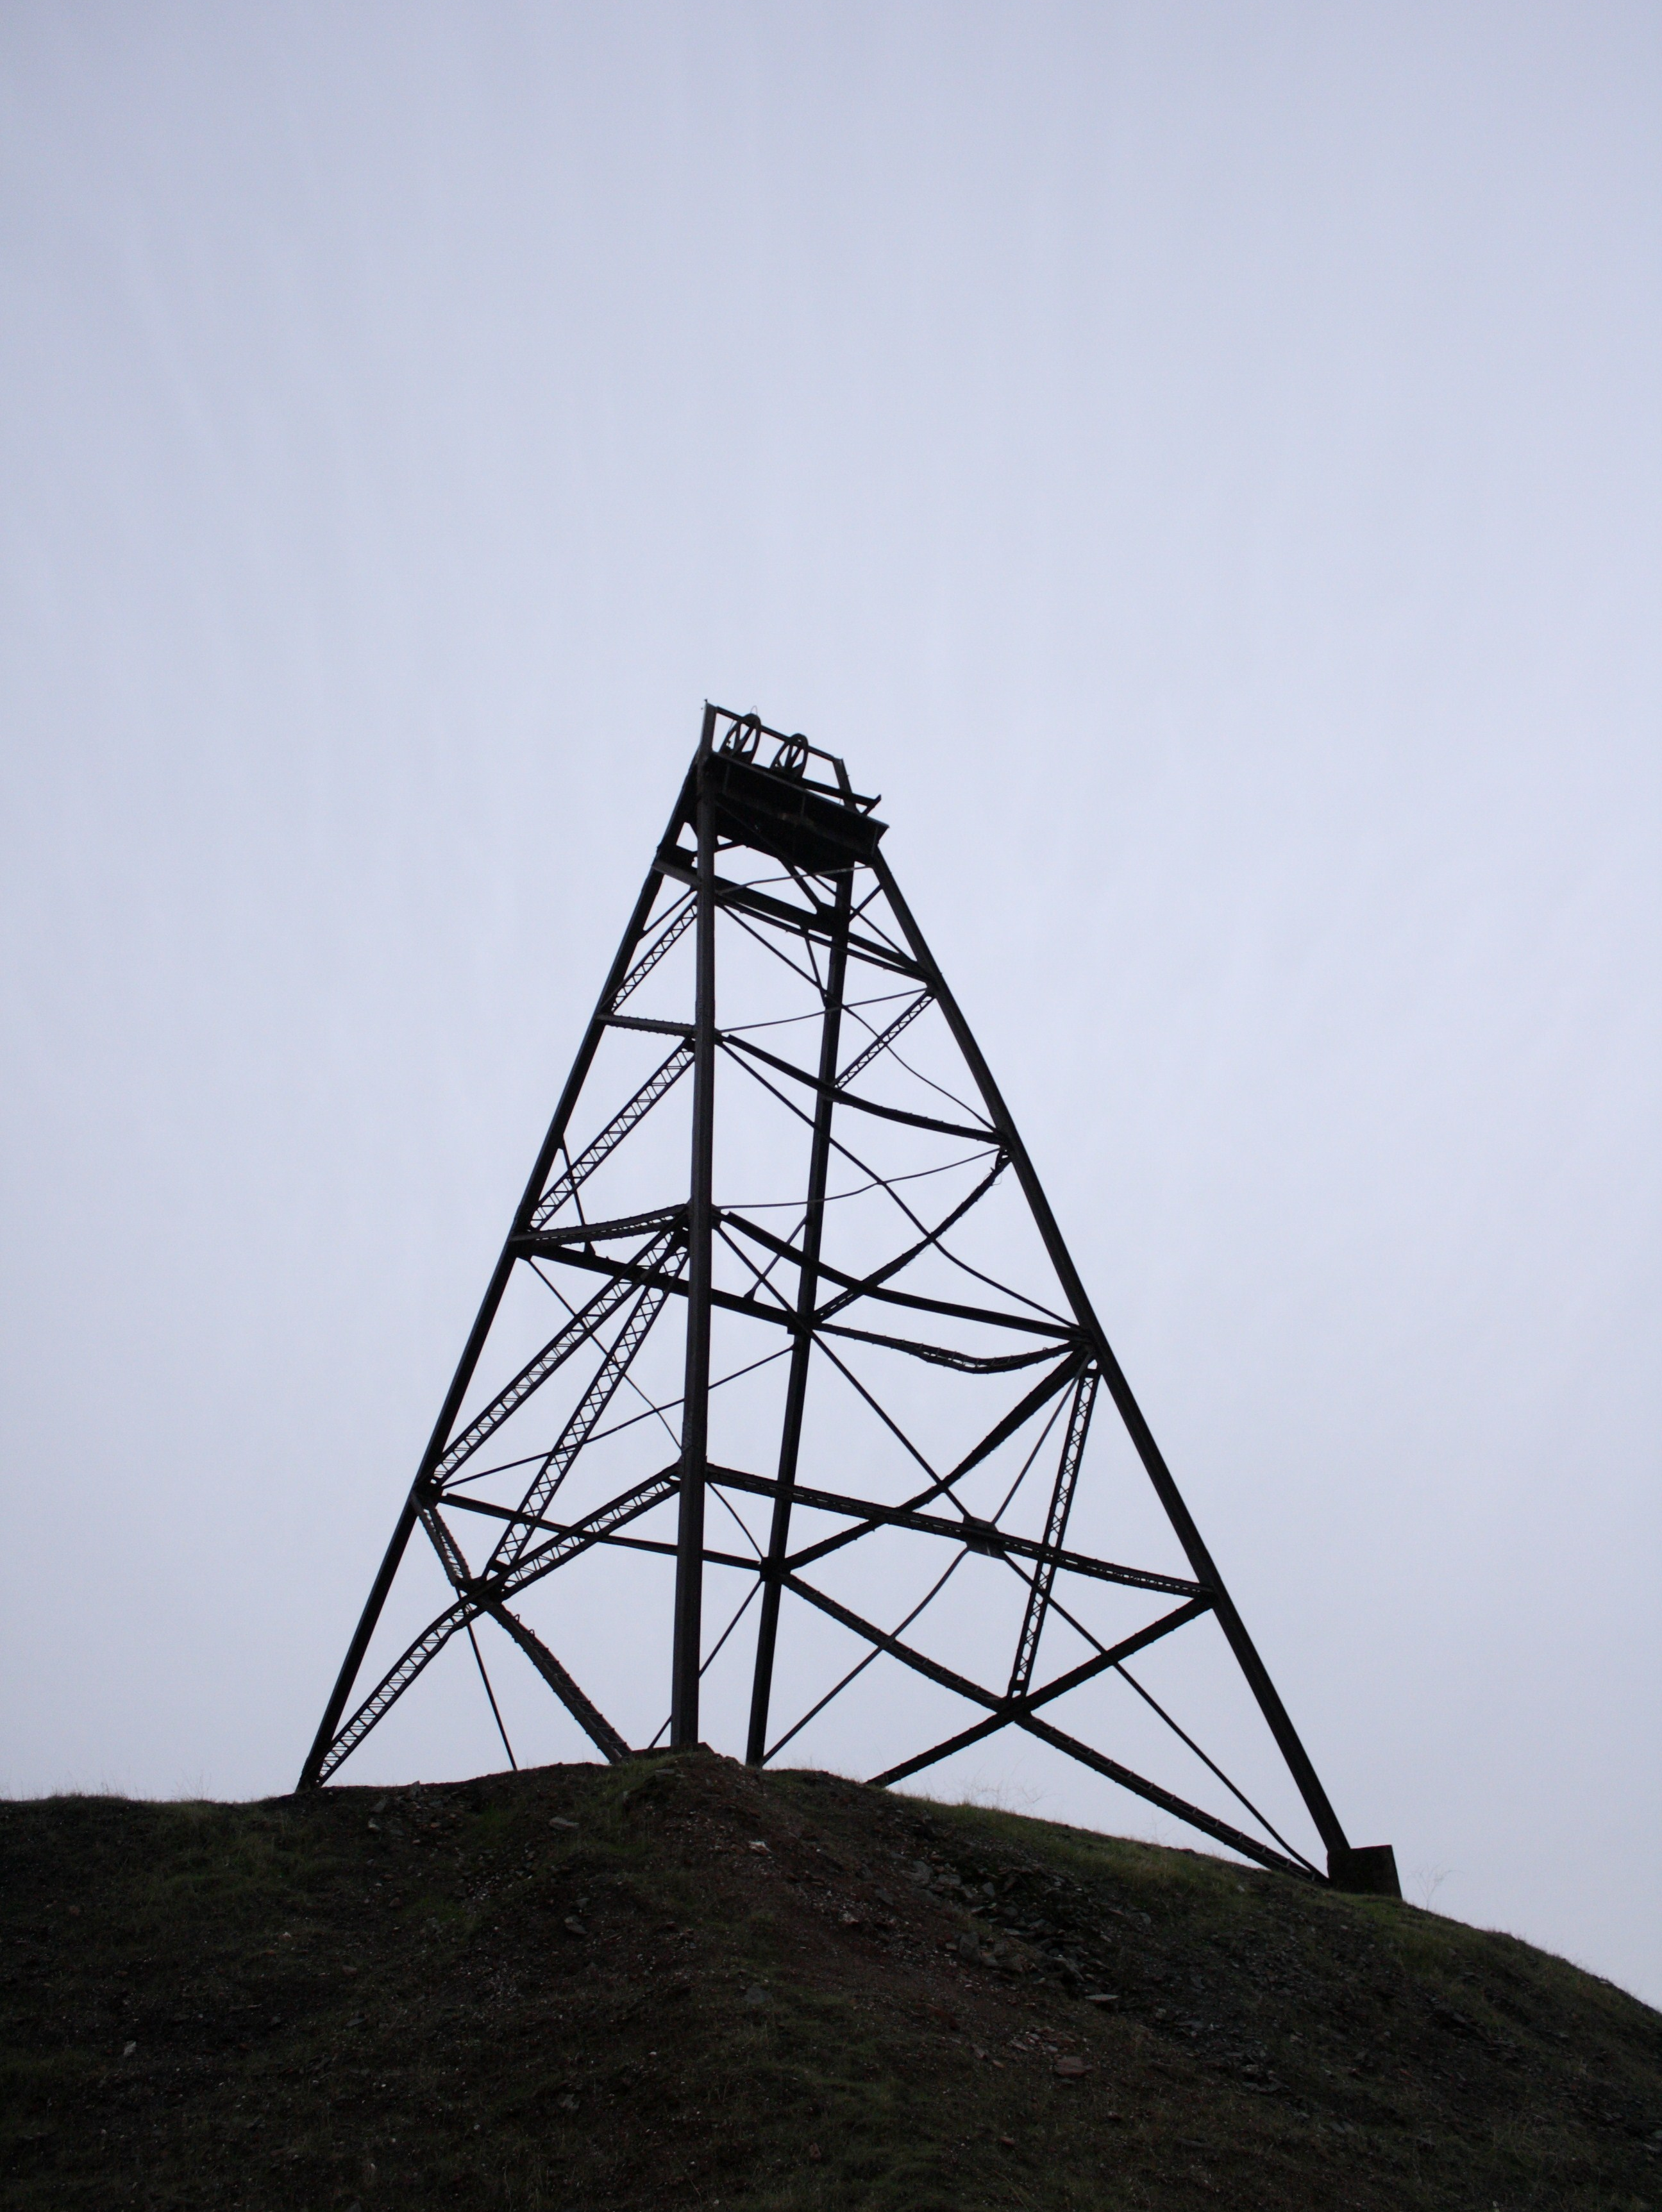
Seeking Rescue
“On August 5, 2010, 33 Chilean miners were trapped by a massive cave-in after the rock inside the mine collapsed. They were restricted to a small safe area and to the mine shafts below the collapse, 2,300 feet (700 m) deep inside the earth.
Continued on next page.

Slide 5
Seeking Rescue, cont.
“The situation looked bleak. They were separated from home and family by almost a half a mile of unmovable rock overhead, and they had only a small supply of food and water. Although they had tools and knowledge, because of the instability of the mine they could not save themselves. Their only chance was to be found and rescued” (Connie Goulding, “Seeking Rescue,” Ensign, June 2015, 63).

Slide 6
A Dangerous Situation
If you had been in this situation, what thoughts or feelings might you have had?

Slide 7
To Be Rescued
In 2 Nephi 9 we read that Jacob described dangerous conditions we all face and need to be rescued from. This chapter is a continuation of Jacob’s sermon in 2 Nephi 6–8.

Slide 8
To Be Rescued
In 2 Nephi 9 we read that Jacob described dangerous conditions we all face and need to be rescued from. This chapter is a continuation of Jacob’s sermon in 2 Nephi 6–8.
Read 2 Nephi 9:10, looking for what Jacob said we need to be rescued from.

Slide 9
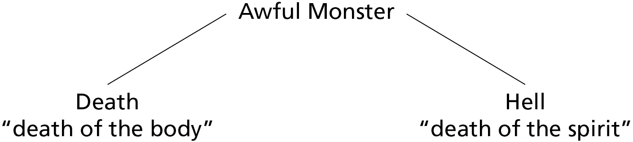
Physical Death
In 2 Nephi 9:10, Jacob’s use of the terms death and hell refer to two types of separation. When Jacob used the word death in this sermon, he referred to “the death of the body,” which is the separation of the physical body from the spirit. This separation is often referred to as physical death.

Slide 10
Spiritual Death
When Jacob used the word hell, he referred to “the death of the spirit,” which is a person’s separation from the presence of God. In the scriptures, this separation is often referred to as “spiritual death.”

Slide 11
Death and Hell
Why do you think the phrase “awful monster” is an appropriate way to describe death and hell?

Slide 12
The Cause of Death
Read 2 Nephi 9:6, looking for the cause of physical death and spiritual death.

Slide 13
The Cause of Death
Read 2 Nephi 9:6, looking for the cause of physical death and spiritual death.
As a result of the Fall, all people are cut off from the presence of God and all people will eventually die physically.

Slide 14
The Cause of Death
Read 2 Nephi 9:6, looking for the cause of physical death and spiritual death.
As a result of the Fall, all people are cut off from the presence of God and all people will eventually die physically.
Read 2 Nephi 9:7–9 and look for phrases that describe what would happen to our bodies and spirits if physical and spiritual death remained forever.

Slide 15
First Judgment
When Jacob spoke of “the first judgment which came upon man,” he referred to results of the Fall of Adam and Eve. When he spoke of “corruption,” he referred to our mortal bodies, which will die. When he spoke of “incorruption,” he referred to our resurrected bodies, which will live forever.

Slide 16
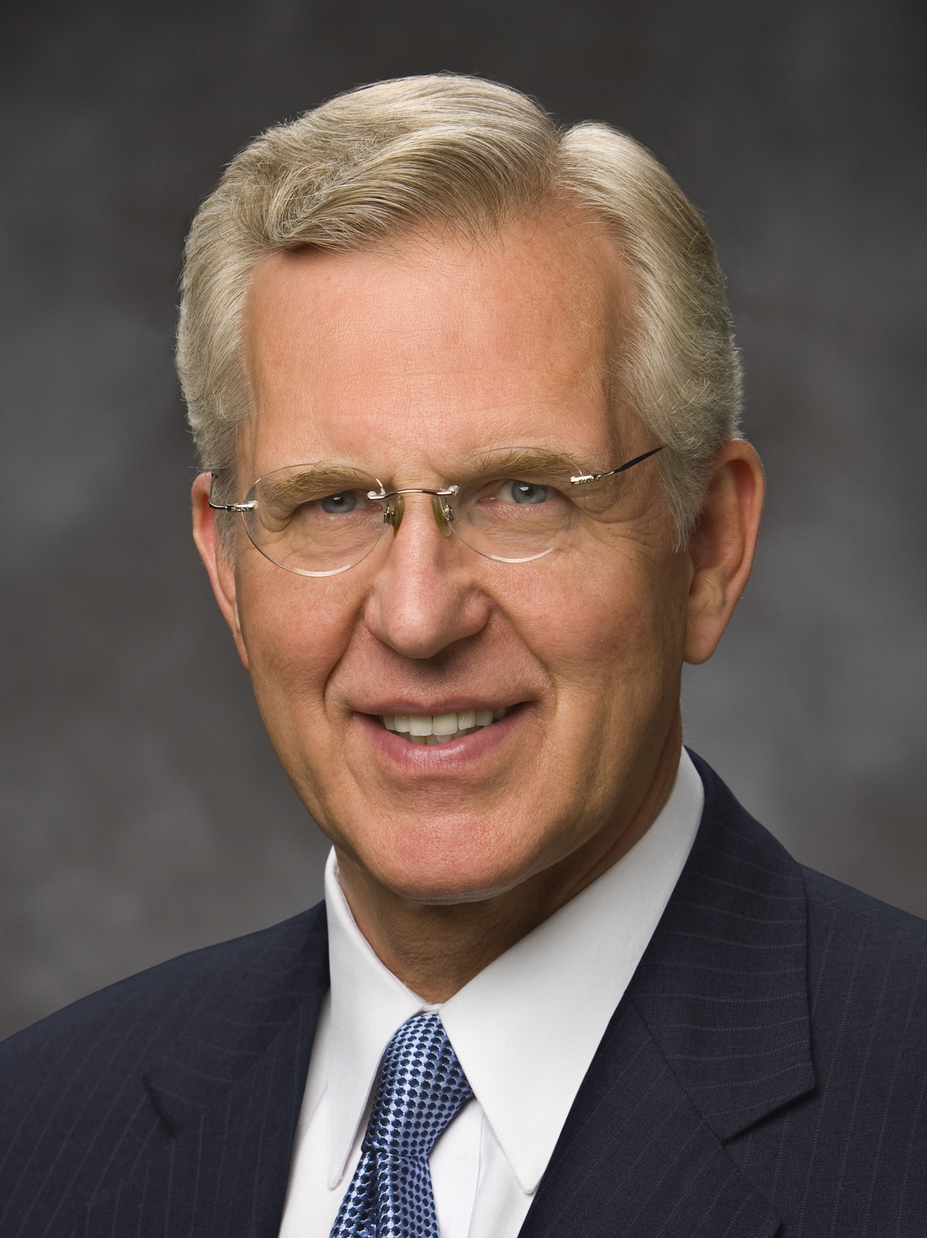
Elder D. Todd Christofferson
“If our separation from God and our physical death were permanent, moral agency would mean nothing. Yes, we would be free to make choices, but what would be the point? The end result would always be the same no matter what our actions: death with no hope of resurrection and no hope of heaven. As good or as bad as we might choose to be, we would all end up ‘angels to a devil’ [2 Nephi 9:9]” (D. Todd Christofferson, “Moral Agency,” Ensign, June 2009, 50).

Slide 17
What Would Happen
If there had been no Atonement of Jesus Christ, what would happen to our bodies and to our spirits?

Slide 18
What Would Happen
If there had been no Atonement of Jesus Christ, what would happen to our bodies and to our spirits?
How would you feel if you had no hope of resurrection or heaven and if you knew that no matter how hard you tried to follow the commandments you would still end up as “angels to a devil”?

Slide 19
Seeking Rescue, cont.
“On the 17th day of their trial, hope was renewed for the miners when a small shaft was created by a drill bit that broke through the rock that held them captive. … Hope was restored. … Food, water, medicine, and notes from loved ones were sent down the shaft to the miners.
Continued on next page.

Slide 20
Seeking Rescue, cont.
“Eventually, rescuers were able to create a larger shaft, through which they could lower a capsule that was large enough to rescue one man at a time.
“Each miner stepped into the capsule and gave his will over to the plan and the rescuers. …
“The rescue plan succeeded; not one man was lost. They were redeemed … 69 days after the mine collapse and 52 days after they had been found alive” (Goulding, “Seeking Rescue,” 65).

Slide 21
Our Deliverance
How is the rescue of the Chilean miners similar to our deliverance from physical and spiritual death?

Slide 22
Our Deliverance
How is the rescue of the Chilean miners similar to our deliverance from physical and spiritual death?
The miners could not rescue themselves from the mine, just as we cannot rescue ourselves from sin and death. In order to be rescued, the miners had to trust the rescue plan and the rescuers. Similarly, we must trust in the plan of redemption and in our Savior.

Slide 23
God Prepared a Way
Read 2 Nephi 9:10 again, looking for what God has done to deliver us from physical and spiritual death.

Slide 24
God Prepared a Way
Read 2 Nephi 9:10 again, looking for what God has done to deliver us from physical and spiritual death.
Jacob’s main message in 2 Nephi 9:10 is that God has prepared “a way for our escape from the grasp of ... death and hell.”

Slide 25
God Prepared a Way
Read 2 Nephi 9:10 again, looking for what God has done to deliver us from physical and spiritual death.
Jacob’s main message in 2 Nephi 9:10 is that God has prepared “a way for our escape from the grasp of ... death and hell.”
Read 2 Nephi 9:11–13, looking for how we are delivered or rescued from physical and spiritual death. Take note of the number of times you see the word deliver, or a form of it, in these verses.

Slide 26
Our Bodies and Spirits
What will happen to the bodies and the spirits of all people who die?

Slide 27
Our Bodies and Spirits
What will happen to the bodies and the spirits of all people who die?
How are we delivered from physical and spiritual death?

Slide 28
Our Bodies and Spirits
What will happen to the bodies and the spirits of all people who die?
How are we delivered from physical and spiritual death?
Through His Atonement, Jesus Christ delivers all mankind from the physical and spiritual death brought by the Fall of Adam and Eve.

Slide 29
Our Bodies and Spirits
What will happen to the bodies and the spirits of all people who die?
How are we delivered from physical and spiritual death?
Through His Atonement, Jesus Christ delivers all mankind from the physical and spiritual death brought by the Fall of Adam and Eve.
How can this truth help us understand the Savior’s goodness and mercy?

Slide 30
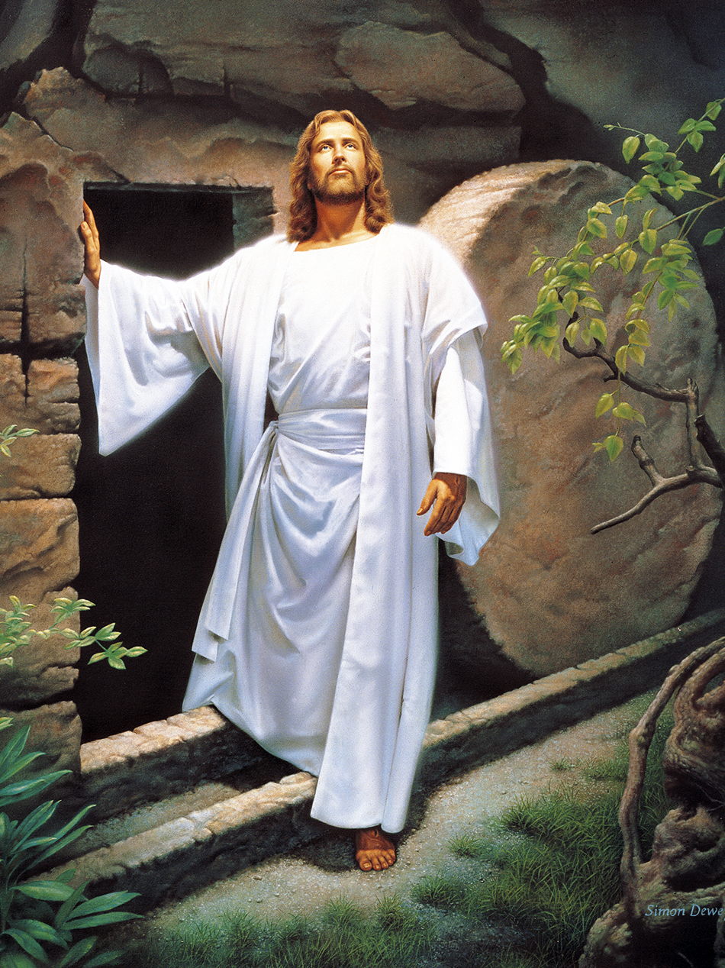
The Resurrection
Read 2 Nephi 9:14–15, looking for what will happen after we are resurrected.

Slide 31
The Resurrection
Read 2 Nephi 9:14–15, looking for what will happen after we are resurrected.
According to verse 14, what will we have a perfect knowledge of when we stand before Jesus Christ to be judged?

Slide 32
The Resurrection
Read 2 Nephi 9:14–15, looking for what will happen after we are resurrected.
According to verse 14, what will we have a perfect knowledge of when we stand before Jesus Christ to be judged?
How can Jacob’s teachings in verse 14 help us understand the importance of our choices in this life?

Slide 33
2 Nephi 9:16–19
2 Nephi 9:16–19 describes the conditions of those who are judged to be wicked and those who are judged to be righteous. Those who remain filthy after the Resurrection are known as the sons of perdition.

Slide 34
Sons of Perdition
These are individuals who “served Satan and turned utterly against God” during their mortal lives (Guide to the Scriptures, “Sons of Perdition,” scriptures.lds.org). They will experience everlasting punishment in outer darkness (see D&C 76:31–48). All other people will receive a degree of glory (see D&C 76:50–112).

Slide 35
Qualities of the Righteous
Read 2 Nephi 9:18, looking for some of the qualities of the righteous.

Slide 36
Qualities of the Righteous
Read 2 Nephi 9:18, looking for some of the qualities of the righteous.
To “[endure] the crosses of the world” means to deny oneself of ungodliness and keep God’s commandments (see Joseph Smith Translation, Matthew 16:25–26). To “[despise] the shame of it” means to choose to not be ashamed of the gospel even though we may be mocked for seeking to live according to its teachings (see 1 Nephi 8:24–34).

Slide 37
Faithfully Endure
What blessing will those who faithfully “[endure] the crosses of the world” receive?

Slide 38
Faithfully Endure
What blessing will those who faithfully “(endure) the crosses of the world” receive?
The Savior’s “way of deliverance” (2 Nephi 9:11) does not just deliver us from the physical and spiritual death brought about by the Fall. The Savior also has the power to deliver us from the spiritual death that results from our own sins, enabling us to be counted among those who are saved in the kingdom of God.

Slide 39
Our Desires and Actions
While deliverance from the Fall of Adam and Eve is a gift to all mankind, our deliverance from the consequences of our sins depends partly on our desires and actions.

Slide 40
Our Desires and Actions
While deliverance from the Fall of Adam and Eve is a gift to all mankind, our deliverance from the consequences of our sins depends partly on our desires and actions.
Read 2 Nephi 9:21, 23–24, looking for phrases to complete the following principle. Through the Atonement of Jesus Christ, we can overcome the consequences of our sins as we …

Slide 41
The Atonement of Jesus Christ
Through the Atonement of Jesus Christ, we can overcome the consequences of our sins as we have faith in Jesus Christ, repent, are baptized, and endure to the end. Consider marking the phrases in 2 Nephi 9:21, 23–24 that teach this principle.

Slide 42
The Atonement of Jesus Christ
How do having faith in Jesus Christ, repenting, being baptized, and enduring to the end help us overcome the consequences of our sins through the Savior’s Atonement?

Slide 43
The Atonement of Jesus Christ
How do having faith in Jesus Christ, repenting, being baptized, and enduring to the end help us overcome the consequences of our sins through the Savior’s Atonement?
For those who have already been baptized, how might worthily partaking of the sacrament help them continue to overcome the consequences of their sins?

Slide 44
Renewing Our Covenant
As we partake of the sacrament, we renew our covenant with the Lord to take His name upon us, always remember Him, and keep His commandments. The Lord in turn promises that His Spirit will always be with us, and the companionship of the Spirit cleanses us from sin.

Slide 45
I Stand All Amazed
Listen to this young single adult choir sing “I Stand All Amazed” (Hymns, no. 193). As you listen to them sing, think about how you feel about the Savior and His atoning sacrifice.
https://www.lds.org/media-library/video/2015-04-2031-i-stand-all-amazed?lang=eng

