Slide 1
2 Nephi 2 (Part 1)
Lesson 23

Slide 2
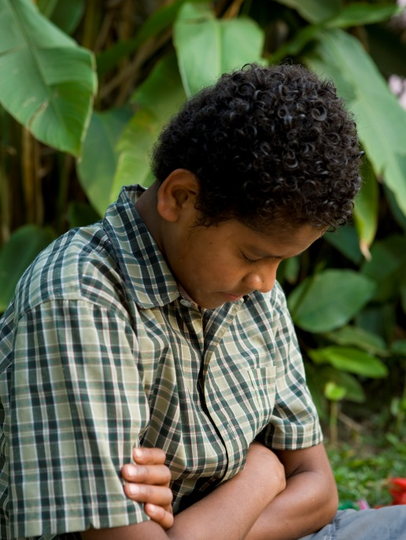
Devotional
Hymn:
Prayer:
Thought:

Slide 3
Questions about Afflictions
Think about some of the afflictions you or your loved ones have experienced.

Slide 4
Questions about Afflictions
Think about some of the afflictions you or your loved ones have experienced.
What questions might people have as they experience afflictions?

Slide 5
Jacob’s Afflictions
Read 2 Nephi 2:1, looking for the cause of Jacob’s afflictions.

Slide 6
Jacob’s Afflictions
Read 2 Nephi 2:1, looking for the cause of Jacob’s afflictions.
Read 2 Nephi 2:2–3, looking for what Lehi taught Jacob about his afflictions.

Slide 7
Consecrate
The Lord can consecrate our afflictions for our gain. The word consecrate means to dedicate or make holy.

Slide 8
Consecrate
The Lord can consecrate our afflictions for our gain. The word consecrate means to dedicate or make holy.
What do you think it means that the Lord can consecrate our afflictions for our gain?

Slide 9
Consecrate
The Lord can consecrate our afflictions for our gain. The word consecrate means to dedicate or make holy.
What do you think it means that the Lord can consecrate our afflictions for our gain?
When have you seen that the Lord can consecrate our afflictions for our gain?

Slide 10
The Fall
Some of our afflictions, like Jacob’s, come from other people’s poor choices. However, many afflictions are the result of the Fall of Adam and Eve. The phrase “the Fall” refers to the conditions and consequences of mortality that came to Adam and Eve and their descendants because of Adam and Eve’s choice to partake of the forbidden fruit in the Garden of Eden.

Slide 11
The Dual Nature of the Fall
The Fall has a dual nature, including the Fall of Adam and Eve and the fall of each individual. Adam and Eve transgressed, and by this transgression they brought two types of death into the world: physical death (all must eventually die) and spiritual death (all are separated from God). Also, all of us commit sin, which brings spiritual death into the world, for which we are each responsible. Without a solution, these conditions would have been permanent.

Slide 12
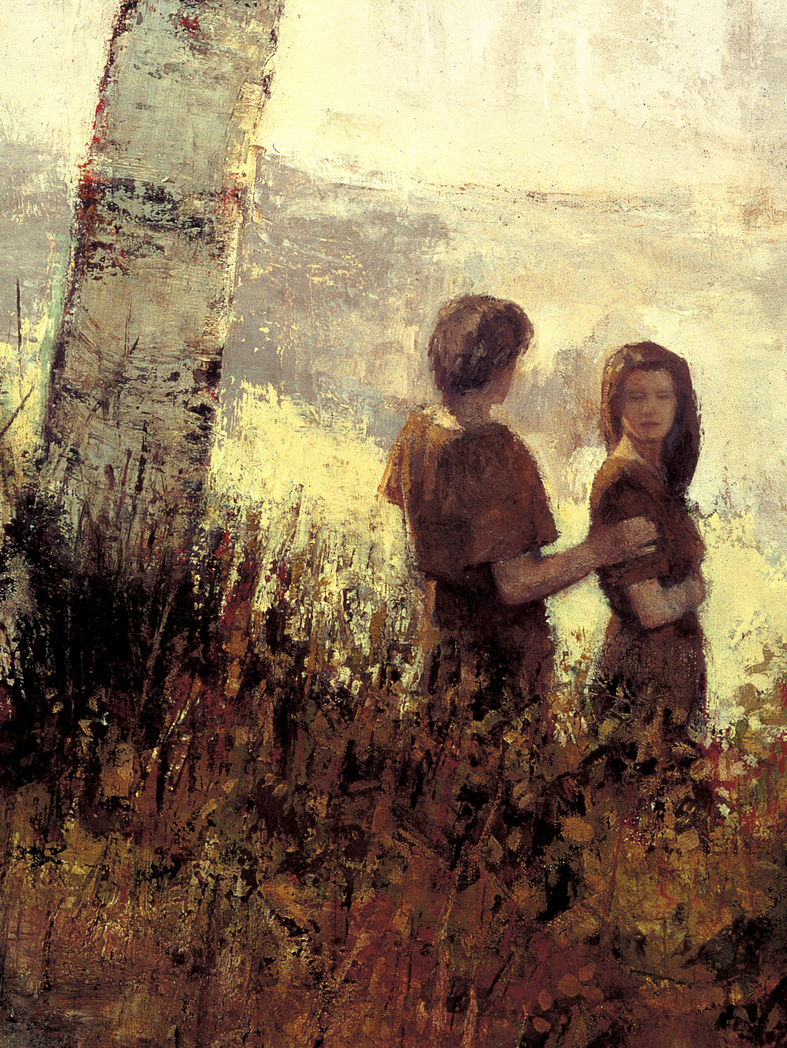
Consequences of the Fall
Read 2 Nephi 2:19–25, looking for results or consequences of the Fall.

Slide 13
Consequences of the Fall
Read 2 Nephi 2:19–25, looking for results or consequences of the Fall.
Adam and Eve were driven out of the Garden of Eden (2 Nephi 2:19).

Slide 14
Consequences of the Fall
Read 2 Nephi 2:19–25, looking for results or consequences of the Fall.
Adam and Eve were driven out of the Garden of Eden (2 Nephi 2:19).
Adam and Eve had to “till the earth” and work for their food (2 Nephi 2:19).

Slide 15
Consequences of the Fall
Read 2 Nephi 2:19–25, looking for results or consequences of the Fall.
Adam and Eve were driven out of the Garden of Eden (2 Nephi 2:19).
Adam and Eve had to “till the earth” and work for their food (2 Nephi 2:19).
Adam and Eve were able to have children (2 Nephi 2:20, 23).

Slide 16
Consequences of the Fall
Read 2 Nephi 2:19–25, looking for results or consequences of the Fall.
Adam and Eve were driven out of the Garden of Eden (2 Nephi 2:19).
Adam and Eve had to “till the earth” and work for their food (2 Nephi 2:19).
Adam and Eve were able to have children (2 Nephi 2:20, 23).
All mankind are temporarily lost or separated from God (spiritual death) (2 Nephi 2:21).

Slide 17
Consequences of the Fall
Adam and Eve would experience physical death (2 Nephi 2:22).

Slide 18
Consequences of the Fall
Adam and Eve would experience physical death (2 Nephi 2:22).
They were able to experience joy (2 Nephi 2:23).

Slide 19
Consequences of the Fall
Adam and Eve would experience physical death (2 Nephi 2:22).
They were able to experience joy (2 Nephi 2:23).
They were able to experience misery (2 Nephi 2:23).

Slide 20
Consequences of the Fall
Adam and Eve would experience physical death (2 Nephi 2:22).
They were able to experience joy (2 Nephi 2:23).
They were able to experience misery (2 Nephi 2:23).
They were able to do good (2 Nephi 2:23).

Slide 21
Consequences of the Fall
Adam and Eve would experience physical death (2 Nephi 2:22).
They were able to experience joy (2 Nephi 2:23).
They were able to experience misery (2 Nephi 2:23).
They were able to do good (2 Nephi 2:23).
They received knowledge of sin (2 Nephi 2:23).

Slide 22
Subject to the Fall
Although God does not hold us responsible for Adam and Eve’s decision, we are still subject to the conditions brought about by the Fall.

Slide 23
Subject to the Fall
Although God does not hold us responsible for Adam and Eve’s decision, we are still subject to the conditions brought about by the Fall.
If there were no resurrection, how would physical death prevent us from becoming like Heavenly Father?

Slide 24
Subject to the Fall
Although God does not hold us responsible for Adam and Eve’s decision, we are still subject to the conditions brought about by the Fall.
If there were no resurrection, how would physical death prevent us from becoming like Heavenly Father?
In addition to the physical death and separation from God that we inherited from the Fall, what effect do our own sins have on our relationship with God?

Slide 25
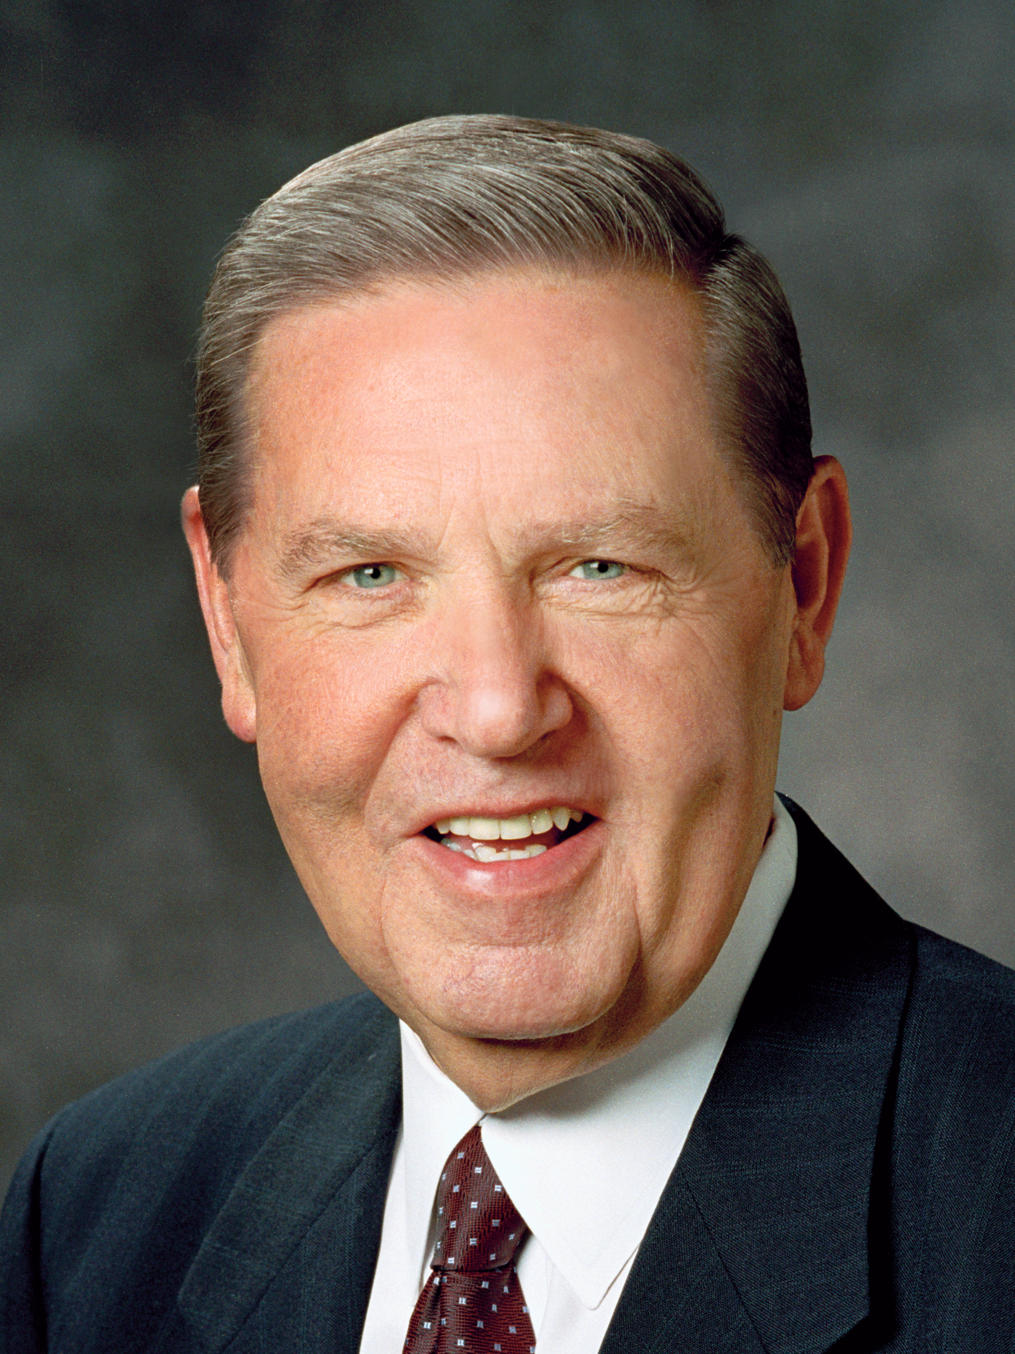
Elder Jeffrey R. Holland
While rock climbing without any safety gear in southern Utah, two brothers encountered a protruding ledge that kept them from reaching the top of a canyon wall. They could not get over it, nor could they safely climb back down. The older brother was able to boost the younger brother up and over the ledge to safety, but he knew he could not reach the ledge himself without jumping. He also knew he faced the risk of falling to his death if he tried to jump.
Continued on the next page.

Slide 26
Elder Jeffrey R. Holland, cont.
Since he did not want his younger brother to see him fall and die, he told his brother to go look for a tree branch. The older brother then leapt as high as he could and grabbed the ledge, but, unable to hold onto it, he started slipping toward his death. (See Jeffrey R. Holland, “Where Justice, Love, and Mercy Meet,” Ensign or Liahona, May 2015, 104.)

Slide 27
What Would You Think?
If you had been in the older brother’s situation, what do you think would have been going through your mind?

Slide 28
What Would You Think?
If you had been in the older brother’s situation, what do you think would have been going through your mind?
What similarities do you see between the older brother’s situation and our condition here in mortality?

Slide 29
Elder Jeffrey R. Holland
“Because we were then born into that fallen world [that resulted from Adam and Eve’s transgression] and because we too would transgress the laws of God, we also were sentenced to the same penalties that Adam and Eve faced.
Continued on next page.

Slide 30
Elder Jeffrey R. Holland, cont.
“What a plight! The entire human race in free fall—every man, woman, and child in it physically tumbling toward permanent death, spiritually plunging toward eternal anguish. Is that what life was meant to be?” (Jeffrey R. Holland, “Where Justice, Love, and Mercy Meet,” 105).

Slide 31
Question
What would the future hold for us if there were no way to overcome the negative consequences of the Fall?

Slide 32
Elder Jeffrey R. Holland
“‘But then suddenly, like a lightning strike in a summer storm, two hands shot out from somewhere above the edge of the cliff, grabbing my wrists with a strength and determination that belied their size. My faithful little brother had not gone looking for any fictitious tree branch.
Continued on the next page.

Slide 33
Elder Jeffrey R. Holland, cont.
“‘Guessing exactly what I was planning to do, he had never moved an inch. He had simply waited—silently, almost breathlessly—knowing full well I would be foolish enough to try to make that jump. When I did, he grabbed me, held me, and refused to let me fall. Those strong brotherly arms saved my life that day as I dangled helplessly above what would surely have been certain death’” (Jeffrey R. Holland, “Where Justice, Love, and Mercy Meet,” 104–5).

Slide 34
Saved from the Fall
If you had been in this situation, what feelings might you have had for the person who had saved you from falling?

Slide 35
Saved from the Fall
If you had been in this situation, what feelings might you have had for the person who had saved you from falling?
Read the first sentence of 2 Nephi 2:26, looking for who has saved us from the Fall. In this context, the word redeem means to rescue or deliver from penalty by making a payment.

Slide 36
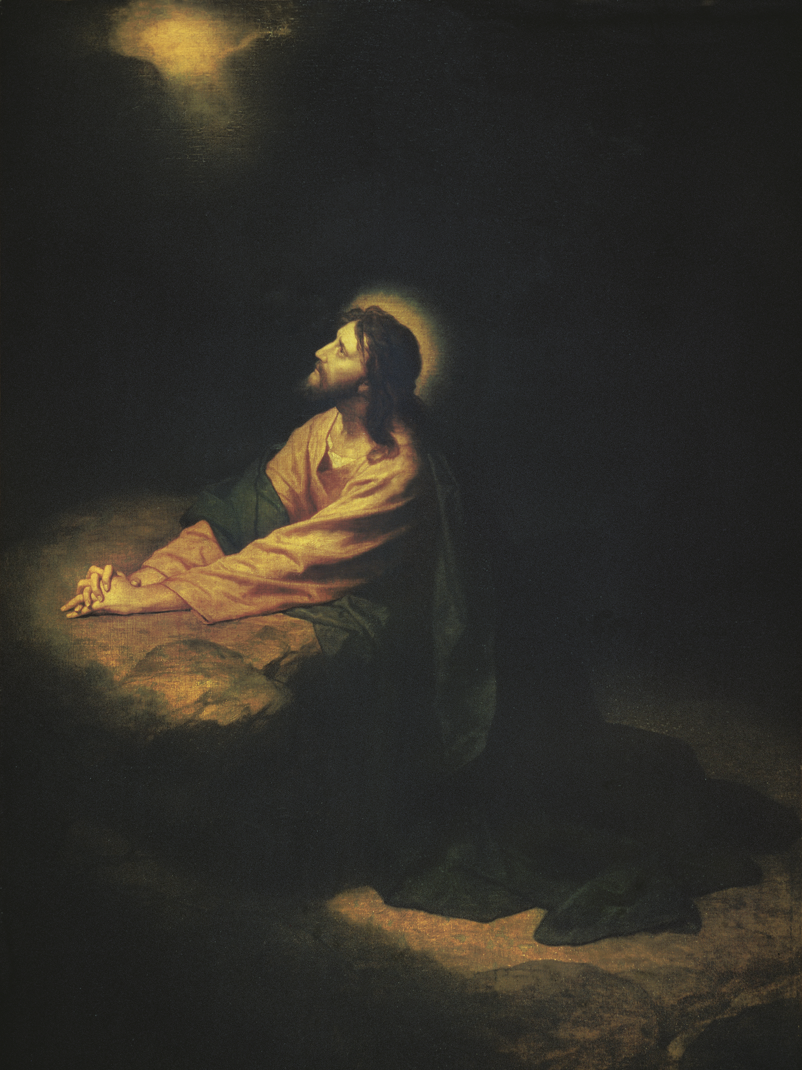
Redemption through the Savior
Read 2 Nephi 2:6–10, looking for phrases in these verses that show what the Savior has done to redeem us from the effects of the Fall and from our individual sins.

Slide 37
Redemption through the Savior
Read 2 Nephi 2:6–10, looking for phrases in these verses that show what the Savior has done to redeem us from the effects of the Fall and from our individual sins.
The phrase “make intercession” means to plead on behalf of another person or to act in another person’s place.

Slide 38
Redemption through the Savior
Read 2 Nephi 2:6–10, looking for phrases in these verses that show what the Savior has done to redeem us from the effects of the Fall and from our individual sins.
The phrase “make intercession” means to plead on behalf of another person or to act in another person’s place.
Through His Atonement, Jesus Christ unconditionally redeems all mankind from the effects of the Fall of Adam and Eve.

Slide 39
The Atonement of Jesus Christ
“Through the Atonement, Jesus Christ redeems all people from the effects of the Fall. All people who have ever lived on the earth and who ever will live on the earth will be resurrected and brought back into the presence of God to be judged (see 2 Nephi 2:5–10; Helaman 14:15–17). Through the Savior’s gift of mercy and redeeming grace, we will all receive the gift of immortality and live forever in glorified, resurrected bodies.

Slide 40
The Atonement of Jesus Christ
“Although we are redeemed unconditionally from the universal effects of the Fall, we are accountable for our own sins” (True to the Faith: A Gospel Reference [2004], 18).

Slide 41
How to Receive Redemption
Read 2 Nephi 2:7–9, 21, looking for how we can receive redemption from our own sins.

Slide 42
How to Receive Redemption
Read 2 Nephi 2:7–9, 21, looking for how we can receive redemption from our own sins.
Complete this statement: Through His Atonement, Jesus Christ offers us redemption from our own sins as we …

Slide 43
How to Receive Redemption
Read 2 Nephi 2:7–9, 21, looking for how we can receive redemption from our own sins.
Complete this statement: Through His Atonement, Jesus Christ offers us redemption from our own sins as we …
Through His Atonement, Jesus Christ offers us redemption from our own sins as we choose to believe in Him and repent.

Slide 44
The Savior’s Sacrifice
What thoughts and feelings do you have as you consider the Savior’s sacrifice to redeem you from sin and death?

Slide 45
The Savior’s Sacrifice
What thoughts and feelings do you have as you consider the Savior’s sacrifice to redeem you from sin and death?
Consider whether there are sins you may have committed that you have not repented of. Do whatever is necessary to repent so you can be forgiven and redeemed through the Atonement of Jesus Christ.

Slide 46
Review
What do you think are some of the fortunate, or positive, consequences of the Fall?

Slide 47
Review
What do you think are some of the fortunate, or positive, consequences of the Fall?
The phrase “till the earth” means that after Adam and Eve were driven from the garden, they and their descendants have had to work to obtain food. How do you think work helps us progress in Heavenly Father’s plan?

Slide 48
Review
How would having children help Adam and Eve become more like Heavenly Father? In what ways are families important in Heavenly Father’s plan?

Slide 49
Review
How would having children help Adam and Eve become more like Heavenly Father? In what ways are families important in Heavenly Father’s plan?
How can the opportunity to experience joy and misery help us progress in Heavenly Father’s plan?

Slide 50
The Fall Is Essential
The Fall of Adam and Eve is an essential part of Heavenly Father’s plan of happiness.

Slide 51
The Fall Is Essential
The Fall of Adam and Eve is an essential part of Heavenly Father’s plan of happiness.
How has your eternal progress been shaped and influenced by both the Fall of Adam and Eve and the Atonement of Jesus Christ?

