Slide 1
1 Nephi 20–22
Lesson 21

Slide 2
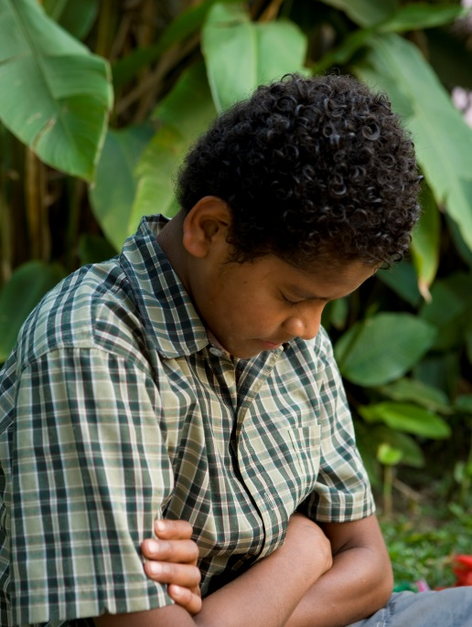
Devotional
Hymn:
Prayer:
Thought:

Slide 3

Worried, Stressed, or Afraid?
What are some circumstances that cause you to feel worried, stressed, or afraid?

Slide 4
Worried, Stressed, or Afraid?
What are some circumstances that cause you to feel worried, stressed, or afraid?
Do you think it is possible to have peace even if you are experiencing difficulties in your life? Why or why not?

Slide 5
Worried, Stressed, or Afraid?
What are some circumstances that cause you to feel worried, stressed, or afraid?
Do you think it is possible to have peace even if you are experiencing difficulties in your life? Why or why not?
As you study 1 Nephi 20 today, look for a principle that can help you have greater peace in your lives, even during difficult times.

Slide 6
The Writings of Isaiah
1 Nephi 20 contains the writings of Isaiah, which Nephi quoted to persuade his people to believe in their Redeemer and to help them have hope (see 1 Nephi 19:23–24). The chapter begins with the Lord’s words addressed to Israelites who had rebelled against the Lord and broken their covenants.

Slide 7
The House of Israel
Read 1 Nephi 20:1–5, 8, looking for words and phrases that show how the house of Israel had rebelled against the Lord.

Slide 8
The House of Israel
Read 1 Nephi 20:1–5, 8, looking for words and phrases that show how the house of Israel had rebelled against the Lord.
A sinew (verse 4) is a tissue that connects bone to muscle. The phrase “thy neck is an iron sinew” indicates that many people in the house of Israel were filled with pride. Just as iron does not bend, a prideful person will not bow his or her neck in humility.

Slide 9
The House of Israel
In 1 Nephi 20:9–17, the Lord told the people that despite their wickedness, He would not abandon them.

Slide 10
The House of Israel
In 1 Nephi 20:9–17, the Lord told the people that despite their wickedness, He would not abandon them.
Read 1 Nephi 20:18–19, looking for how the Israelites would have been blessed if they had obeyed the Lord’s commandments.

Slide 11
The House of Israel
In 1 Nephi 20:9–17, the Lord told the people that despite their wickedness, He would not abandon them.
Read 1 Nephi 20:18–19, looking for how the Israelites would have been blessed if they had obeyed the Lord’s commandments.
How would you state a principle based on verse 18 using the words if and then?

Slide 12
Obedience Brings Peace
If we hearken to the Lord’s commandments, then we will have peace.

Slide 13
Obedience Brings Peace
If we hearken to the Lord’s commandments, then we will have peace.
How can hearkening to the Lord’s commandments bring peace even in the midst of some of the challenges you might face?

Slide 14
Peace
Read 1 Nephi 20:22, looking for what this verse teaches about peace.

Slide 15
Peace
Read 1 Nephi 20:22, looking for what this verse teaches about peace.
How does Isaiah’s teaching in verse 22 relate to the principle we identified in verse 18?

Slide 16
Peace
Read 1 Nephi 20:22, looking for what this verse teaches about peace.
How does Isaiah’s teaching in verse 22 relate to the principle we identified in verse 18?
Has there ever been a time when you may have lacked peace because of your own disobedience?

Slide 17
Peace
Read 1 Nephi 20:22, looking for what this verse teaches about peace.
How does Isaiah’s teaching in verse 22 relate to the principle we identified in verse 18?
Has there ever been a time when you may have lacked peace because of your own disobedience?
Choose one way that you will be more obedient to the Lord’s commandments so you can feel greater peace.

Slide 18
Forgotten
Have there ever been times when you felt forgotten?

Slide 19
Forgotten
Have there ever been times when you felt forgotten?
As recorded in 1 Nephi 21, Nephi quoted Isaiah’s prophecy about the gathering of scattered Israel. This was an important subject to Nephi and his family, who had been scattered from Jerusalem, their homeland, because of the wickedness of the people living in the area.

Slide 20
Chosen to Serve the Lord
In 1 Nephi 21:1–13, Nephi copied Isaiah’s prophecies into his own record. Isaiah wrote that the Lord reminded the Israelites that they had been chosen to serve the Lord and bring the message of His salvation “unto the ends of the earth” (1 Nephi 21:6).

Slide 21
The Israelites
Read 1 Nephi 21:14, looking for how the Israelites (referred to in this verse as “Zion”) would feel in their scattered condition.

Slide 22
The Israelites
Read 1 Nephi 21:14, looking for how the Israelites (referred to in this verse as “Zion”) would feel in their scattered condition.
What are some reasons that people today may sometimes feel that the Lord has forgotten them?

Slide 23
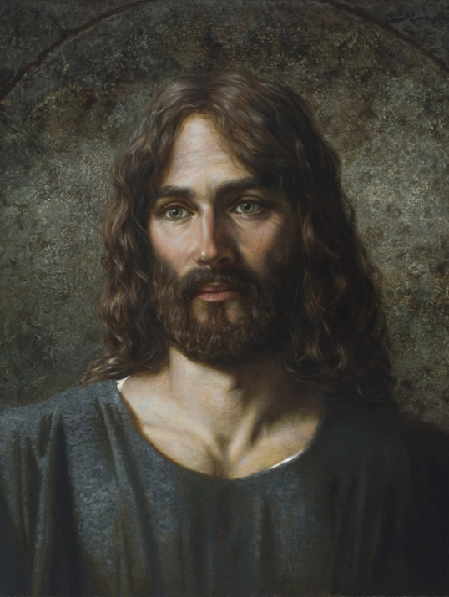
He Never Forgets
Read 1 Nephi 21:15–16, looking for what the Lord said to reassure the Israelites that He had not forgotten them.

Slide 24
He Never Forgets
Read 1 Nephi 21:15–16, looking for what the Lord said to reassure the Israelites that He had not forgotten them.
The phrase “thy walls are continually before me” in verse 16 indicates that the Lord is always watching over and protecting His people.

Slide 25
He Never Forgets
Read 1 Nephi 21:15–16, looking for what the Lord said to reassure the Israelites that He had not forgotten them.
The phrase “thy walls are continually before me” in verse 16 indicates that the Lord is always watching over and protecting His people.
According to verse 16, why will the Savior not forget His people? To engrave is to cut or carve something into an object so the imprint remains there permanently.

Slide 26
The Savior’s Love
In what way have we been graven upon the palms of the Savior’s hands?

Slide 27
The Savior’s Love
In what way have we been graven upon the palms of the Savior’s hands?
How does this demonstrate the Savior’s love for us?

Slide 28
The Savior’s Love
In what way have we been graven upon the palms of the Savior’s hands?
How does this demonstrate the Savior’s love for us?
What can we learn from these verses that can reassure us when we may be tempted to feel that the Lord has forgotten us?

Slide 29
The Savior’s Love
In what way have we been graven upon the palms of the Savior’s hands?
How does this demonstrate the Savior’s love for us?
What can we learn from these verses that can reassure us when we may be tempted to feel that the Lord has forgotten us?
The Lord loves us, and He will never forget us.

Slide 30
The Savior’s Love
In what way have we been graven upon the palms of the Savior’s hands?
How does this demonstrate the Savior’s love for us?
What can we learn from these verses that can reassure us when we may be tempted to feel that the Lord has forgotten us?
The Lord loves us, and He will never forget us.
What experiences have helped you know that the Lord loves you and will never forget you?

Slide 31
The Descendants of Israel
In 1 Nephi 21:17–22:5, Nephi quoted Isaiah, who prophesied that in the latter days the descendants of Israel will be gathered in great numbers. After Nephi had read Isaiah’s prophecies, Nephi’s brethren asked him to explain what the prophecies meant. Nephi taught his brethren that the house of Israel would “be scattered upon all the face of the earth, and also among all nations” (1 Nephi 22:3). The remainder of 1 Nephi 22 explains the gathering of Israel.

Slide 32
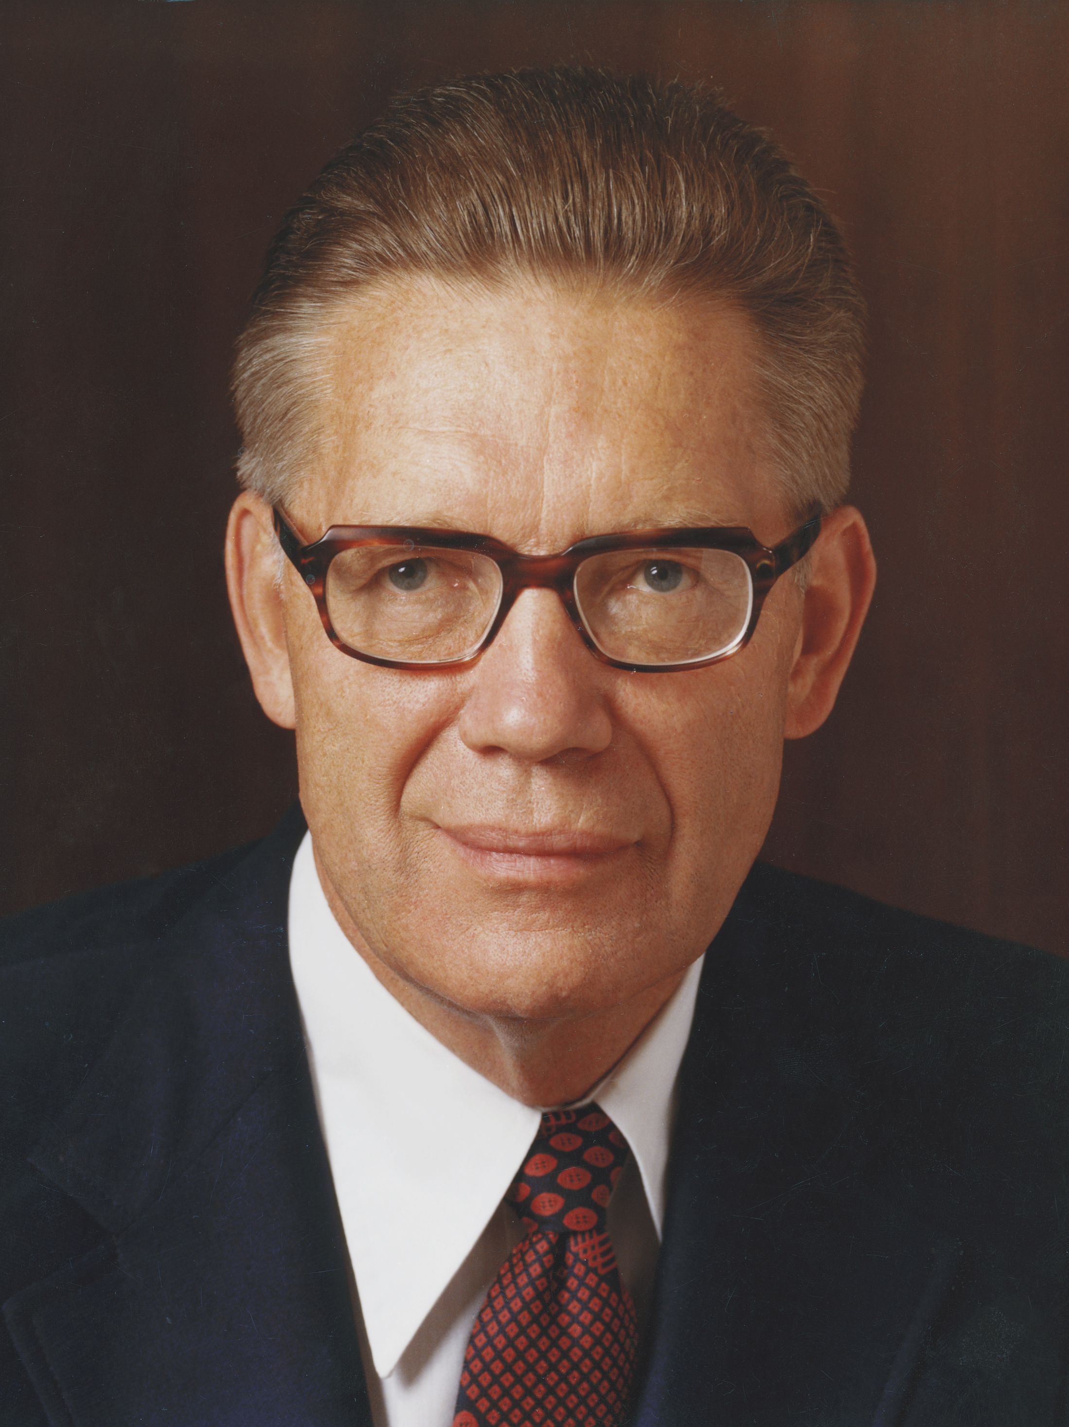
Elder Bruce R. McConkie
“The gathering of Israel consists in believing and accepting and living in harmony with all that the Lord once offered his ancient chosen people. … It consists of believing the gospel, joining the Church, and coming into the kingdom. … It may also consist of assembling to an appointed place or land of worship” (Bruce R. McConkie, A New Witness for the Articles of Faith [1985], 515).

Slide 33
The Gathering of Israel
Read 1 Nephi 22:8–11, looking for what Nephi said the Lord would do to gather Israel in the latter days.

Slide 34
The Gathering of Israel
Read 1 Nephi 22:8–11, looking for what Nephi said the Lord would do to gather Israel in the latter days.
What is the “marvelous work” mentioned in 1 Nephi 22:8?

Slide 35
The Gathering of Israel
Read 1 Nephi 22:8–11, looking for what Nephi said the Lord would do to gather Israel in the latter days.
What is the “marvelous work” mentioned in 1 Nephi 22:8?
The marvelous work Nephi spoke of is the Restoration of the gospel, and when the scriptures mention the Lord “[making] bare his arm,” they refer to the Lord showing His power through the Restoration of the gospel.

Slide 36
The Restoration of the Gospel
According to 1 Nephi 22:9–10, who will be able to be blessed because of the Restoration of the gospel? The phrase “all the kindreds of the earth” (verse 9) refers to all of God’s children everywhere.

Slide 37
The Restoration of the Gospel
According to 1 Nephi 22:9–10, who will be able to be blessed because of the Restoration of the gospel? The phrase “all the kindreds of the earth” (verse 9) refers to all of God’s children everywhere.
Through the Restoration of the gospel, all of God’s children everywhere may be blessed.

Slide 38
The Restoration of the Gospel
According to 1 Nephi 22:9–10, who will be able to be blessed because of the Restoration of the gospel? The phrase “all the kindreds of the earth” (verse 9) refers to all of God’s children everywhere.
Through the Restoration of the gospel, all of God’s children everywhere may be blessed.
In 1 Nephi 22:11, what does Nephi say the Lord will bring unto the house of Israel in the last days?

Slide 39
The House of Israel
Read 1 Nephi 22:12, looking for the effect that the Lord’s covenants and gospel will have on the house of Israel.

Slide 40
The House of Israel
Read 1 Nephi 22:12, looking for the effect that the Lord’s covenants and gospel will have on the house of Israel.
According to verse 12, what will scattered Israel experience and come to know?

Slide 41
Scattered Israel
Scattered Israel will be gathered and will come to know that Jesus Christ is their Savior.

Slide 42
Scattered Israel
Scattered Israel will be gathered and will come to know that Jesus Christ is their Savior.
In what ways are the prophecies Nephi recorded in 1 Nephi 22:9–12 being fulfilled today?

Slide 43
Scattered Israel
Scattered Israel will be gathered and will come to know that Jesus Christ is their Savior.
In what ways are the prophecies Nephi recorded in 1 Nephi 22:9–12 being fulfilled today?
As we share the gospel with others, we can help them come to know that Jesus Christ is their Savior, be baptized, and receive the gift of the Holy Ghost, thereby being gathered spiritually into the Lord’s Church.

Slide 44
1 Nephi 22:13–31
As recorded in 1 Nephi 22:13–31, Nephi continued to write about the prophecies of Isaiah. He explained that in the latter days God would preserve the righteous and destroy the wicked. Nephi concluded by promising that all who repent will dwell safely with the Savior.

