Slide 1
1 Nephi 16
Lesson 17

Slide 2

Devotional
Hymn:
Prayer:
Thought:

Slide 3
Responding to Challenges
What are some common ways people respond to challenges and hardships they face?

Slide 4
Responding to Challenges
What are some common ways people respond to challenges and hardships they face?
Reflect on how you are responding to the challenges of life.

Slide 5
Trials and Hardships
Lehi’s family often experienced hardships as they traveled in the wilderness. As we study 1 Nephi 16 today, look for how the different individuals in Lehi’s family responded to these trials and how we can invite God’s help in the way that we choose to respond to our personal challenges.

Slide 6
1 Nephi 16:1–8
Laman and Lemuel complained to Nephi that he had spoken hard things to them as he explained their father’s vision to them. Nephi responded that “the guilty taketh the truth to be hard” (1 Nephi 16:2) and exhorted them to keep the commandments of God. Nephi’s brethren humbled themselves as a result of his diligence in teaching them. In 1 Nephi 16:7–8, we learn that Lehi’s sons and their companion Zoram each married one of Ishmael’s daughters.

Slide 7
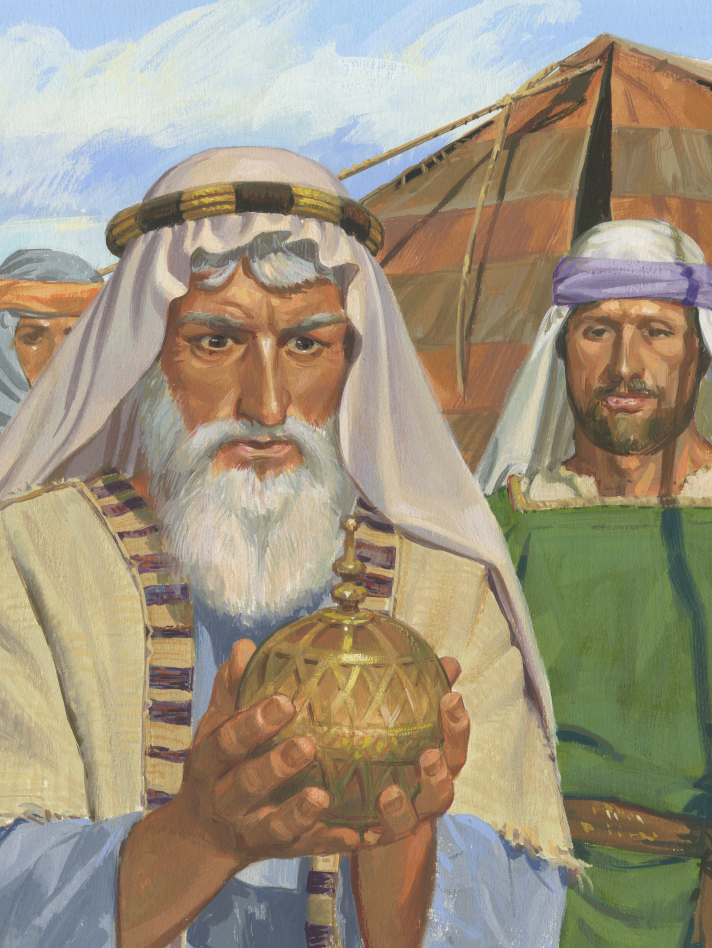
Help from the Lord
Read 1 Nephi 16:9–10, looking for what the Lord provided to help Lehi’s family during their journey.

Slide 8
Help from the Lord
Read 1 Nephi 16:9–10, looking for what the Lord provided to help Lehi’s family during their journey.
Lehi and his family called this ball the Liahona (see Alma 37:38).

Slide 9
Help from the Lord
Read 1 Nephi 16:9–10, looking for what the Lord provided to help Lehi’s family during their journey.
Lehi and his family called this ball the Liahona (see Alma 37:38).
In what ways do you think such a gift would have been helpful to Lehi and his family in their circumstances?

Slide 10
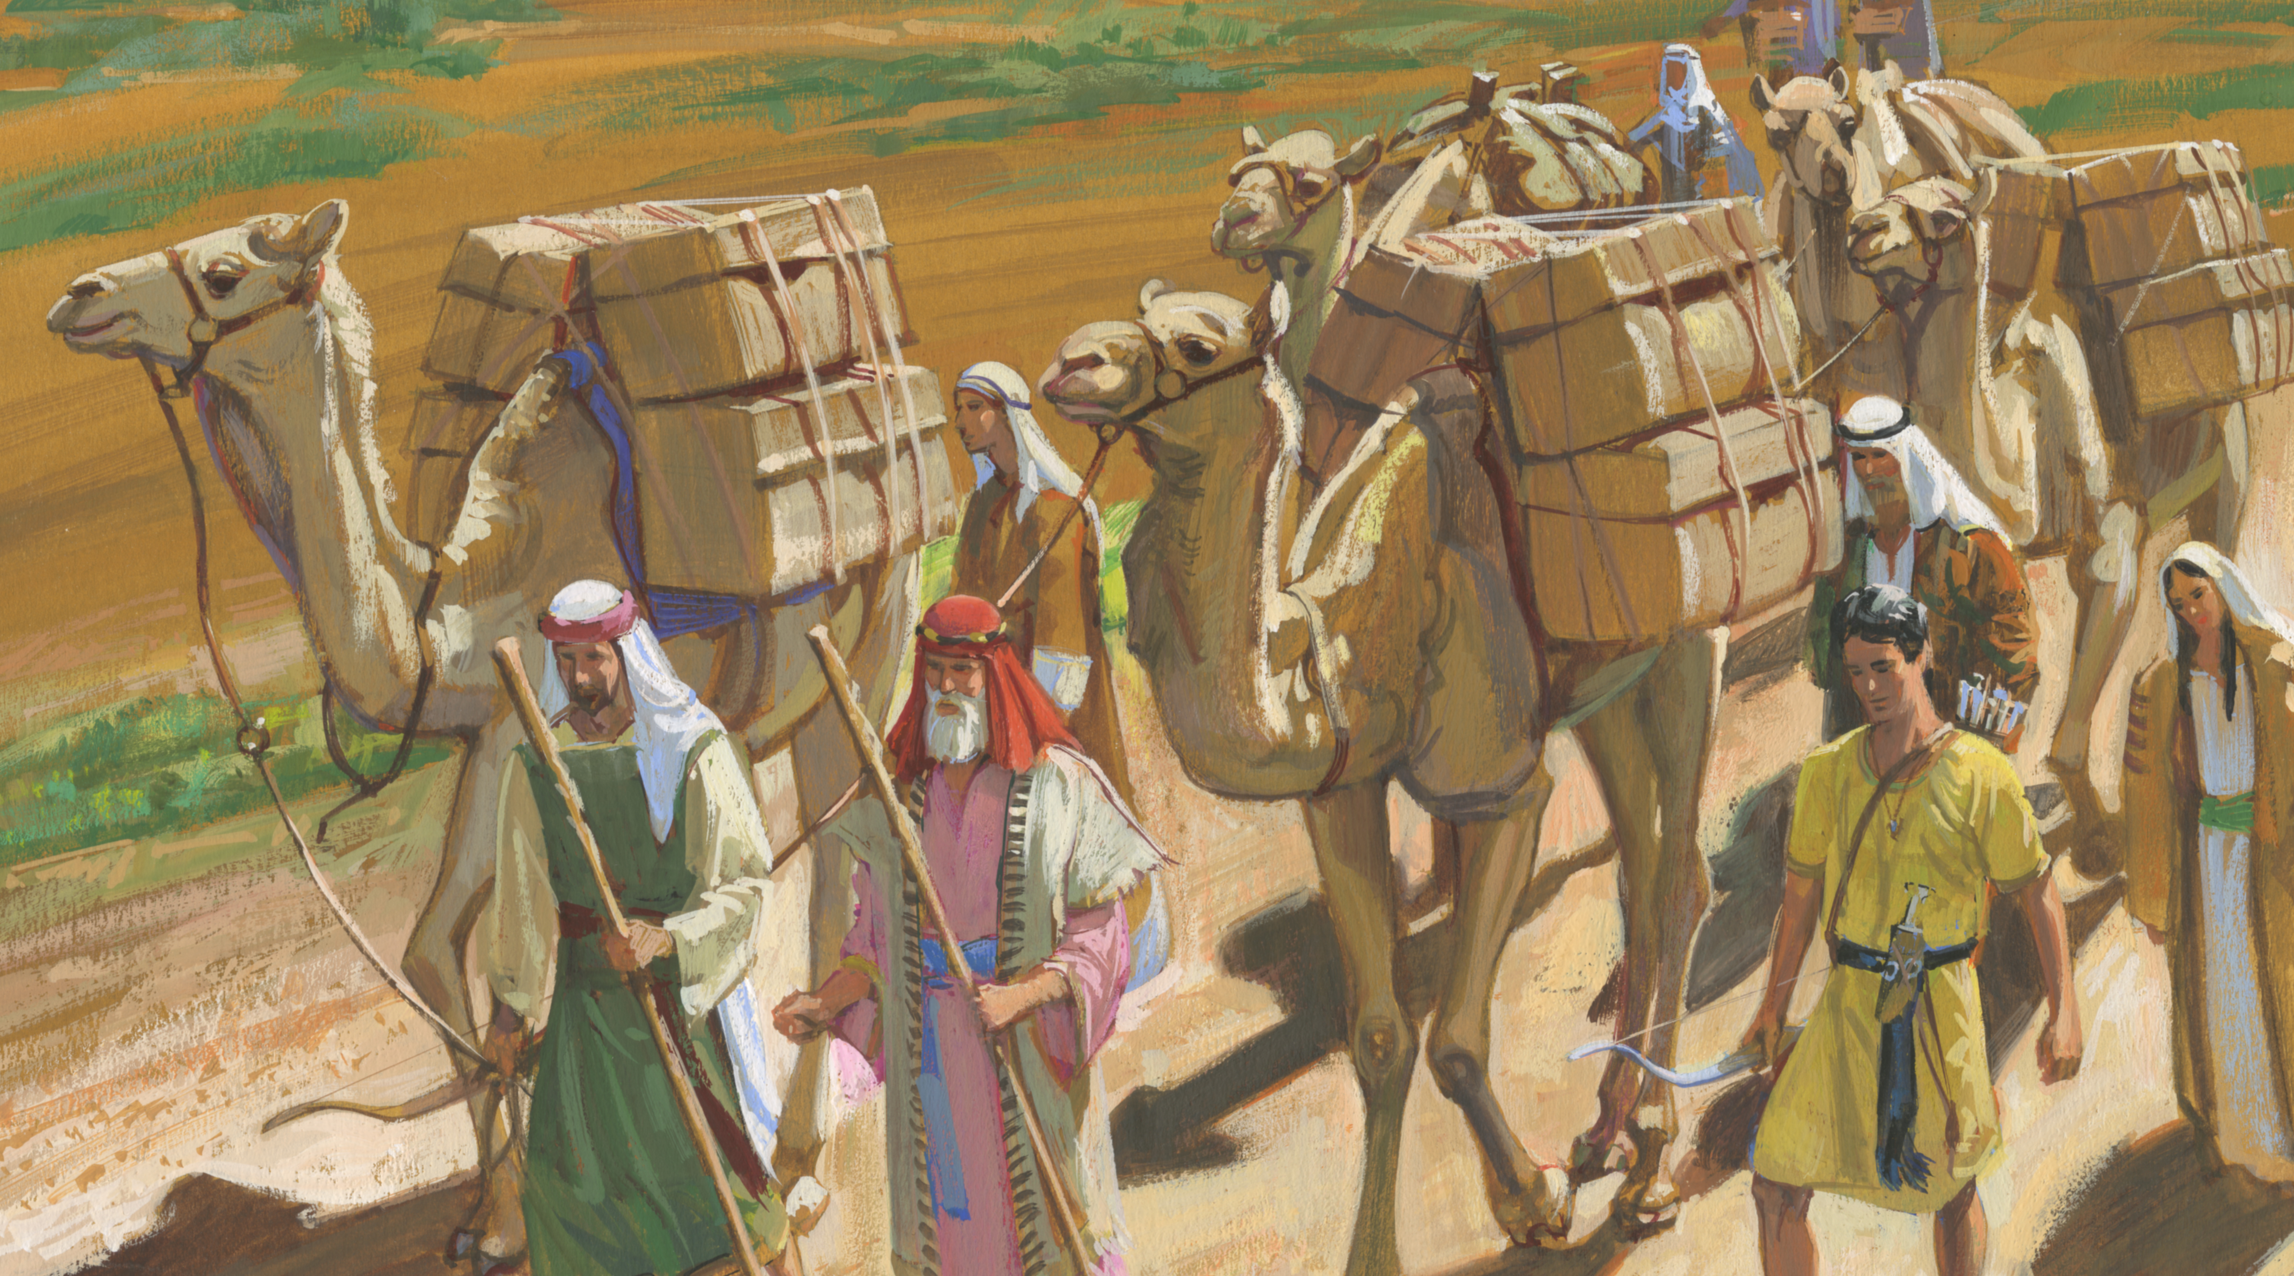
The Liahona
Read 1 Nephi 16:16, looking for how the Liahona helped Lehi’s family.

Slide 11
Lehi’s Family
Read 1 Nephi 16:17–19, looking for what happened after Lehi’s family had traveled many days with the help of the Liahona.

Slide 12
Lehi’s Family
Read 1 Nephi 16:17–19, looking for what happened after Lehi’s family had traveled many days with the help of the Liahona.
What hardship did Nephi experience?

Slide 13
Lehi’s Family
Read 1 Nephi 16:17–19, looking for what happened after Lehi’s family had traveled many days with the help of the Liahona.
What hardship did Nephi experience?
How did Nephi’s brethren respond after Nephi’s bow broke?

Slide 14
Lehi’s Family
Read 1 Nephi 16:17–19, looking for what happened after Lehi’s family had traveled many days with the help of the Liahona.
What hardship did Nephi experience?
How did Nephi’s brethren respond after Nephi’s bow broke?
What hardship did the broken and useless bows bring upon the rest of the family?

Slide 15
Facing Trials
Why do you think righteous people, such as Nephi, sometimes have to face trials?

Slide 16
The Broken Bow
Read 1 Nephi 16:20–22, looking for how some of Lehi’s family reacted to the trial of Nephi’s broken bow.

Slide 17
The Broken Bow
Read 1 Nephi 16:20–22, looking for how some of Lehi’s family reacted to the trial of Nephi’s broken bow.
Read 1 Nephi 16:23–25, looking for Nephi’s response to this trial and how his response affected his family.

Slide 18
The Broken Bow
Read 1 Nephi 16:20–22, looking for how some of Lehi’s family reacted to the trial of Nephi’s broken bow.
Read 1 Nephi 16:23–25, looking for Nephi’s response to this trial and how his response affected his family.
What can we learn by comparing these two responses to the same trial?

Slide 19
Nephi Went to Lehi
Why is it significant that Nephi went to his father for direction, even though Lehi had been murmuring?

Slide 20
Nephi Went to Lehi
Why is it significant that Nephi went to his father for direction, even though Lehi had been murmuring?
By going to Lehi for direction, Nephi showed respect for him as his father and priesthood leader and helped remind him to turn to the Lord. Seeking counsel from parents and priesthood leaders, despite their imperfections, is a way of honoring them and exercising faith in the Lord.

Slide 21
Results of Nephi’s Efforts
Read 1 Nephi 16:30–32, looking for what resulted from Nephi’s efforts to respond faithfully to this difficulty.

Slide 22
Results of Nephi’s Efforts
Read 1 Nephi 16:30–32, looking for what resulted from Nephi’s efforts to respond faithfully to this difficulty.
What principle can we learn from Nephi’s response to his family’s adversity?

Slide 23
Our Own Effort
If we put forth our own effort and seek the Lord’s direction, then He will help us through our difficulties.

Slide 24
Our Own Effort
If we put forth our own effort and seek the Lord’s direction, then He will help us through our difficulties.
Why do you think putting forth our own effort is important in order to receive the Lord’s help through our difficulties?

Slide 25
Our Own Effort
If we put forth our own effort and seek the Lord’s direction, then He will help us through our difficulties.
Why do you think putting forth our own effort is important in order to receive the Lord’s help through our difficulties?
When have you applied this principle during difficult circumstances?

Slide 26
The Liahona
Read 1 Nephi 16:26–29, looking for details about how the Lord used the Liahona to guide Lehi’s family.

Slide 27
The Liahona
Read 1 Nephi 16:26–29, looking for details about how the Lord used the Liahona to guide Lehi’s family.
Using words and phrases contained in verses 28 and 29, how would you finish this principle? Sources of direction from the Lord work in our lives according to …

Slide 28
The Liahona
Read 1 Nephi 16:26–29, looking for details about how the Lord used the Liahona to guide Lehi’s family.
Using words and phrases contained in verses 28 and 29, how would you finish this principle? Sources of direction from the Lord work in our lives according to …
Sources of direction from the Lord work in our lives according to the faith, diligence, and heed we give to them.

Slide 29
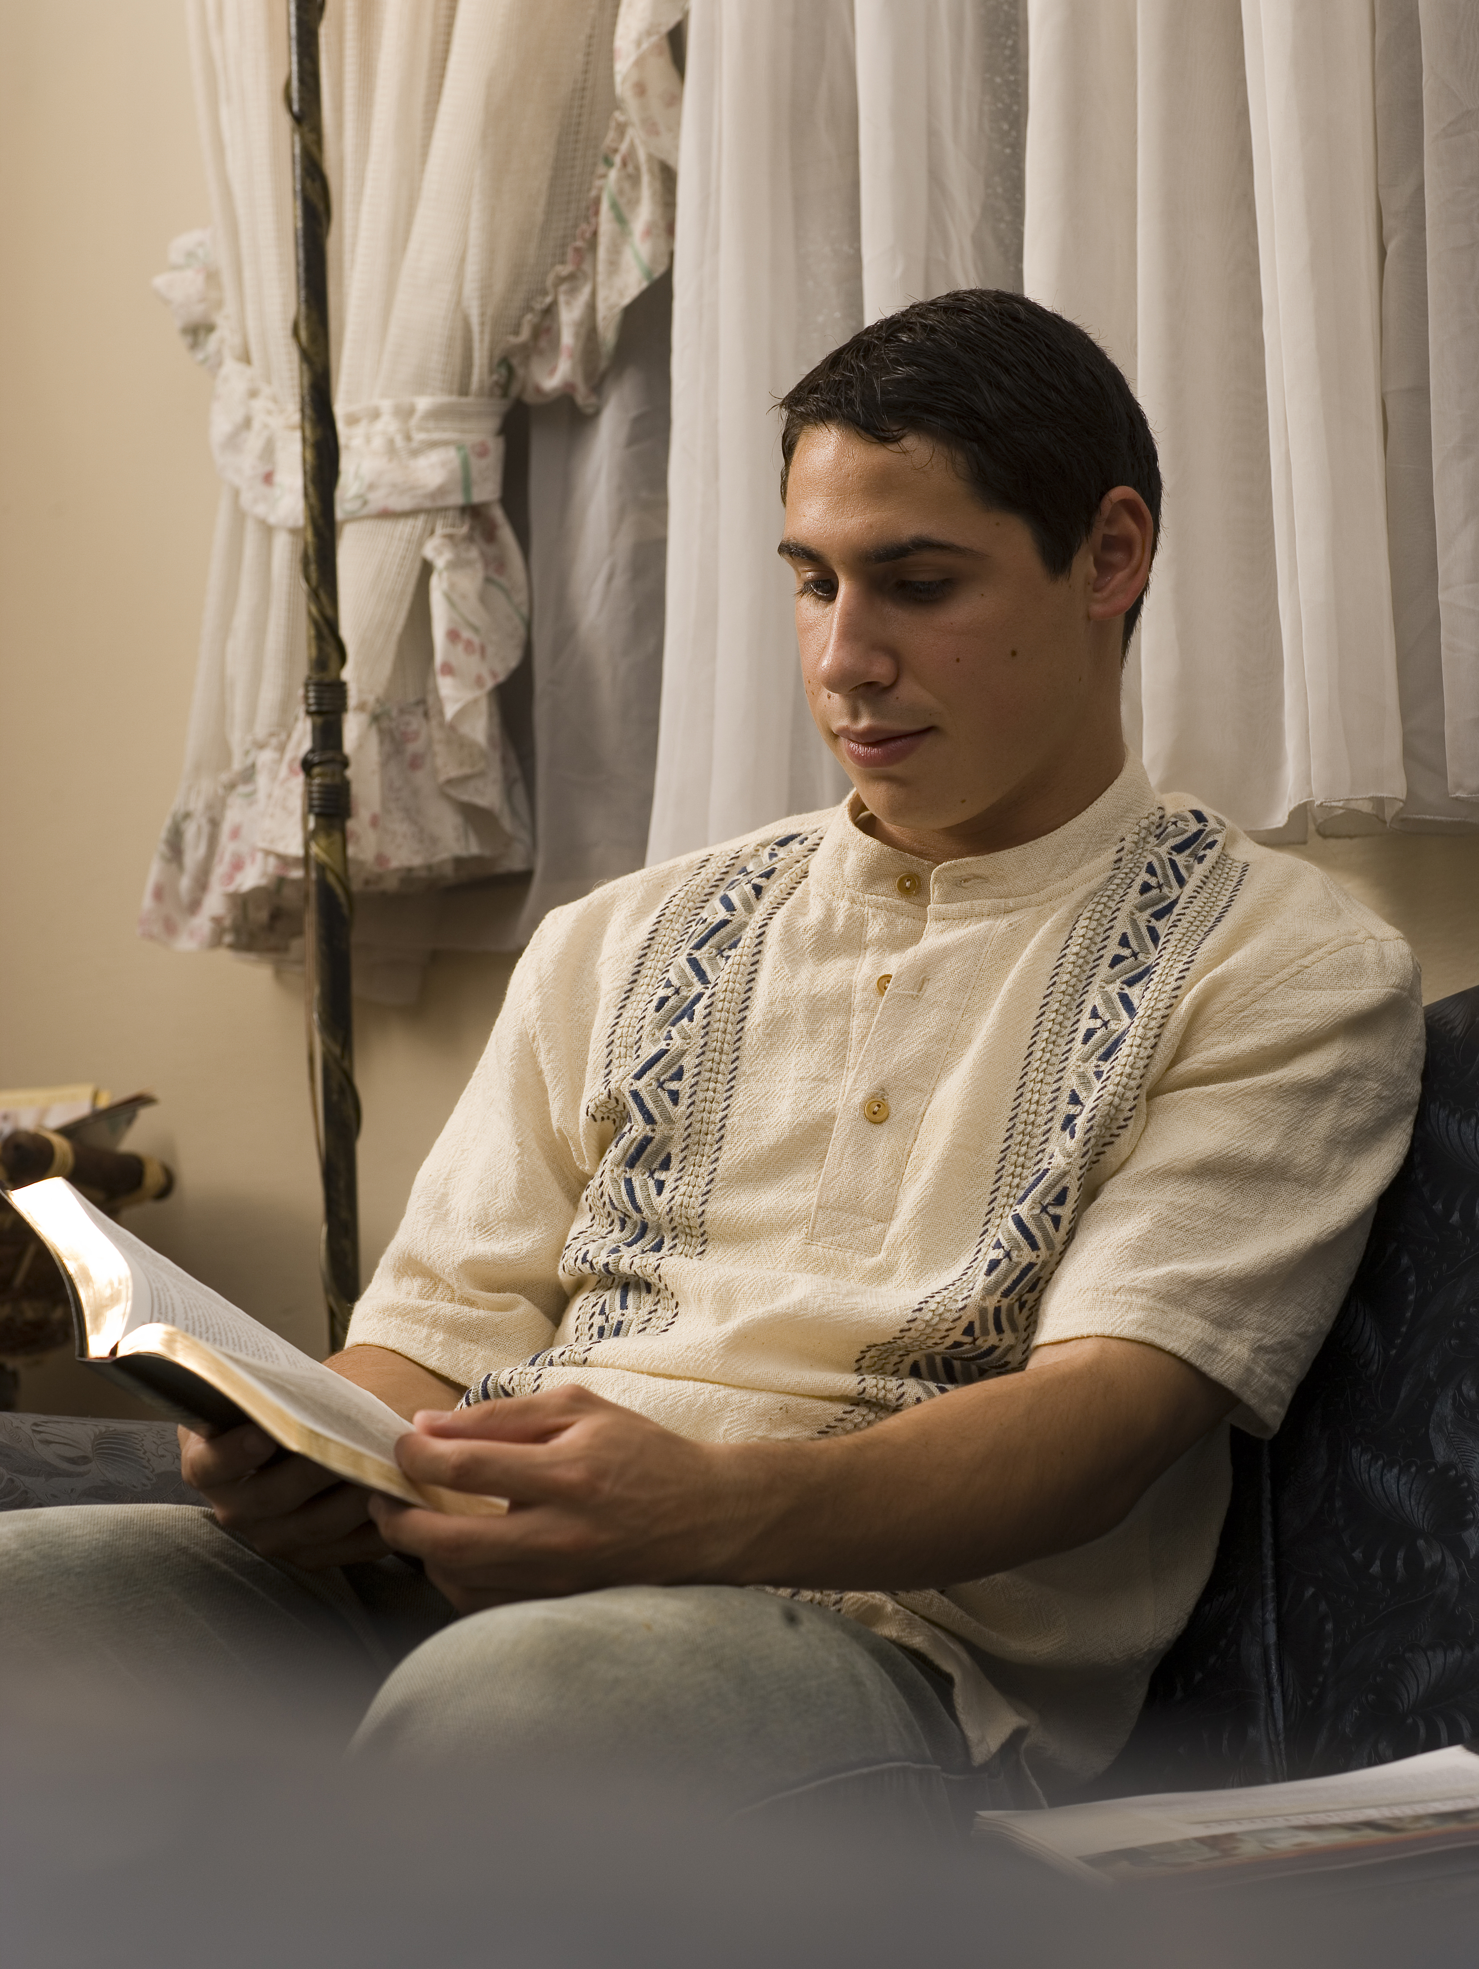
Following the Lord’s Direction
What is the difference between casually following the direction of the Lord and following the Lord’s direction with faith and diligence?

Slide 30
Following the Lord’s Direction
What is the difference between casually following the direction of the Lord and following the Lord’s direction with faith and diligence?
What are some of the “means” (1 Nephi 16:29) by which the Lord guides us today?

Slide 31
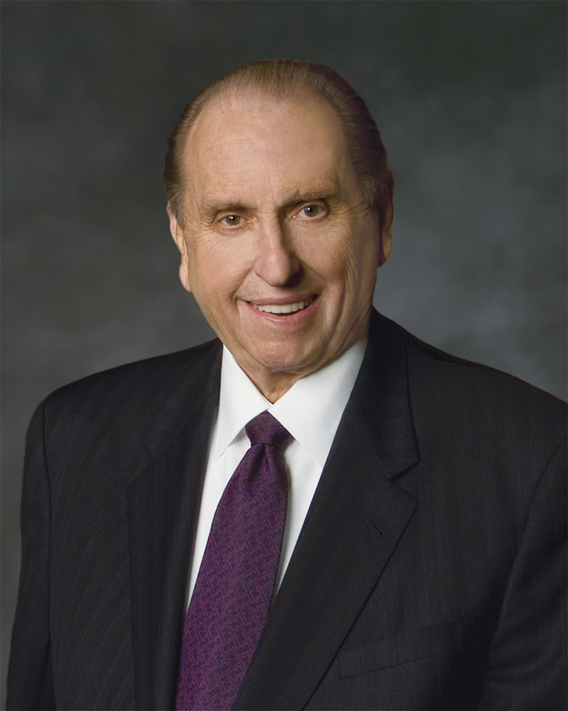
President Thomas S. Monson
“The same Lord who provided a Liahona for Lehi provides for you and for me today a rare and valuable gift to give direction to our lives, to mark the hazards to our safety, and to chart the way, even safe passage—not to a promised land, but to our heavenly home. The gift to which I refer is known as your patriarchal blessing. …
Continued on next page.

Slide 32
President Thomas S. Monson, cont.
“… Your blessing is not to be folded neatly and tucked away. It is not to be framed or published. Rather, it is to be read. It is to be loved. It is to be followed. Your patriarchal blessing will see you through the darkest night. It will guide you through life’s dangers. … Your patriarchal blessing is to you a personal Liahona to chart your course and guide your way” (Thomas S. Monson, “Your Patriarchal Blessing: A Liahona of Light,” Ensign, Nov. 1986, 65–66).

Slide 33
Patriarchal Blessing
What are two or three ways in which a patriarchal blessing is like the Liahona?

Slide 34
Patriarchal Blessing
What are two or three ways in which a patriarchal blessing is like the Liahona?
What might cause us to miss important messages contained in our patriarchal blessing?

Slide 35
Patriarchal Blessing
What are two or three ways in which a patriarchal blessing is like the Liahona?
What might cause us to miss important messages contained in our patriarchal blessing?
When have you been blessed by following the guidance of your patriarchal blessing?

Slide 36
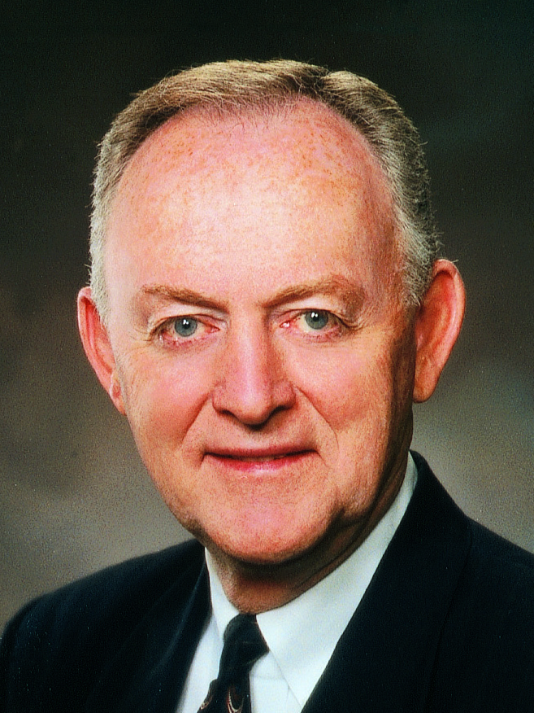
Elder W. Rolfe Kerr
“The words of Christ can be a personal Liahona for each of us, showing us the way. Let us not be slothful because of the easiness of the way. Let us in faith take the words of Christ into our minds and into our hearts as they are recorded in sacred scripture and as they are uttered by living prophets, seers, and revelators.
Continued on next page.

Slide 37
Elder W. Rolfe Kerr, cont.
“Let us with faith and diligence feast upon the words of Christ, for the words of Christ will be our spiritual Liahona telling us all things what we should do” (W. Rolfe Kerr, “The Words of Christ—Our Spiritual Liahona,” Ensign or Liahona, May 2004, 37).

Slide 38
The Scriptures
What are two or three ways in which the scriptures and words of latter-day prophets are like the Liahona?

Slide 39
The Scriptures
What are two or three ways in which the scriptures and words of latter-day prophets are like the Liahona?
What might cause us to miss important messages contained in the scriptures or in the words of the latter-day prophets?

Slide 40
The Scriptures
What are two or three ways in which the scriptures and words of latter-day prophets are like the Liahona?
What might cause us to miss important messages contained in the scriptures or in the words of the latter-day prophets?
When have you been blessed by following the guidance of the scriptures or latter-day prophets?

Slide 41
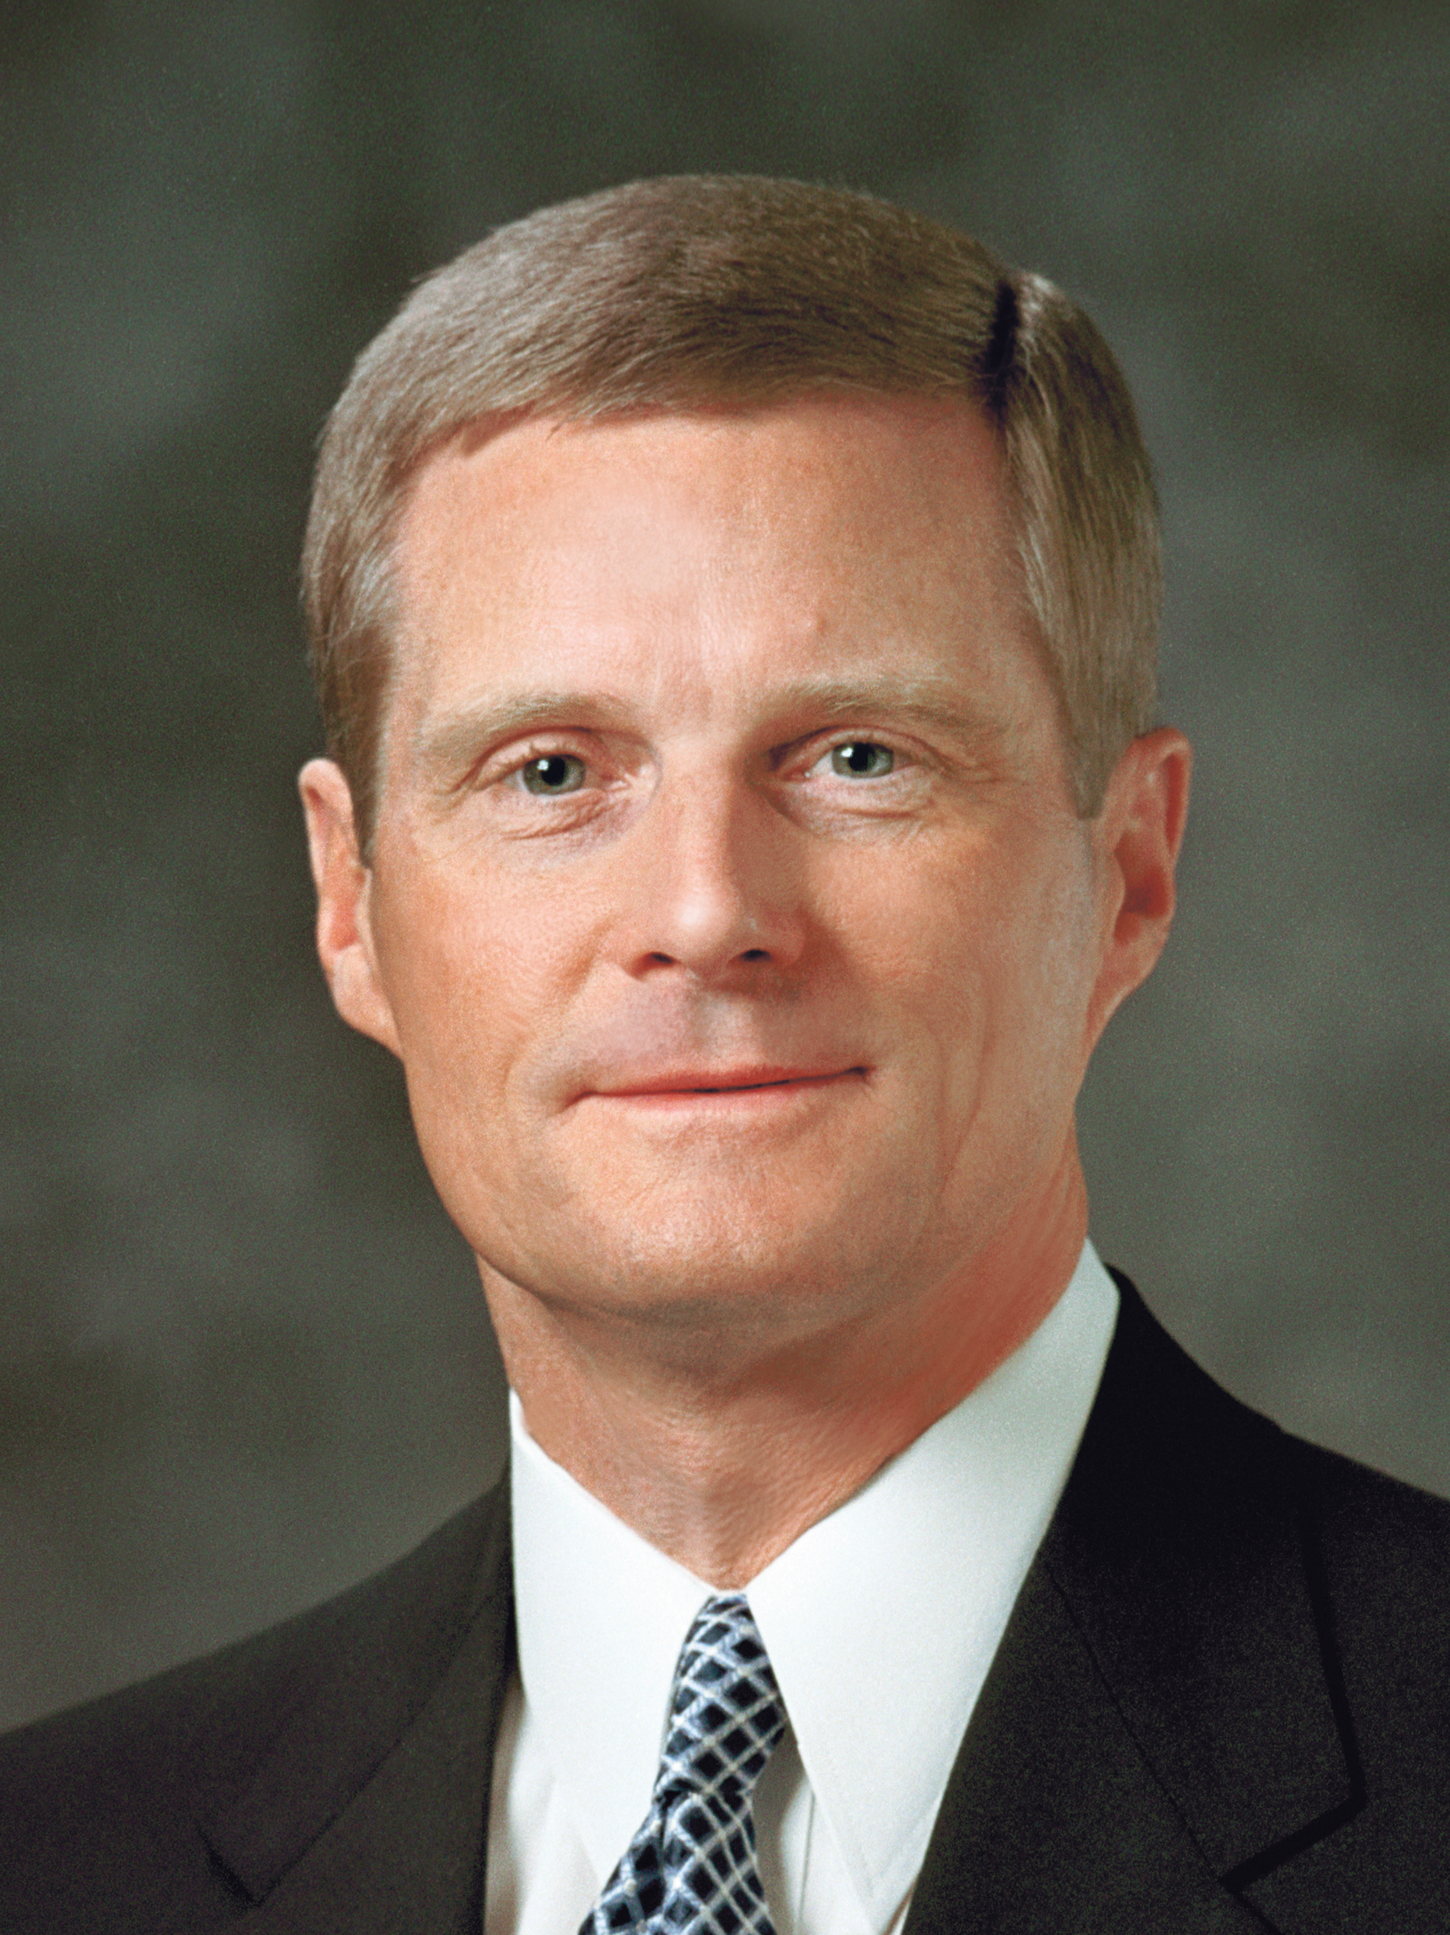
Elder David A. Bednar
“As we strive to align our attitudes and actions with righteousness, then the Holy Ghost becomes for us today what the Liahona was for Lehi and his family in their day. The very factors that caused the Liahona to work for Lehi will likewise invite the Holy Ghost into our lives. And the very factors that caused the Liahona not to work anciently will likewise cause us to withdraw ourselves from the Holy Ghost today” (David A. Bednar, “That We May Always Have His Spirit to Be with Us,” Ensign or Liahona, May 2006, 30).

Slide 42
The Holy Ghost
What are two or three ways in which the Holy Ghost is like the Liahona?

Slide 43
The Holy Ghost
What are two or three ways in which the Holy Ghost is like the Liahona?
What might cause us to miss important messages from the Holy Ghost?

Slide 44
The Holy Ghost
What are two or three ways in which the Holy Ghost is like the Liahona?
What might cause us to miss important messages from the Holy Ghost?
When have you been blessed by following the guidance of the Holy Ghost?

Slide 45
1 Nephi 16:33–39
In 1 Nephi 16:33–39 we learn that Ishmael died. Some of his children mourned exceedingly and again began to murmur against Lehi and Nephi. Laman, Lemuel, and the sons of Ishmael conspired to kill Lehi and Nephi, but the voice of the Lord rebuked them and they repented and turned away from their anger.

