Slide 1
1 Nephi 6, 9
Lesson 10

Slide 2

Devotional
Hymn:
Prayer:
Thought:
Notes:
ID 272818

Slide 3
Author’s Purpose
Think of books or movies that are popular with youth today. What was the author’s or creator’s purpose for the books or movies?

Slide 4
Purpose of the Book of Mormon
Read 1 Nephi 6:1–4. Whom do you think “the God of Abraham, and the God of Isaac, and the God of Jacob” (verse 4) refers to?

Slide 5
Purpose of the Book of Mormon
Read 1 Nephi 6:1–4. Whom do you think “the God of Abraham, and the God of Isaac, and the God of Jacob” (verse 4) refers to?
How would you state Nephi’s intent in your own words?

Slide 6
Purpose of the Book of Mormon
Read 1 Nephi 6:1–4. Whom do you think “the God of Abraham, and the God of Isaac, and the God of Jacob” (verse 4) refers to?
How would you state Nephi’s intent in your own words?
One purpose of the Book of Mormon is to persuade all people to come unto Jesus Christ and be saved.

Slide 7
The Mission of the Savior
Turn to the index of the Book of Mormon and scan all the headings associated with Jesus Christ. What are a few of the ways the Book of Mormon teaches about the mission of the Savior?

Slide 8
The Mission of the Savior
Turn to the index of the Book of Mormon and scan all the headings associated with Jesus Christ. What are a few of the ways the Book of Mormon teaches about the mission of the Savior?
How might understanding Nephi’s purpose for writing influence the way you study the Book of Mormon?

Slide 9
Messages in the Book of Mormon
Read 1 Nephi 6:5–6. According to these verses, what truth can we learn about the messages contained in the Book of Mormon?

Slide 10
Messages in the Book of Mormon
Read 1 Nephi 6:5–6. According to these verses, what truth can we learn about the messages contained in the Book of Mormon?
The messages contained in the Book of Mormon are pleasing to God and are of great worth to His children.

Slide 11
Messages in the Book of Mormon
Read 1 Nephi 6:5–6. According to these verses, what truth can we learn about the messages contained in the Book of Mormon?
The messages contained in the Book of Mormon are pleasing to God and are of great worth to His children.
How can understanding this truth help us as we study the Book of Mormon?

Slide 12
Understanding Commandments
What are some commandments or standards of the Lord that some youth may not yet understand the reason for?

Slide 13
Small Plates and Large Plates
In 1 Nephi 9:1–5, Nephi tells about his effort to keep records on two sets of plates known as the small plates of Nephi and the large plates of Nephi. (The words small and large refer to the number of plates in each set. The small plates of Nephi had fewer plates than the large plates of Nephi.) “These plates” = small plates and “the other plates” = large plates. You may want to consider writing these words in your scriptures.

Slide 14
Two Sets of Plates
Read 1 Nephi 9:1–4, looking for what was contained on each set of plates.

Slide 15
Two Sets of Plates
Read 1 Nephi 9:1–4, looking for what was contained on each set of plates.
According to verse 3, why did Nephi begin keeping a second record?

Slide 16
Two Sets of Plates
Read 1 Nephi 9:1–4, looking for what was contained on each set of plates.
According to verse 3, why did Nephi begin keeping a second record?
Imagine being in Nephi’s situation. Consider the effort and difficulty it would require to make a second set of plates and to maintain two records at once.

Slide 17
The Purpose of the Commandment
Read 1 Nephi 9:5–6. What did Nephi understand about the purpose of the commandment to make the small plates?

Slide 18
The Purpose of the Commandment
Read 1 Nephi 9:5–6. What did Nephi understand about the purpose of the commandment to make the small plates?
What are different ways someone could respond in Nephi’s situation?

Slide 19
The Purpose of the Commandment
Read 1 Nephi 9:5–6. What did Nephi understand about the purpose of the commandment to make the small plates?
What are different ways someone could respond in Nephi’s situation?
What is admirable about Nephi’s faith in the Lord?

Slide 20
Mormon’s Abridgment
Nearly 1,000 years later, the prophet Mormon made an abridgment, or shortened version, of the records that had been written by his people. As he created this abridgment, he found the small plates of Nephi and was prompted by the Spirit to include them unabridged in his record “for a wise purpose” (Words of Mormon 1:7) that was unknown to him at the time.

Slide 21
The Lord’s “Wise Purpose”
At least part of the Lord’s “wise purpose” (1 Nephi 9:5; Words of Mormon 1:7) for having Nephi keep two sets of records became apparent when Joseph Smith translated the Book of Mormon. Joseph began his translation with Mormon’s abridgment of the large plates of Nephi. Martin Harris, who had been helping Joseph, wanted to show the translation to his wife and family.

Slide 22
The Lord’s “Wise Purpose”
Reluctantly, the Prophet allowed Martin to borrow the 116 pages of manuscript that had been completed up to that time. The 116 pages were stolen from Martin, and, as a consequence, the plates, the Urim and Thummim, and the gift to translate were temporarily taken from Joseph Smith (see D&C 3:14).

Slide 23
The Lord’s “Wise Purpose”
After Joseph Smith went through a period of repentance (see D&C 3:10), the Lord told him not to retranslate the lost portion (see D&C 10:30). Instead He commanded him to translate the small plates of Nephi (see D&C 10:41), which covered the same period of time.

Slide 24
The Lord’s “Wise Purpose”
He informed Joseph that those who had taken the 116 pages had changed them and planned to use them to discredit the work (see D&C 10:10–19). The Lord had foreseen these events many hundreds of years earlier and had provided the second record to thwart Satan’s plan. (See History of the Church, 1:20–23; D&C 10:38–46.)

Slide 25
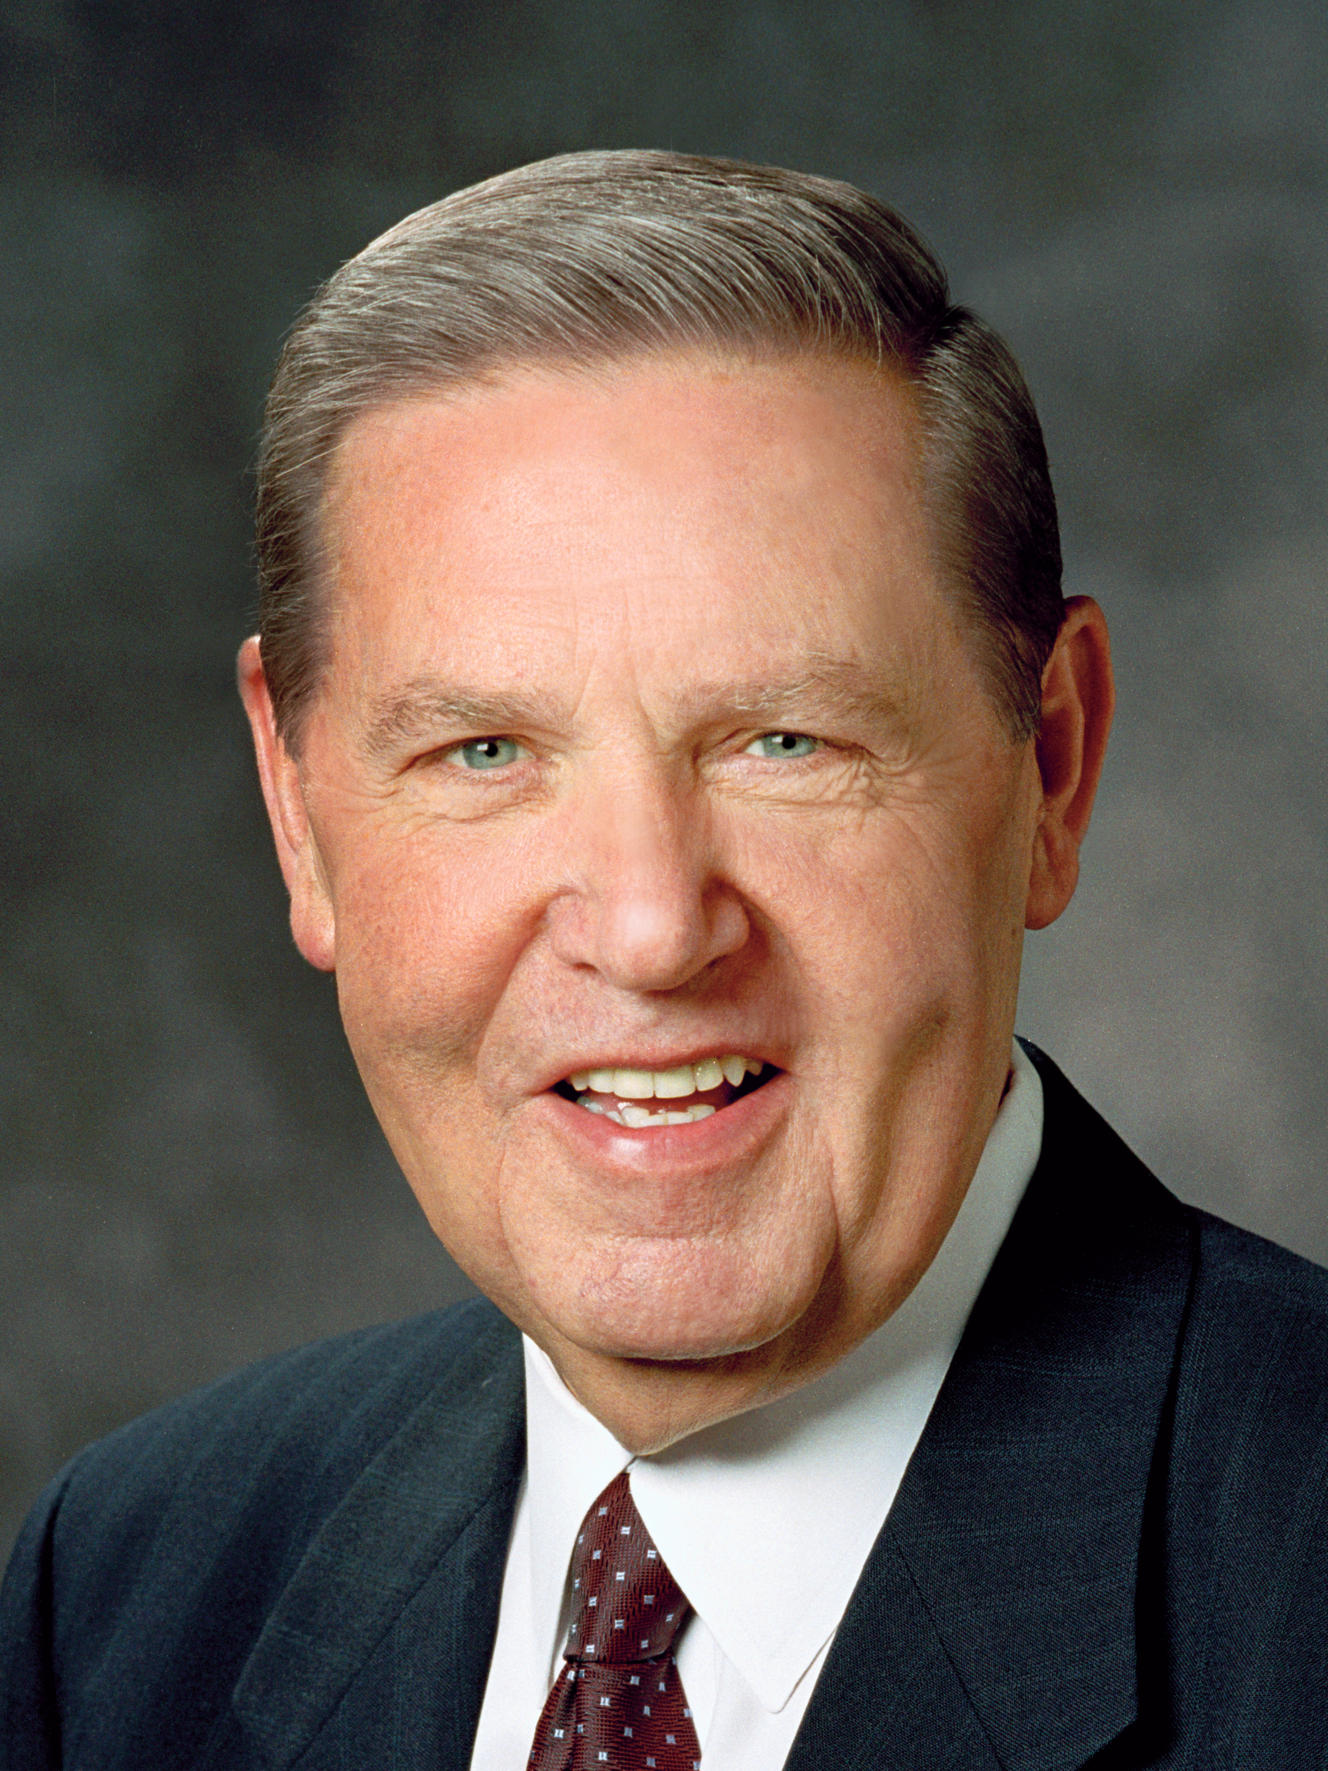
Elder Jeffrey R. Holland
“It strikes me that there is a wiser purpose than that [compensating for the loss of the 116 pages], or, more accurately, a wiser purpose in that. The key to such a suggestion of a wiser purpose is in verse 45 of Doctrine and Covenants section 10.
Continued on next page.

Slide 26
Elder Jeffrey R. Holland, cont.
“As the Lord instructs Joseph on the procedure for translating and inserting the material from the small plates into what had been begun as the translation of the abridged large plates, he says, ‘Behold, there are many things engraven upon the [small] plates of Nephi which do throw greater views upon my gospel’ (emphasis added).
Continued on next page.

Slide 27
Elder Jeffrey R. Holland, cont.
“… We got back more than we lost. And it was known from the beginning that it would be so. It was for a wiser purpose. …
“I think it would be exciting if the 116 pages of manuscript turned up some day, but if they were delivered to my office tomorrow I would never trade them for the material in the small plates of Nephi” (Jeffrey R. Holland, “A Standard unto My People” [address given at the Church Educational System Symposium, Aug. 9, 1994], 7–8, 9).

Slide 28
Trusting and Obeying the Lord
How would you complete this statement: Trusting and obeying the Lord, even when we do not fully understand the reason for a commandment, …

Slide 29
Trusting and Obeying the Lord
How would you complete this statement: Trusting and obeying the Lord, even when we do not fully understand the reason for a commandment, …
Trusting and obeying the Lord, even when we do not fully understand the reason for a commandment, can lead to great blessings.

Slide 30
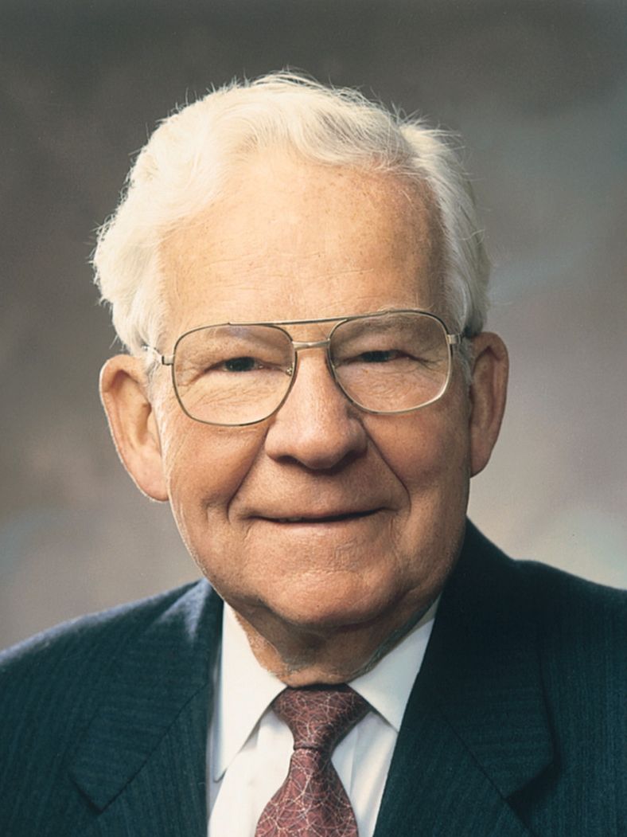
Elder Marvin J. Ashton
“Sometimes when we are asked to be obedient, we do not know why, except the Lord has commanded. … Nephi followed instructions even though he didn’t fully understand the wise purpose. His obedience resulted in blessings to mankind all over the world” (Marvin J. Ashton, “Who Will Forfeit the Harvest?” Ensign, Nov. 1978, 51).

Slide 31
The Lord Knows All Things
What truth did Nephi teach about the Lord in 1 Nephi 9:6?

Slide 32
The Lord Knows All Things
What truth did Nephi teach about the Lord in 1 Nephi 9:6?
The Lord knows all things, has all power, and prepares a way to accomplish His work.

Slide 33
The Lord Knows All Things
What truth did Nephi teach about the Lord in 1 Nephi 9:6?
The Lord knows all things, has all power, and prepares a way to accomplish His work.
How does Nephi’s experience and the account of the lost 116 manuscript pages illustrate this truth?

Slide 34
The Lord Knows All Things
What truth did Nephi teach about the Lord in 1 Nephi 9:6?
The Lord knows all things, has all power, and prepares a way to accomplish His work.
How does Nephi’s experience and the account of the lost 116 manuscript pages illustrate this truth?
Why is it helpful to know that “the Lord knoweth all things from the beginning” (1 Nephi 9:6)?

Slide 35
Obedience
How can understanding the truths we identified help someone when they encounter a commandment that they do not fully understand the reason for?

Slide 36
Obedience
How can understanding the truths we identified help someone when they encounter a commandment that they do not fully understand the reason for?
When have you or someone you know been obedient to the Lord without completely understanding the reasons? What blessings came as a result?

Slide 37
Following Nephi’s Example
Write in your class notebook or study journal a goal to obey a commandment of the Lord that you may not fully understand the reason for. Follow Nephi’s example by trusting and obeying the Lord by keeping this commandment.

