Slide 1
Acquiring Spiritual Knowledge
Part 2

Slide 2

Devotional
Hymn:
Prayer:
Thought:
Notes:
738194

Slide 3
Questions?
What questions do you have about life or about the Church and its teachings and history?

Slide 4
Three Principles
This portion of the learning experience on acquiring spiritual knowledge is intended to help you learn three principles that can guide you when you have questions or are presented with questions from others:
act in faith;
examine concepts and questions with an eternal perspective; and
seek further understanding through divinely appointed sources.

Slide 5
Act in Faith
“We act in faith when we choose to trust God and turn to Him first through sincere prayer, a study of His teachings, and obedience to His commandments.
“As we seek to develop our understanding and to resolve concerns, it is important that we rely on the testimony that we already have of Jesus Christ, the Restoration of His gospel, and the teachings of His ordained prophets.
Continued on next page.

Slide 6
Act in Faith, cont.
“Elder Jeffrey R. Holland taught: ‘When those moments come and issues surface, the resolution of which is not immediately forthcoming, hold fast to what you already know and stand strong until additional knowledge comes’ (“Lord, I Believe,” Ensign or Liahona, May 2013, 94). The Lord Himself has invited us to ‘look unto [Him] in every thought; doubt not, fear not’ (D&C 6:36).
Continued on next page.

Slide 7
Act in Faith, cont.
“During times when we may not immediately find answers to our questions, it is helpful to remember that although Heavenly Father has revealed all that is necessary for our salvation, He has not yet revealed all truth.
Continued on next page.

Slide 8
Act in Faith, cont.
“As we continue to seek for answers, we must live by faith—trusting that we will eventually receive the answers we seek (see Proverbs 3:5–6; Ether 12:6). As we are faithful to the truth and light we have already received, we will receive more. Answers to our questions and prayers often come ‘line upon line, precept upon precept’ (2 Nephi 28:30)” (Acquiring Spiritual Knowledge, Doctrinal Mastery Core Document).

Slide 9
Acting in Faith
What did you learn from principle 1, “Act in Faith,” from the Doctrinal Mastery Core Document that can help you act in faith when you have questions or concerns?

Slide 10
Acting in Faith
What did you learn from principle 1, “Act in Faith,” from the Doctrinal Mastery Core Document that can help you act in faith when you have questions or concerns?
How can living according to truths you have already received be helpful when you have questions or concerns?

Slide 11
Live by Faith
As we continue to seek for answers, we must live by faith—trusting that we will eventually receive the answers we seek.

Slide 12
Live by Faith
As we continue to seek for answers, we must live by faith—trusting that we will eventually receive the answers we seek.
Which Book of Mormon doctrinal mastery passage supports this statement of doctrine?

Slide 13
Doctrinal Mastery Passage
Read Ether 12:6, looking for words or phrases that help us understand why it is important for us to live by faith as we seek answers to our questions.

Slide 14
Doctrinal Mastery Passage
Read Ether 12:6, looking for words or phrases that help us understand why it is important for us to live by faith as we seek answers to our questions.
What do you think it means that “ye receive no witness until after the trial of your faith” (Ether 12:6)?

Slide 15
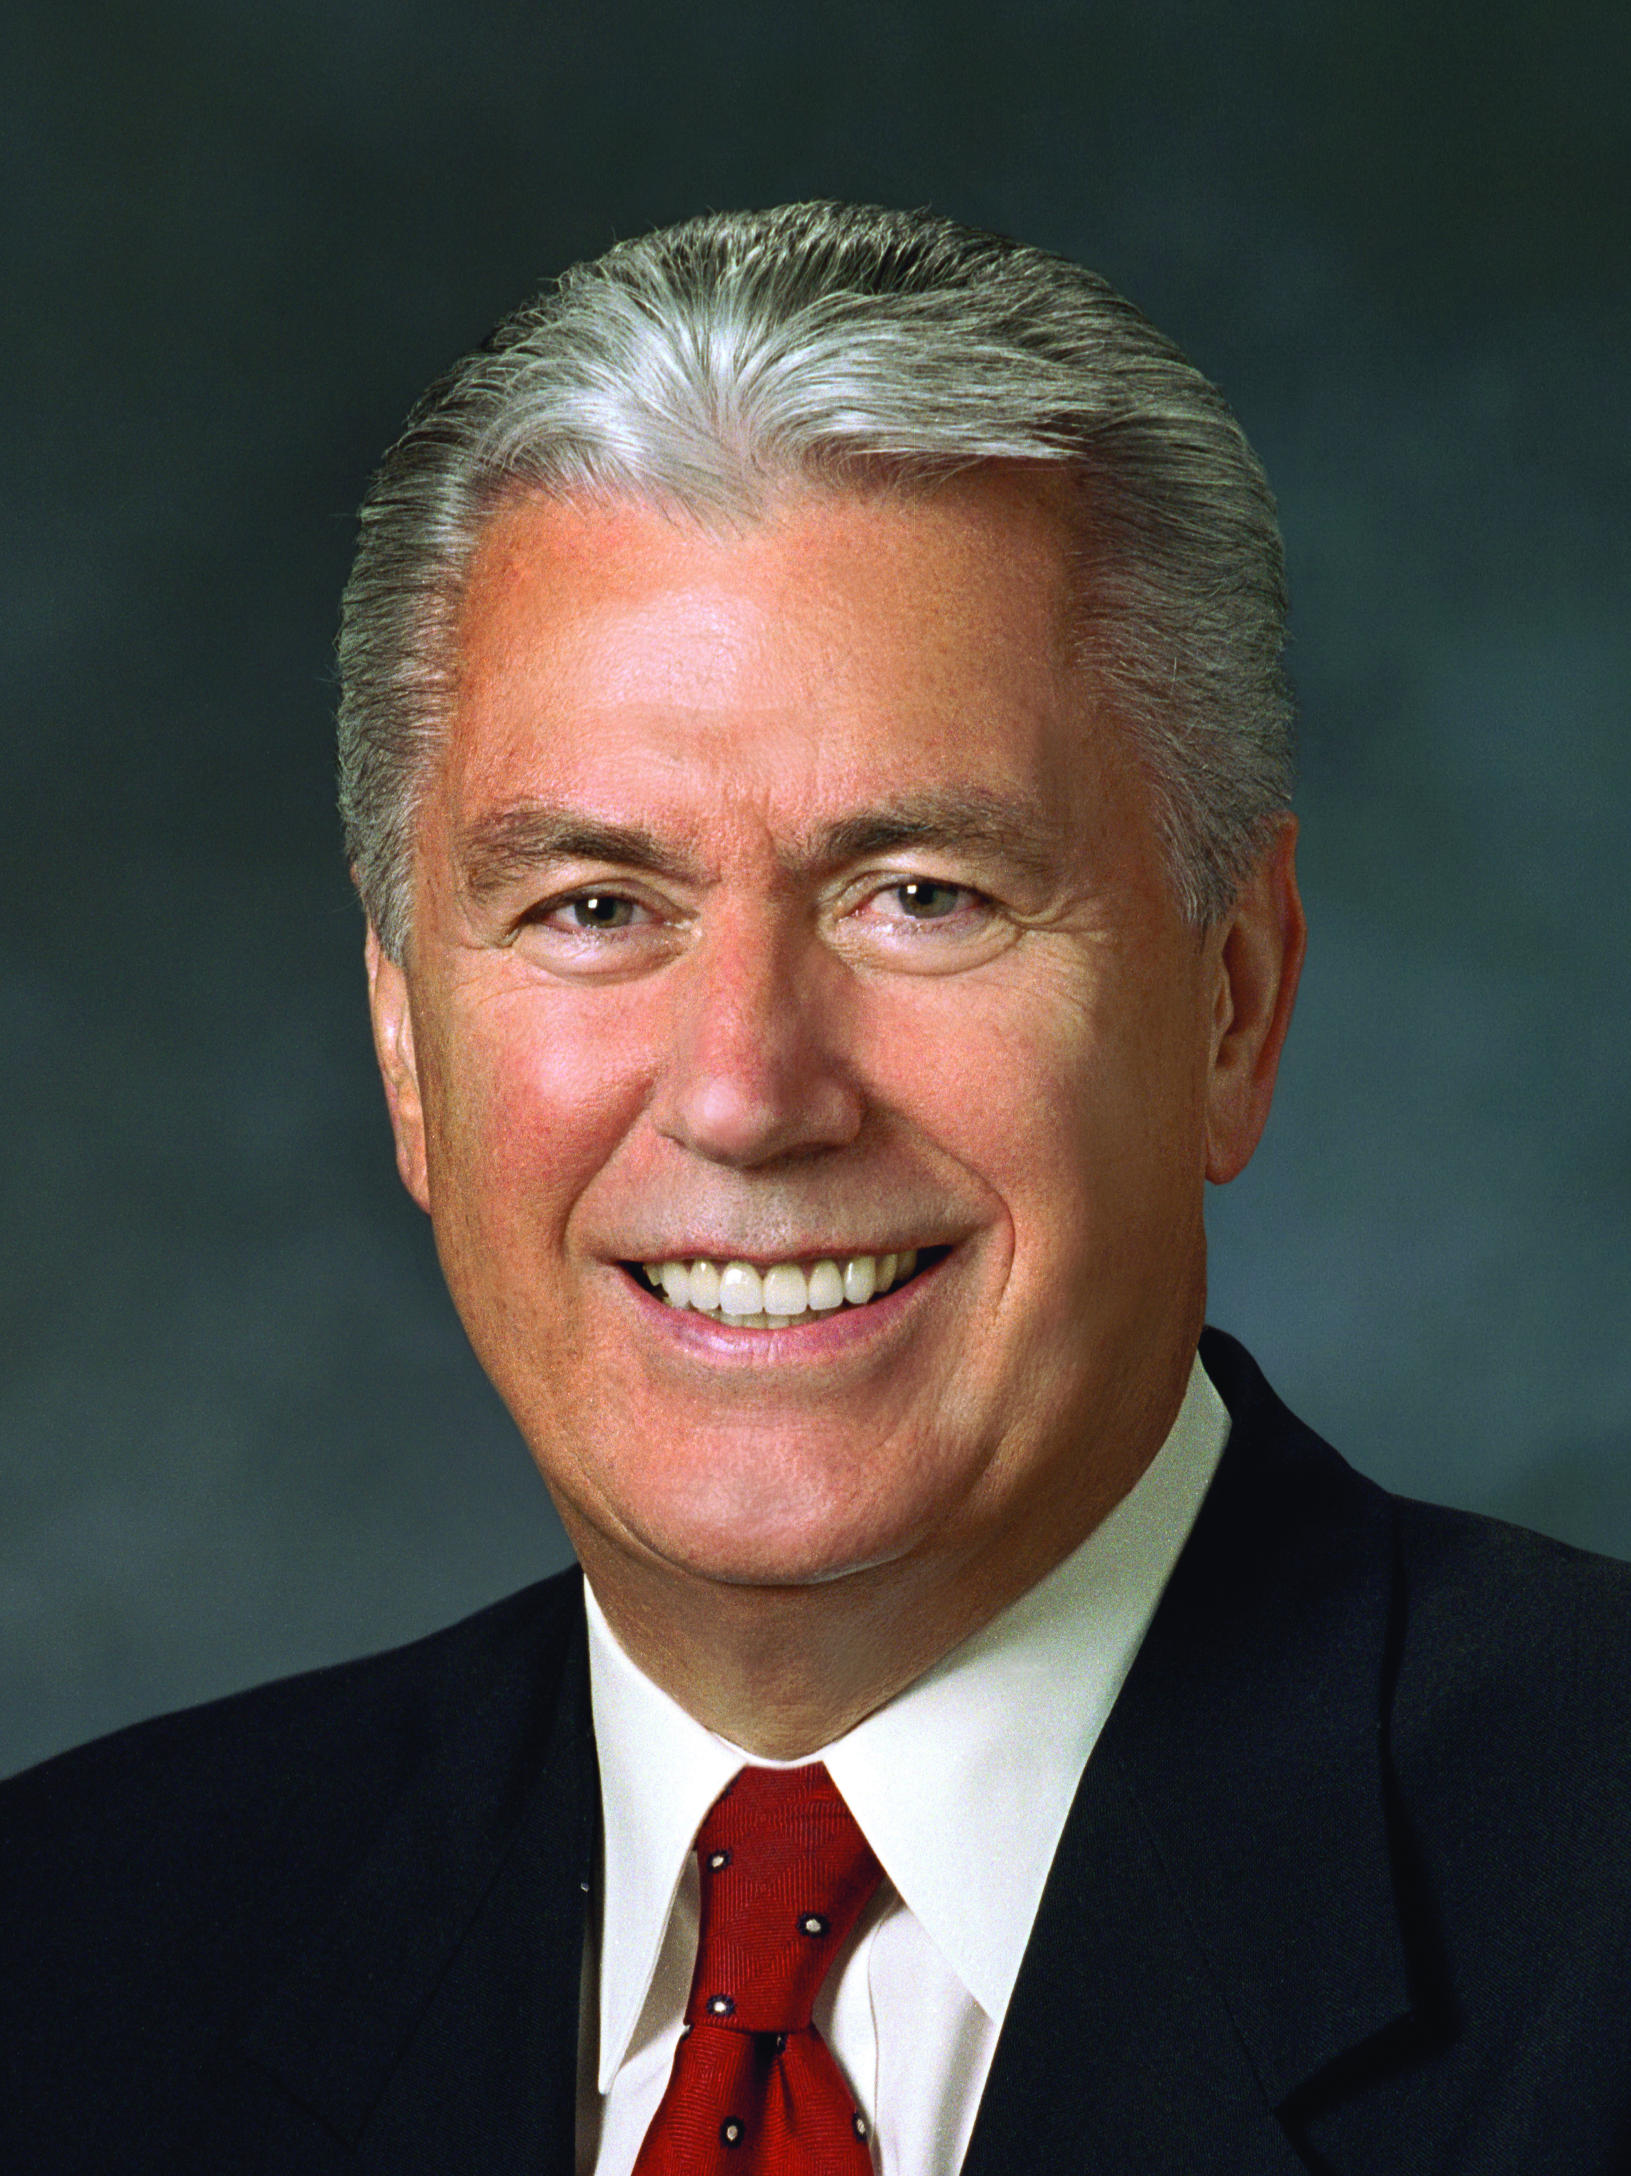
President Dieter F. Uchtdorf
“As you exercise your faith, applying gospel principles every day under any circumstances, you will taste the sweet fruits of the gospel, and by this fruit you will know of its truth” (Dieter F. Uchtdorf, “The Reflection in the Water” [Church Educational System fireside for young adults, Nov. 1, 2009], LDS.org).

Slide 16
President Dieter F. Uchtdorf
“As you exercise your faith, applying gospel principles every day under any circumstances, you will taste the sweet fruits of the gospel, and by this fruit you will know of its truth” (Dieter F. Uchtdorf, “The Reflection in the Water” [Church Educational System fireside for young adults, Nov. 1, 2009], LDS.org).
According to President Uchtdorf, what can we do in order to receive or strengthen our testimony of the truthfulness of the gospel?

Slide 17
Exercising Our Faith
Why do you think the Lord expects us to exercise our faith before we receive a witness or testimony of the truthfulness of the gospel?

Slide 18
Exercising Our Faith
Why do you think the Lord expects us to exercise our faith before we receive a witness or testimony of the truthfulness of the gospel?
What is a truth you have received a testimony of by choosing to exercise your faith by applying gospel principles on a daily basis? How did that testimony come to you?

Slide 19
Statements of Truth
As we are faithful to the truth and light we have already received, we will receive more.

Slide 20
Statements of Truth
As we are faithful to the truth and light we have already received, we will receive more.
Answers to our questions and prayers often come “line upon line, precept upon precept.”

Slide 21
Statements of Truth
As we are faithful to the truth and light we have already received, we will receive more.
Answers to our questions and prayers often come “line upon line, precept upon precept.”
How might these truths help a person understand why his or her testimony of the gospel has not grown more quickly?

Slide 22
Statements of Truth
As we are faithful to the truth and light we have already received, we will receive more.
Answers to our questions and prayers often come “line upon line, precept upon precept.”
How might these truths help a person understand why his or her testimony of the gospel has not grown more quickly?
What doctrinal mastery passage supports these two truths?

Slide 23
Doctrinal Mastery Passage
Read 2 Nephi 28:30, looking for phrases that support the truths in the Doctrinal Mastery Core Document.

Slide 24
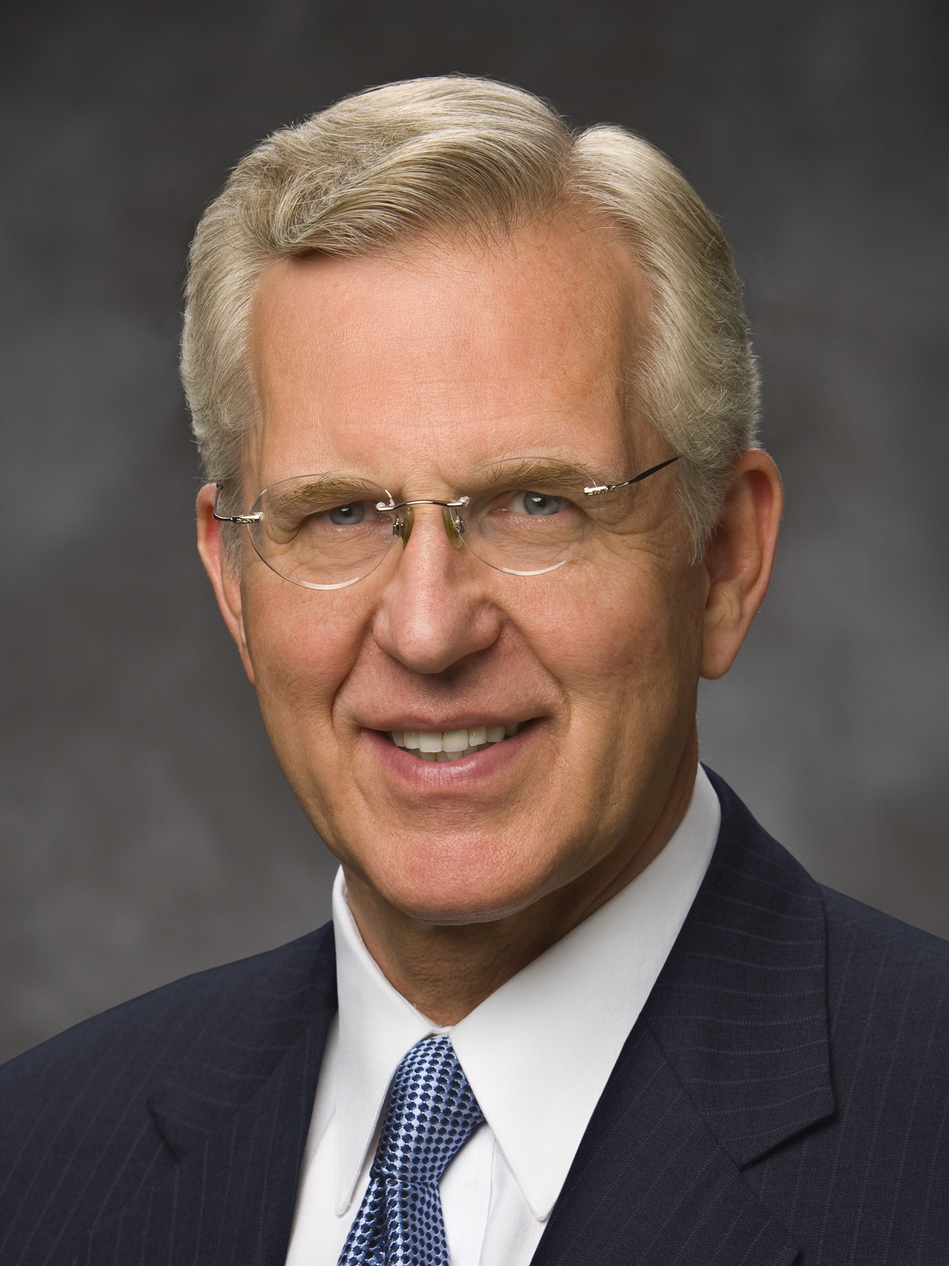
Elder D. Todd Christofferson
“I prayed for some miraculous intervention to deliver us. Although I offered that prayer many times with great sincerity and earnest desire, the answer in the end was no. Finally, I learned to pray as the Savior did: ‘Nevertheless not my will, but thine, be done’ (Luke 22:42). I sought the Lord’s help with each tiny step along the way to a final resolution.
Continued on the next page.

Slide 25
Elder D. Todd Christofferson, cont.
“… More than once I fell down before my Heavenly Father, begging in tears for His help. And He did help. Sometimes it was nothing more than a sense of peace, a feeling of assurance that things would work out. …
“Though I suffered then, I am grateful now that there was not a quick solution to my problem.
Continued on the next page.

Slide 26
Elder D. Todd Christofferson, cont.
“The fact that I was forced to turn to God for help almost daily over an extended period of years taught me how to truly pray and get answers to prayer and taught me in a practical way to have faith in God. I came to know my Savior and my Heavenly Father in a way and to a degree that might not have happened otherwise or that might have taken me much longer. … I learned to trust in the Lord with all my heart. I learned to walk with Him day by day” (D. Todd Christofferson, “Recognizing God’s Hand in Our Daily Blessings” Ensign, Jan. 2012, 18–19).

Slide 27
Receiving Answers
According to what you learned from Elder Christofferson, what are some reasons why God might choose not to answer some of our questions and prayers immediately or in the way we desire?

Slide 28
A Concern
“I hear about other people receiving answers to their prayers, but that doesn’t happen to me. It just doesn’t feel like God loves me, even though I’m trying to do what’s right. Why doesn’t God answer my prayers?”

Slide 29
A Concern
“I hear about other people receiving answers to their prayers, but that doesn’t happen to me. It just doesn’t feel like God loves me, even though I’m trying to do what’s right. Why doesn’t God answer my prayers?”
If you had this concern and question, how could you choose to act in faith?

Slide 30
Religious Beliefs
Think of times when you may have noticed that your religious beliefs and views on life were different than some of the beliefs and views of your friends and associates who are not members of The Church of Jesus Christ of Latter-day Saints.

Slide 31
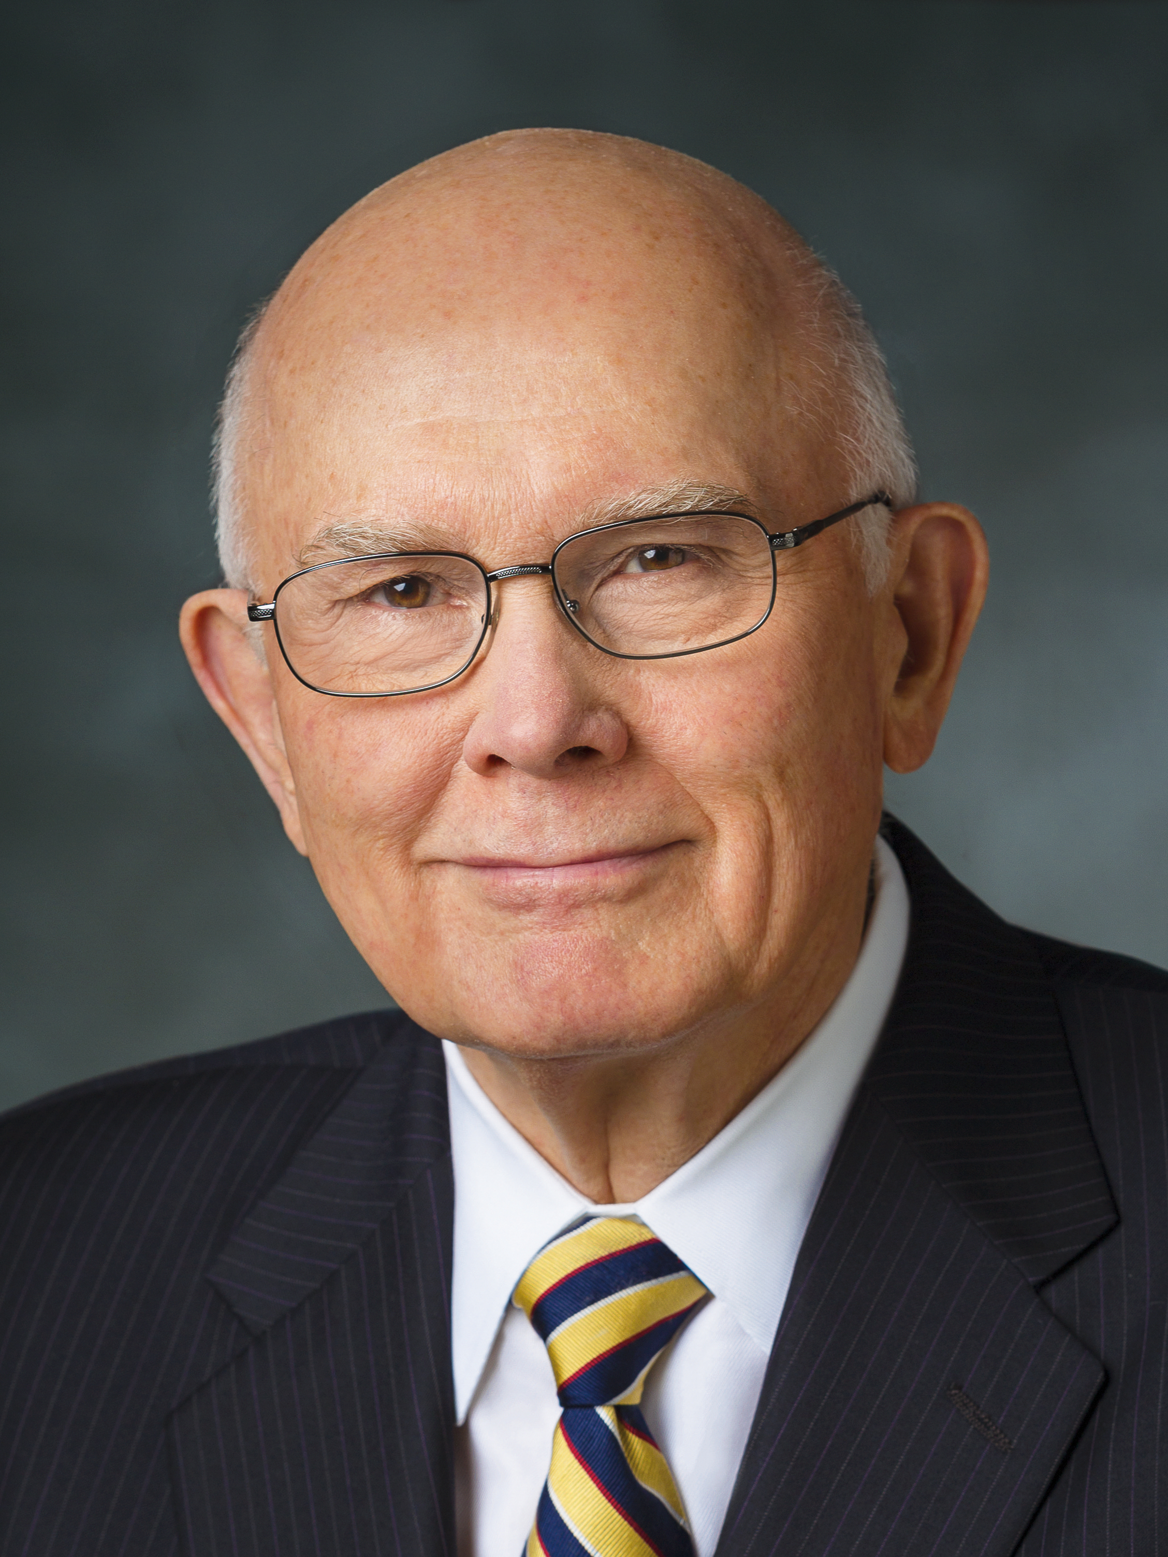
Elder Dallin H. Oaks
“On many important subjects our assumptions [or beliefs] … are different from [those of] many of our friends and associates. They are also different from many assumptions currently used in the media. … For example, because Latter-day Saints know our Heavenly Father’s plan for His children, we know that this mortal life is not a one-act play sandwiched between an unknowable past and an uncertain future. This life is like the second act in a three-act play.
Continued on the next page.

Slide 32
Elder Dallin H. Oaks, cont.
“Its purpose is defined by what is revealed about our spiritual existence in act 1 and our eternal destiny in act 3. Because of our knowledge of this plan and other truths that God has revealed, we start with different assumptions than those who do not share our knowledge. As a result, we reach different conclusions on many important subjects that others judge only in terms of their opinions about mortal life” (Dallin H. Oaks, “As He Thinketh in His Heart” [evening with a General Authority, Feb. 8, 2013], lds.org/broadcasts).

Slide 33
Different Views
According to Elder Oaks, why do Latter-day Saints view questions relating to our life on earth and religious subjects differently than how others might view them?

Slide 34
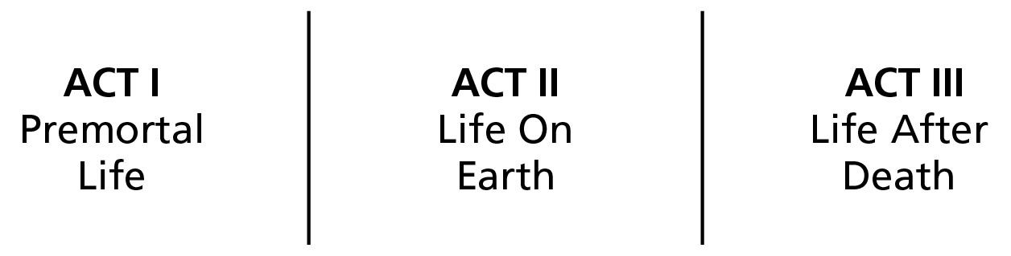
Three-Act Play

Slide 35
Act 1—Premortal Life
What is an example of an important subject that we might view differently if we didn’t have knowledge of our premortal life or of life after death?

Slide 36
Elder Dallin H. Oaks
“I suggest that it may be preferable for our young people to refrain from arguing with their associates. … They will often be better off to respond by identifying the worldly premises or assumptions in the assertions they face and then by identifying the different assumptions or premises that guide the thinking of Latter-day Saints” (Dallin H. Oaks, “As He Thinketh in His Heart,” [evening with a General Authority, Feb. 8, 2013], lds.org/broadcasts).

Slide 37
Elder Dallin H. Oaks
“I suggest that it may be preferable for our young people to refrain from arguing with their associates. … They will often be better off to respond by identifying the worldly premises or assumptions in the assertions they face and then by identifying the different assumptions or premises that guide the thinking of Latter-day Saints” (Dallin H. Oaks, “As He Thinketh in His Heart,” [evening with a General Authority, Feb. 8, 2013], lds.org/broadcasts).
A premise is an idea that is used to support a conclusion, and an assertion is a declaration of a person’s position, point of view, or opinion.

Slide 38
What Can We Do?
Based on Elder Oaks’s suggestion, what can we do when we are presented with a difficult concept or question?

Slide 39
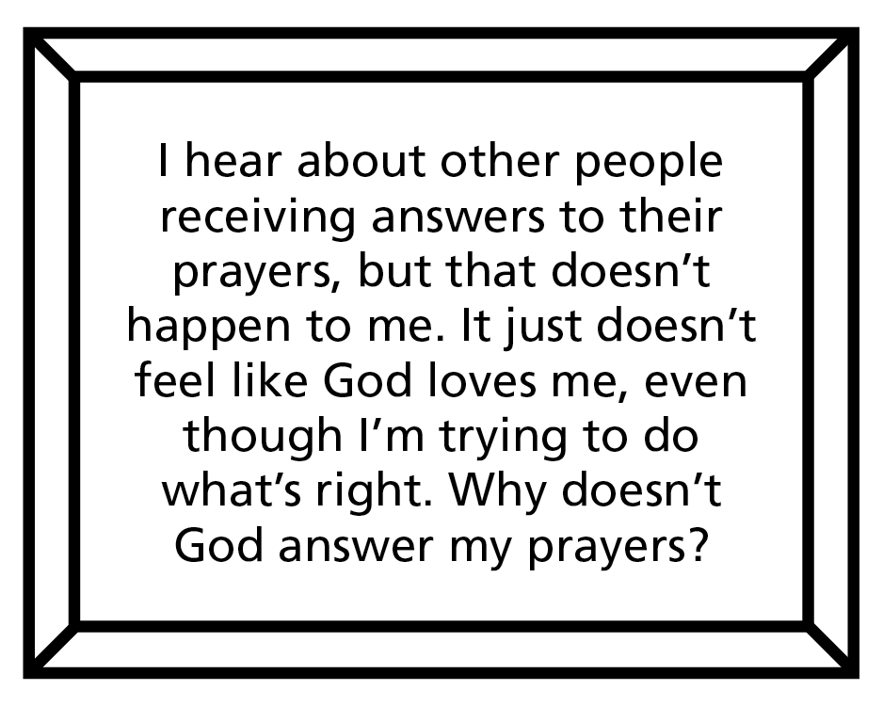
Beliefs and Assumptions
This simple frame represents the beliefs or assumptions a person asking the question might have if he or she did not view the question in the context of what we know about Heavenly Father, His plan of salvation, and the teachings of Jesus Christ.

Slide 40
Beliefs and Assumptions
When considering a person’s beliefs or assumptions, we should do so with kindness and respect, being sensitive to the person’s feelings and to the guidance of the Holy Ghost.

Slide 41
Inaccurate Beliefs and Assumptions
What are some beliefs or assumptions that may not be accurate and could influence a person to have this concern or question?

Slide 42
Inaccurate Beliefs and Assumptions
God answers everyone’s prayers in the same way; God loves some of His children, but He doesn’t really love me; God doesn’t love me if He doesn’t answer my prayers in the way I hope and expect Him to; if I am trying to do what’s right, then God should answer all my prayers immediately.

Slide 43
Inaccurate Beliefs and Assumptions
Why do you think it is important to think about the beliefs or assumptions that we or others might have when asking questions about God, our life on earth, or the Church and its teachings and history?

Slide 44
Inaccurate Beliefs and Assumptions
Why do you think it is important to think about the beliefs or assumptions that we or others might have when asking questions about God, our life on earth, or the Church and its teachings and history?
How might these inaccurate beliefs or assumptions indicate that the person may be viewing the question with a limited perspective?

Slide 45
Examine Concepts and Questions with an Eternal Perspective
“To examine doctrinal concepts, questions, and social issues with an eternal perspective, we consider them in the context of the plan of salvation and the teachings of the Savior. We seek the help of the Holy Ghost in order to see things as the Lord sees them. This allows us to reframe the question (to see the question differently) and view ideas based on the Lord’s standard of truth rather than accepting the world’s premise or assumptions (see 1 Corinthians 2:5, 9–11).
Continued on next page.

Slide 46
Examine Concepts and Questions with an Eternal Perspective, cont.
“We can do this by asking questions such as ‘What do I already know about Heavenly Father, His plan, and how He deals with His children?’ and ‘What gospel teachings relate to or clarify this concept or issue?’
Continued on next page.

Slide 47
Examine Concepts and Questions with an Eternal Perspective, cont.
“Even questions that relate to historical events may need to be examined with an eternal perspective. As we stay anchored to our trust in our Heavenly Father and His plan of salvation, we are able to see issues more clearly. It may also help to examine historical questions in the proper historical context by considering the culture and norms of the time period rather than imposing current perspectives and attitudes.
Continued on next page.

Slide 48
Examine Concepts and Questions with an Eternal Perspective, cont.
“It is important to remember that historical details do not carry the saving power of ordinances, covenants, and doctrine. To be distracted by less significant details at the expense of missing the unfolding miracle of the Restoration is like spending time analyzing a gift box and ignoring the wonder of the gift itself” (Acquiring Spiritual Knowledge, Doctrinal Mastery Core Document).

Slide 49
Eternal Perspective
How can we examine concepts and questions with an eternal perspective?

Slide 50
Eternal Perspective
How can we examine concepts and questions with an eternal perspective?
To examine doctrinal concepts, questions, and social issues with eternal perspective, we consider them in the context of the plan of salvation and the teachings of the Savior.

Slide 51
Examining Questions with an Eternal Perspective
https://www.lds.org/media-library/video/2016-05-2000-examining-questions-with-an-eternal-perspective?lang=eng

Slide 52
Beliefs and Assumptions
Why do you think it was helpful for Lauren to think about the beliefs or assumptions that may have influenced her friend’s question about God?

Slide 53
Beliefs and Assumptions
Why do you think it was helpful for Lauren to think about the beliefs or assumptions that may have influenced her friend’s question about God?
What happened as Lauren examined her friend’s question with an eternal perspective?

Slide 54
Based on Eternal Truth
What do we know about Heavenly Father, His plan, and the teachings of the Savior that could help us look at this question differently and find answers based on eternal truth?

Slide 55
Eternal Truths
God may answer our prayers differently based on His knowledge of our individual needs and what is best for us.

Slide 56
Eternal Truths
God may answer our prayers differently based on His knowledge of our individual needs and what is best for us.
God loves all His children, including me.

Slide 57
Eternal Truths
God may answer our prayers differently based on His knowledge of our individual needs and what is best for us.
God loves all His children, including me.
God loves me even when He doesn’t answer my prayers in the way I hope and expect Him to.

Slide 58
Eternal Truths
God may answer our prayers differently based on His knowledge of our individual needs and what is best for us.
God loves all His children, including me.
God loves me even when He doesn’t answer my prayers in the way I hope and expect Him to.
Even if I am trying to do what’s right, God may not answer all my prayers immediately. This provides opportunities for me to grow spiritually.

Slide 59

Based on Eternal Truths
This new frame represents truths we know about Heavenly Father, His plan of salvation, and the teachings of the Savior.

Slide 60
Based on Eternal Truths
This new frame represents truths we know about Heavenly Father, His plan of salvation, and the teachings of the Savior.
How does viewing this question in the context of what we know about Heavenly Father, His plan, and the teachings of the Savior allow us to see the question differently?

Slide 61
I Have a Question
What sources might you turn to when you have a question about the Church or need help when making an important decision?

Slide 62
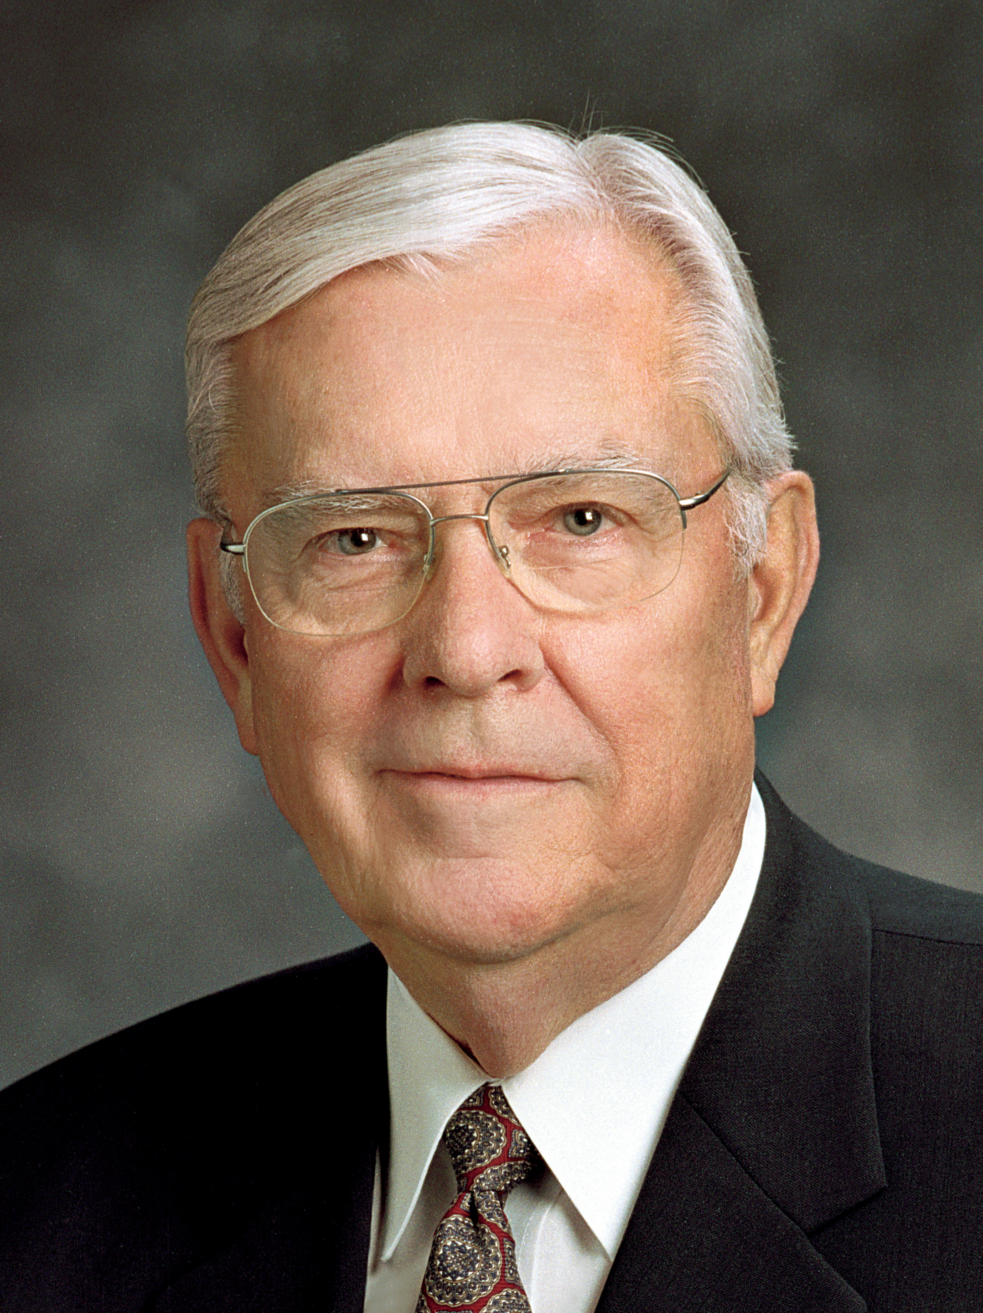
Elder M. Russell Ballard
“James did not say, ‘If any of you lack wisdom, let him Google!’” (M. Russell Ballard, “The Opportunities and Responsibilities of CES Teachers in the 21st Century” [evening with a General Authority, Feb. 26, 2016], lds.org/broadcasts).

Slide 63
James 1:5
According to James 1:5, what did the Apostle James teach?

Slide 64
James 1:5
According to James 1:5, what did the Apostle James teach?
When we have a question or concern, why do you think it is important to first look to God for help?

Slide 65
Seek Further Understanding through Divinely Appointed Sources
“As part of the Lord’s appointed process for obtaining spiritual knowledge, He has established sources through which He reveals truth and guidance to His children. These sources include the Light of Christ, the Holy Ghost, the scriptures, parents, and Church leaders.
Continued on next page.

Slide 66
Seek Further Understanding through Divinely Appointed Sources, cont.
“The First Presidency and the Quorum of the Twelve Apostles—the Lord’s prophets upon the earth today—are a vital source of truth. The Lord has chosen and ordained these individuals to speak for Him” (Acquiring Spiritual Knowledge, Doctrinal Mastery Core Document).

Slide 67
Discovering and Understanding Truth
What has God given us to help us discover and understand truth?

Slide 68
Discovering and Understanding Truth
What has God given us to help us discover and understand truth?
As part of the Lord’s appointed process for obtaining spiritual knowledge, He has established sources through which He reveals truth and guidance to His children.

Slide 69
Discovering and Understanding Truth
What has God given us to help us discover and understand truth?
As part of the Lord’s appointed process for obtaining spiritual knowledge, He has established sources through which He reveals truth and guidance to His children.
What blessings can we receive as we turn to the Lord’s divinely appointed sources of truth?

Slide 70
Divinely Appointed Sources
What are some divinely appointed sources you could turn to if you had this concern and question?

Slide 71
MormonNewsroom.org
On this website (mormonnewsroom.org), the Church clarifies information regarding various issues of public interest related to the Church and corrects partial or incorrect information that is reported in the media.

Slide 72
LDS.org/topic
The Gospel Topics essays (lds.org/topics) contain valuable and forthright information on many difficult historical and doctrinal issues.

Slide 73
Divine Sources
How have you been blessed as you have turned to divine sources for answers when you were confronted with a question or issue?

Slide 74
Seek Further Understanding through Divinely Appointed Sources
“We can also learn truth through other trustworthy sources. However, sincere seekers of truth should be wary of unreliable sources of information. We live in a time when many ‘call evil good, and good evil’ (Isaiah 5:20). Satan is the father of lies and seeks to distort truth and persuade us to turn away from the Lord and His appointed servants.
Continued on next page.

Slide 75
Seek Further Understanding through Divinely Appointed Sources, cont.
“As we turn to the Lord’s divinely appointed sources for answers and direction, we can be blessed to discern between truth and error. Learning to recognize and avoid unreliable sources can protect us from misinformation and from those who seek to destroy faith” (Acquiring Spiritual Knowledge, Doctrinal Mastery Core Document).

Slide 76
Unreliable Sources
Why is it important to be wary of unreliable sources of information?

Slide 77
Unreliable Sources
Why is it important to be wary of unreliable sources of information?
Read Moroni 10:5. How can we recognize truth in sources of information that are not produced by the Church?

Slide 78

The Holy Ghost
During the school year, in addition to studying the teachings of the Book of Mormon sequentially, you will be studying the nine doctrinal topics from the Doctrinal Mastery Core Document (which correspond to topics in the Sunday youth curriculum). You will also study the Book of Mormon doctrinal mastery passages associated with each topic.

Slide 79
Acquiring Spiritual Knowledge
As each topic is studied, you will use the principles of acquiring spiritual knowledge discussed in this lesson to consider real questions, issues, and opportunities for personal application.

Slide 80
Acquiring Spiritual Knowledge
As each topic is studied, you will use the principles of acquiring spiritual knowledge discussed in this lesson to consider real questions, issues, and opportunities for personal application.
As we act in faith, examine concepts and questions with an eternal perspective, and seek further understanding through divinely appointed sources, God will give us answers and provide direction in our lives.

