Slide 1
Acquiring Spiritual Knowledge
Part 1

Slide 2

Devotional
Hymn:
Prayer:
Thought:
Notes:
738194

Slide 3
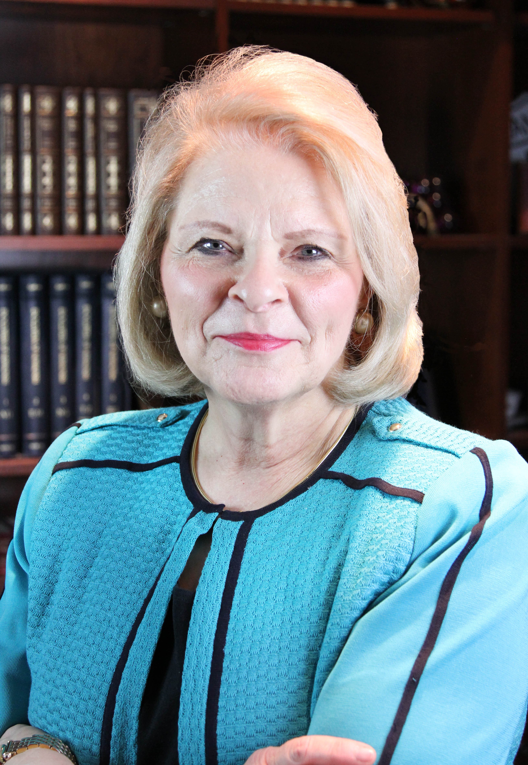
Sheri L. Dew
“A marvelous young woman … called me, distraught. Through sobs she blurted, ‘I’m not sure I believe the Church is true anymore, and I’m scared. What if my family isn’t going to be together forever?’”

Slide 4
Sheri L. Dew
“A marvelous young woman … called me, distraught. Through sobs she blurted, ‘I’m not sure I believe the Church is true anymore, and I’m scared. What if my family isn’t going to be together forever?’”
If this young woman came to you for help, what might you say or do to help her?

Slide 5
Sheri L. Dew, cont.
“I asked, ‘Do you want a testimony?’ ‘Yes,’ she said.
“‘Are you willing to work for it?’ Again, ‘Yes’” (Sheri L. Dew, “Will You Engage in the Wrestle?” [Brigham Young University–Idaho devotional, May 17, 2016], byui.edu/devotionals).

Slide 6
Sheri L. Dew, cont.
“I asked, ‘Do you want a testimony?’ ‘Yes,’ she said.
“‘Are you willing to work for it?’ Again, ‘Yes’” (Sheri L. Dew, “Will You Engage in the Wrestle?” [Brigham Young University–Idaho devotional, May 17, 2016], byui.edu/devotionals).
Why do you think it might have been helpful to ask this young woman if she desired a testimony of the gospel and if she was willing to work for it?

Slide 7
Doctrinal Mastery
During your experience in seminary, you will have many opportunities to work to increase your understanding and testimony of the gospel. You will also learn how to find answers to your questions and the questions others may have about the Church—including its teachings and history. One way you can do this is through Doctrinal Mastery.

Slide 8
Doctrinal Mastery
Doctrinal Mastery includes learning and applying principles of acquiring spiritual knowledge. Doctrinal Mastery also includes developing a deeper understanding of key doctrines of the gospel of Jesus Christ.

Slide 9
Acquiring Spiritual Knowledge
“Because our Heavenly Father loves us and wants us to progress toward becoming like Him, He has encouraged us to ‘seek learning, even by study and also by faith’ (D&C 88:118). In our search for truth, we can trust Him completely, relying on His wisdom, His love, and His power to teach and bless us.
Continued on next page.

Slide 10
Acquiring Spiritual Knowledge, cont.
“God knows all things and is the source of all truth (see Mosiah 4:9). He has promised to reveal truth to our minds and hearts through the Holy Ghost if we will diligently seek Him (see D&C 8:2–3)” (“Acquiring Spiritual Knowledge,” Doctrinal Mastery Core Document).

Slide 11
Source of All Truth
Who is the source of all truth?

Slide 12
Source of All Truth
Who is the source of all truth?
God knows all things and is the source of all truth.

Slide 13
Source of All Truth
Who is the source of all truth?
God knows all things and is the source of all truth.
Which doctrinal mastery passage supports this doctrine?

Slide 14
Source of All Truth
Who is the source of all truth?
God knows all things and is the source of all truth.
Which doctrinal mastery passage supports this doctrine?
Read Mosiah 4:9, looking for how this verse helps us understand why we should look to God as we search for truth.

Slide 15
Source of All Truth
Who is the source of all truth?
God knows all things and is the source of all truth.
Which doctrinal mastery passage supports this doctrine?
Read Mosiah 4:9, looking for how this verse helps us understand why we should look to God as we search for truth.
What experiences have helped you know that God knows all things and is the source of all truth?

Slide 16
A Pattern
God has given a pattern to help us acquire spiritual knowledge.

Slide 17
A Pattern
God has given a pattern to help us acquire spiritual knowledge.
How would you explain what a pattern is?

Slide 18
A Pattern
God has given a pattern to help us acquire spiritual knowledge.
How would you explain what a pattern is?
The word pattern is defined as a model that helps us understand the correct way of doing something—particularly something that will be done repeatedly.

Slide 19
Acquiring Spiritual Knowledge
“To help us, Heavenly Father has taught us how to acquire spiritual knowledge. He has established the conditions we must follow in order to gain such knowledge.
Continued on next page.

Slide 20
Acquiring Spiritual Knowledge, cont.
“His divinely ordained pattern requires that we have an honest desire to know the truth (see Moroni 10:4–5) and are willing to live according to that which God has revealed (see John 7:17). Our sincere desire will lead us to seek truth through prayer (see James 1:5–6; 2 Nephi 32:8–9) and a serious study of the word of God (see 2 Timothy 3:15–17; 2 Nephi 32:3)” (“Acquiring Spiritual Knowledge,” Doctrinal Mastery Core Document).

Slide 21
God’s Pattern
1. Have an honest desire to know the truth.
2. Be willing to live according to the truth that God has revealed.
3. Seek truth through prayer.
4. Seek truth through a serious study of the word of God.

Slide 22
Applying God’s Pattern
Why do you think it is important for us to apply God’s pattern for acquiring spiritual knowledge every day and not just when we have pressing questions or concerns?

Slide 23
Applying God’s Pattern
It is important that we apply this pattern every day because doing these things invites the Spirit of the Lord to always be with us and can help us recognize the influence of the Holy Ghost. By consistently following this pattern, we demonstrate to the Lord our desire to acquire spiritual knowledge at all times—not just when we have pressing questions or concerns.

Slide 24
Doctrinal Mastery Passages
Doctrinal mastery passages in the Book of Mormon support God’s pattern for acquiring spiritual knowledge.

Slide 25
Moroni 10:4–5
Read Moroni 10:4–5, looking for a scriptural phrase that teaches God’s pattern for acquiring spiritual knowledge.

Slide 26
Moroni 10:4–5
Read Moroni 10:4–5, looking for a scriptural phrase that teaches God’s pattern for acquiring spiritual knowledge.
What do you think it means to “ask God … with a sincere heart, with real intent” (Moroni 10:4)?

Slide 27
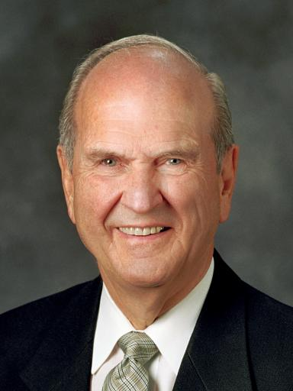
President Russell M. Nelson
“‘Real intent’ means that one really intends to follow the divine direction given” (Russell M. Nelson, “Ask, Seek, Knock,” Ensign or Liahona, Nov. 2009, 81).

Slide 28
President Russell M. Nelson
“‘Real intent’ means that one really intends to follow the divine direction given” (Russell M. Nelson, “Ask, Seek, Knock,” Ensign or Liahona, Nov. 2009, 81).
Why do you think it is important that we seek truth with a sincere heart and that we really intend to follow the direction God gives us?

Slide 29
2 Nephi 32:8–9
Read 2 Nephi 32:8–9, looking for a scriptural phrase that teaches God’s pattern for acquiring spiritual knowledge.

Slide 30
2 Nephi 32:8–9
Read 2 Nephi 32:8–9, looking for a scriptural phrase that teaches God’s pattern for acquiring spiritual knowledge.
What do you think it means to “pray always” (2 Nephi 32:9)?

Slide 31
2 Nephi 32:3
Read 2 Nephi 32:3, looking for a scriptural phrase that teaches God’s pattern for acquiring spiritual knowledge.

Slide 32
2 Nephi 32:3
Read 2 Nephi 32:3, looking for a scriptural phrase that teaches God’s pattern for acquiring spiritual knowledge.
What do you think is the difference between reading casually and “feast[ing] upon the words of Christ” (2 Nephi 32:3)?

Slide 33
2 Nephi 32:3
Read 2 Nephi 32:3, looking for a scriptural phrase that teaches God’s pattern for acquiring spiritual knowledge.
What do you think is the difference between reading casually and “feast[ing] upon the words of Christ” (2 Nephi 32:3)?
How can choosing to pray always and to feast upon the words of Christ help us acquire spiritual knowledge?

Slide 34
Asking Questions
Do you think it is good for people to ask questions about the teachings of the Church or aspects of Church history that may be difficult to understand?

Slide 35
Acquiring Spiritual Knowledge
“Sometimes we may discover new information or have questions regarding the doctrine, practices, or history of the Church that seem difficult to understand. Asking questions and seeking answers is a vital part of our effort to learn truth. Some of the questions that come to our minds may be inspired by the Holy Ghost. Inspired questions should be considered gifts from God that provide opportunities for us to increase our understanding and to strengthen our assurance that the Lord is willing to teach us.
Continued on next page.

Slide 36
Acquiring Spiritual Knowledge, cont.
“Whatever the source of our questions may be, we have been blessed with the ability to think and reason and to have the Lord’s influence expand our minds and deepen our understanding. The attitude and intent with which we ask questions and seek answers will greatly affect our ability to learn through the Holy Ghost” (“Acquiring Spiritual Knowledge,” Doctrinal Mastery Core Document).

Slide 37
Learning Truth
What is the role of asking questions and seeking answers in our effort to learn truth?

Slide 38
Learning Truth
What is the role of asking questions and seeking answers in our effort to learn truth?
Asking questions and seeking answers is a vital part of our effort to learn truth.

Slide 39
Learning Truth
What is the role of asking questions and seeking answers in our effort to learn truth?
Asking questions and seeking answers is a vital part of our effort to learn truth.
Why do you think asking questions and seeking answers is a vital part of our effort to learn truth?

Slide 40
Learning Truth
What is the role of asking questions and seeking answers in our effort to learn truth?
Asking questions and seeking answers is a vital part of our effort to learn truth.
Why do you think asking questions and seeking answers is a vital part of our effort to learn truth?
Why does our attitude and intent matter when we ask questions?

Slide 41
Our Attitude and Intent
The attitude and intent with which we ask questions and seek answers will greatly affect our ability to learn through the Holy Ghost.

Slide 42
Sheri L. Dew
“I told [the young woman], ‘Bring your scriptures and every question you have. Questions are good. Let’s see what the Lord will teach us.’
“She took me at my word and brought one thorny question after another. We searched the scriptures and the teachings of prophets for answers. Little by little, she began to realize that just because she had questions didn’t mean she didn’t have a testimony.
Continued on the next page.

Slide 43
Sheri L. Dew, cont.
“The scriptures are filled with accounts of prophets who had questions. And she began to recognize when the Spirit was bearing witness to her—including bearing witness that prophets, seers, and revelators are truly prophets. Her testimony began to grow, and time passed.
Continued on the next page.

Slide 44
Sheri L. Dew, cont.
“Then about a year ago she called again. ‘I wanted you to be one of the first to know that I am holding in my hand a temple recommend. Will you come when I receive my endowment?’ Then she added, ‘Do you know what you said that helped me the most? You told me that questions are good, and that allowed me to see myself as a seeker rather than a doubter’” (Sheri L. Dew, “Will You Engage in the Wrestle?” [Brigham Young University–Idaho devotional, May 17, 2016], byui.edu/devotionals).

Slide 45
Attitude and Intent
How might this young woman’s attitude and intent as a seeker of truth have affected her ability to find answers to her questions?

Slide 46
Sheri L. Dew
“I was overjoyed! But two days later, I received a much different call from another [young woman]. ‘Sister Dew,’ she said, ‘before you hear it from someone else, I want you to know that I’m pregnant.’ She said that for several years she had doubted the truthfulness of the gospel and had finally decided there was no reason to live the law of chastity.
Continued on the next page.

Slide 47
Sheri L. Dew, cont.
“I told her that I was not her judge and that I loved her. Then I asked her if she would like to have a testimony. ‘No, I don’t think so,’ she said.
“The contrast was stunning. At about the same time, these two young women had questions that threatened their testimonies. One of them sent out a cry for help, and family, friends and leaders followed President Monson’s counsel and went to her rescue.
Continued on the next page.

Slide 48
Sheri L. Dew, cont.
“The other girl nursed her doubt and convinced herself that her immoral choices were acceptable. …
“One girl’s questions propelled her to become a seeker of truth. The other girl used her questions to justify her immorality.
“My dear friends, questions are good. Questions are good if they are inspired questions, asked in faith, and asked of credible sources where the Spirit will direct and confirm the answer. …
Continued on the next page.

Slide 49
Sheri L. Dew, cont.
“None of us are entitled to revelation without effort on our part. Answers from God don’t just magically appear. If we want to grow spiritually, the Lord expects us to ask questions and seek answers. ‘If thou shalt ask,’ He promised, ‘thou shalt receive revelation upon revelation, knowledge upon knowledge’ [D&C 42:61]. How much clearer can it be? The Lord loves inspired questions asked in faith because they lead to knowledge, to revelation, and to greater faith” (Sheri L. Dew, “Will You Engage in the Wrestle?” [Brigham Young University–Idaho devotional, May 17, 2016], byui.edu/devotionals).

Slide 50
Our Attitude and Intent
How can the experiences of the two young women Sister Dew spoke of help us understand the importance of our attitude and intent when asking questions?

Slide 51
Our Attitude and Intent
How can the experiences of the two young women Sister Dew spoke of help us understand the importance of our attitude and intent when asking questions?
How do the experiences of the two young women help us understand our role in diligently seeking answers to our questions?

