Slide 1

Hyde Park Seminary:
General Conference Jeopardy
October 2013

Slide 2
Rules:
Played in two teams.
Game will be 2 days. Scores after Day 1 carry over.
Videos will be played once and will not be replayed.
The spokesperson for a given team will rotate every turn. Only they choose the category and give the answer; however, all team members may provide input to the spokesperson freely.
You can only pick a option where the previous number in the same category has already been chosen (i.e., you can’t choose ‘Sat AM 200’ if ‘Sat AM 100’ has not been played already).
If a 400 is chosen the next round is automatically the 500 which is an all-play written round. Everyone can score points. The 500 round does not count as either team’s turn.

Slide 3
General Conference: Oct 2013
Saturday
Morning
Saturday
Afternoon
Priesthood
Sunday Morning
Sunday Afternoon
100
100
100
100
100
200
200
200
200
200
300
300
300
300
300
400
400
400
400
400
500
500
500
500
500
Final

Slide 5

Saturday Morning - 100
“Now is the time for members and missionaries to come together, to work together, to labor in the Lord’s vineyard to bring souls unto Him. He has prepared the means for us to share the gospel in a multitude of ways, and He will assist us in our labors if we will act in faith to fulfill His work.”
- President Thomas S. Monson

Slide 6

Saturday Morning - 100
What was the topic of
President Monson’s opening talk?

Slide 7
Missionary Work.

Slide 8
Saturday Morning - 200

Slide 9
Saturday Morning - 200
When do the greatest
blessings of conference occur?

Slide 10
“The greatest blessings of general conference come to us after the conference is over.”
- Elder Robert D. Hales

Slide 11
Saturday Morning - 300

Slide 12
Saturday Morning - 300
“When we plead for relief from physical, mental, and spiritual difficulties, He may increase our r______ and r________.”
- Elder David A. Bednar

Slide 13
“Sometimes we may ask God for success, and He gives us physical and mental stamina. We might plead for prosperity, and we receive enlarged perspective and increased patience, or we petition for growth and are blessed with the gift of grace. He may bestow upon us conviction and confidence as we strive to achieve worthy goals. And when we plead for relief from physical, mental, and spiritual difficulties, He may increase our resolve and resilience.”
- Elder David A. Bednar
“When we plead for relief from physical, mental, and spiritual difficulties, He may increase our resolve and resilience.”
- Elder David A. Bednar

Slide 14
Saturday Morning - 400

Slide 15
Saturday Morning - 400
Which Chapter in the Book of Mormon does Elder Uchtdorf’s analogy involving the seed come from?

Slide 16
Alma 32.

Slide 17
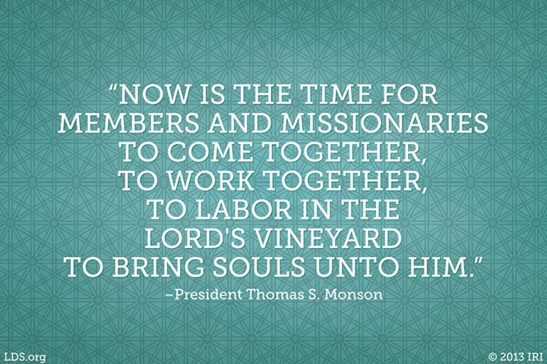
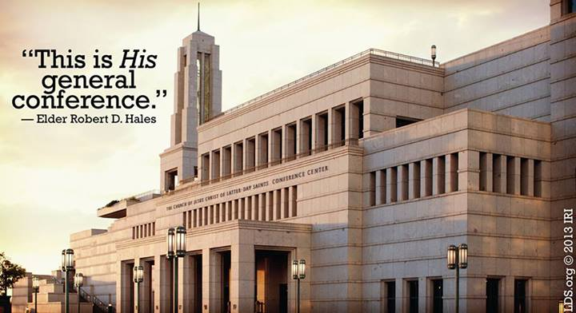
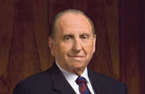
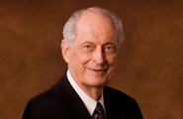
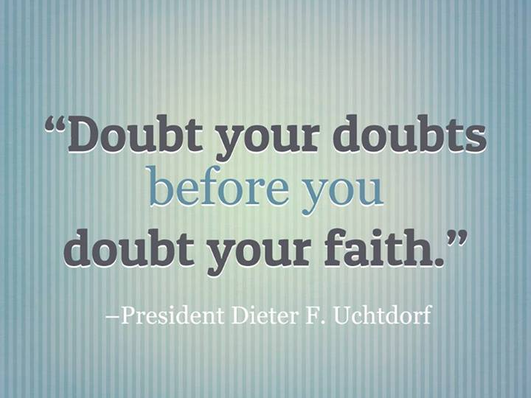
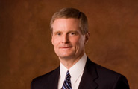
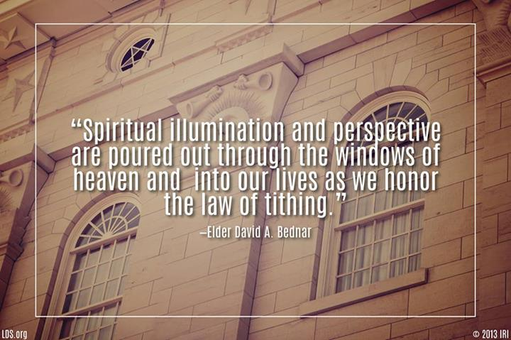
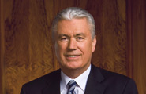
Saturday Morning - 500
1
2
A
B
4
C
3
D

Slide 18
1
2
A
B
4
C
3
D

Slide 20
Saturday Afternoon - 100

Slide 21
Saturday Afternoon - 100
“Make scripture reading a part of your regular routine, and the blessings will follow. There is in the scriptures a voice of ______, but there is also great ________.”
- Elder Boyd K. Packer

Slide 22
“Make scripture reading a part of your regular routine, and the blessings will follow. There is in the scriptures a voice of warning, but there is also great nourishment.”
- Elder Boyd K. Packer

Slide 23
Saturday Afternoon - 200

Slide 24
Saturday Afternoon - 200
“There is not a higher good than m________ and f_________ in marriage. There is no superior career, and no amount of money, authority, or public acclaim can exceed the ultimate rewards of f______. Whatever else a woman may accomplish, her moral i______ is no more optimally employed than here.”
- Elder D. Todd Christofferson

Slide 25
“There is not a higher good than motherhood and fatherhood in marriage. There is no superior career, and no amount of money, authority, or public acclaim can exceed the ultimate rewards of family. Whatever else a woman may accomplish, her moral influence is no more optimally employed than here.”
- Elder D. Todd Christofferson

Slide 26
Saturday Afternoon - 300

Slide 27
Saturday Afternoon - 300
Name 3 things that Elder Holland suggests we can do if we are depressed or going through other mental and emotional challenges.

Slide 28
Never lose faith
Never harden your heart.
Seek the counsel of those who hold keys for your spiritual well-being
Ask for and cherish priesthood blessings
Take the sacrament every week
Hold fast to the perfecting promises of the Atonement of Jesus Christ
Believe in miracles
Remember the Savior’s own anguished example: if the bitter cup does not pass, drink it
Be strong
Trust in happier days ahead

Slide 29
Saturday Afternoon - 400

Slide 30
Saturday Afternoon - 400
“Brothers and sisters, f___ will be replaced with f___ and c______ when members and the full-time missionaries kneel in prayer and ask the Lord to bless them with missionary opportunities…. These opportunities will never require a forced or a contrived response. They will flow as a natural result of our ____ for our brothers and sisters. Just be positive, and those who you speak with will feel your ____ .”
- Elder M. Russell Ballard

Slide 31
“Brothers and sisters, fear will be replaced with faith and confidence when members and the full-time missionaries kneel in prayer and ask the Lord to bless them with missionary opportunities…. These opportunities will never require a forced or a contrived response. They will flow as a natural result of our love for our brothers and sisters. Just be positive, and those who you speak with will feel your love.”
- Elder M. Russell Ballard

Slide 32

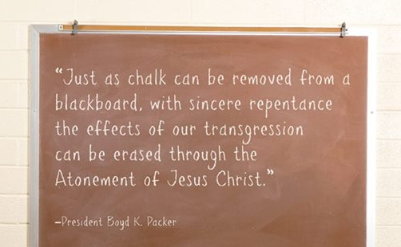
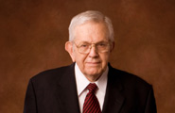
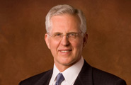
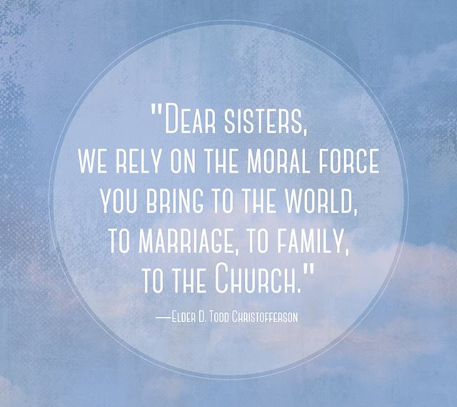
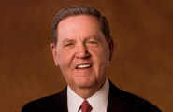
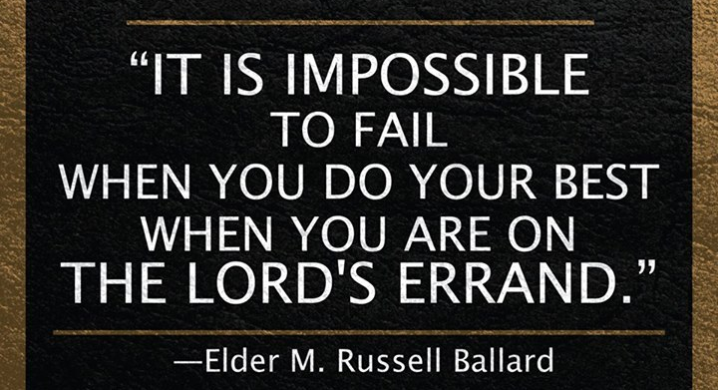
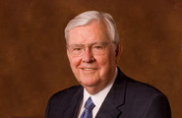
Saturday Afternoon - 500
1
2
A
B
4
C
3
D

Slide 33
1
2
A
B
4
C
3
D

Slide 35
Priesthood - 100

Slide 36
Priesthood - 100
Why did Elder Perry “encourage you to use your bright minds to study and learn the Articles of Faith and the doctrines they teach”?

Slide 37
“They are among the most important and certainly the most concise statements of doctrine in the Church. If you will use them as a guide to direct your studies of the gospel of Jesus Christ, you will find yourself prepared to declare your witness of the restored truth to the world.”
- Elder L. Tom Perry

Slide 38
Priesthood - 200

Slide 39
Priesthood - 200
“No matter how many times you
have slipped or fallen, ____ __!”
- President Dieter F. Uchtdorf

Slide 40
“No matter how many times you
have slipped or fallen, rise up!”
- President Dieter F. Uchtdorf

Slide 41
Priesthood - 300

Slide 42
Priesthood - 300
What human characteristic served as one of the reasons “the Savior went to such lengths to tell of His Atonement and of His taking upon Himself the pains and sorrows of all of our Heavenly Father’s children”?

Slide 43
“It is a human characteristic to become hardened to the pains of others.”
- President Henry B. Eyring

Slide 44
Priesthood - 400

Slide 45
Priesthood - 400
“Brethren, our home teaching efforts—remember, they are o______. The work will never be c______ until the Lord and Master says, “It is enough.” ….We should do so f_______ and with hearts filled with g_______.”
- President Thomas S. Monson

Slide 46
“Brethren, our home teaching efforts—remember, they are ongoing. The work will never be concluded until the Lord and Master says, “It is enough.” …. We should do so faithfully and with hearts filled with gladness.”
- President Thomas S. Monson

Slide 47
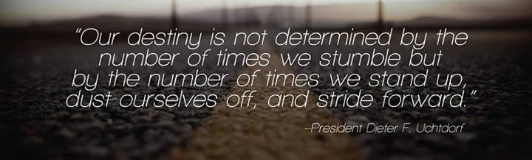
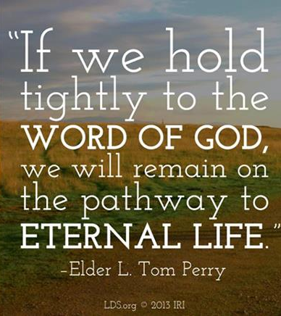
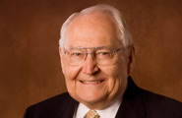

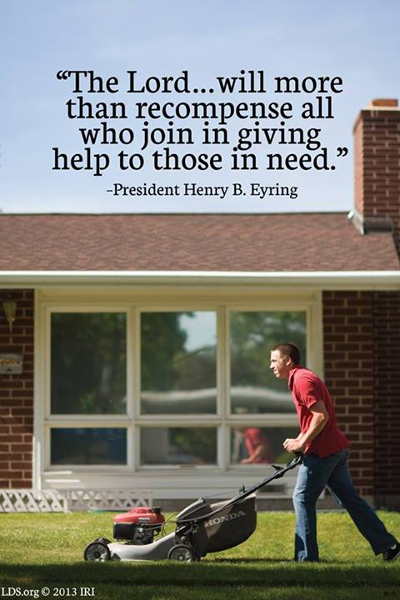
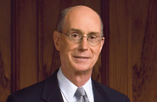
Priesthood - 500
1
2
A
B
3
4
C
D

Slide 48
1
2
A
B
3
4
C
D

Slide 50
Sunday Morning - 100

Slide 51
Sunday Morning - 100
What did President Eyring say
was the one plan of happiness?

Slide 52
“There is but one plan of happiness.
That plan is to follow all the commandments of God.”
- President Henry B. Eyring

Slide 53
Sunday Morning - 200

Slide 54
Sunday Morning - 200
“Man’s ____ cannot make _____ what God has declared _______.”
Elder Dallin H. Oaks

Slide 55
“Man’s laws cannot make moral what God has declared immoral.”
- Elder Dallin H. Oaks

Slide 56
Sunday Morning - 300

Slide 57
Sunday Morning - 300
“The Lord sees w________ differently than He does r_______. Whereas the Lord warns that unrepented r______ will bring punishment, when the Lord speaks of w________, it is always with m_____.”
- Elder Richard G. Scott

Slide 58
“The Lord sees weaknesses differently than He does rebellion. Whereas the Lord warns that unrepented rebellion will bring punishment, when the Lord speaks of weaknesses, it is always with mercy.”
- Elder Richard G. Scott

Slide 59
Sunday Morning - 400

Slide 60
Sunday Morning - 400
What personal experience did President Monson share at the beginning of this talk that related to the theme discussed here?
(hint: it was not included in the sound byte)

Slide 61
The death of his wife, Frances, on May 17, 2013.

Slide 62
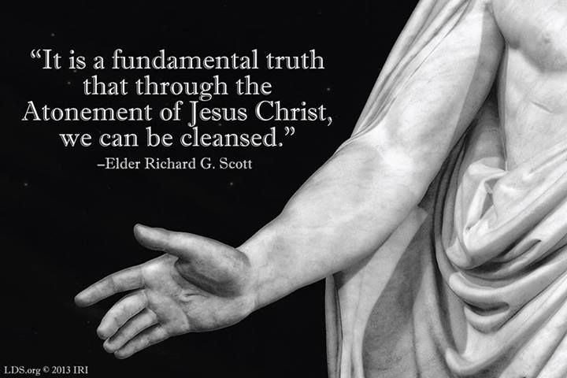

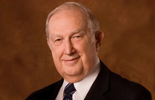
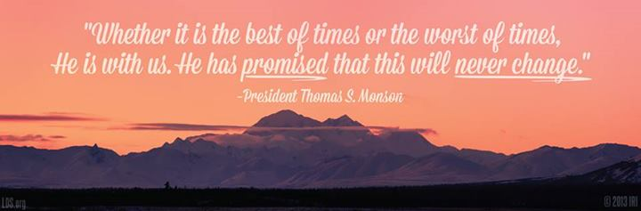
Sunday Morning - 500
A
1
2
B
C
3

Slide 63
A
1
2
B
C
3

Slide 65
Sunday Afternoon - 100

Slide 66
Sunday Afternoon - 100
“The most universal subjugation in our day, as it has been throughout history, is i_______ or p______ b_____ that are inconsistent with the gospel of Jesus Christ. Substituting the philosophies of men for gospel truth can lead us away from the s_______ of the Savior’s message.”
- Elder Quentin L. Cook

Slide 67
“The most universal subjugation in our day, as it has been throughout history, is ideology or political beliefs that are inconsistent with the gospel of Jesus Christ. Substituting the philosophies of men for gospel truth can lead us away from the simplicity of the Savior’s message.”
- Elder Quentin L. Cook

Slide 68
Sunday Afternoon - 200

Slide 69
Sunday Afternoon - 200
Why was Elder Anderson talking about drapes?

Slide 70
“A man may open the drapes so the warm sunlight comes into the room, but the man does not own the sun or the light or the warmth it brings. The blessings of the priesthood are infinitely greater than the one who is asked to administer the gift.”
- Elder Neil L. Anderson

Slide 71
Sunday Afternoon - 300

Slide 72
Sunday Afternoon - 300
How is permanent change possible?
What is required of us?
- Elder Russell M. Nelson

Slide 73
“We can change our behavior. Our very desires can change. How? There is only one way. True change—permanent change—can come only through the healing, cleansing, and enabling power of the Atonement of Jesus Christ. He loves you—each of you! He allows you to access His power as you keep His commandments, eagerly, earnestly, and exactly. It is that simple and certain. The gospel of Jesus Christ is a gospel of change!”
- Elder Russell M. Nelson

Slide 74
Sunday Afternoon - 400

Slide 75
Sunday Afternoon - 400
“May heaven’s blessings be with you. May your homes be filled with love and c_____ and with the Spirit of the Lord. May you constantly n_____ your testimonies of the gospel, that they will be a protection to you.”
- President Thomas S. Monson

Slide 76
“May heaven’s blessings be with you. May your homes be filled with love and courtesy and with the Spirit of the Lord. May you constantly nourish your testimonies of the gospel, that they will be a protection to you.”
- President Thomas S. Monson

Slide 77

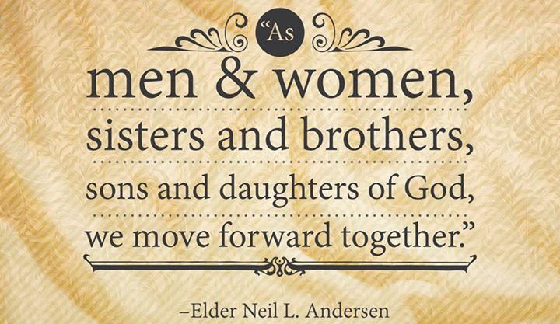
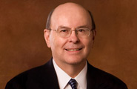
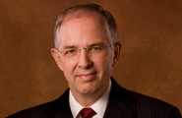

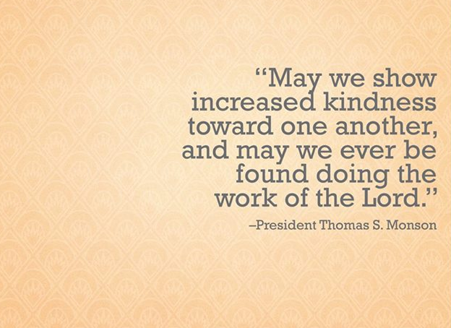
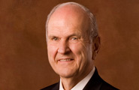
Sunday Afternoon - 500
1
2
A
B
4
3
C
D

Slide 78
1
2
A
B
4
3
C
D

Slide 80
FINAL
What was the name last name of the Member of the Quorum of the Seventy who had a little fly trouble in conference?

Slide 81
Elder Terence M. Vinson
Quorum of Seventy

